Slide 1
Mythology and EarthQuakes
worldwile

Slide 2
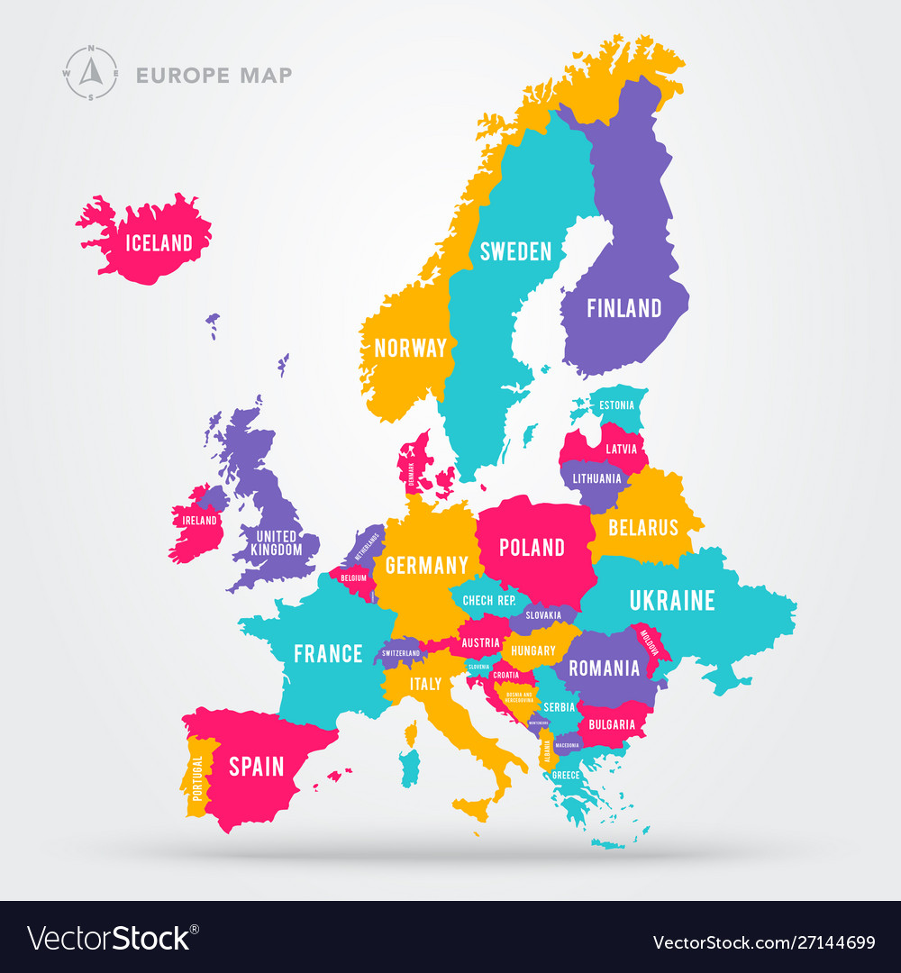
Europe

Slide 3
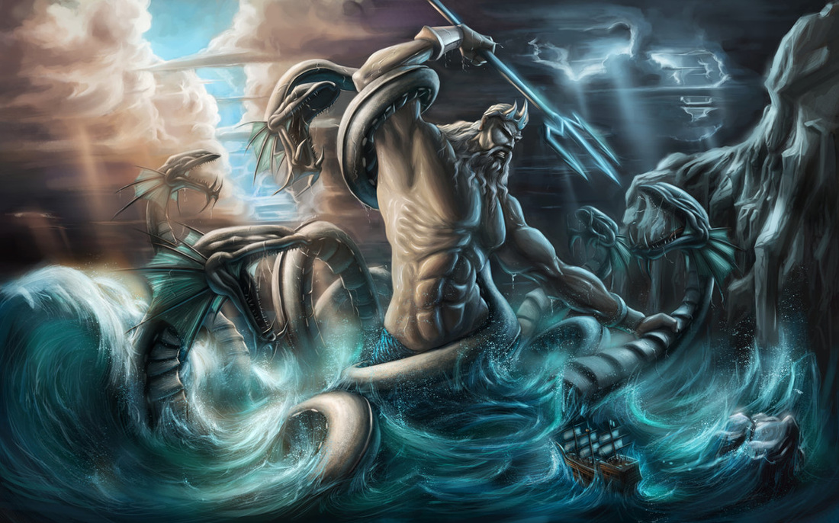
Greece
Poseidon was the cause and god of earthquakes. When he was in a bad mood, he would strike the ground with a trident, causing this and other calamities. He also used earthquakes to punish and inflict fear upon people as revenge. One of his nicknames is Earthshaker

Slide 4
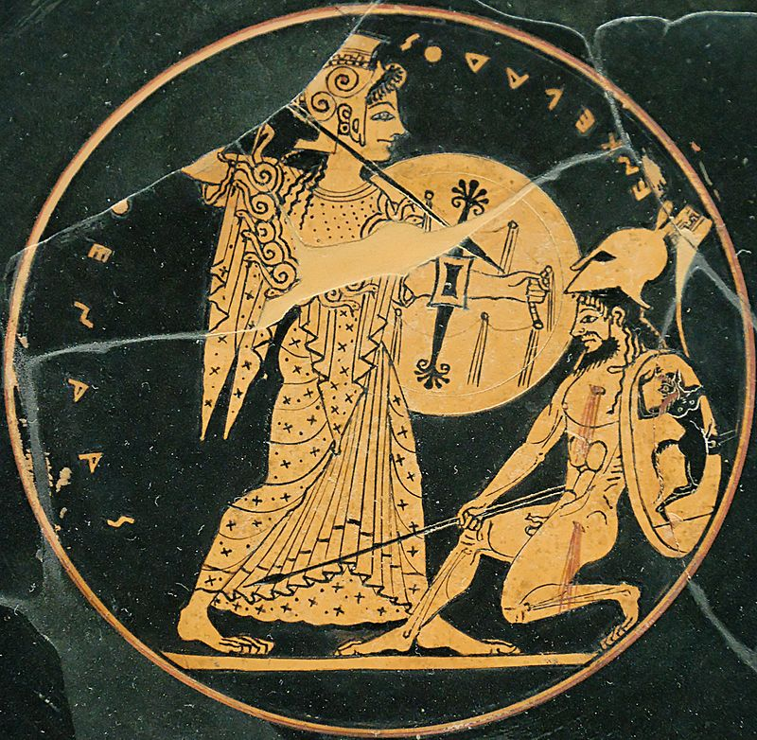
Greece
Enceladus had snake-like limbs. In Greek mythology, Enceladus (Ancient Greek: Ἐγκέλαδος Enkélados) was one of the Giants, the offspring of Gaia (Earth), and Uranus (Sky). During the battle between the Titans and the Olympian gods, the goddess Athena wounded him with a hurled spear. The Titan was buried on the island of Sicily, under Mount Etna. The injured Titan received the blame for the earthquakes and volcanic fires that erupted from the mountain

Slide 5
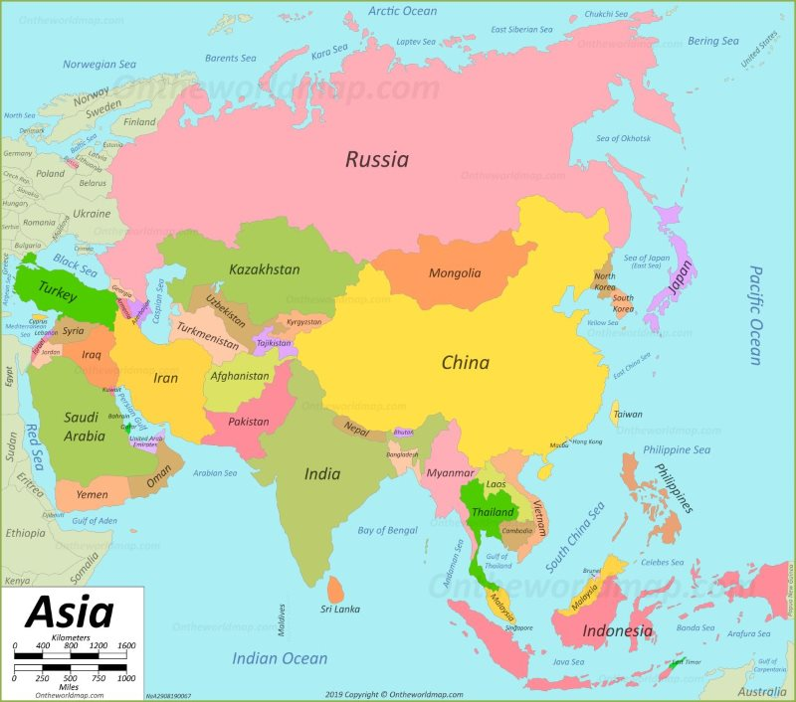
Asia

Slide 6
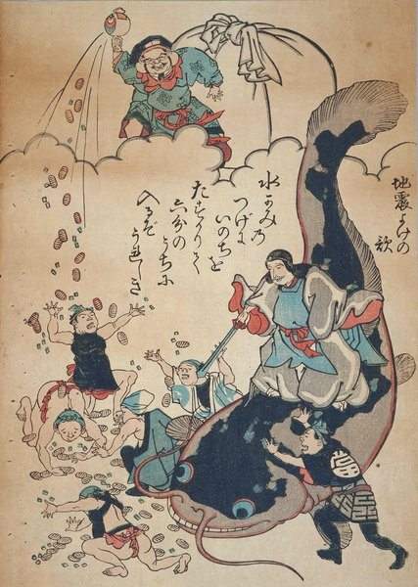
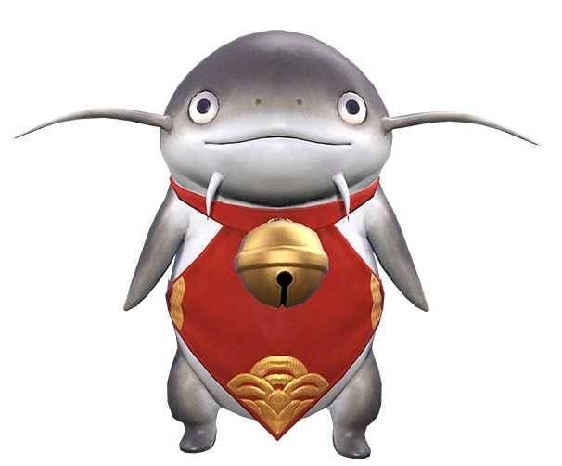
Japan
A giant catfish named Namazu lived in mud beneath the earth and causes earthquakes. A prankster, Namazu could be restrained only by Kashima, a god who protected the people from earthquakes. So long as Kashima kept a mighty magical rock over the catfish, the earth was still. But when he relaxed, the catfish thrashed about, causing earthquakes.

Slide 7
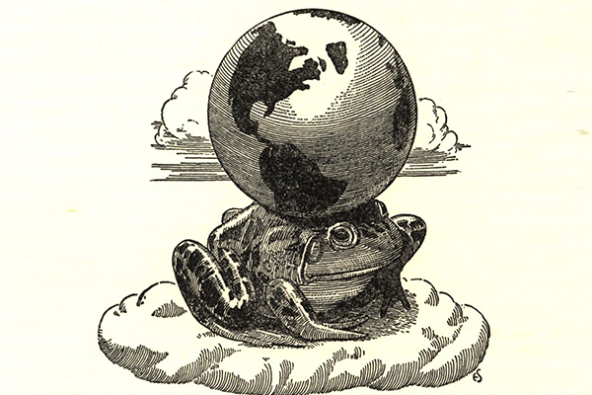
Mongolia, China
A gigantic frog which carried the world on its back twitched periodically, producing slight quakes.

Slide 8
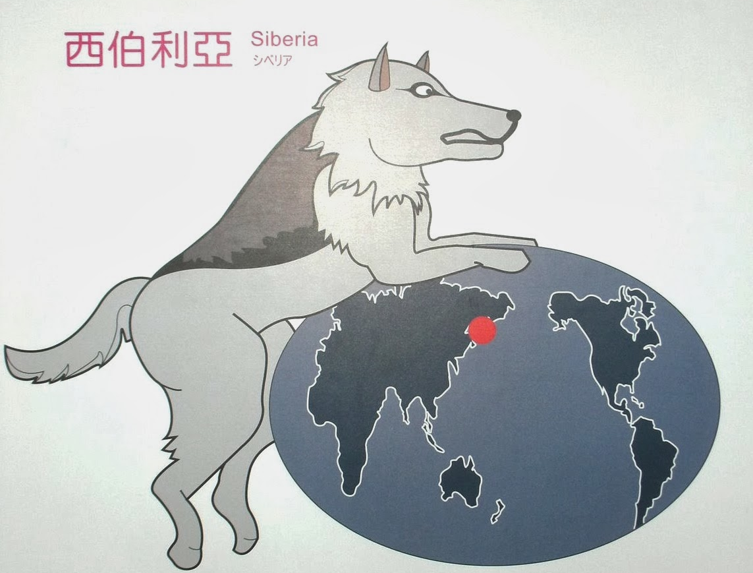
Kamchatka, Siberia, Russia
A god named Tuli drove an earth-laden sled pulled by dogs. When the dogs stopped to scratch at fleas, the earth shook.

Slide 9
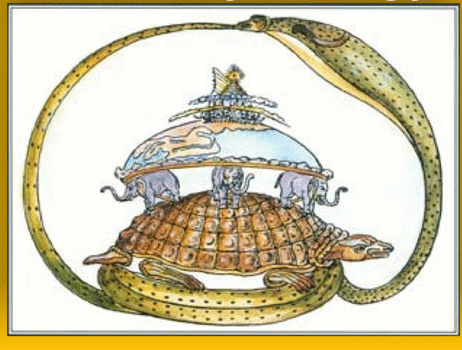
Hindus of India
eight mighty elephants held up the land. When one of them grew weary, it lowered and shook its head, causing an earthquake.

Slide 10
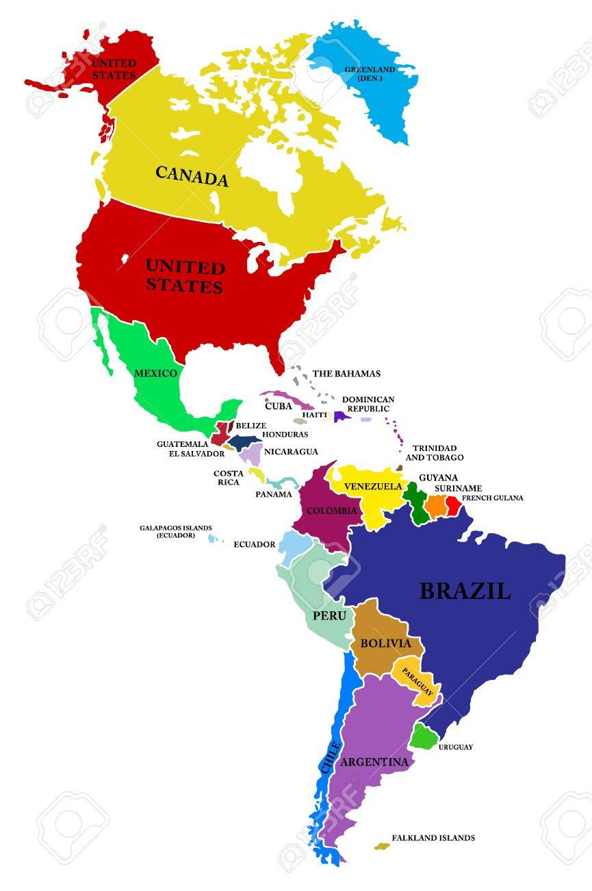
South, Central and North America

Slide 11
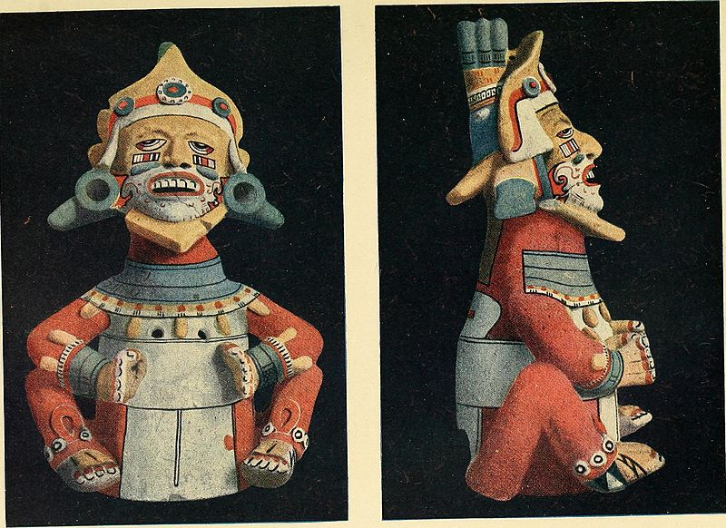
Peru
Whenever a god visited the earth to count how many people were there, his footsteps caused earthquakes. To shorten his task, the people ran out of their houses to shout 'I'm here, I'm here!' (incorporating in their myth, the wisdom of leaving flimsy houses during an earthquake).

Slide 12
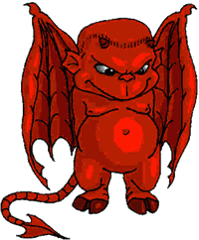
Mexican Vaqueiros California
El Diablo, an Indian god, made a giant rip in the ground so that he and his cohorts did not have to take the long way around when they wanted to stir up mischief on Earth.

Slide 13
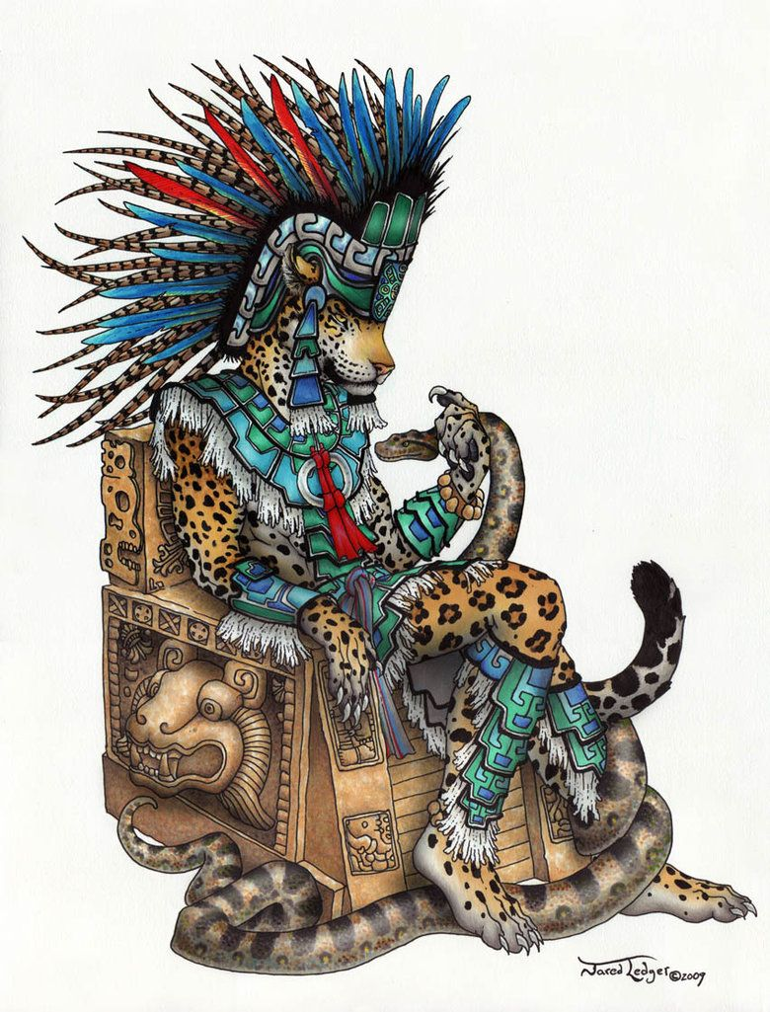
The Aztecs
The Aztecs who lived in the Valley of Mexico personified the source of earthquakes in Tepeyollotl, a mountain god, who took the form of a jaguar leaping toward the sun.

Slide 14
Gabrielino Indias, South California
Long ago, Great Spirit made a beautiful land that turtles carried on their backs in lakes and rivers calling Earth Turtle Island. One day the turtles began to argue. Three swam east; the other three swam west. The earth shook and cracked. The turtles could not swim far, because their load was heavy. So they made up. But once in a while, the turtles argue again. Each time, the earth shakes.

Slide 15
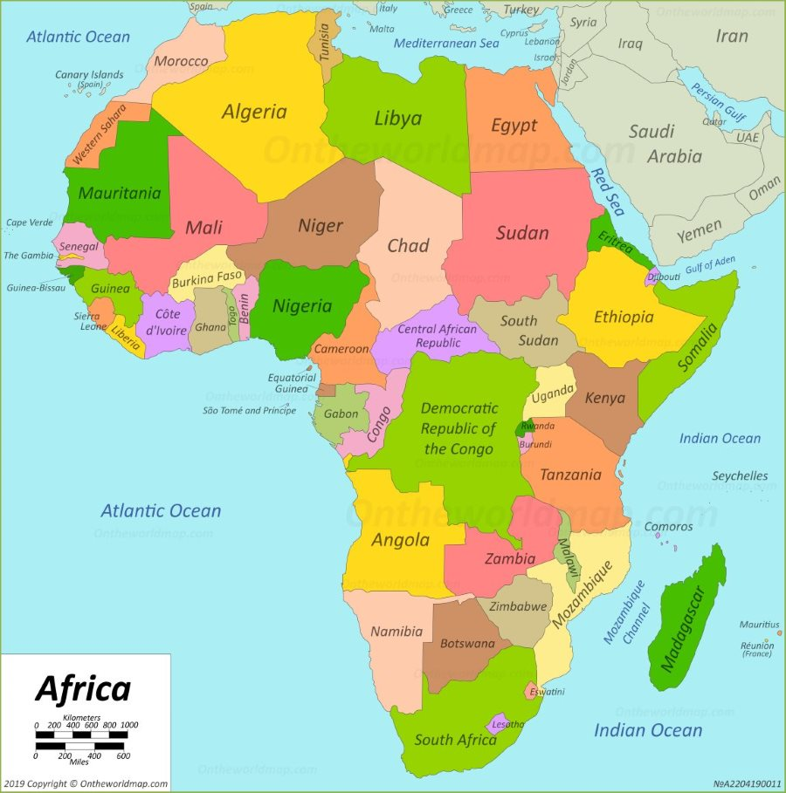
Africa

Slide 16
West Africa
In West Africa, the Earth is considered a flat disk, held up by an enormous mountain in the west and by a giant in the east. The giant’s wife holds up the sky. The Earth trembles when he stops to hug her.
Other West Africans claimed that a Giant carries the Earth on his head. All the plants that grow on the Earth are his hair, and people and animals are the insects that crawl through his hair. He usually sits and faces the east, but once in a while he turns to the west and then back to the east, with a jolt that is felt as an earthquake.

Slide 17
Eastern Africa
In different parts of Africa, earthquake legends have also arisen. One of these from Eastern Africa involves a compliant cow. The cow stands on a huge flat stone, and the stone in turn is resting on the back of a giant fish. The cow balances the earth on the tip of one of its long horns, but the weight of this sometimes causes her neck to ache. When the aching gets too bad she tosses the globe onto the other horn. It is this movement that causes the earth to shake.

Slide 18
Mozambique
The people of Mozambique believe, the Earth is a living creature, and it has the same kinds of problems people have. Sometimes, it gets sick with fever and chills and we can feel its shaking.

Slide 19
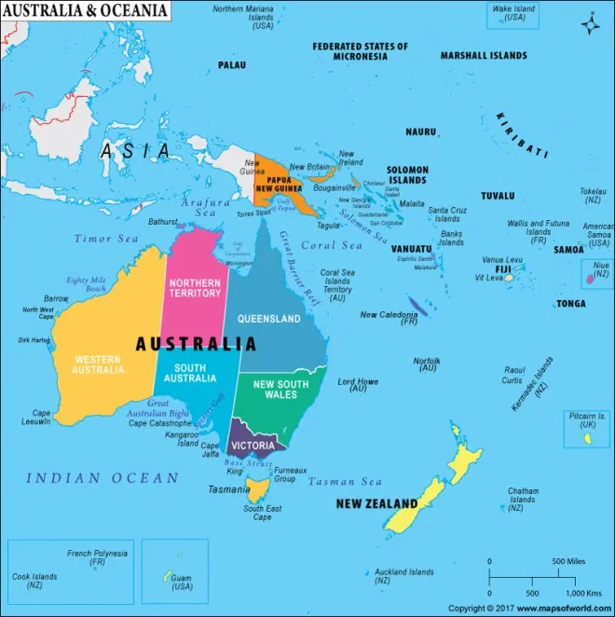
Australia - Oceania

Slide 20
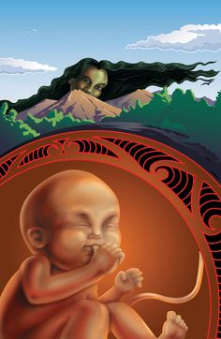
New Zealand
Narly people from New Zealand saw Mother Earth with a child in her womb, the young god Ru. When he stretches and kicks as babies do, he causes earthquakes.

Slide 21
References
https://www.crystalinks.com/earthquakes-mythology.html

