Slide 1
The game: The last pair separates!
Jelgava Primary School No. 4

Slide 2
Instructions
1. Every child finds a pair and stands together, a pair behind a pair making a column.

Slide 3
2. The catcher stands alone with his back at the front of the column.

Slide 4
3. The catcher says «The last pair separates!» and then the last pair splits in half running to the opposite sides.

Slide 5
4. If you are the last pair you have to get away from the catcher and then you need to come together, hold hands and stand in the front of the column.

Slide 6
5. If you are a catcher you have to catch one of the players in the last pair and make a pair with the player you catch.

Slide 7
6. If you are not caught you become the catcher.

Slide 8
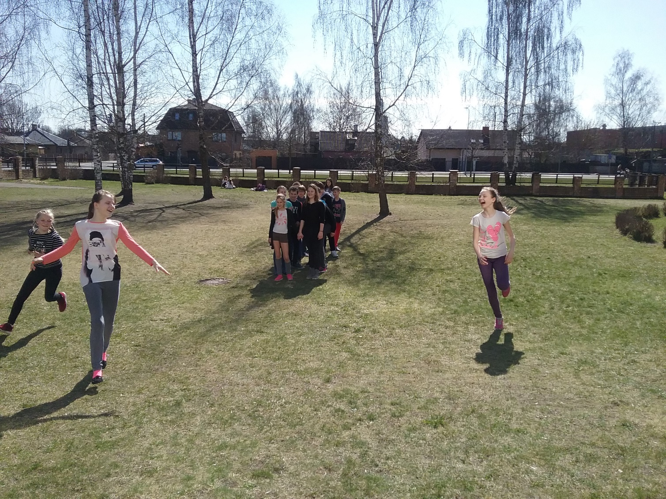
Have fun! Enjoy the game!

