Slide 1
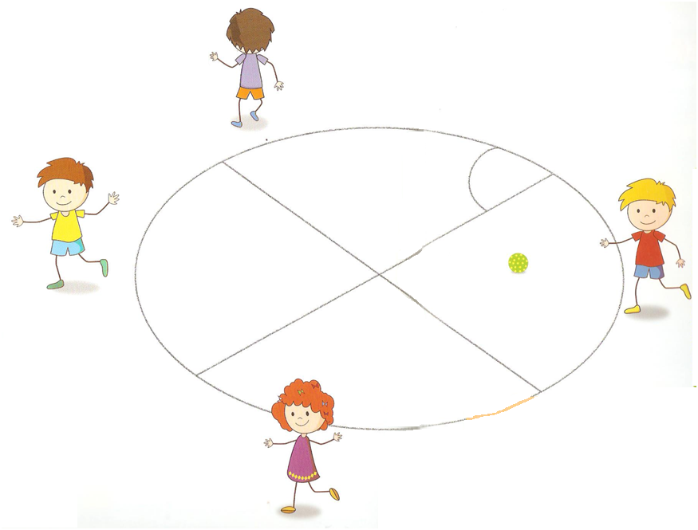
CAKE STEALING GAME
Project B. L. O. S. S. O. M. !
Brinje Grosuplje Primary School, SLOVENIA

Slide 2
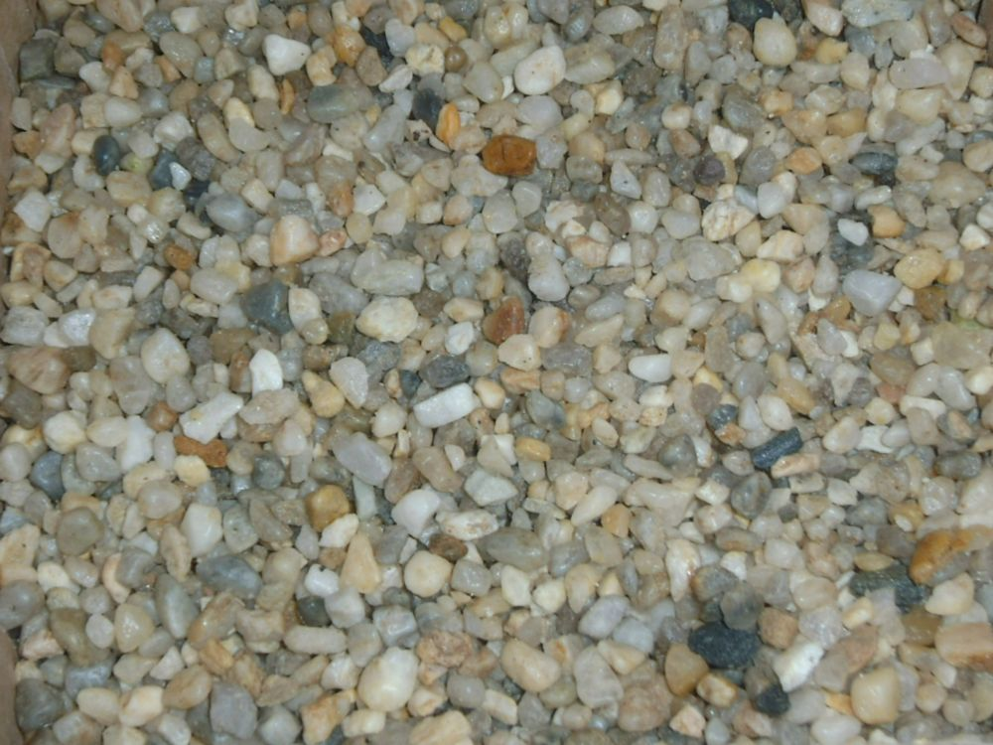
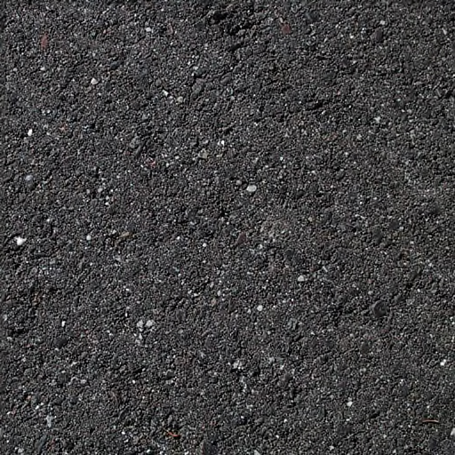
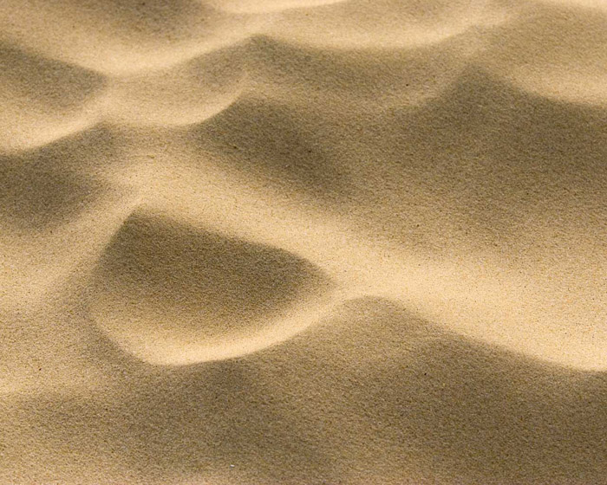
For this game you need enough space and the type of surface that can be drawn on (asphalt or sand field).

Slide 3
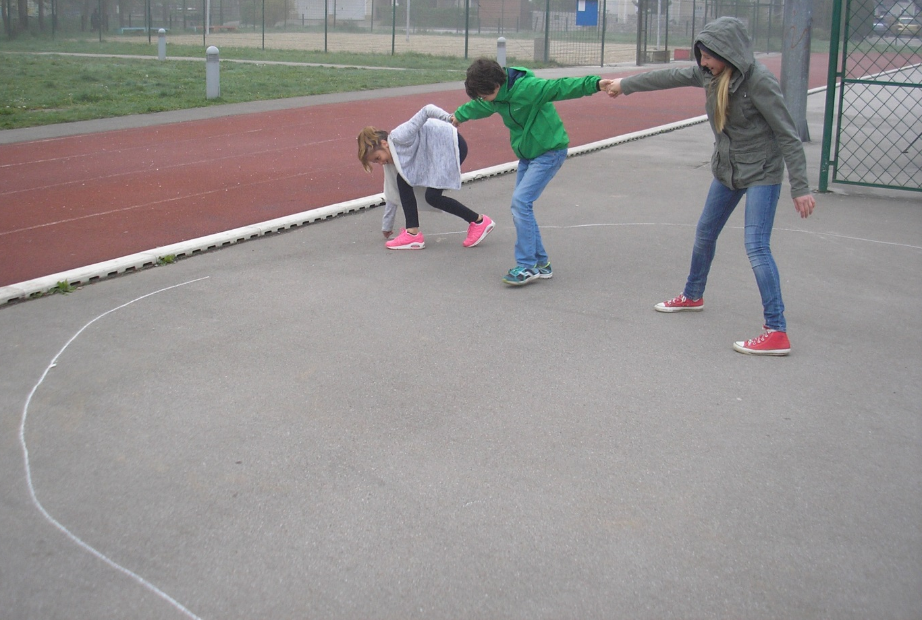
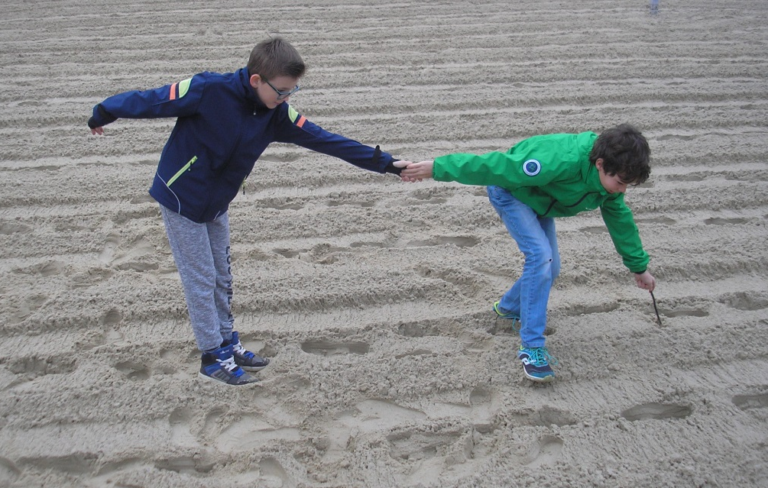
Draw a circle (a cake) with a radius of approximately 2m. Then split it into the number of parts that equals the number of players.

Slide 4
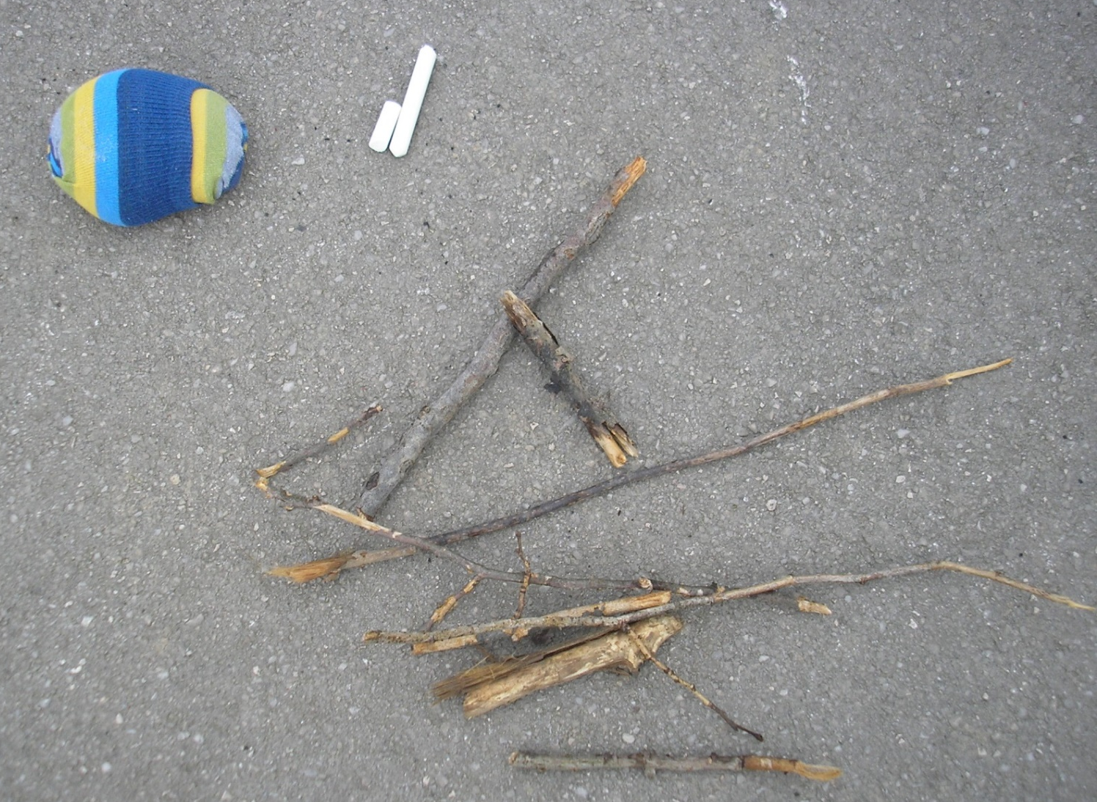
The players draw or use a counting rhyme for defining the person who begins the game. This player then gets an object for throwing (e.g.: a soft cloth ball).

Slide 5
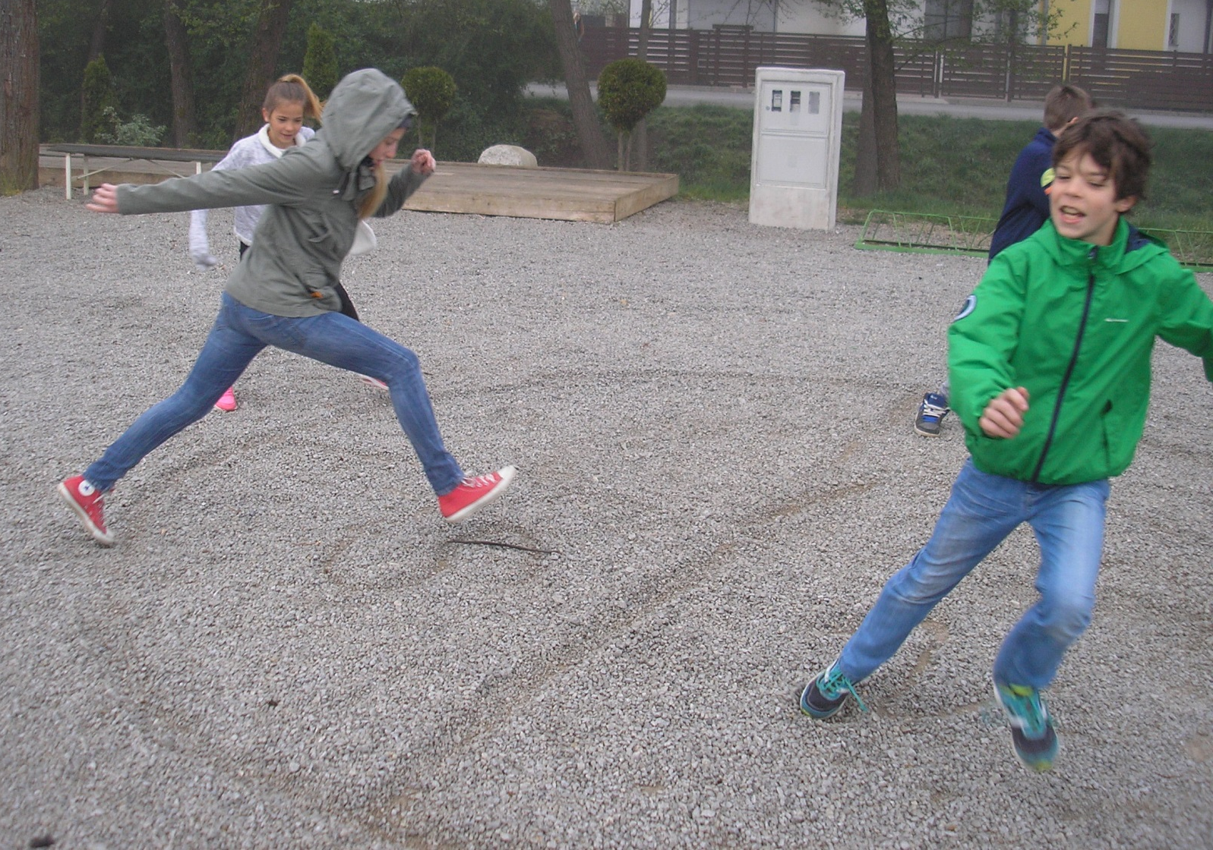
All the players stand on the fringe of his/her part of the cake. When they are all ready, the player throws a ball inside of one of the co-players’ parts of the cake. The player, who now has a ball on his/her cake, runs to the ball as fast as he/she can, steps on it and says loudly: “Stop!”

Slide 6
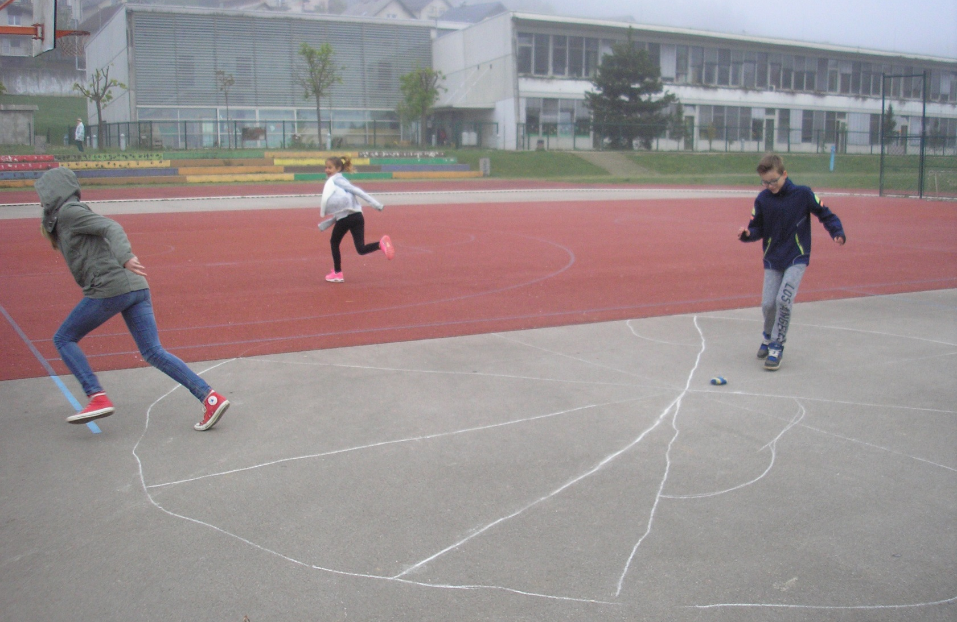
Meanwhile, the rest of the players run away, out of their cake, as far as they can. When they hear “Stop!”, they have to stop immediately.

Slide 7
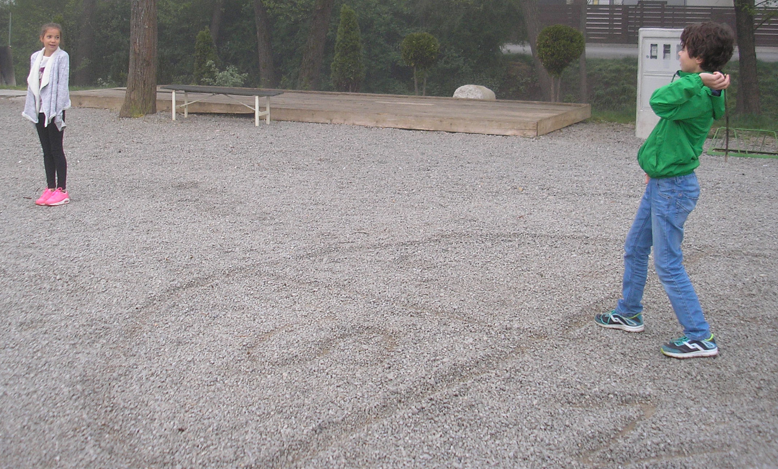
The player with the ball chooses one of his co-players and tries to hit him with the ball. He/She can only target while standing inside his/her cake.

Slide 8
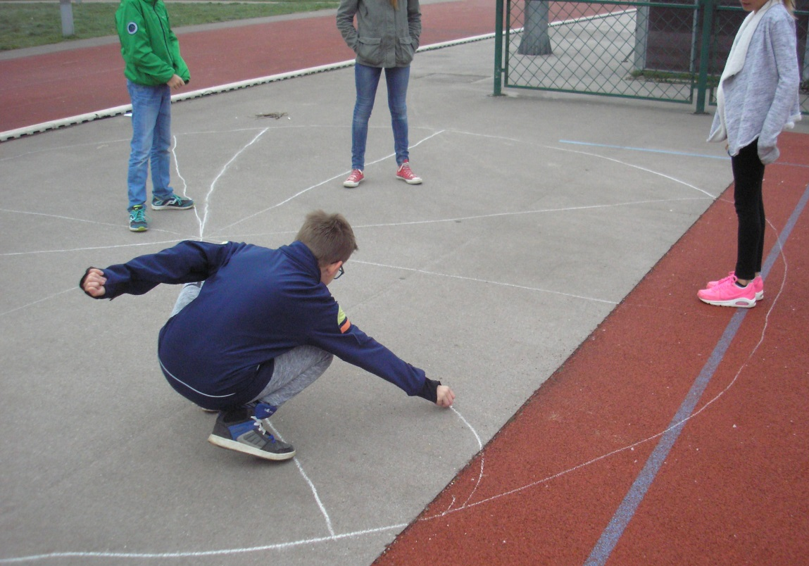
If he manages to hit someone, then he/she can take some of his/her cake, but only as much as he/she can draw with a chalk while still standing inside his own cake. If the player doesn’t hit the targeted co-player, then this co-player can take part of his cake.

Slide 9
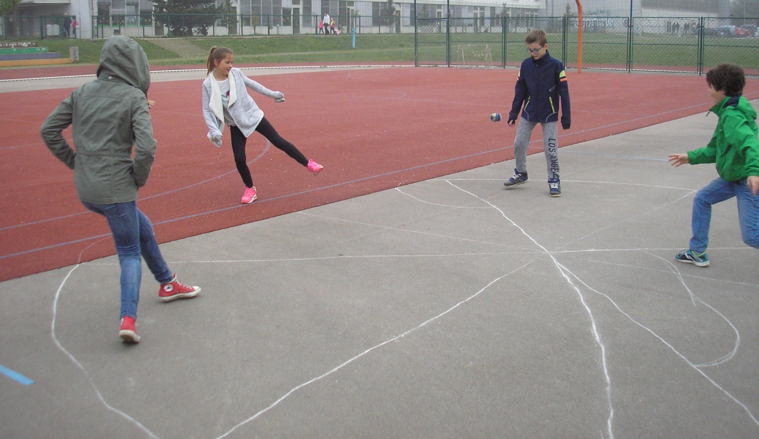
The game is continued by the player who has lost a part of his cake. If the player runs out of the cake, he is no longer a participant of the game. The winner is the one who in the end owns the whole circle - cake.

Slide 10
REMEMBER: It's not whether you win or lose. It's how you enjoy the game. Have a great time playing it! Luna, Maruša, Hana, Neža, Majk, Tine, Maja, Majda Grosuplje, May 2016

