Slide 1
Passport to Europe !
Poland October, 2019
Mini project „Mindfulness”

Slide 2
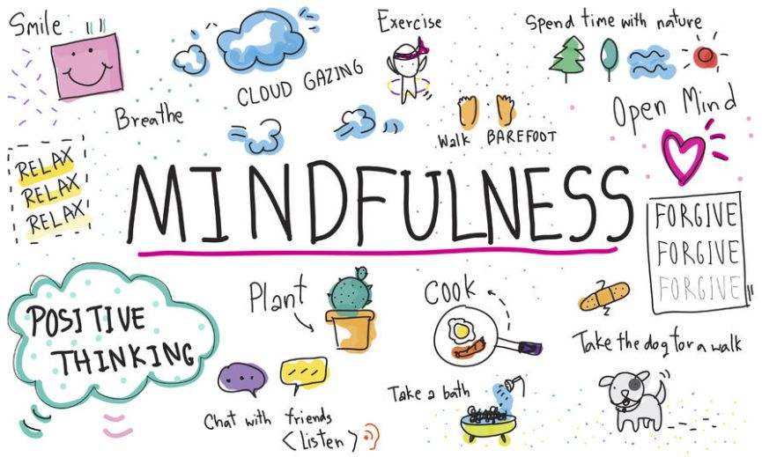
Mindfulness

Slide 3
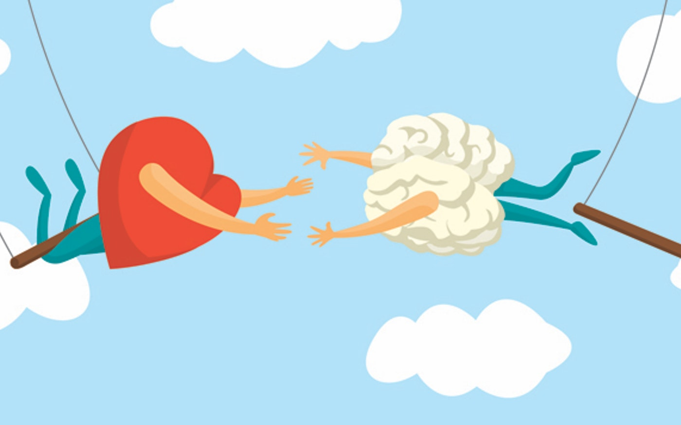
What is it?
Self-awareness. A moment of focus only on yourself. Forget about all worries. Focus on the ongoing moment. It is used as a therapeutic method.

Slide 4
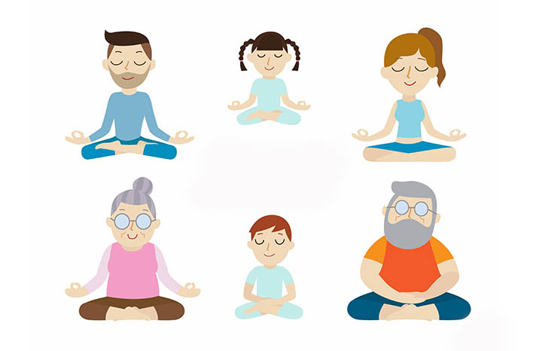
A FEW TIPS HOW TO MAKE OUR MEDITATION BE MORE EFFECTIVE

Slide 5
1. sit comfortably

Slide 6
2. CLOSE YOUR EYES

Slide 7
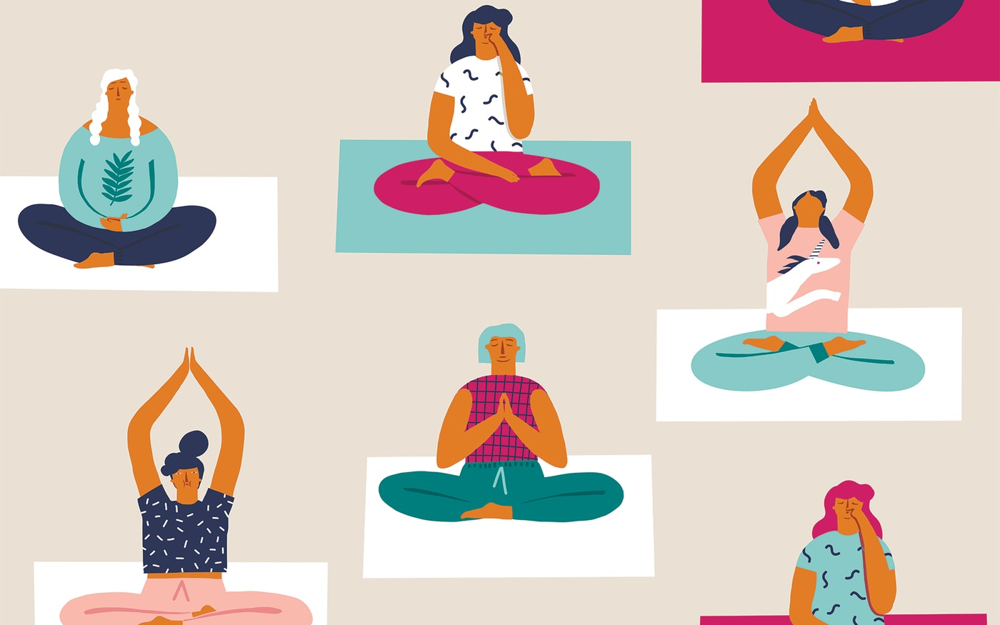
3. Think about yourself

Slide 8
4. Breathe deeply

Slide 9
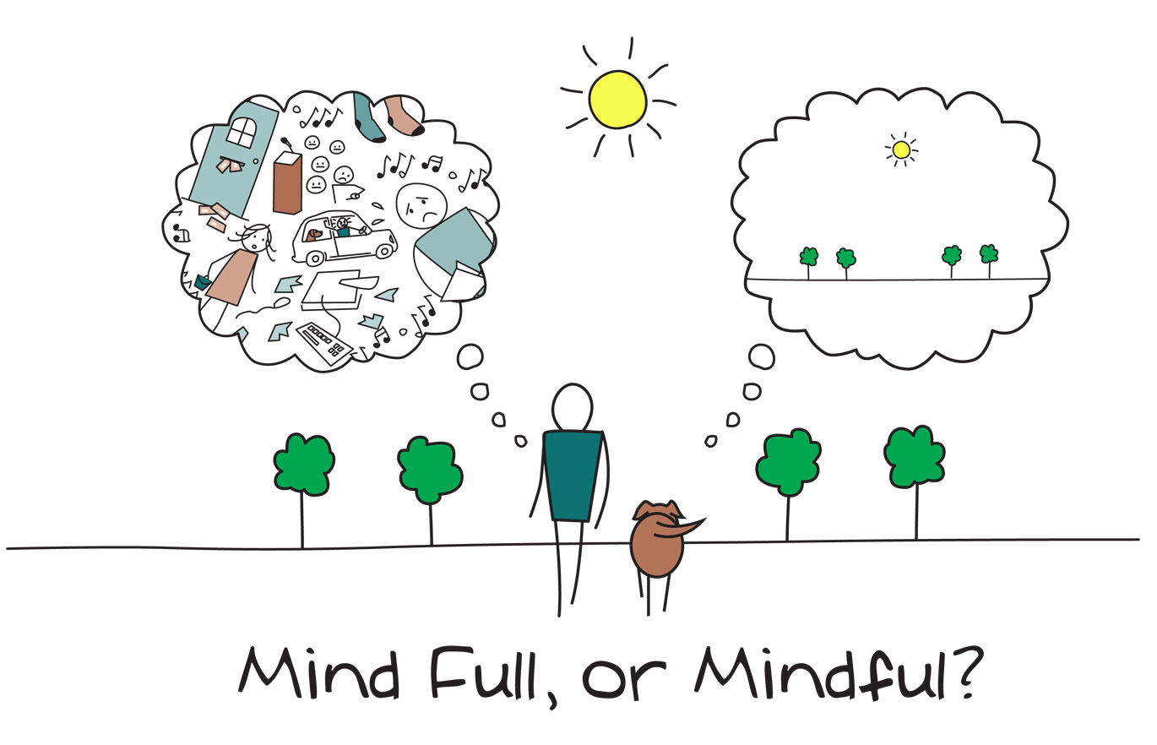
5.think about ONLY one thing.

Slide 10
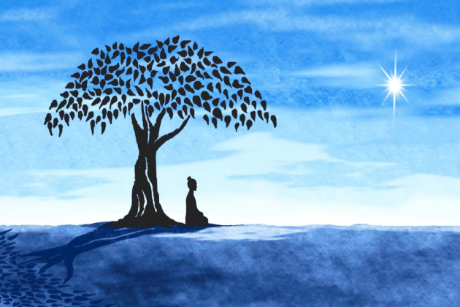
6. Enjoy the moment

Slide 11
7. Forget about all worries.

Slide 12
8. Try to relax

Slide 13
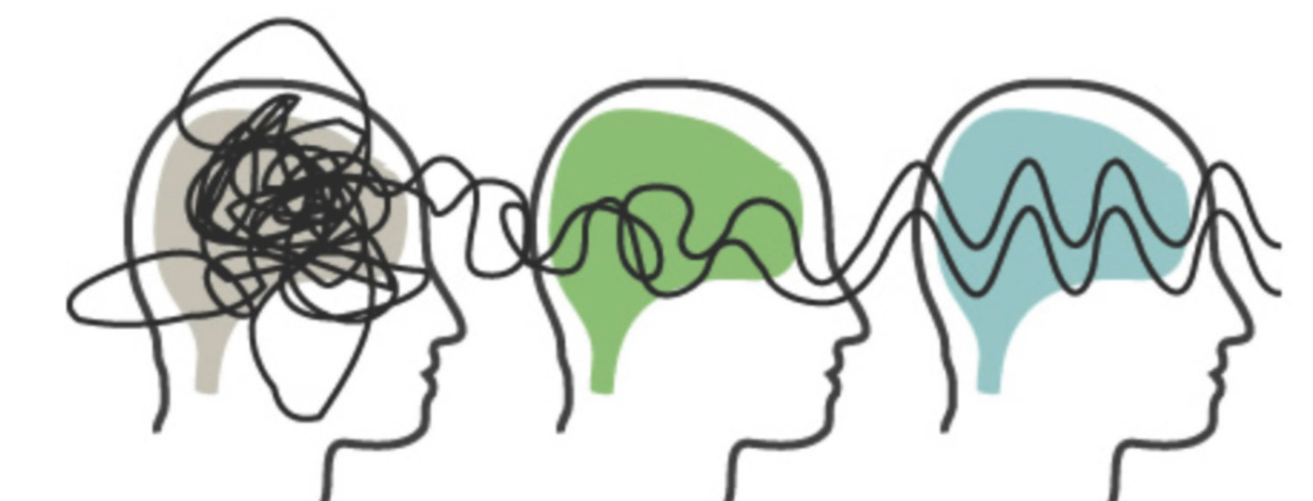
9. Don't complicate. Have a clear brain.

Slide 14
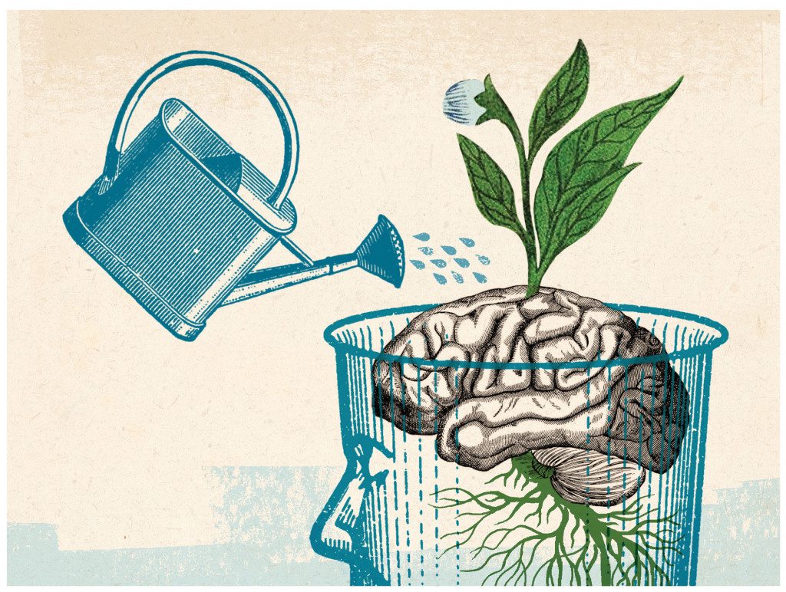
Now you are ready to do it. So enjoy

Slide 15
Links
https://www.youtube.com/watch?v=i50ZAs7v9es&fbclid=IwAR0WrLRrRYsvf1J9h68Wc9BJk4Gzrv_lv-ImhpQ2rIjGejUnHlKeKSk3pcI
https://www.youtube.com/watch?v=cDflnqo0TQs&fbclid=IwAR1PYEg6_yQ-zjWxlVmYIlt4HlRSLKkcpCUEjGXvesHflTK4hiOBLmLpVLY
https://www.youtube.com/watch?v=L-IZArfQHOo&fbclid=IwAR3laBmu8TMTODryyMMmug7QXkCyiTMnTYI4khb2Uh77B2e-vXfamjrk4YE
https://www.youtube.com/watch?v=numT6_r2Kss&fbclid=IwAR1E7oZGDBMQ6ewmDrJ4QdpgKhdbojJgTp_zScCECMgU_3e5ahEenGKVOig&app=desktop

Slide 16
THE END
Presentations have been prepared by
Justyna Rachwał, Karolina Radomska and Wiktoria Kuliś

