Slide 1
Cyber-helpers
ZSiPO w Skale
PASSPORT TO EUROPE

Slide 2
Internet Safety Facts
95% of teens use the internet
It’s more important than ever to share internet safety information since so many teens are online
71% of youth are concerned about cyberbulling
With so much concern about bulling online, teens today should know what their options are when they encounter cyberbullies.

Slide 3
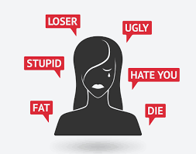
What are cyber villians?
Cyberbullies & Trolls
Anyone intentionally being mean, rude, unpolite, offensive ot threating online
Cyberstalkers & Identity Thieves
Someone who seeks out personal information about you, either to find you or to use your information fot their own gain.

Slide 4
What to do about cyber villians
Just ignore
Tell an adult
ALWAYS tell an adult. Do this to ensure your own safety – if no one knows, no one can help.
Most of trolls are looking for reaction, so don’t give it to them. Block them if you can
Report bad behviour
Many websites have a reporting feature for uses who break rules.

Slide 5
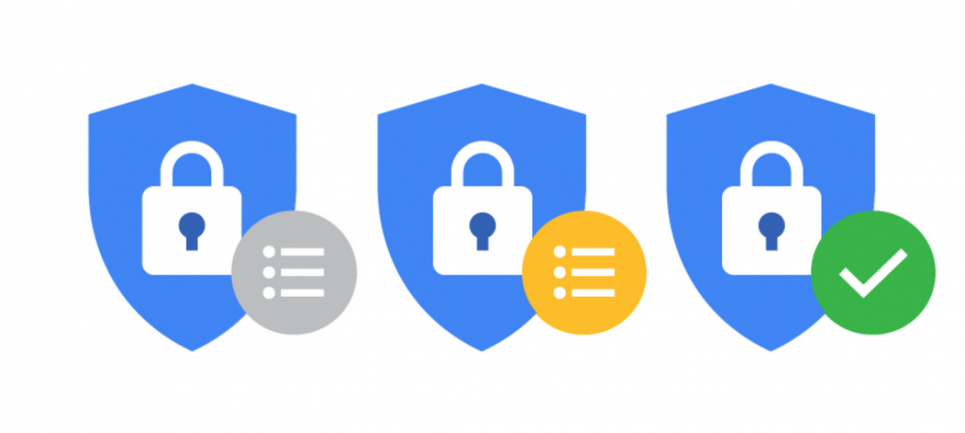
Privacy settings
Why are they important?
What to look for
Makes sure your profile are set so that only your friends can see your photos, posts and any contact information.
You can usually block specific users so they can’t see your profile at all.
Most social media sites have settings that allow you to choose who can see you content.

Slide 7
Sharing is great Oversharing - not
Think about what you want to share or send. Would you want your parents see it? How about your whole school? Future employers?
It’s always dangerous to share personal detais online. Nothing in internet is comletely confidential
Problem arises when you post things like your phone nubmer, address, current address

