Slide 1
Project number: 2018-1-ES01-KA229-050298
PASSPORT TO EUROPE

Slide 2
SKAŁA (it’s the town where we are now; the town's name comes from the area in which the Skała is located)

Slide 3
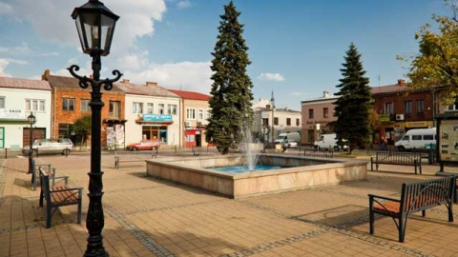
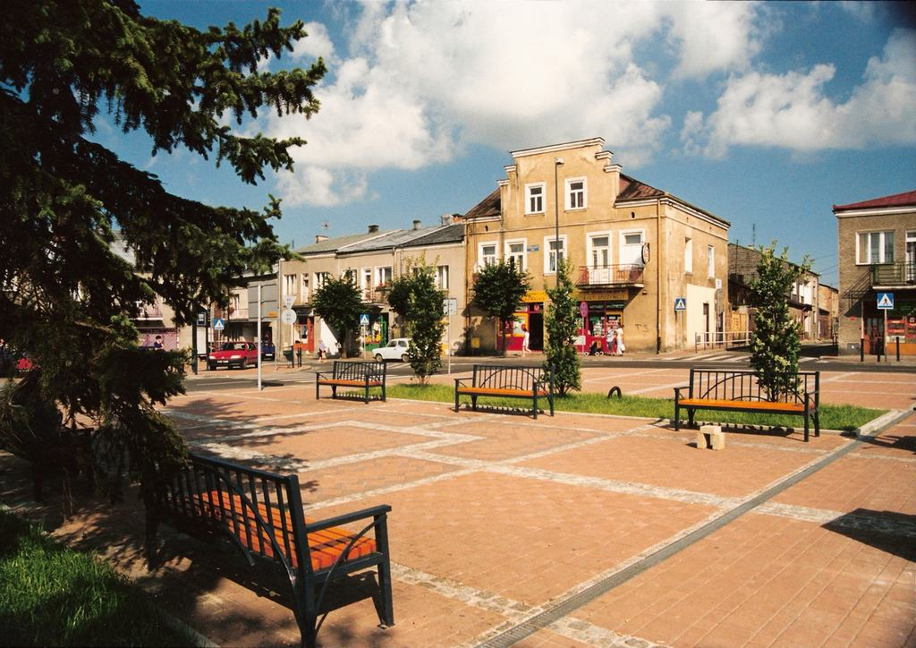

Slide 4
SYMBOL OF TOWN SKAŁA
CITY FLAG
CITY COAT OF ARMS

Slide 5
SKAŁA – where town is this in map of Poland?

Slide 6
CITY MAP
Centre of Skała
Our school

Slide 7
SKAŁA – where is this town?
a small town north of Cracow,
Cracow is 20 km away,
Around 6,000 people live in Skała,
a big problem in the city and commune is smog.

Slide 8
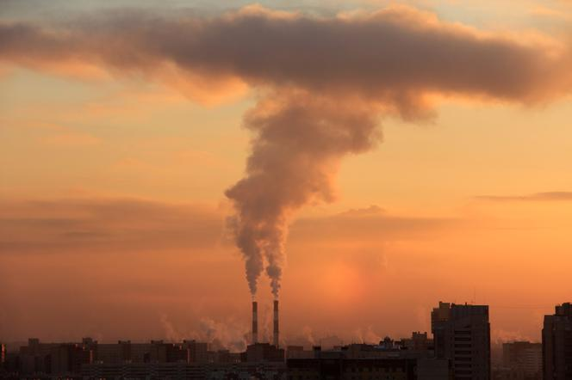
OUR BIG PROBLEM - SMOG
SMOG is poisonous fumes that arise from burning garbage.
Some people told the smog is a dragon, who destroy our town and life…

Slide 9
SMOG IN SKAŁA
It’s a very serious problem in this small town, because in every year people burn a lot of rubbish and destroy our helath and life.
People in ovens burn old clothes, shoes, tires, rubber elements, and plastics. It all stinks very much.

Slide 10
SMOG ON THE PICTURE
These white fumes that we see in the picture is not fog, it's a smog that arises when people burn garbage in houses.

Slide 11
Happening in Skała in honour to 5 people who died by smog in our town!
In December 2016, the happening "let's honour the victims of smog" was organized on the market.
In the middle of the square, a coffin and a number five made of candles were erected. Apparently as many as five people died as a result of inhaling smog.

Slide 12
POLLUTION IN EUROPE AND POLAND
Pollution in Europe

Slide 13
Article about Skała in American newspapers
Financial Times’s newspaper write: „With a staggering 33 out of Europe's 50 bridge polluted cities, according to a World Health Organization, this year, Poland is the continent's capital of smog. It regularly surpasses EU limits on pollution.”
“For years Polish cities have been the most polluted, which makes Poland a disgraceful leader — the red spot on the map of Europe,” said Ewa Lutomska of Polski Alarm Smogowy, a pollution watchdog.

Slide 14
2016, December
December, a pollution tracking agency, has an average of 979 micrograms (one millionth of a gram) per cubic meter of air, far exceeding Beijing's 737 and almost 20 times higher than EU limits.
Public transport in the country was free. People in were wearing masks or didn’t go out.

Slide 15
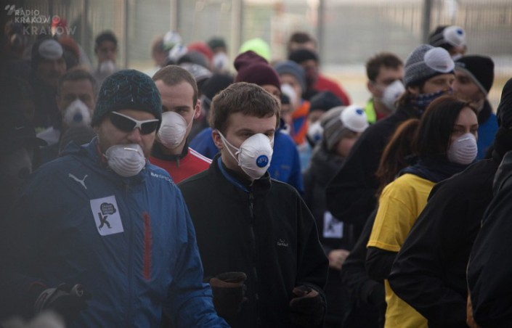
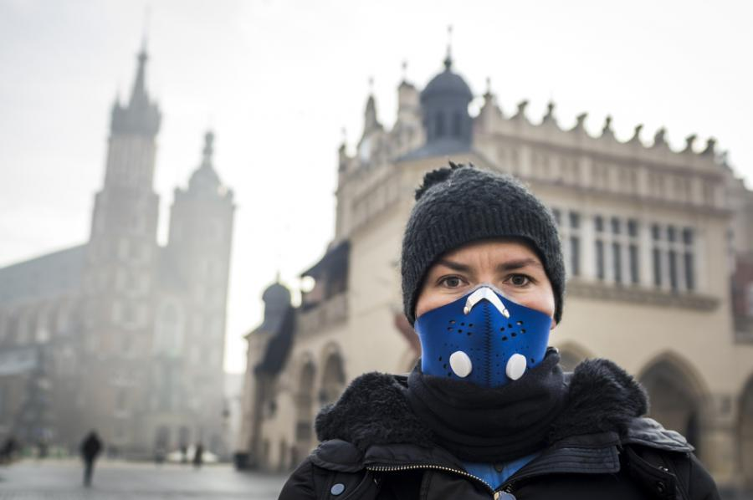

Slide 16
Poniatowski Bridge
The picture shows a smog that covers the buildings of Warsaw.

Slide 17
SMOG
In the picture we can see smog. It’s a poisonous smoke.

Slide 19
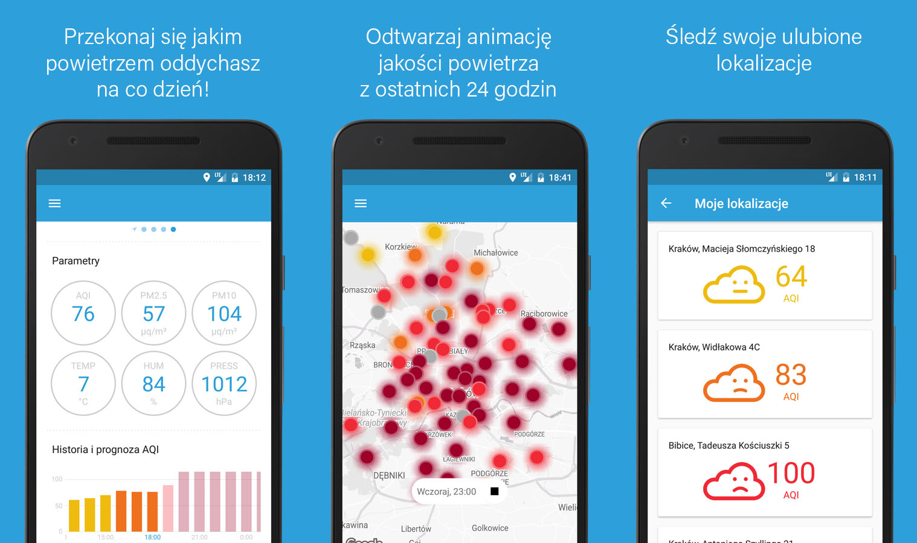
AIRLY – aplication about pollution.
We have an application that shows the degree of pollution in our country, this is AIRLY.
Here we can see degrees aboutt pollution
Here we can see where is the most polluted place in Poland
Here we can see what the state of air is and if we can go outside

Slide 20
Cleaning up the world in Skała on 29 March 2018
One and a half year ago, class 2B (now 3B) organized a cleaning campaign around the school.
Equipped with garbage bags and protective gloves, we divided into small groups and assigned a cleaning area to each group.
We started from 9 o'clock and cleaned the next 5 hours. The work was fast and efficient.
Together, we were able to collect over 25 rubbish bags. The greater part of them were plastic bottles, metal cans and glass.
In the pictures you can see the effects of our work.

Slide 21
My class after the action

Slide 22
Area after and before the cleaning

Slide 23
Sometimes we found things thrown out of the house…

Slide 24
BIOLOGICAL COMPETITION AT OUR SCHOOL
On March 14, a competition was held under the ERASMUS + project: Passport to Europe.
The first pot depicted sown seeds any functions of the spice plant, used in Polish cuisine and the second pot depicted the planted split plant cleansing the air of impurities. An irrigation system had to be constructed from this raw material for this pot.

Slide 25
