Slide 1
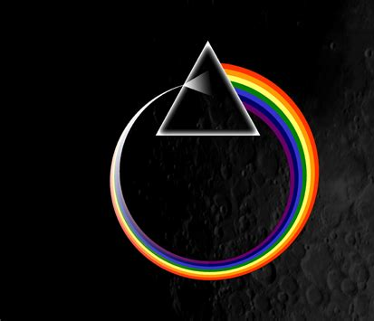
Choose your apprentice
You are an entrepreneur, like Alan Sugar on The Apprentice.
You need to ‘hire’ an engineer to set up life on the moon!
It’s a big, challenging job that will make history.
It needs the right apprentice - someone with resilience, determination, engineering expertise and great people skills!

Slide 2
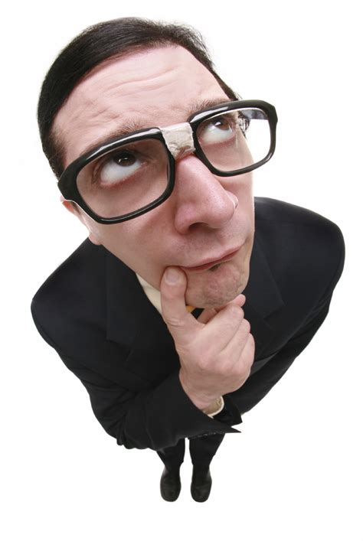
Choose your apprentice
Line up the cards in front of you - that is your apprentice line up.
Each time I reveal a layer of information about each apprentice, you need to ‘fire’ one person by removing them from your line up.
Who will you ‘fire’ and ‘hire’?

Slide 3
Choose your apprentice
The apprentices…
Fire one now so you have six remaining
Ali | Patrick | Jamie | David | Adriana | Hannah | Delroy

Slide 4
Choose your apprentice
Fire one now so you have five remaining
Ali Abdul | Patrick Murphy | Jamie Small | David Campbell | Adriana Carboni | Hannah Mann | Delroy Baiey

Slide 5
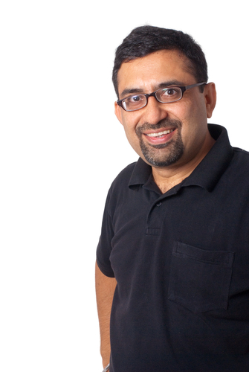
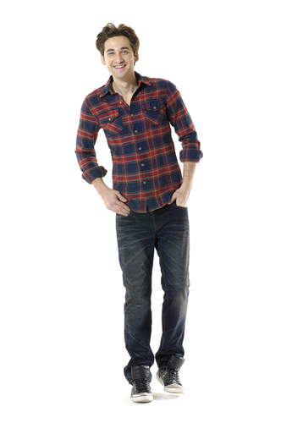
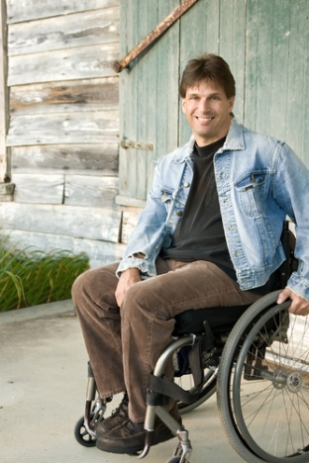
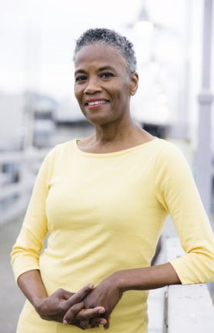
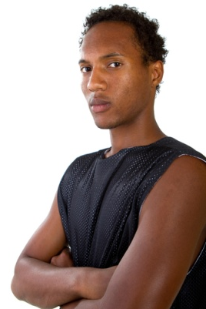
Choose your apprentice
Fire one now so you have four remaining
Ali Abdul | Patrick Murphy | Jamie Small | David Campbell | Adriana Carboni | Hannah Mann | Delroy Baiey

Slide 6
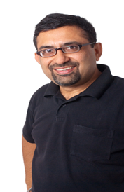
Choose your apprentice
Fire one now so you have three remaining
Ali Abdul | Patrick Murphy | Jamie Small | David Campbell | Adriana Carboni | Hannah Mann | Delroy Baiey
Hetero-sexual
Gay
Lesbian
Hetero-sexual
Hetero-sexual
Lesbian
Hetero-sexual

Slide 7
Choose your apprentice
Fire one now so you have two remaining
Ali Abdul | Patrick Murphy | Jamie Small | David Campbell | Adriana Carboni | Hannah Mann | Delroy Baiey
Physically fit but wears glasses
Physically fit and mentally fit
Physically fit but suffers anxiety
Physically and mentally fit
Physically disabled, mentally fit
Physically and mentally fit
Pregnant, physically & mentally fit

Slide 8
Choose your apprentice
Fire one now so you have one remaining
Ali Abdul | Patrick Murphy | Jamie Small | David Campbell | Adriana Carboni | Hannah Mann | Delroy Baiey
Entrepren-eur / business man
Doctor of engineering
Engineer and project manager
Army engineering officer
Engineer graduate
Firewoman
Ex-Army

Slide 9
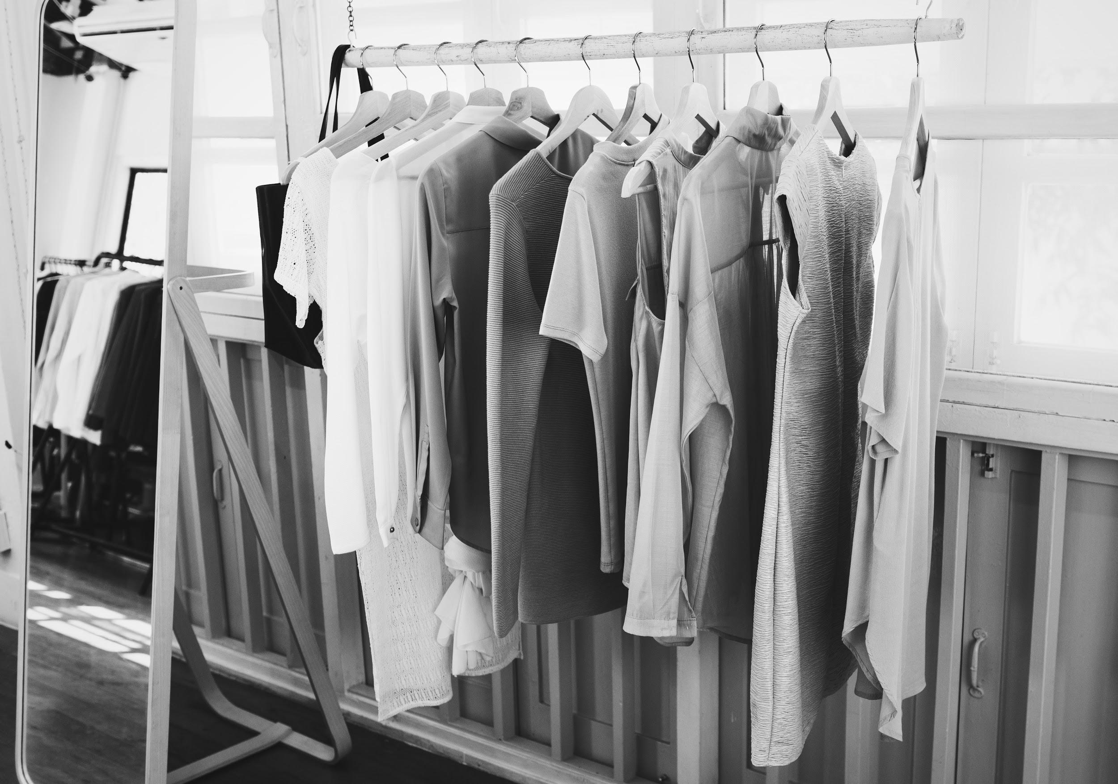
01
Prejudice

Slide 10
Who was your choice?
What choice did you make?
Are you pleased with your hired apprentice?
Would you have made a different decision if you had the qualifications information first?
What is wrong with judging people with such little information?
What do you think influenced your decisions?
Do you think people often judge people like this in our everyday life?
What could be the consequences of pre-judging people?

Slide 11
Prejudice
judging someone without knowing them, on the basis of what they look like or what group they belong to, for example all black people are good dancers.

Slide 12
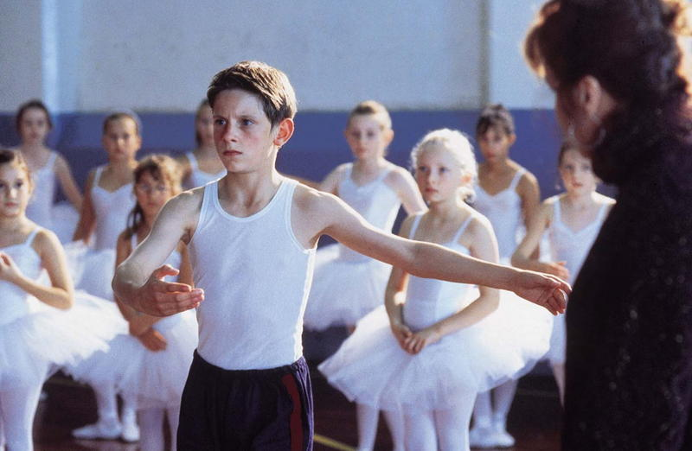
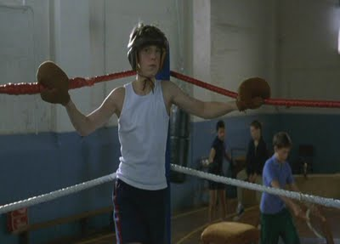
Mercury
Venus
\

Slide 13
What are the main topics in the poem?

Slide 14
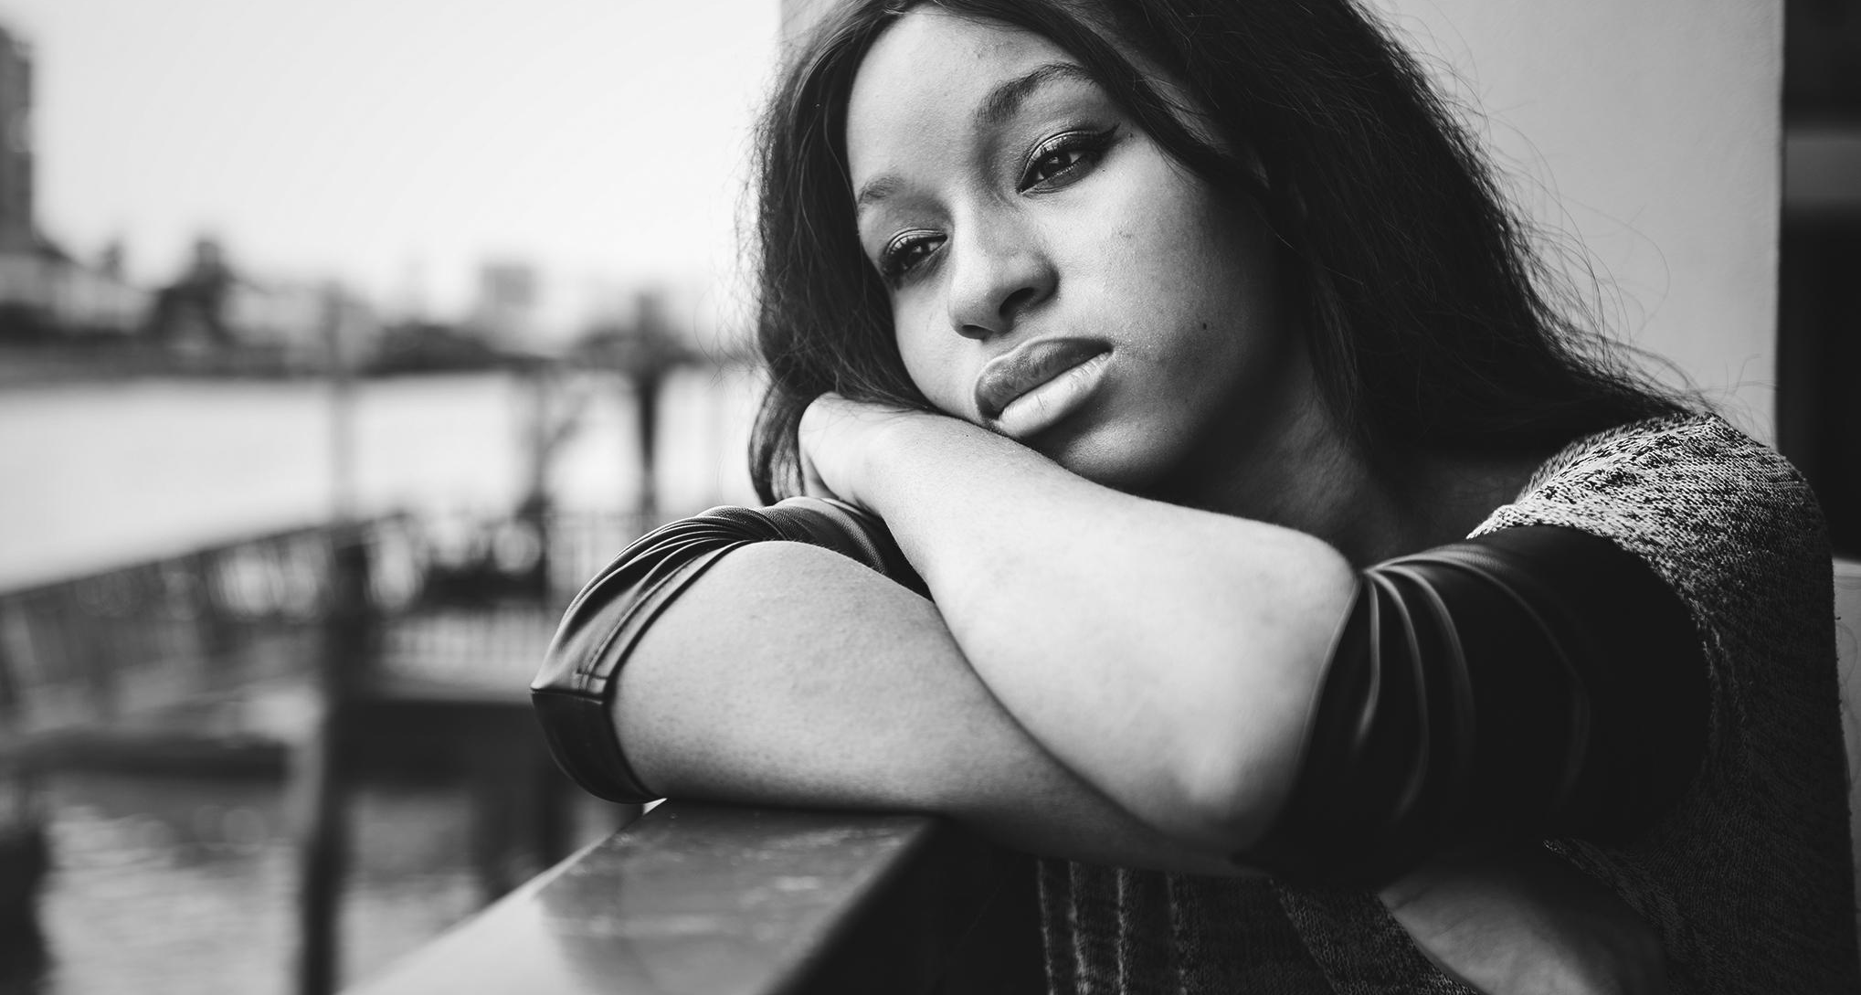
02
STEREOTYPES
Stereotypes: thinking all people who belong to a certain group are the same and labelling them, for example all young people who wear hoodies are thugs.

