Slide 1
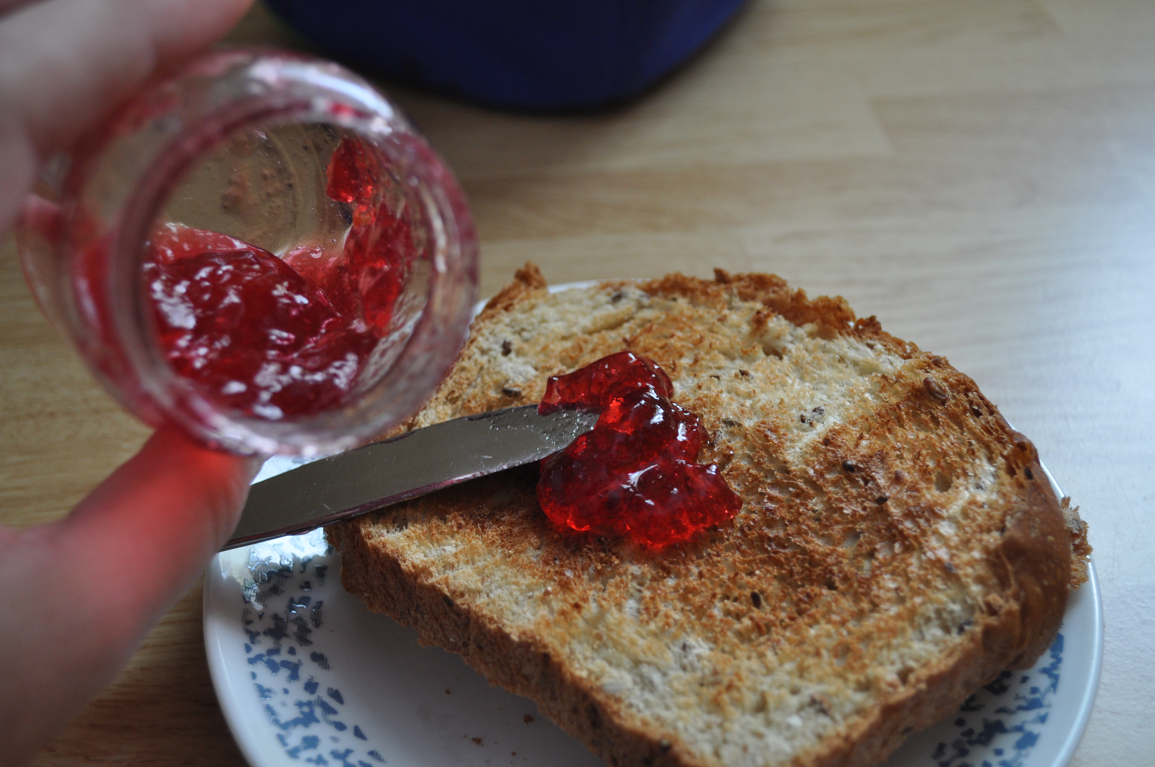
MENU 1
GROUP 1
TOTAL CALORIES
980 Kcal.
(picture of one of the dishes)
NAMES OF THE MEMBERS OF THE GROUP:
Carlos Plou Paula Sanchez
María Ruiz Jordan Nasser
Francesca Rosa Nurean Durdeana

Slide 2
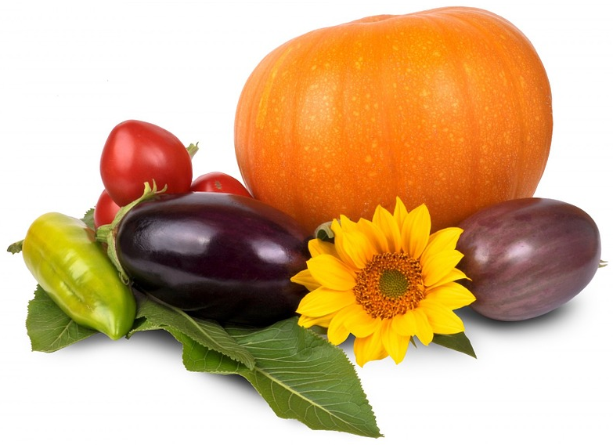
OUR MENU
BREAKFAST:
Apple pie
Strawberry jam on freshly baked bread and a cup of coffee
MID-MORNING SNACK:
Jam on toast
DINNER: vegetable soup
LUNCH: grilled steak with mixed seasonal vegetables

Slide 3
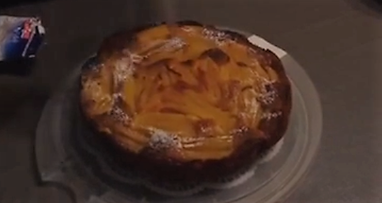
name/s of cook/s: Francesca Rosa
Watch video:
https://youtu.be/7cImZflmgoA
BREAKFAST
Ingredients:
4 apples
200 g of flour
yeast
3 eggs
130 g of butter
150 g of sugar
salt
30 g of brandy
Instructions and presentation:
preheat the oven to 180°C;
peel the apples and cut them into pieces;
put the flour, the eggs, the butter, the sugar, brandy and the yeast into bimby and mix everything;
spread the dough into a cake pan and put the apples on it;
put the cake into the oven and let it bake for 40 minutes.
PRESENTATION: Spread powered sugar onto the cake

Slide 4
Name of cook: Jordan
Watch video:
VIDEO EMBEDDED(OR PICTURE IF THERE IS NO VIDEO)
MID-MORNING SNACK
Ingredients:
Bread
Toaster
Jam
Knife
Instructions and presentation:
Get the bread out of the bag and put two slices into the toaster. Get a jar of jam out of the fridge and wait for the toast to be ready. Now get a knife and spread the jam on the toast. Now it is done put them on a plate and eat.

Slide 5
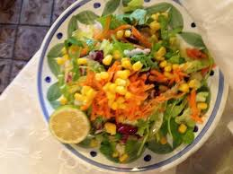
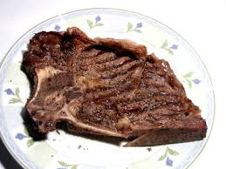
name/s of cook/s: Francesca Rosa
LUNCH
Instructions:
Steak: put the two pieces of steak in a heat-resistant dish. Sprinkle some oil and pepper. Put into oven and grill for 5/7 minutes, 150°C. Add salt when done.
Vegetables: peel, wash and grate the carrots. Wash the seasonal vegetables (lettuce, tomatoes, celery), cut in slices or pieces. Put them in a large bowl, tip with the grated carrots, the olives and the mais.
Presentation:
Steak: serve well hot and season with some more oil and balsamic vinegar.
Vegetables: season with olive oil and vinegar/lemon juice
Ingredients:
(for 2 people)
two large pieces of T-bone steak
raw seasonal vegetables: carrots, celery, brown/green olives, mais, tomatoes, lettuce)
Extra virgin olive oil
lemon juice
balsamic vinegar
salt, pepper

Slide 6
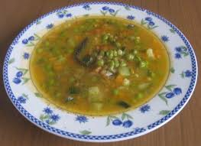
name of cook: Nurean Durdeana
DINNER
Ingredients:
2 carrots1 onion
2 average-sized
potatoes
a bunch of celery
a handful of peas
2 zucchini
1 garlic clove
extra virgin olive oil
Parmesan cheese
salt, pepper
Instructions:
Peel the carrots, the onions and the potatoes. Scratch out the zucchini peel. Cut all the vegetables in slices or pieces (except for the peas). Put the vegetables into a large potful of salted cold water. Keep boiling over high heat for 3 hours tipping with broth when the liquid decreases.
Presentation:
Serve hot with a sprinkle of olive oil, pepper and Parmesan cheese.

