Slide 1
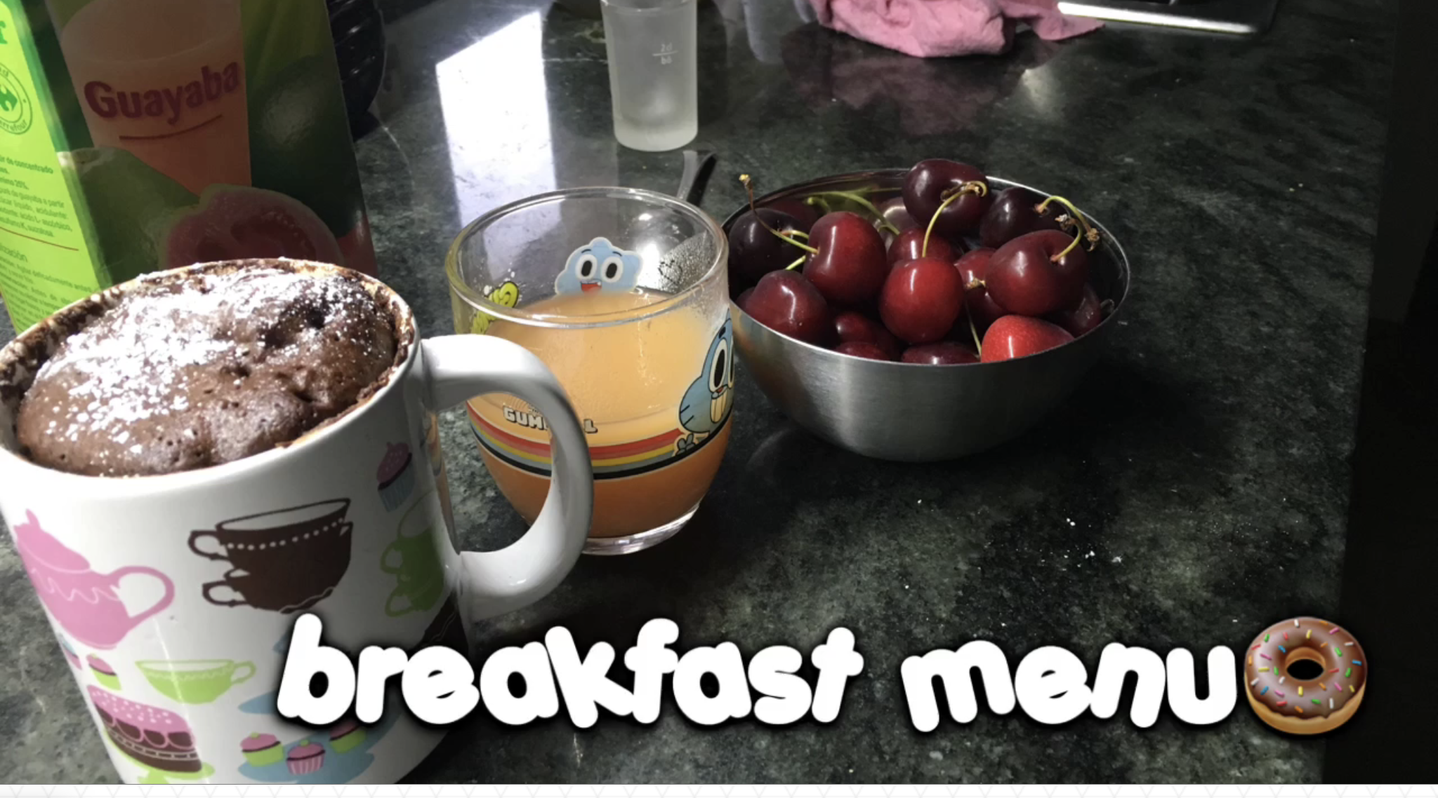
MENU 7
GROUP 7
TOTALCALORIES
1.200 Kcal.
(picture of one of the dishes)
NAMES OF THE MEMBERS OF THE GROUP:
Sofia ubieto lopez Daniel Martinez David Sobreviela Miguel Ángel Medina
Filippo Ruggeri Nicolò Lecci Riccardo La Bianca

Slide 2
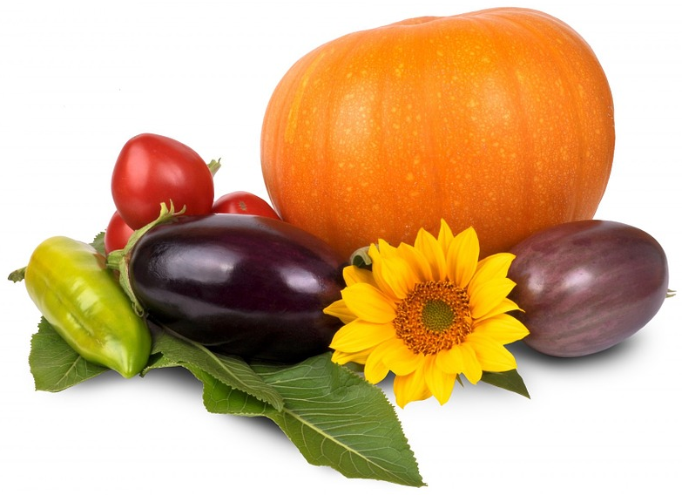
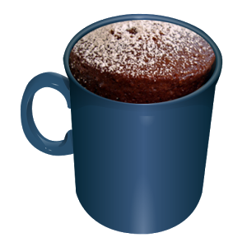
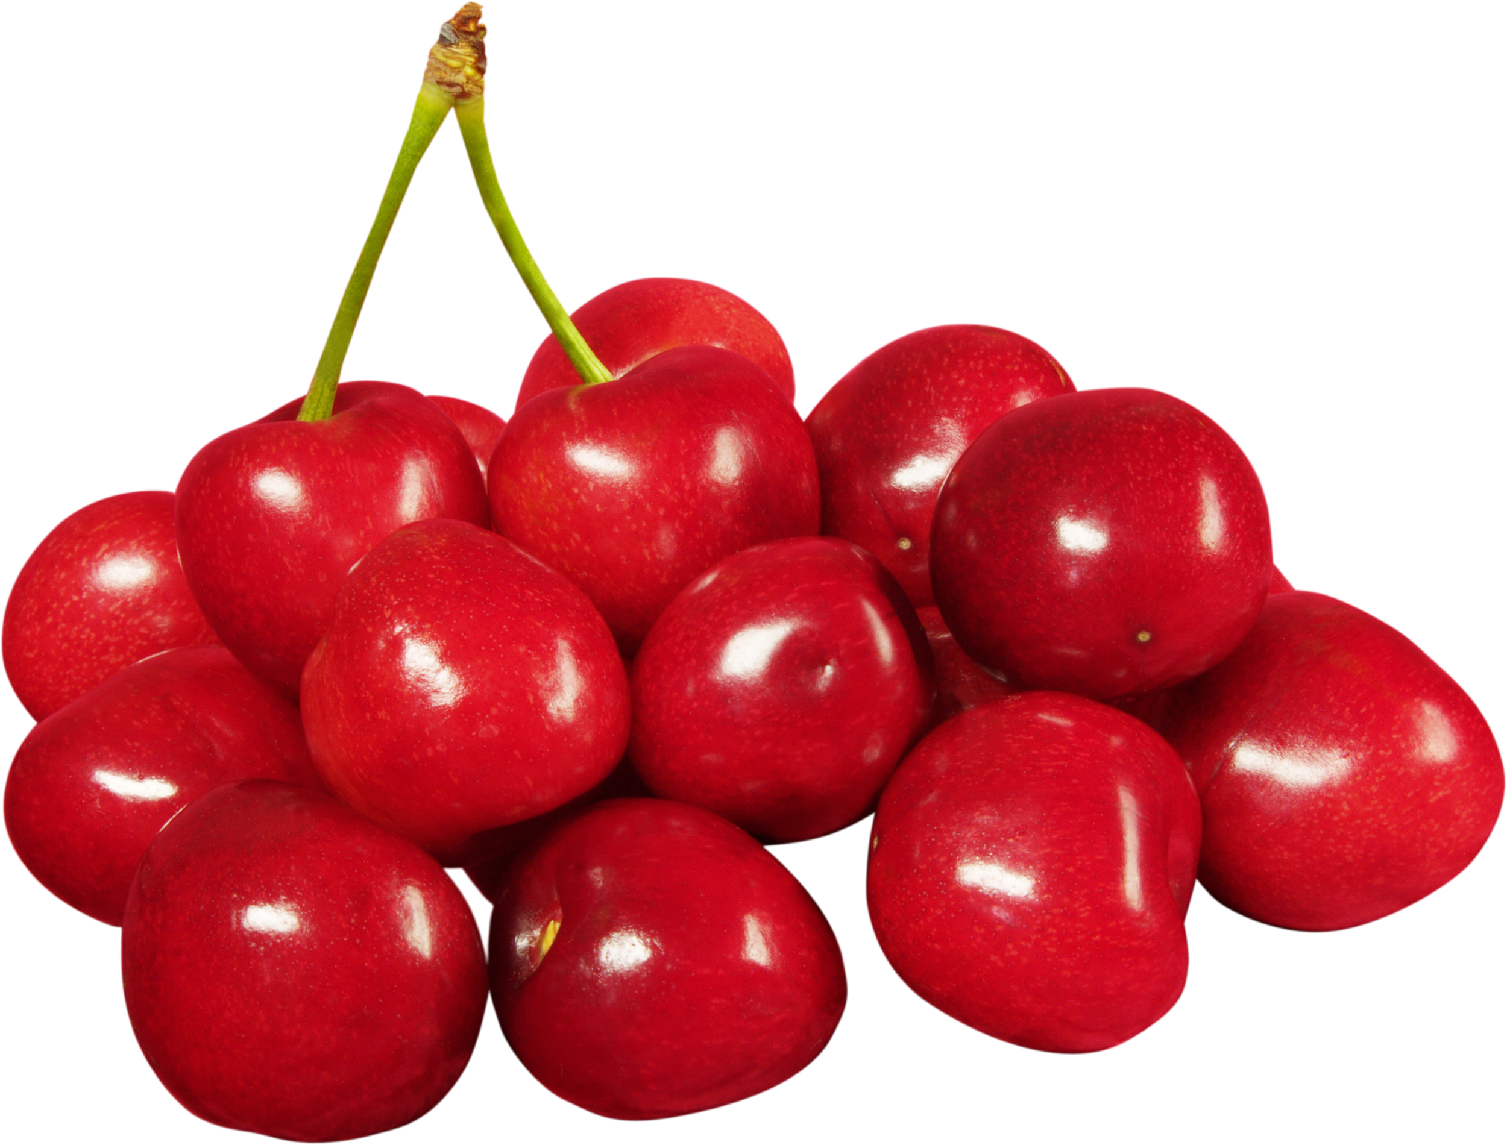
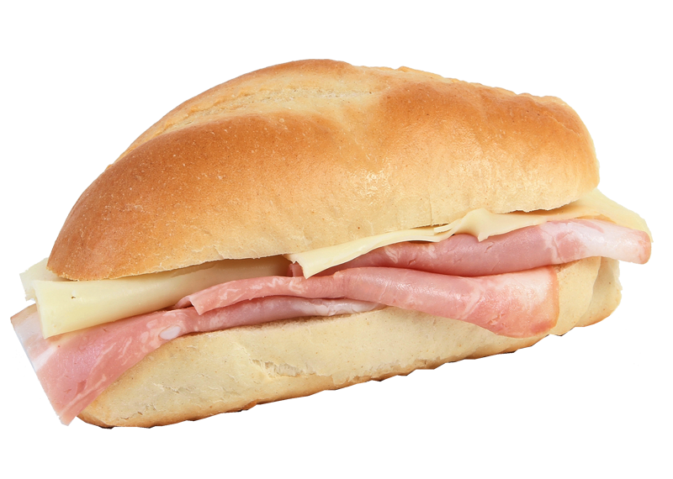
OUR MENU
BREAKFAST:
A milkshake
Mug cake
Cherries.
MID-MORNING SNACK:
Bacon and cheese sandwich
Aquarius
AFTERNOON SNACK:
Nutella crepe (Italians)
LUNCH:
A ham sandwich and Tutti Frutti
DINNER:
whole Italian pizza
risotto with shrimp and courgette
steamed fish (Italians)

Slide 3
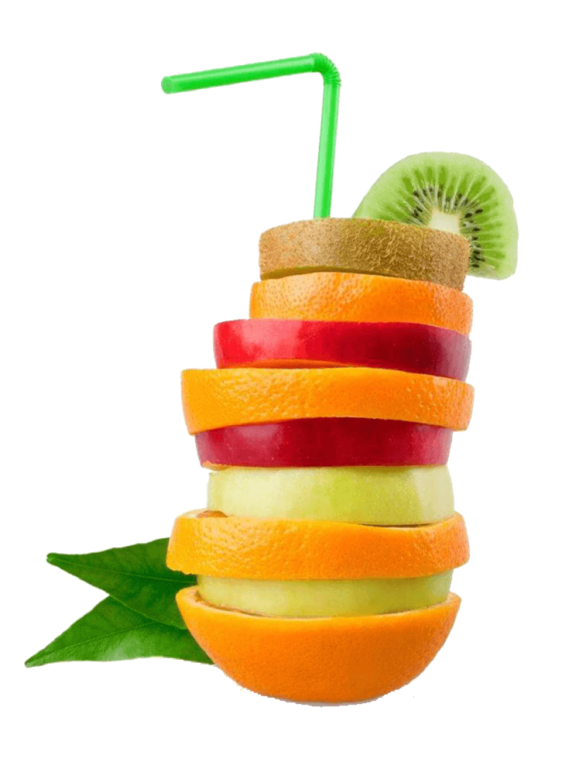
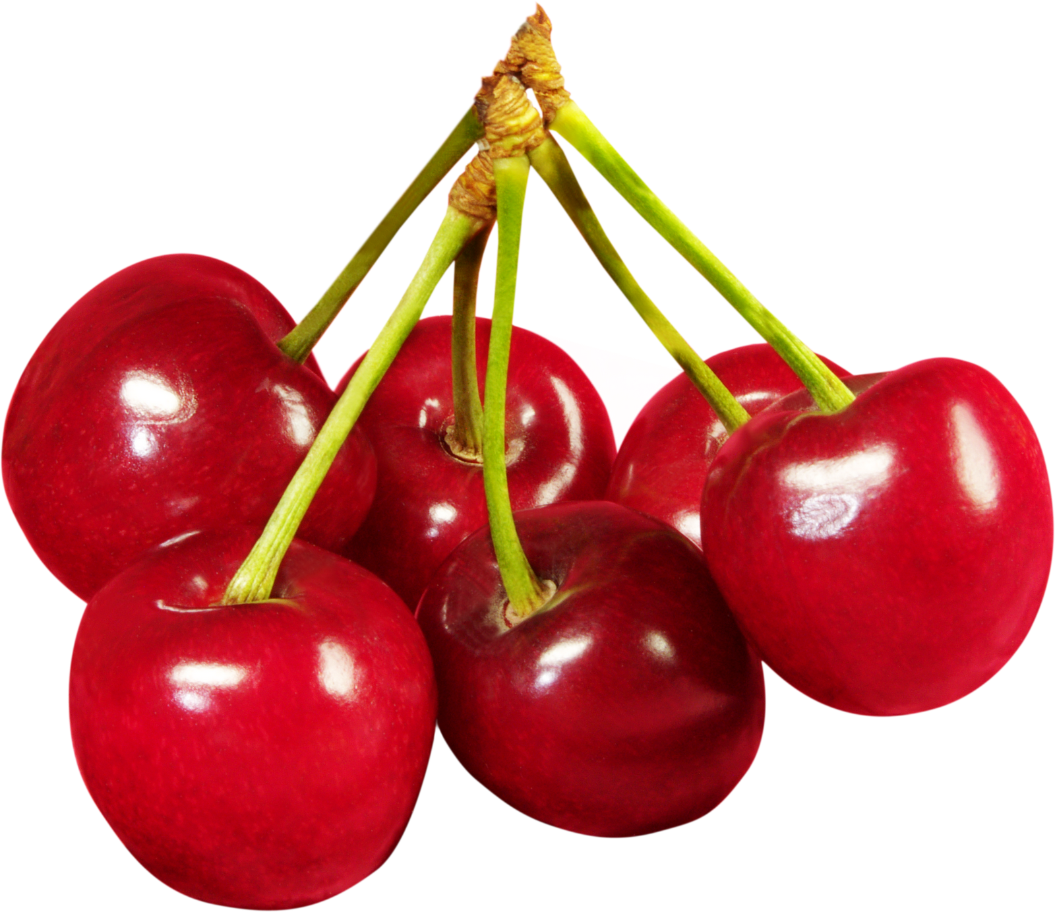
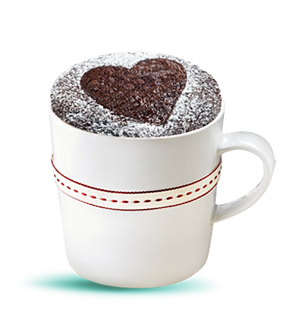
name of cook: Sofia Ubieto Lopez
Watch video:
BREAKFAST
https://youtu.be/OAY0lHdsspo
Ingredients:
For the mug cake:
-4 spoonfuls of flour
-3 spoonful of sugar
-2 spoonfuls of cocoa powder
-half tablespoon of yeast
-3 spoonfuls of milk
-2 spoonfuls of oil
-1 egg
A glass of juice
Cherries
With this recipe, you will learn how to cook a delicious and fast breakfast.
Instructions:
For preparing the mug cake, we need to mix the flour, the sugar, the oil, the milk, the yeast and the cocoa powder all together in a mixture glass with the help of a beater.
After that, we have to beat the egg, and add it to the mix.
Once the mixture has taken the texture, we pour it into a mug and we introduce it in the microwave for 2 minutes more or less, depending on your microwave’s power

Slide 4
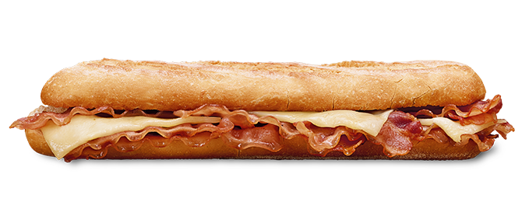
Name of cook: Daniel Martinez
Watch video:
VIDEO EMBEDDED(OR PICTURE IF THERE IS NO VIDEO)
MID-MORNING SNACK
Ingredients:
A piece of bread
Slices of bacon
Some cheese
Instructions and presentation:
First we have to cut the bread into two.
Then we have to put the bacon in the pan and wait it for more or less five minutes
After that we have to put the slices of bacon in the bread after taking them out of the pan.
Finally we have to put the cheese above the bacon and we will have a bacon and cheese sandwich

Slide 5
names of cooks: David Sobreviela / Miguel Ángel Medina
Watch video:
Ham sandwich: https://youtu.be/4K_To8Chd9Y
Tutti Frutti:
https://youtu.be/3GgLyEB_GdE
Mid- lunch snack
Ingredients:
Tutti Frutti:
1 Mango
2 kiwis
2 Oranges
1 apple
Ingredients:
(Ham sandwich):
Bread
Tomatoes
Cheese
Ham
Instructions and presentation:
Tutti Frutti:
Firstly, you cut the kiwis into small pieces and you put it in a bowl.
Secondly, you cut the apple into small pieces and you put it in the same bowl as the kiwi.
Thirdly, you cut the mango into small pieces and you put it in the same bowl as the apple.
Fourthly, you cut the oranges and you squeeze them.
Fifthly, you pour the orange juice with the bowl full of fruit.
Ham sandwich : First we cut the tomato in three or four slices and we put in bread. Then we put two slices of cheese and ham. Finally we put some salt and oil.

Slide 6
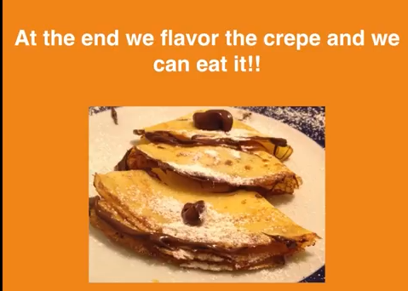
name of cook: Filippo Ruggeri
Watch video:
https://youtu.be/UNgWhgwHNcw
AFTERNOON SNACK
Ingredients:
300ml of milk,
150g of flour,
an egg,
1 tablespoonful of oil,
3 tablespoonfuls of sugar
some flavor like Nutella or fruit jam
Instructions and presentation:
Put all the ingredients in a bottle and shake the mix.
Put the mix in a nonstick pan and cook on a low flame for some minutes.
PRESENTATION: flavor the crepe by spreading Nutella or any fruit jam on it.

Slide 7
name of cook: Filippo Ruggeri
Watch video:
https://youtu.be/UNgWhgwHNcw
DINNER
Ingredients:
sole fillets,
3 carrots,
2 potatoes,
olive oil
lemon juice
salt as needed
Instructions and presentation:
Peel the carrots and the potatoes. After that put them in a pot with some olive oil and start cooking.
After 10 minutes put the fish and leave cooking for other 10 minutes. Add some more olive oil and some salt. Squeeze lemon juice and cook for 5 minutes.
PRESENTATION: Serve the fish with vegetables and mayonnaise. a healthy, good and fast dish to prepare.

