Slide 1
System of education in Poland

Slide 2
Kindergarten (from 3 to 6 years old)
Compulsory one-year pre-school preparation may be completed either in nursery schools or pre-school classes in primary schools.

Slide 3
Primary school (from 7 to 15 years old) 8 grades
STAGE I
Grades I to III: integrated early school education (grades I-III)

Slide 4
Primary school (from 7 to 15 years old) 8 grades
STAGE II
Grades IV to VIII: subject-based education
Education ends with an external final lower secondary school exam providing access to upper secondary education.

Slide 5
High school (from 16 to 19 years old)
The new reformed structure of upper secondary education envisages the following types of schools:
4-year general secondary school (liceum ogólnokształcące) prepare students for higher education and lead to the maturity exam.
5-year technical secondary school (technikum)
stage I 3-year sectoral vocational school (szkoła branżowa I stopnia)
stage II 2-year sectoral vocational school (szkoła branżowa II stopnia)

Slide 6
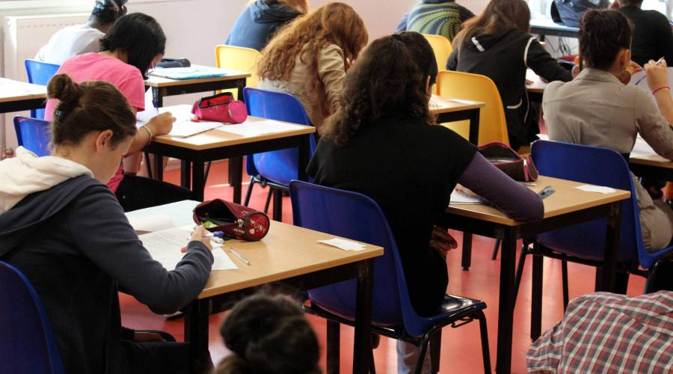
Vocational schools
Vocational schools prepare students for Exams confirming vocational qualifications.
Diploma confirming vocational qualifications in a given profession/s :

Slide 7
Vocational schools
Cook Mechanic

Slide 8
Vocational schools
Beauty therapist Hairdresser

Slide 9
Vocational schools
Accountant Office worker

Slide 10
Vocational schools
Cashier Gardener

Slide 11
Vocational schools
Carpenter Electrician

Slide 12
Higher education Optional University education
There are two types of Higher Education Institutions:
university-type (uczelnia akademicka)
non-university-type (uczelnia zawodowa).

Slide 13
Higher education Optional University education
University-type higher education institutions are those which conduct scientific research and where at least one organisational unit is authorised to award doctoral degrees.
Non-university Higher education institutions are not authorised to award doctoral degrees.

Slide 14
Thank you for your attention !

