Slide 1
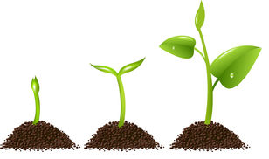
Agronomist
Ana Rita Santos
5th B

Slide 2
What does the agronomist do?
He develops and implements projects in agricultural enterprises.
He controls pests, fertilization, irrigation, soil conservation and quality control of agricultural products.

Slide 3
Professional skills
Knowledge of rural economy, spatial reasoning (agricultural area), teamwork, ability with mathematical calculations, mastery of techniques applied to agriculture.

Slide 4
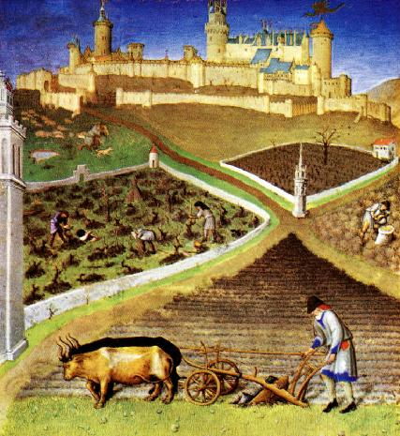
Job market
Agricultural farms, farming companies, input industry, research, rural advisory services, agricultural cooperatives

Slide 5
Specializations
Animal husbandry, silviculture, rural engineering, forest engineering, food technology, agrobusiness.

