Slide 1
CAÍQUE BOM SUCESSO

Slide 2
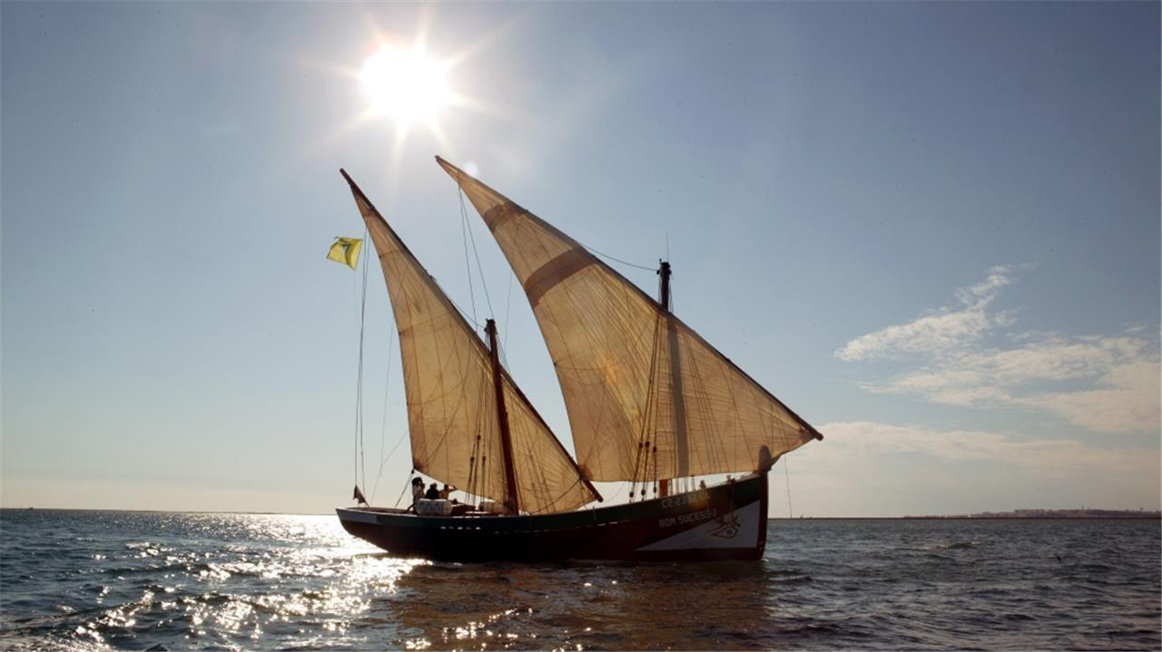
CAÍQUE BOM SUCESSO

Slide 3
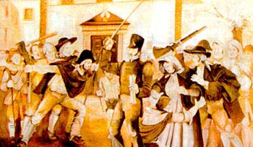
CAÍQUE BOM SUCESSO
After the first Napoleonic invasion, the Portuguese court took refuge in Brazil.
It was in Olhão that the insurrection against the intruders broke out in June 1808.

Slide 4
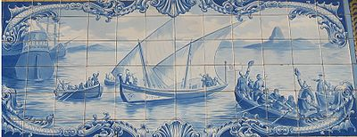
CAÍQUE BOM SUCESSO
To bring to the regent Prince D. João the good news of the expulsion of the French, the "Bom Sucesso" boat left from Olhão on July 6, 1808.

Slide 5
CAÍQUE BOM SUCESSO
It was a small boat with 17 crew, all fishermen from Olhão, having by master Manuel Martins Garrocho and by pilot Manuel de Oliveira Nobre.
The trip took more than two months with no maps or guiding devices. The crew crossed the Atlantic and arrived in Rio de Janeiro on September 22.
All the crew returned home, bringing the honorable title of Vila de Olhão da Restauração.

Slide 6
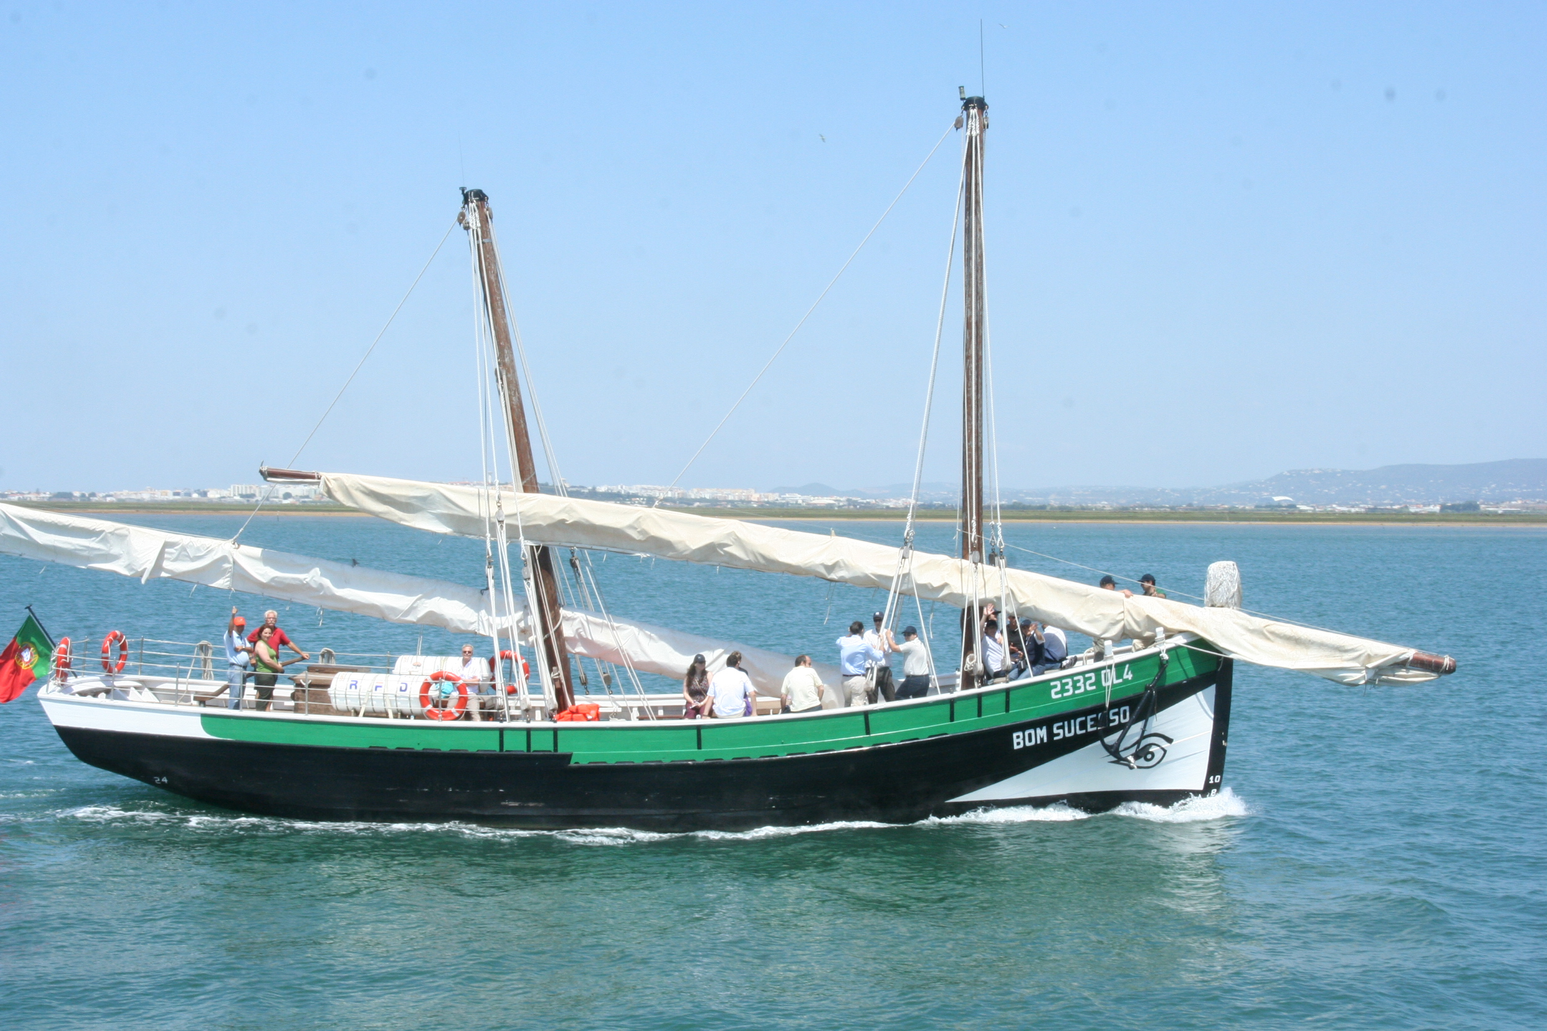
CAÍQUE BOM SUCESSO
So the "Bom Sucesso" vessel has become the most emblematic symbol of the cultural identity of Olhão.

Slide 7
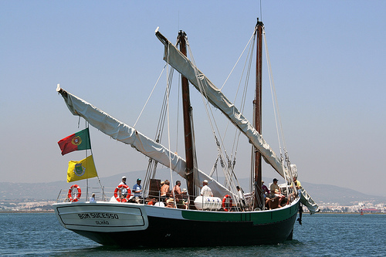
CAÍQUE BOM SUCESSO
Thus, in order to perpetuate the history of Olhão, as well as the memory of maritime people, it was ordered the construction of tthe replica of the "Bom Sucesso" Caíque, which is intended to promote cultural and recreational activities through visits and sailing.

Slide 8
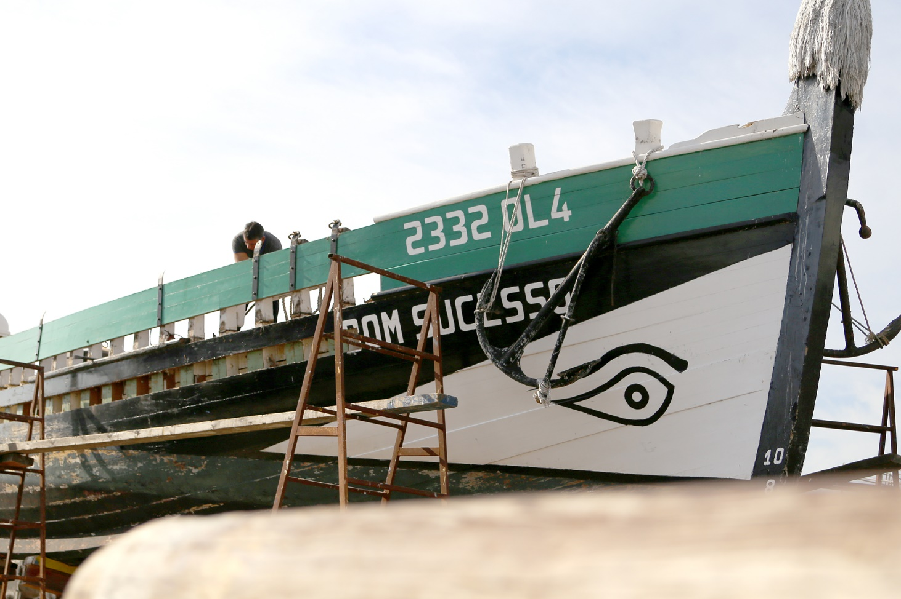
Author:
Lucas Lopes
6th B

