Slide 1
JOB FARMER

Slide 2
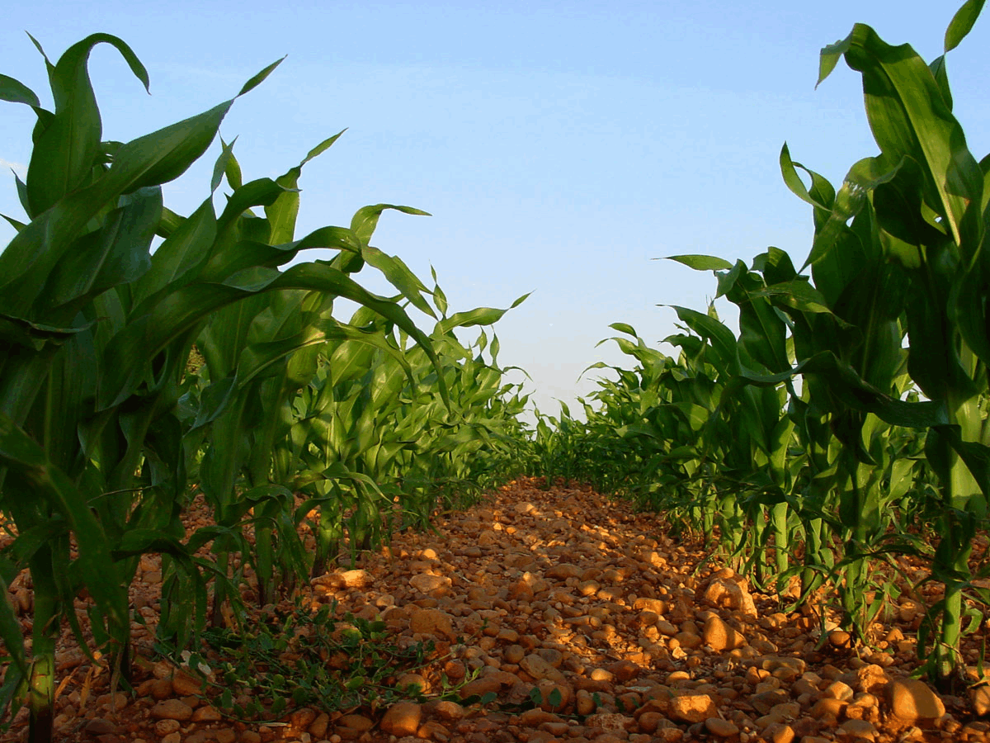
AGRICULTURE IS ONE OF
THE LEADING BASES OF
PORTUGUESE ECONOMY

Slide 3
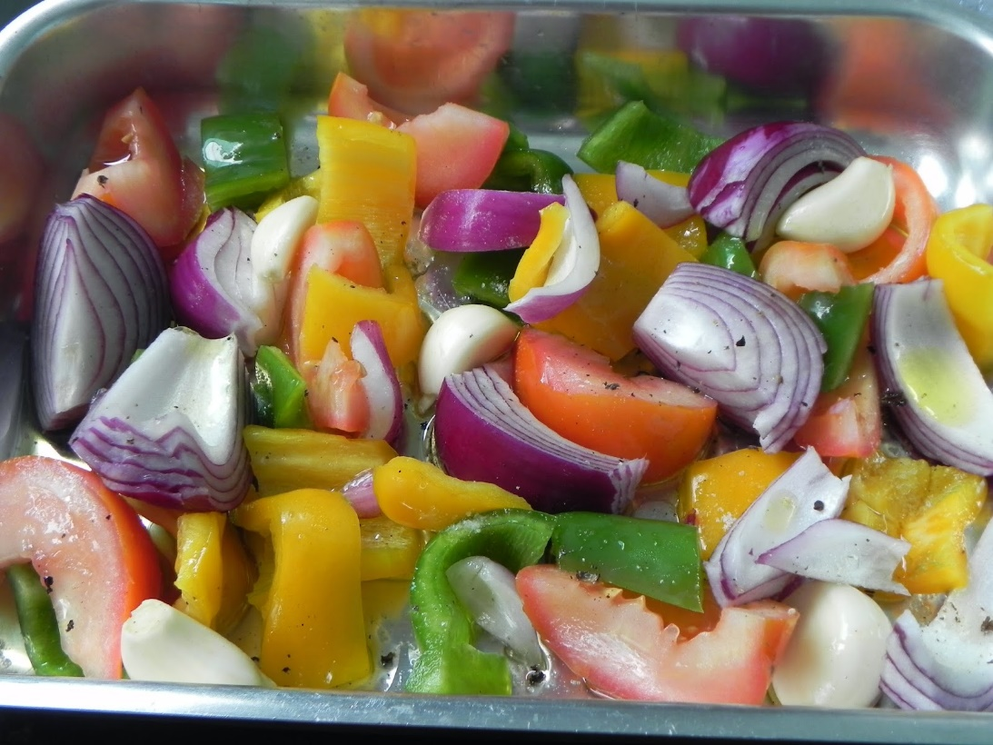
THE MAIN PRODUCTS PRODUCED
BY AGRICULTURE IN PORTUGAL ARE:
POTATOE
CAROB
ORANGE
PEAR.

Slide 4
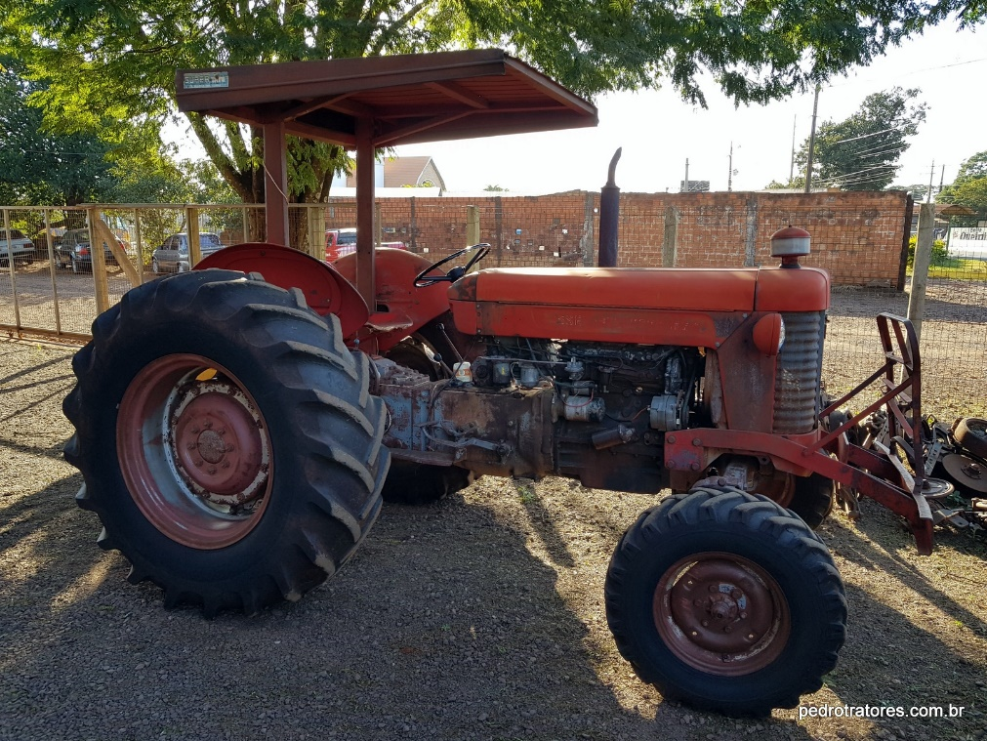
NOWADAYS FARMERS
USE MODERN TOOLS
AND TRACTORS TO DO THEIR WORK

Slide 5
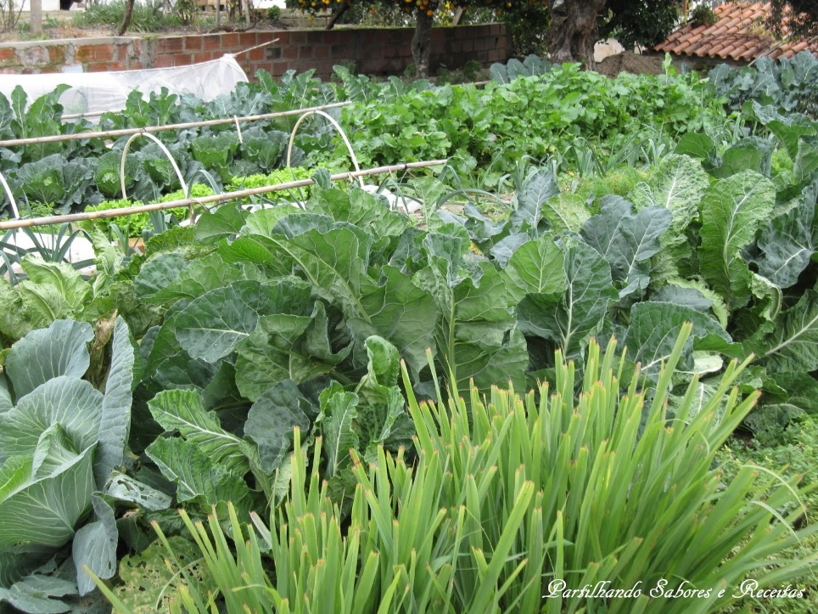
THERE ARE ABOUT 6000 YOUNG ADULTS
THAT OPTED TO FOLLOW AN
AGRICULTURAL LIFE

Slide 6
PRESENTATION DONE BY
CAROLINA CARMO
FOR THE ERASMUS PROGRAM
“OPEN YOUR EYES! OPEN YOUR HEART!”

