Slide 1
The history and values of my nation
5 Portuguese symbols that marked our history
Notes:
Diapositivo 1:
ARTUR + NÁDIA – Lê o título.

Slide 2
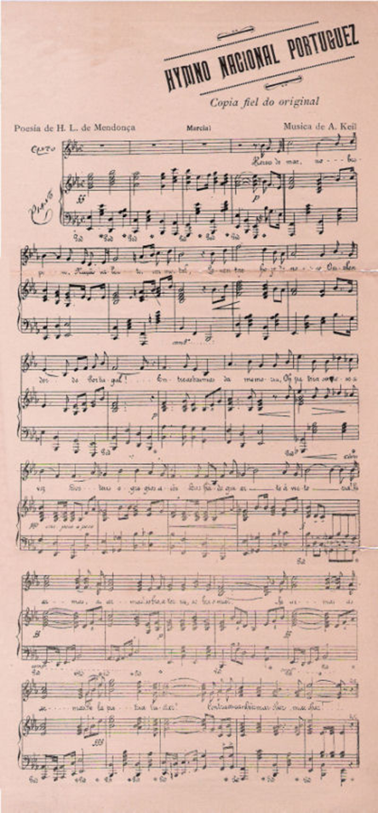
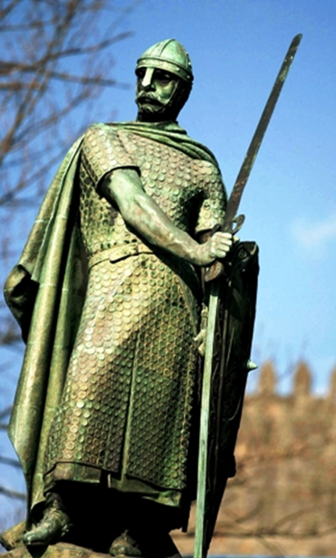
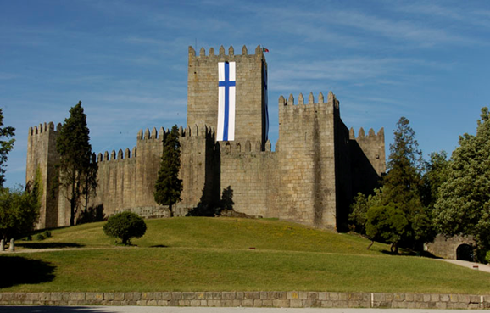
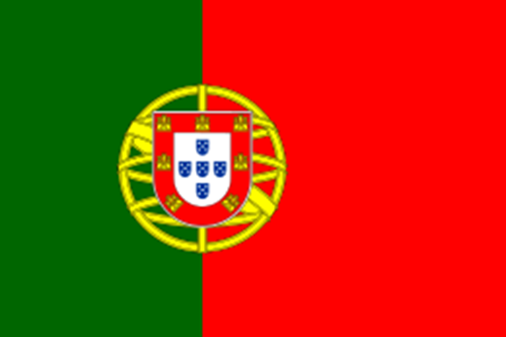
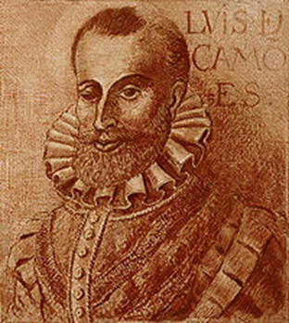
Index:
The Portuguese Flag;
The Portuguese Hymn;
The Guimarães Castle;
King Afonso Henriques;
Luís Vaz de Camões.
Notes:
Diapositivo 2:
ARTUR + NÁDIA – Lê o índice.

Slide 3
The Portuguese Flag
What’s the Portuguese Flag?
What’s the symbolism of the colours?
What do the symbols of the Portuguese flag mean?
When was this flag created?
Notes:
Diapositivo 3:
What’s the Portuguese Flag?
ARTUR – The Portuguese Flag is the national flag of the Portuguese Republic.
What’s the simbolism of the colours?
NÁDIA – Green symbolizes hope and Red symbolizes “the blood of those who died in war”.
What do the symbols of the Portuguese flag mean?
ARTUR – The yellow one (aponta para a esfera armilar) symbolizes “the armillary sphere”, an instrument used by sailors.
NÁDIA – The Portuguese shield (aponta para o escudo português) is divided in 2 parts: The 7 castles, and the cross.
ARTUR – The 7 castles symbolizes (aponta para os castelos) the 7 achievements of the King Afonso III.
NÁDIA – And the cross is a tribute to Jesus. The 5 corners whit the 5 wounds of Christ (aponta para esses mesmos) makes the cross of Christ.

Slide 4
The portuguese hymn
What’s the name of the portuguese hymn?
When was it created and when did it become the national hymn?
Who created it?
Notes:
Diapositivo 4:
What’s the name of the portuguese hymn?
ARTUR – The name is “A Portuguesa”.
When was it created and when did it become the national hymn?
NÁDIA - When was it created and when did it become the national anthem?
It was created in 1890 but only became the national hymn in 1911.

Slide 5
The Guimarães Castle
Was it there that the Portuguese language was born?
What’s the symbolism of this castle?
Was any king born there?
Notes:
Diapositivo 5:
It was there that the Portuguese language was born?
ARTUR – Yes, it was.
What’s the symbolism of this castle?
NÁDIA - Is a symbol of the wars for independence.
Was any king born there?
ARTUR – Yes, there was born the King Afonso Henriques.

Slide 6
King Afonso Henriques (1109 – 1185)
Who was he?
When did he become king?
How many children did he have?
What battles did he fight?
Notes:
Diapositivo 6:
Who was he?
NÁDIA – He was our first king.
When did he became king?
ARTUR – He became a kindg on 1139 after of he defeats and win his mother on The Battle of S. Mamede.
How many children did he had?
NÁDIA – He had 7 childs, including D. Sancho I.
What battles did he had?
ARTUR – He had very battles including The Battle of Ourique and The Battle of Cerneja.

Slide 7
Luís Vaz de Camões (1524 - 1580)
Who was him?
Why did he have only one eye?
Why is he so famous?
Notes:
Diapositivo 7:
Who was him?
NÁDIA – He was a famous portuguese poet.
Why does he have only one eye?
ARTUR – Because in a war on Africa he losts an eye.
Why is he so famous?
NÁDIA – Because he write “Os Lusíadas”, a famous book of poems whitch talk about the life of Vasco da Gama, a famous portuguese sailor.

Slide 8
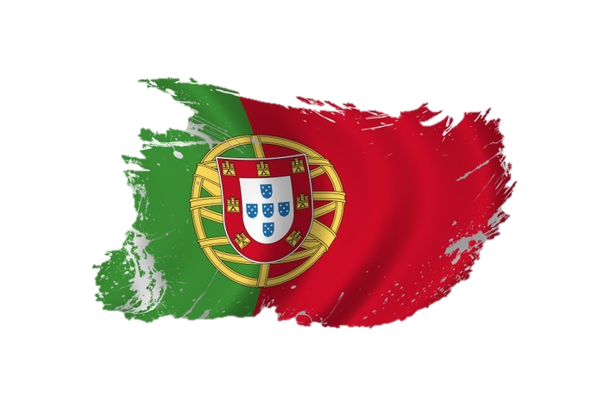
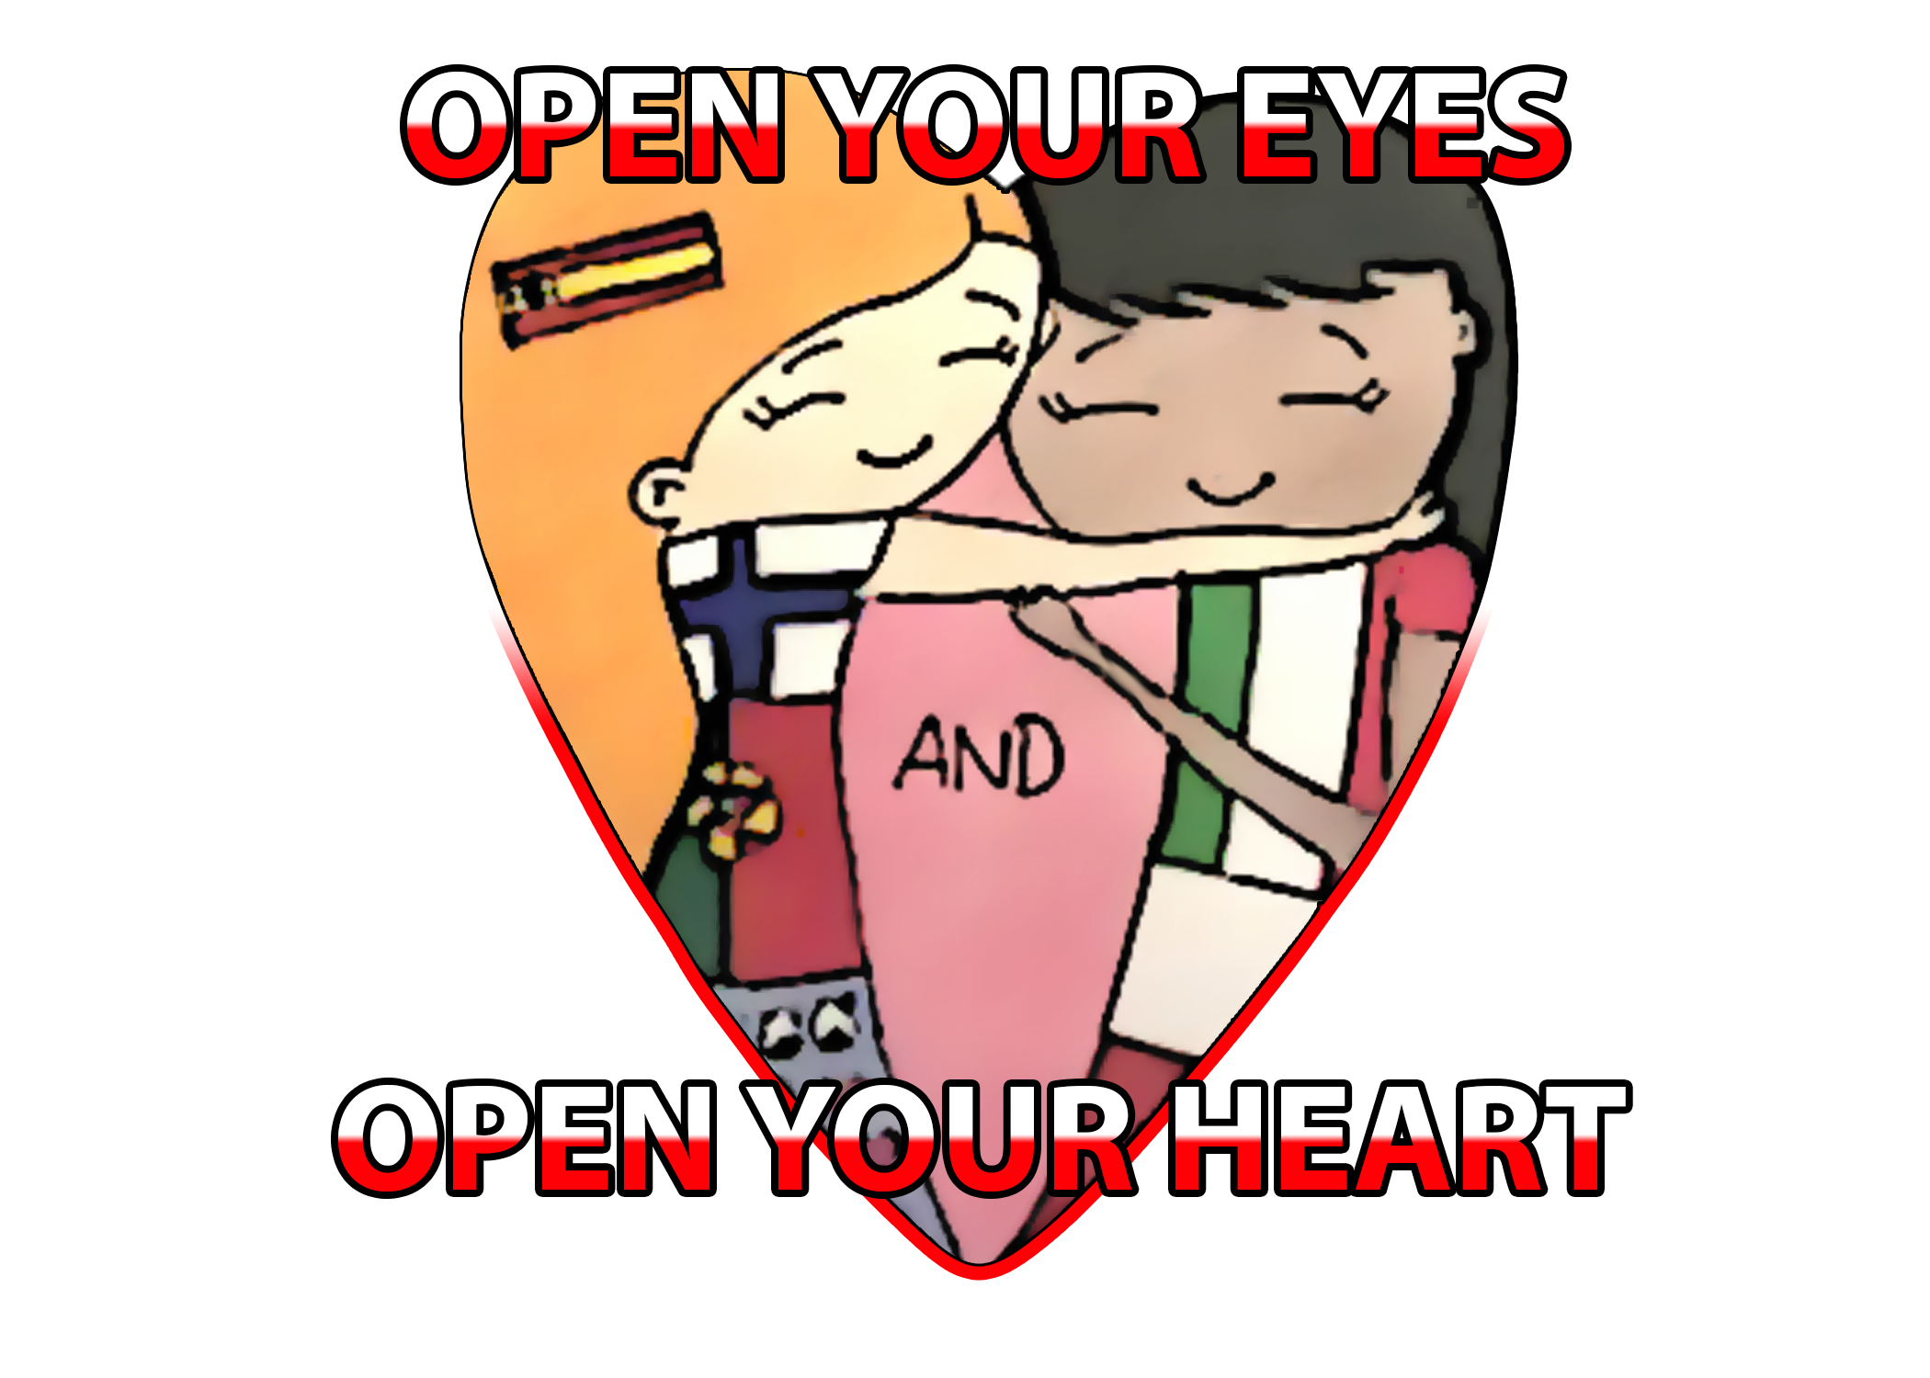
Thanks for watching!
Work done by:
Artur Pudim
and
Nádia Silveira
Notes:
Diapositivo 8:
ARTUR + NÁDIA - Lê as frases finais.

