Slide 1
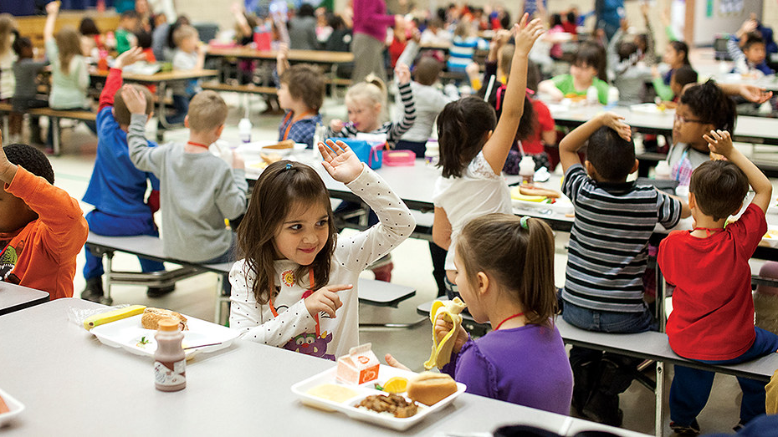
Towards inclusion in Finland
Strong support for every pupil
Tämä valokuva, tekijä Tuntematon tekijä, käyttöoikeus: CC BY-ND.

Slide 2
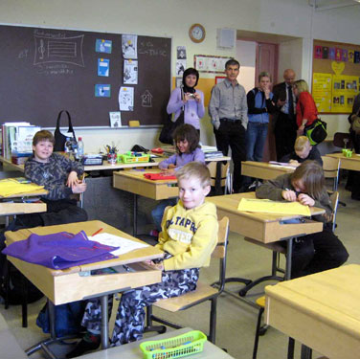
Finland is heading towards full inclusion
Finland doesn't have a full inclusion yet but the school system is gradually becoming inclusive
According to the inclusive plan every pupil would go to the school which is the closest to his/her home
Earlier pupils with special educational needs were always placed in separate classes and sometimes even separate schools
Tämä valokuva, tekijä Tuntematon tekijä, käyttöoikeus: CC BY-NC-ND.

Slide 3
The support of pupils is provided on three levels
1) General support
2) Intensified support
3) Special support
The level of support depends on the needs of the pupil. The class teachers and subject teachers work together with the help of the school social worker and the school psychologist to specify the level, the amount and the form of support

Slide 4
What are the ways to support the pupils? Well, there are many ways.......

Slide 5
There are different forms of support:
Support teaching provided by the teachers before or after the school day
Modified exercises and tests to suit the needs of the pupil (also the needs of a skilled pupil!)
Different kinds of arrangements in the classroom (e.g. use of a class assistant or two teachers in the classroom)
The help of a special educational teacher
Flexible teaching groups
The help of social workers, psychologists and other specialists

Slide 6
Support is systematic
Pupil’s learning and schooling must be monitored and assessed regularly

Slide 7
No full inclusion yet
There are still separate classes for some pupils with special educational needs but only if it's absolutely necessary and for the good of the pupil. For example for some pupils it's very stressful to be in a class with many other pupils (too much noise, too much confrontation).

Slide 8
Finland focuses on the support based on the individual needs of every pupil
The success in PISA tests is probably based on the strong support Finnish schools provide for every pupil including pupils with special needs.
Nobody is let down.
You always get help if you need it

Slide 9
Thank you for reading this!
This presentation was made by the Erasmus+ pupils and teachers of Kirkonkylä School in Mäntsälä (Finland) as part of the Erasmus+ project "Open your eyes, open your heart"

