Slide 1
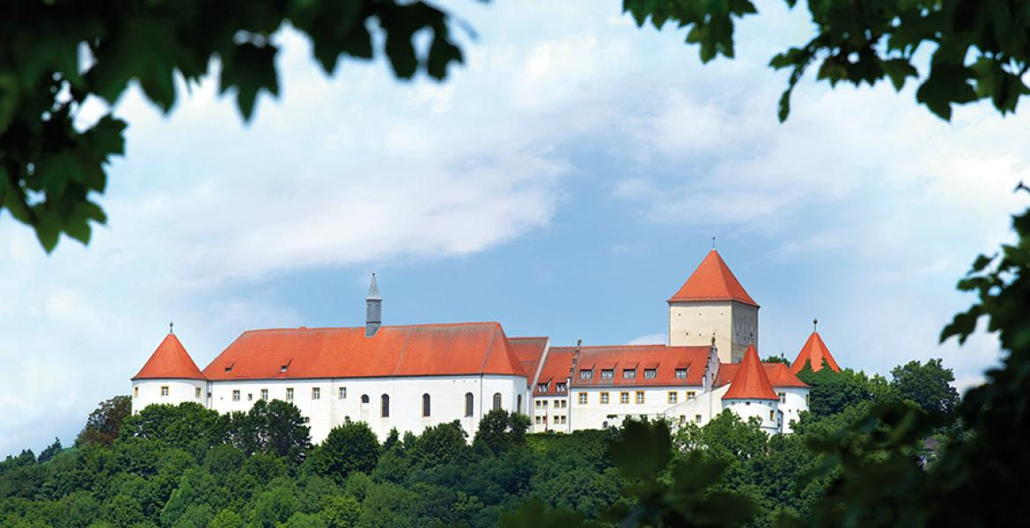
SIGHTS in Wörth

Slide 2
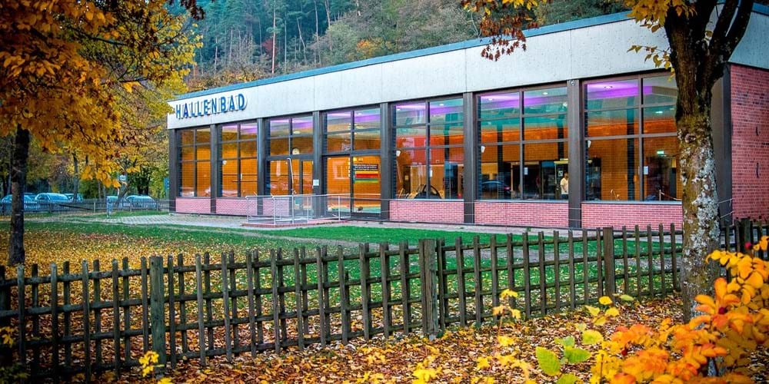
SIGHTS
Indoor swimming-pool

Slide 3
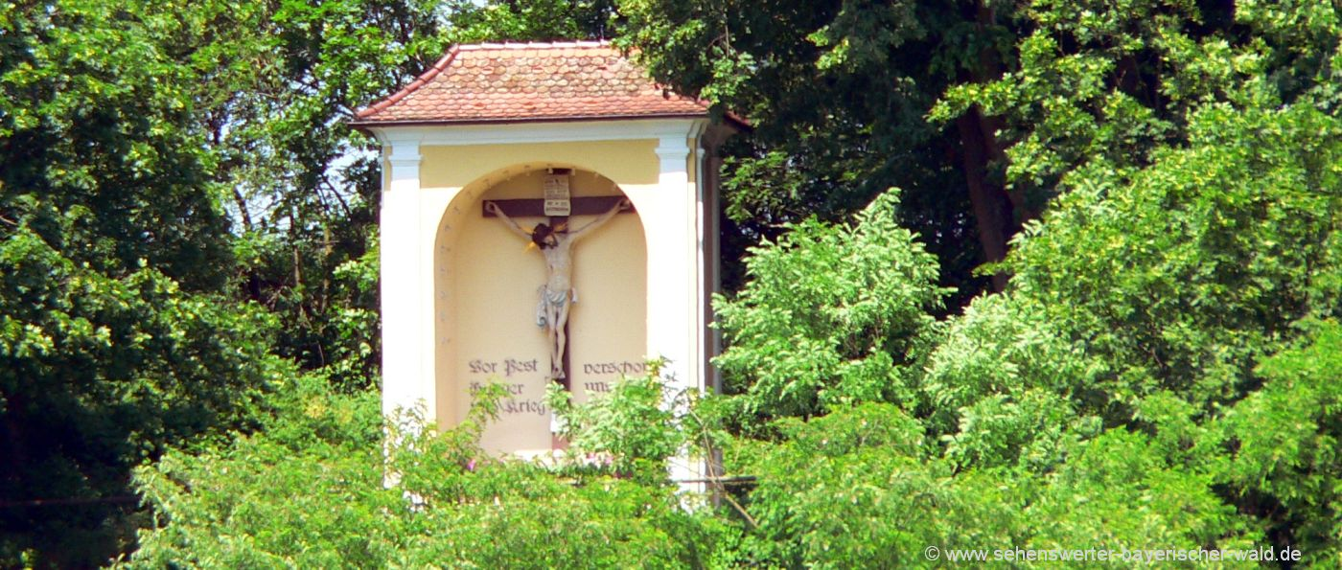
A monument for the people who died during the pest

Slide 4
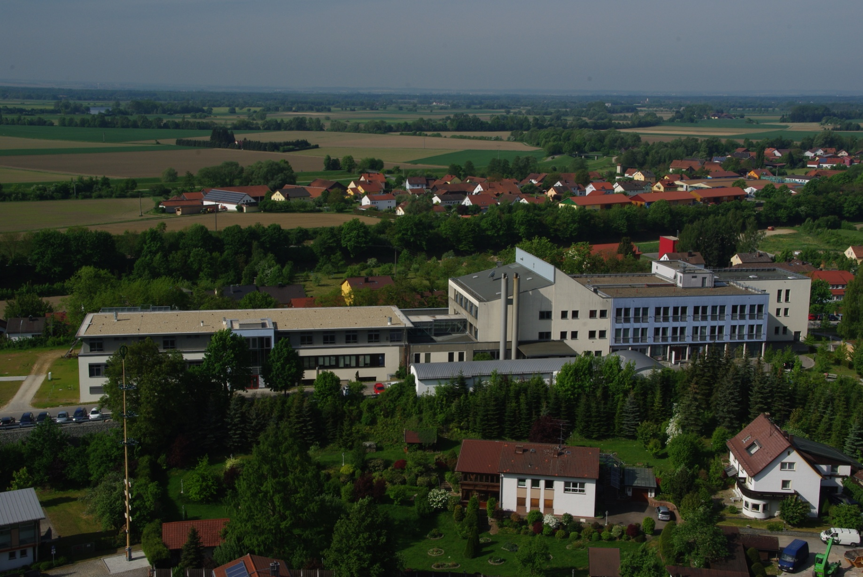
Hostpital in Wörth

Slide 5
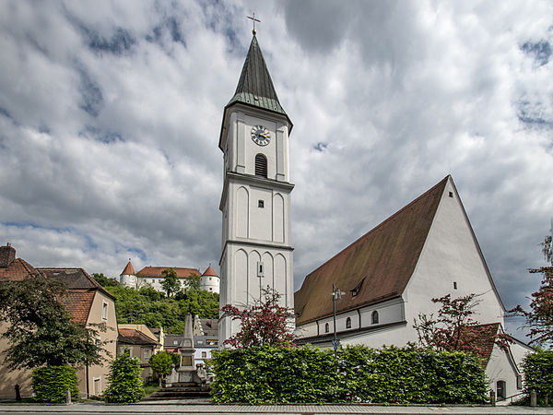
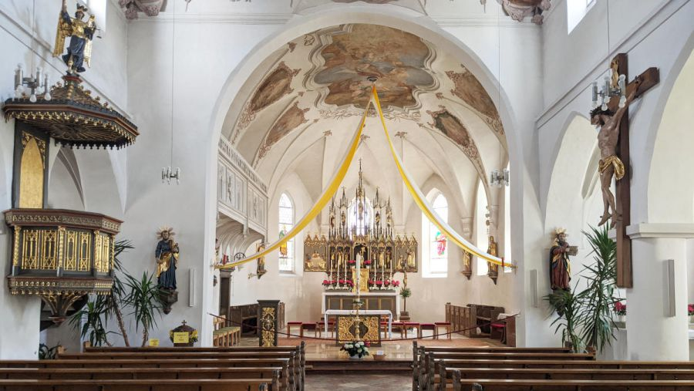
Church st. Peter
Church outside
Church Inside

Slide 6
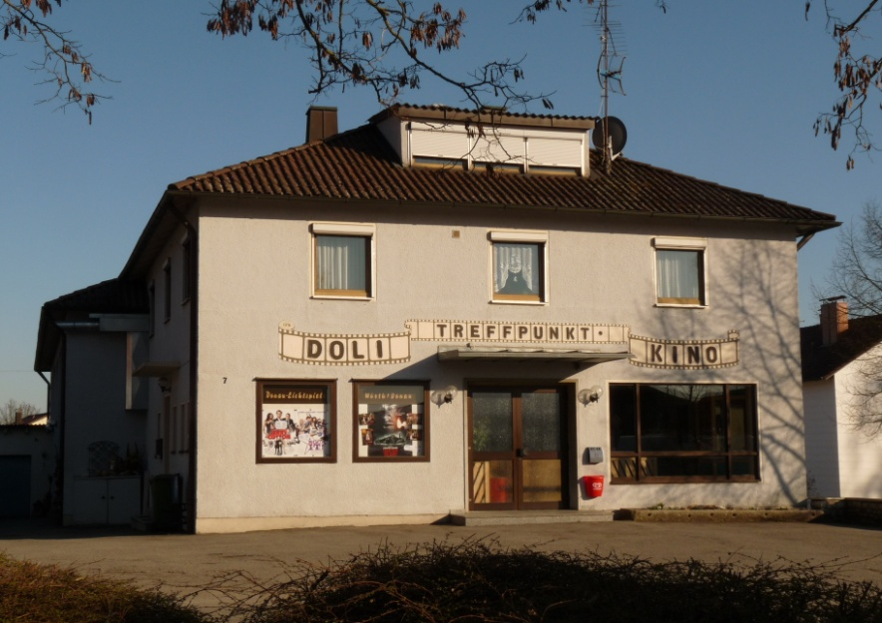
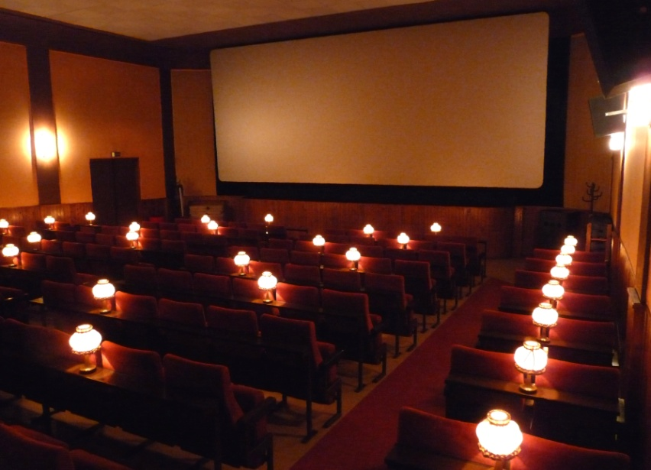
OLD LEGEND CINEMA
The BLING BLING is a light
When the movie starts the BLING BLING goes off

Slide 7
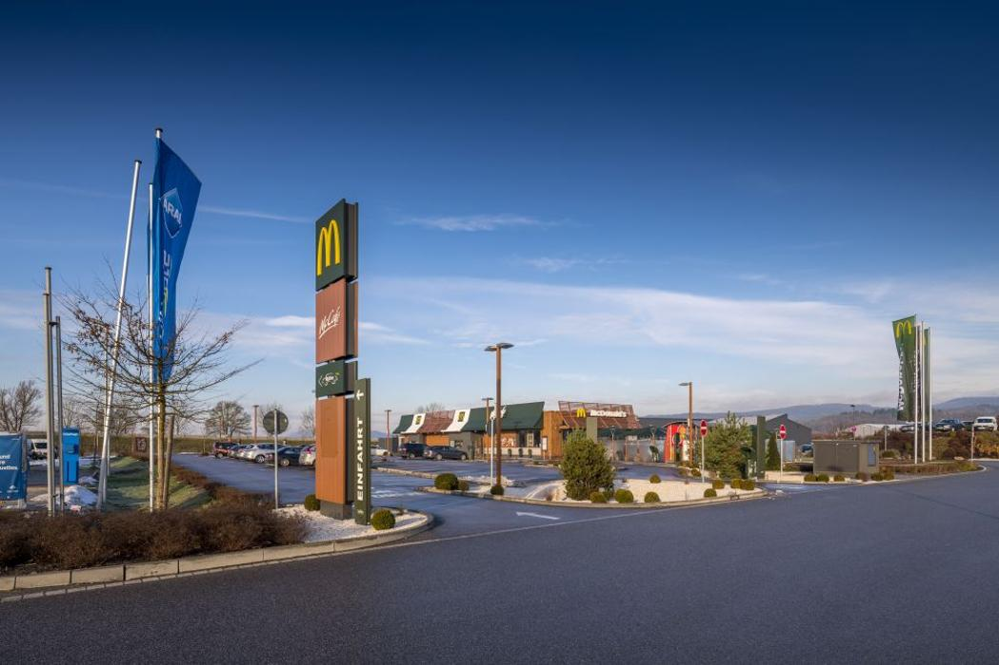
MC DONALD
MC DONALDS and ARAL gasstation
Kids like to meet here
,,Itza Teeny Placy“ ☺

Slide 8
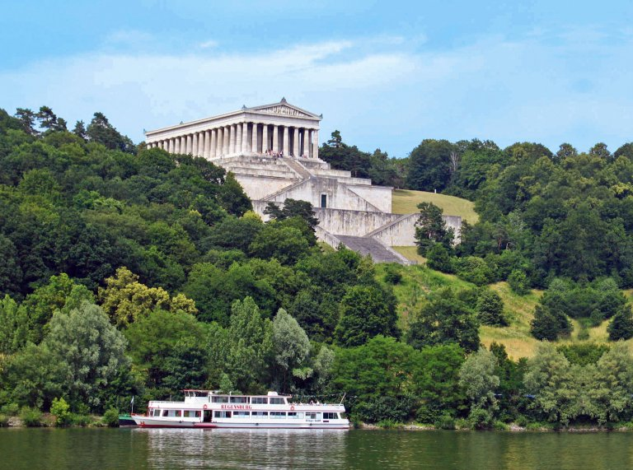
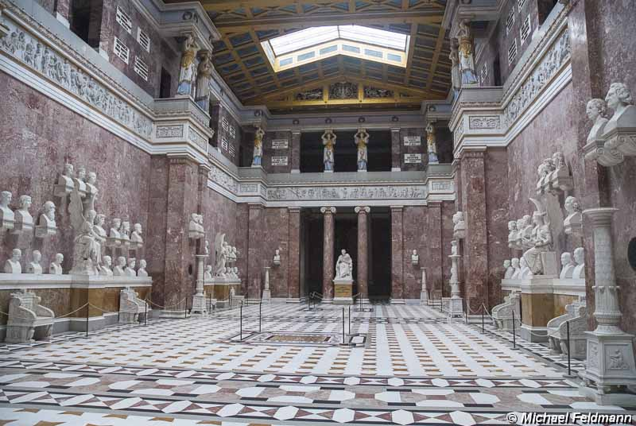
WALHALLA
outside
Inside

Slide 9
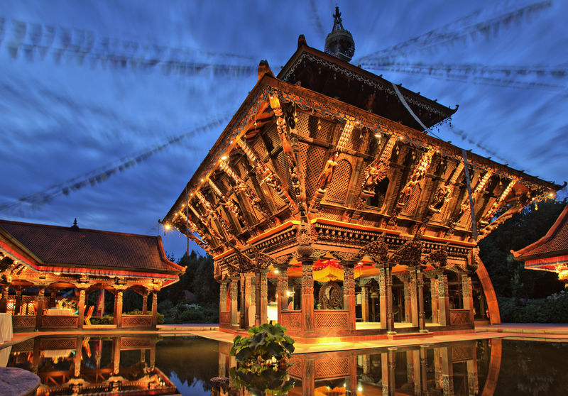
Nepal Himalaya Pavillon
Is a very Relaxing and fascinating place.

Slide 10
By
@thxxtii
@tommy_xrd
@dino.somic
insta

