Slide 1
Social media image
Yellow Team

Slide 2
What can we do as social media consumers to not let the image we see affect our self-esteem?
We need to know that not everything we see on the internet is real
The mainly thing is to accept ourselfs the way we are
We need always need to remember that we are all different and beatiful☺
We need to start showing people that is normal to have different type of bodies

Slide 3
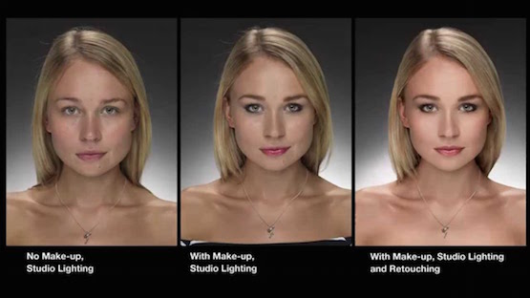
Types of filter and photoshop

Slide 4
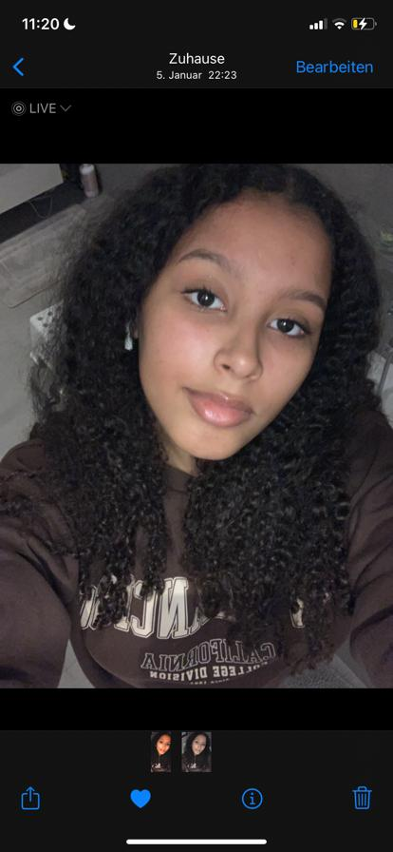
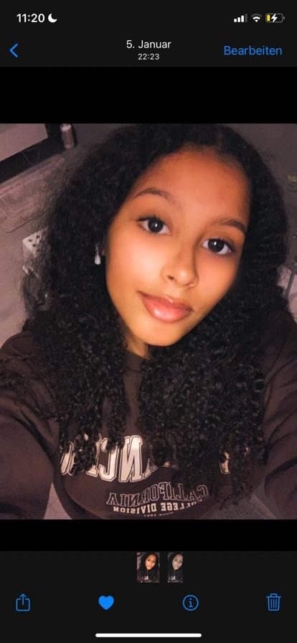
Our example: LOL

