Slide 1
EFFECTS OF SOCIAL MEDIA
HELGA
GEORGIA
ALEJANDRO
EYJOLFUR
FLORIAN
RAGNAR

Slide 2
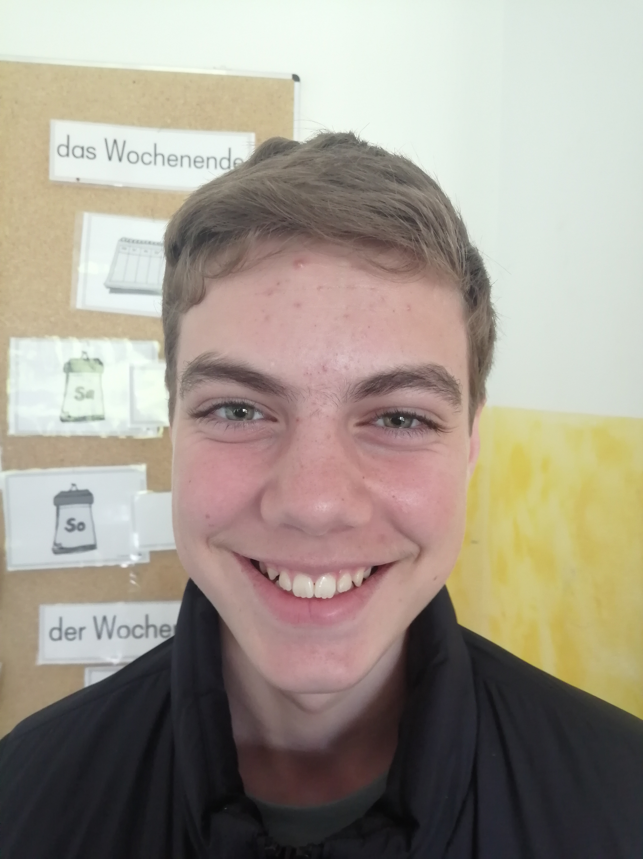
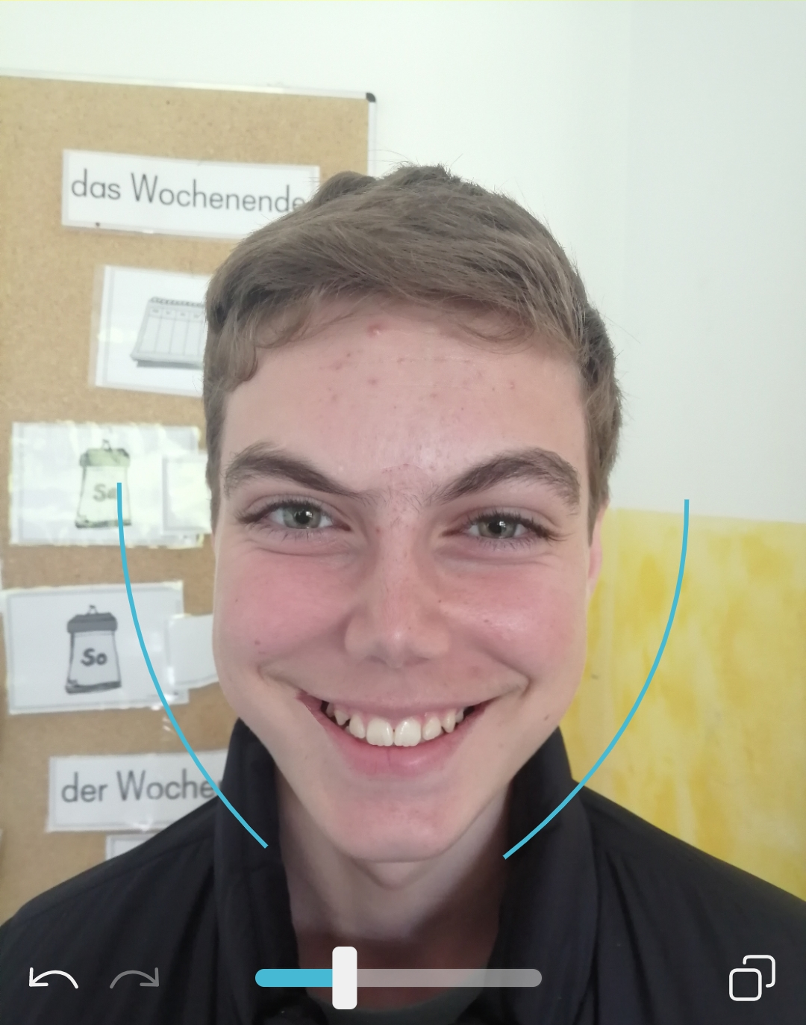
Facetune
Before and After

Slide 3
Selfie culture and Snapchat
Many young people today use Snapchat, a very popular app among them.
This app allows them to take pictures and videos using filters.
They can share them with their friends and post them.
But sometimes teens use this app, because they feel insecure about themshelves, and they don‘t use the normal camera, because they think that they look worse.

Slide 4
Types of photo filters
Usually, filters in Snapchat, change the colours of the surroundings, the shadows, the light…
It also changes faces, for example it can disappear blemishes, change the colour of our eyes or hair.

