Slide 1
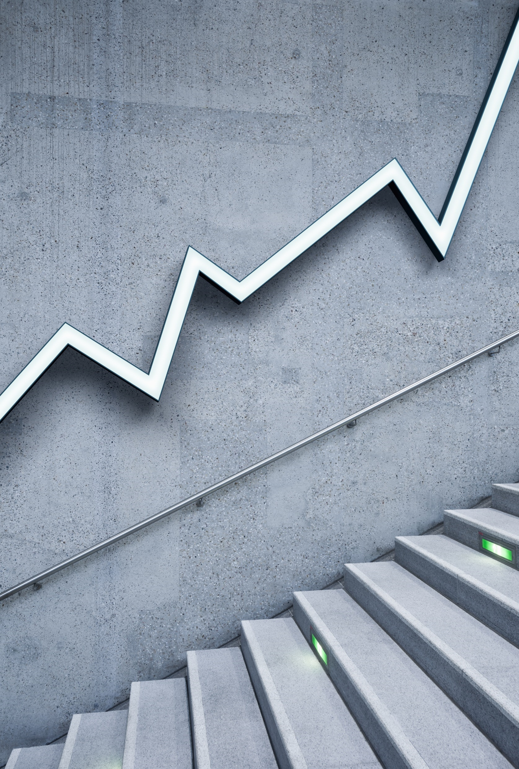
The effects of covid19 in Icelandic society in nov.-dec. 2020

Slide 2
Effects on traveling
2 meters social distance between people everywhere, also on buses and other transport.
Always wear a facemask
When arriving in iceland you had to take a covid-test, quarantene for 5 days and then take a second test, before being allowed to go into society. Special quaratene – hotels were put up in Reykjavík where you had to stay for the first 5 nights, at a small fee.

Slide 3
Effects on sports
no tournaments and competitions were allowed at any level.
Most of professional tournaments were postponed or cancelled.
All swimming pools were closed.
All gyms were closed.
No groupsports involving touching or use of equipment were allowed, not even for children.

Slide 4
Effects on cultural activities
All cinemas and theatres was closed and no concerts were allowed.
Night clubs, dicos and dancing halls were closed.

Slide 5
Effects in casual life
Gathering was in november of 2020 limited to 10 people.
Social distance always 2 .meters.
No private parties or celebrations ( birthdayparties, confirmations, weddings, ect.) involving more than 10 people were allowed.
Restaurants could not take more than 10 guests at a time and guests at each table had to register name and phone number in case of future need for contagion tracing.
Restaurants had to be closed at 22:00 at not allow new guests in after 21:00
Bubs and bars selling alcohol were closed for a few weeks.

Slide 6
Summation
All in all the main effects on Icelandic society were that people stayed at home a lot more than they were used to be.
All companies who possibly could had their staff distance - working from home.
Use of internet and streaming services soared. Netflix especially.
Buying things and services over the internet became a lot more common.
Icelanders travel a lot, but during this year most people stayed at home, saving money.
Peopled postponed most major events like confirmations and weddings.
Children spent less time at kindergarden and playschool as many parents were working more from home.
Crimes related to drunkedness and disorderly conduct were greatly reduced, which is nice, but domestic violence and disturbances increased.
Unemployment increased since a lot of hotels and other companies working in tourism had to temporarily close down or went bankrupt. It will take Iceland a long time to recover economically.

Slide 7
Authors: Hörður and Auðunn

