Slide 1
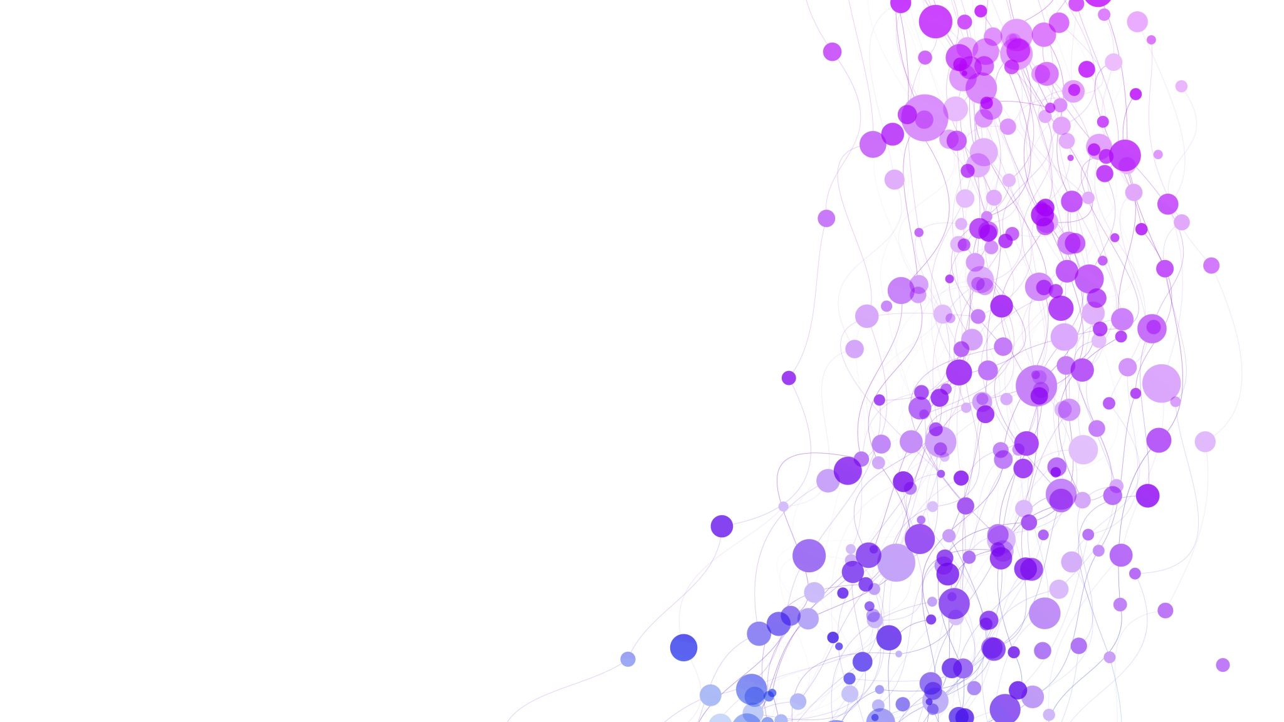
The effects of the Corona pandemic in schools in Iceland

Slide 2
Teaching and school trips
Teaching has been pretty normal here in Víkurskóli, but there has been some schools that had to close for awhile or had limited classes half-days. The larger schools with bigger classes had to divide their classes into groups of no more than 20 students in each group and teach part – time through distance teaching.
In november 2020, when restictions were the strictest, all school trips were cancelled.
We were lucky enough to get to go on a ski trip in febuary but otherwise we haven’t been able to go on any other trips this year.
Any cooperation with other schools was stopped, which meant no visits to each other, no school dances or any kind of direct interaction between schools other than through internet or social media. This really sucked!!!

Slide 3
Class size and classrooms
We are a pretty small school so we haven‘t had a problem with classroom asignments here, but of course that is not the case for many schools here in Iceland.
Student groups (classes) no more than 20 students and social distance of 2 m. (individual seating) which of course is a challenge in most schools.
No swimming classes and only individual sports with no touching and no equipment allowed. (long distance running, walking...)

Slide 4
Breaks
Again, nothing much changed. We all have to be outside at lunch break, but for the sake of space, the oldest kids got to be inside at breakfeast break.
No mixing of older students with the younger, and playground divided into different areas.

Slide 5
Going to school
If you walk to school you don‘t have to worry about wearing a mask. The kids on the schoolbus had to wear a mask in november and december when restrictions were the strictest, but that changed in january 2021, then only adults were required to wear a facemask in public.

Slide 6
Covid rules
Our school is very strict on washing your hands and use sanitizer, but it dosen‘t really bother us. In some schools you had to wear a mask all day, but we here in Víkurskóli we only had to wear it in common areas an at brakes, in our own classroom we could take it off as long as we stayed in our seats and observed the 2 m. rule between students. Teachers and other grown ups had to wear the mask at all times.

Slide 7
Distant school
We never had to go into distance learning, but a lot of the larger elementary schools and high schools here had to be closed and/ or had to use Zoom or Teams to study at home.

Slide 8
Authors: Sædís and urður ósk

