Slide 1
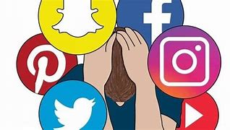
THE INFLUENCE OF SOCIAL IN PEOPLE‘S LIVES

Slide 2
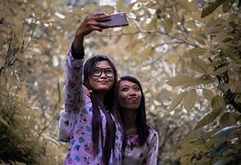
explain how social media contributes to selfie culture
Social media can have both a positive and negative impact on our well-being, concentration and thinking.

Slide 3
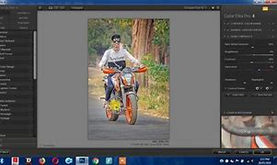
describe the types of photo editing
Simple photo-editing techniques include: Straighten: adjust the horizon of the photo Crop: trimming out a portion (usually peripheral) of the image to help draw attention to the subject or otherwise improve the composition

Slide 4
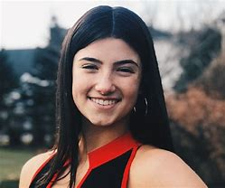
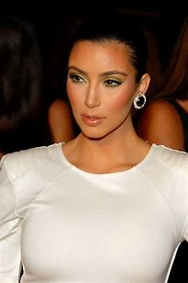
All pepole like photoshopping themselves because they belive that they can look better this way and more people will like them. But that is not always true. Every person is different and beautiful in his own way.like a lot influencers for example:
.

Slide 5
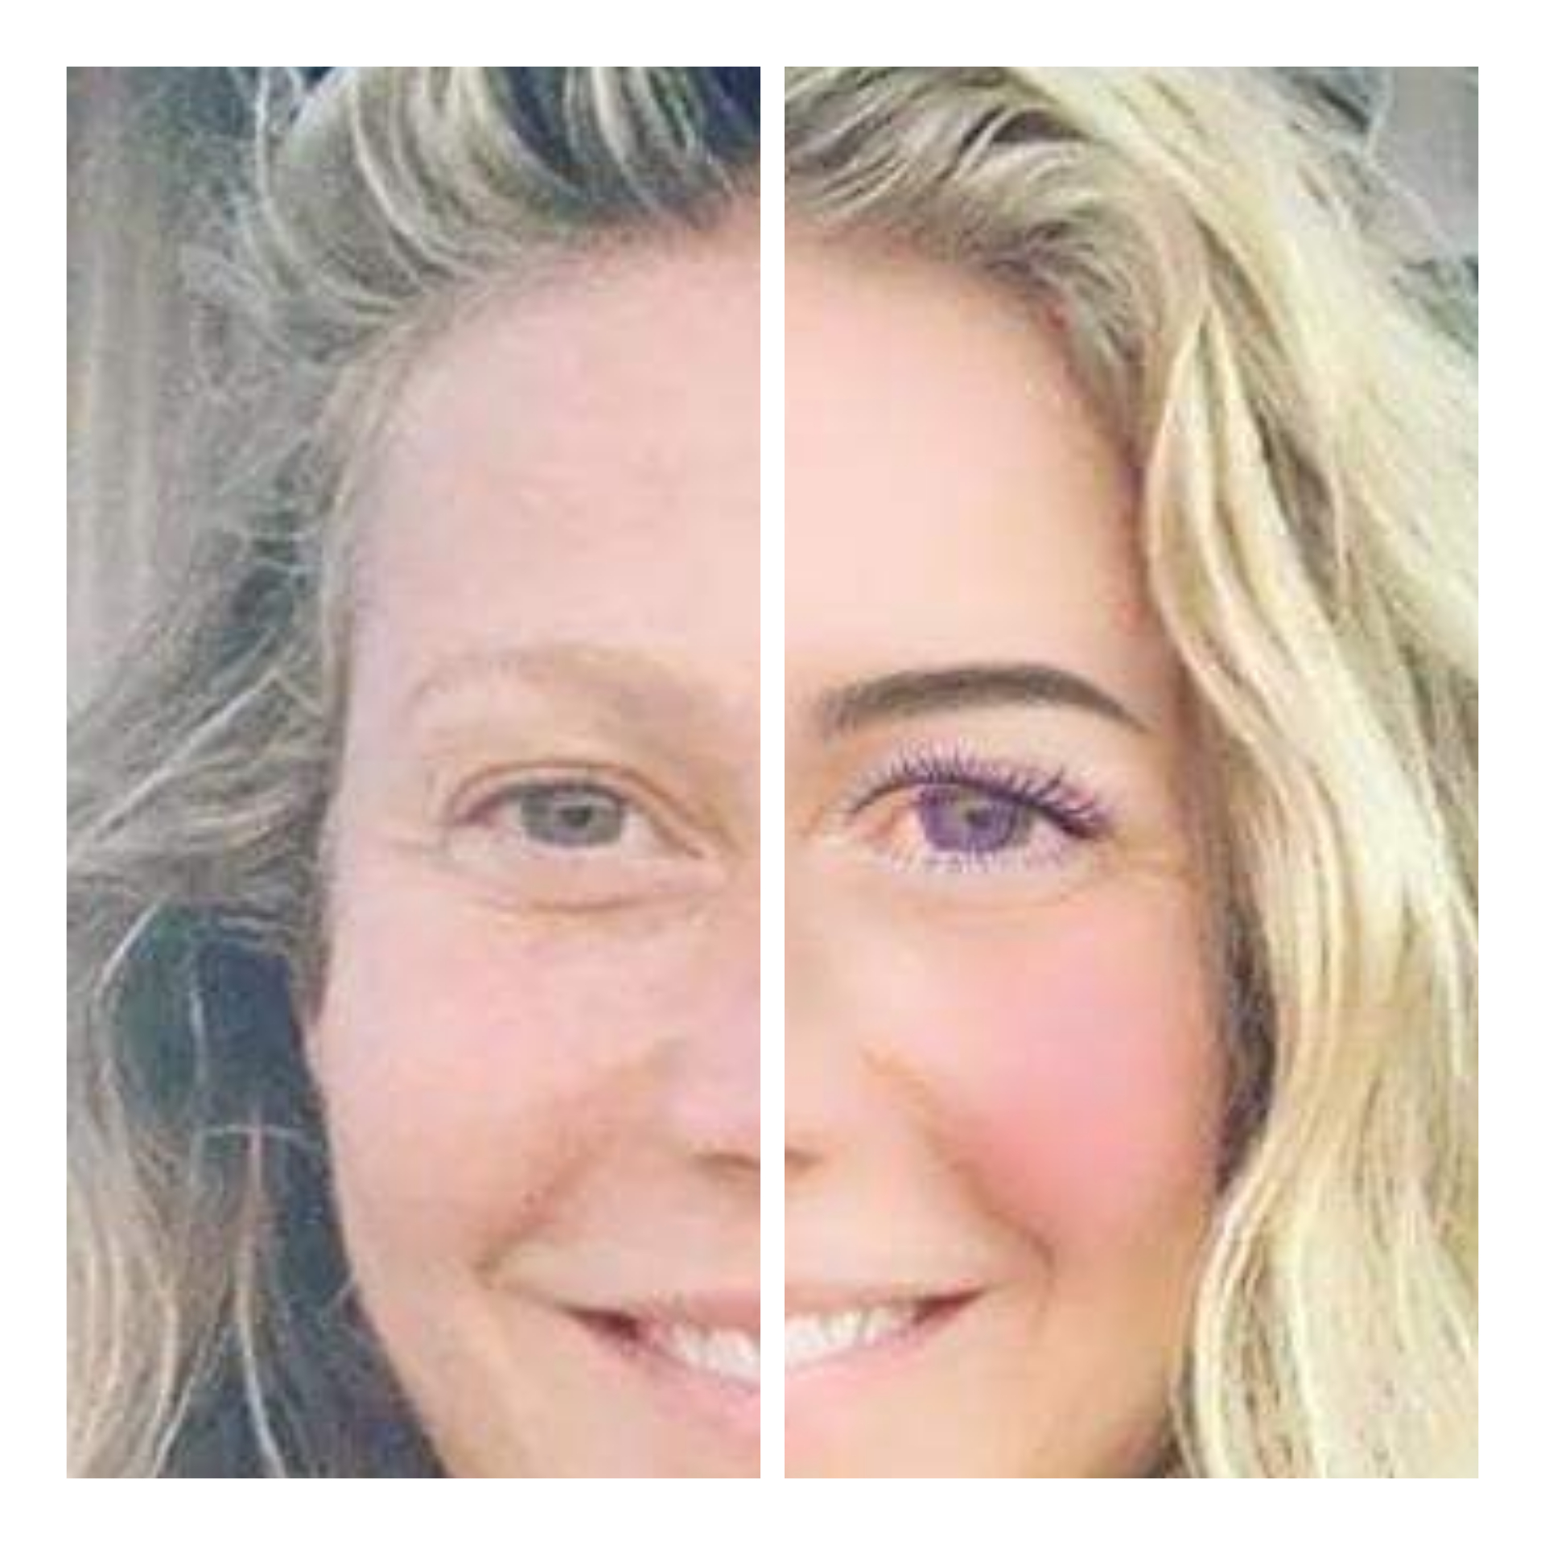
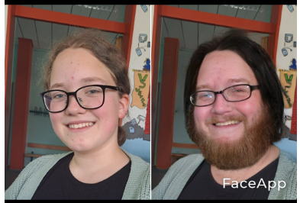
What can we do as social media consuments to not let the images we see affect our self-estem
The school can help by promoting the right role models and by makind sure that they have transmitted the right values to the children so that they have the ability to judge by themselves what is right and what is wrong.
Moreover the society should control what the kids are able to see since they are young and they have not already developped their critical skills.

