Slide 1
Nicolás Copérnico
Núria i Maria. T

Slide 2
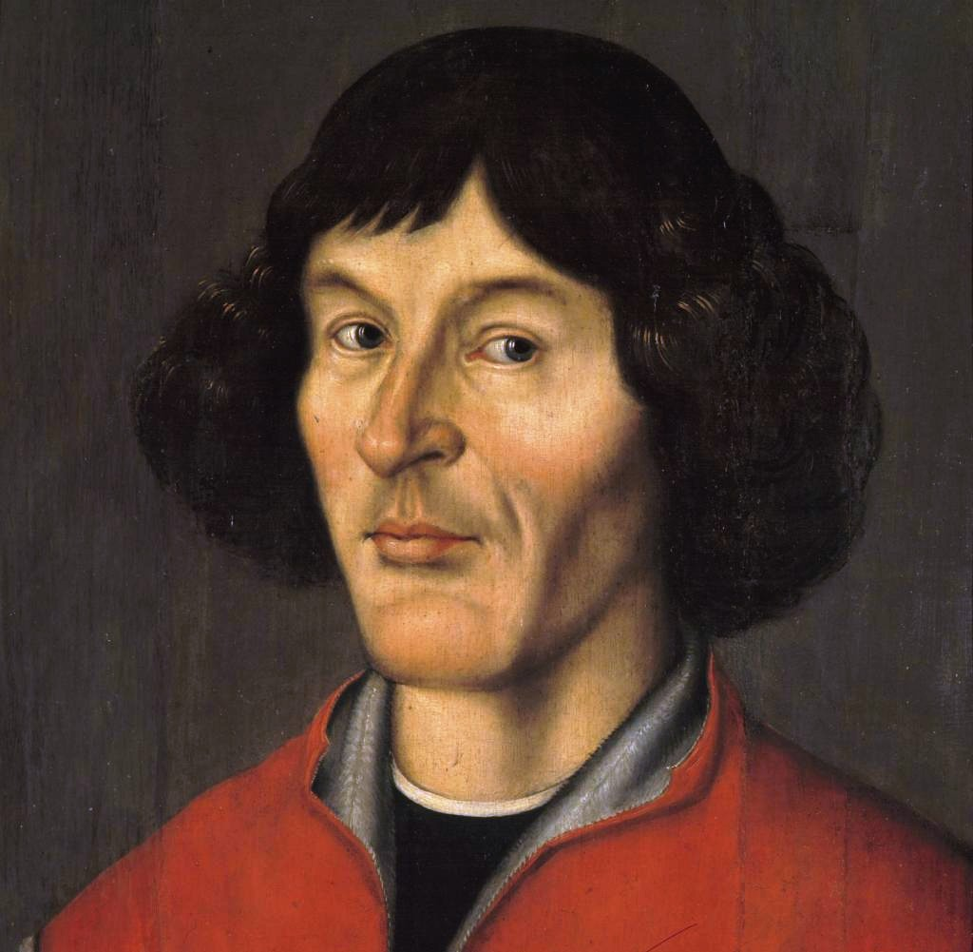
INDEX
Biography
What languages did he speak?
What did he work on?
Why is he famous?
Why did he die?

Slide 3
Biography
Nicolaus Copernicus was born on 19th of february 1473, in Poland, and he died on 24th of May 1543, in Poland.
They were 4 brothers, Andreas, Barbara, Katharina and he.
He was taught first in Cracow and then in Italy, where he graduated as a lawyer of the church. He studied also medicine to serve his fellow clerics. Copernicus spent most of his life working and researching in Frauenburg (Frombork), Warmia where he died.

Slide 4
What languages did he speak?
He spoke a lot of languages.
He spoke:
Latin
German
Polish
Greek
Italian

Slide 5
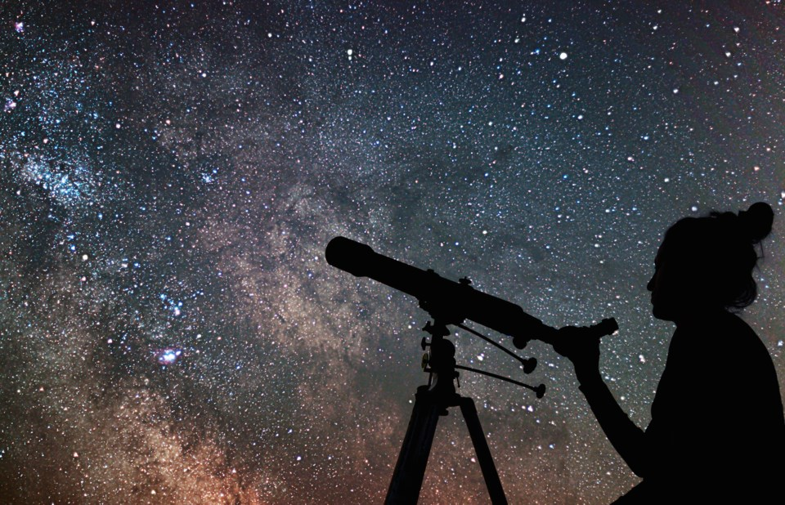
What did he work on?
Nicolaus was an Astronomer, Mathematician, Doctor, Economist, Jurist, Physician, Classical scholar, Governor, Administrator, Diplomat and Soldier. Astronomy was a hobby for him.

Slide 6
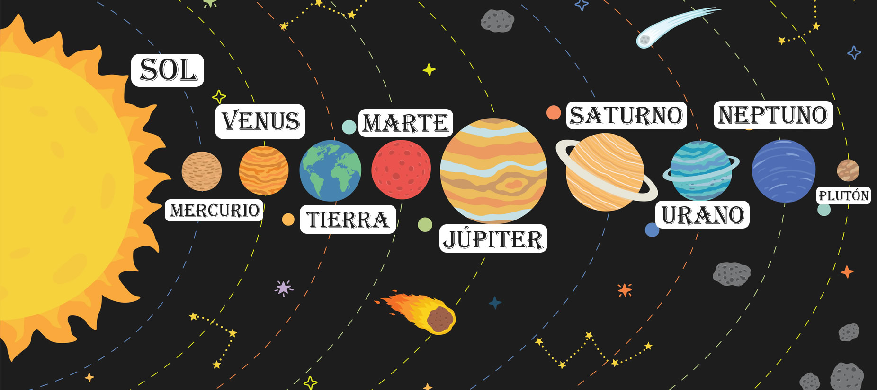
Why is he famous?
People know Copernicus for his ideas about the sun and the earth. His theory was that the sun is in the middle of the solar system and the planets go around it.
His formula is still one of the most important scientific hypotheses in history.
Before his ideas people thought that the earth was in the middle of the system and that the sun and the other planets went around it.

Slide 7
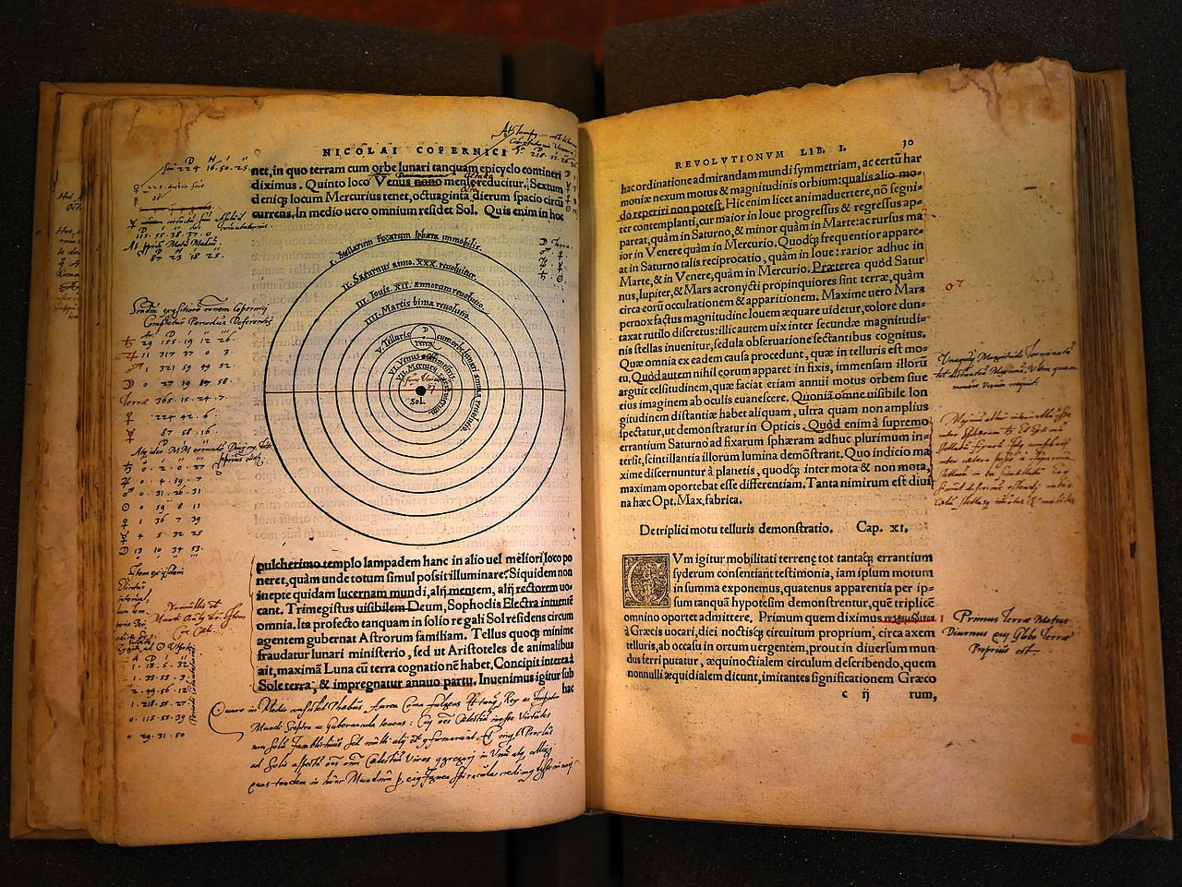
His book
De revolutionibus
orbium
coelestium

Slide 8
Why did he die?
He died on May 24, 1543, in Poland, because of a stroke.

Slide 9
Our Game
If you want to try our game click on this link.
https://learningapps.org/watch?v=pffhcr42t20

