Slide 1
GALILEO GALILEI
Laia Casero and Paula Llaveria

Slide 2
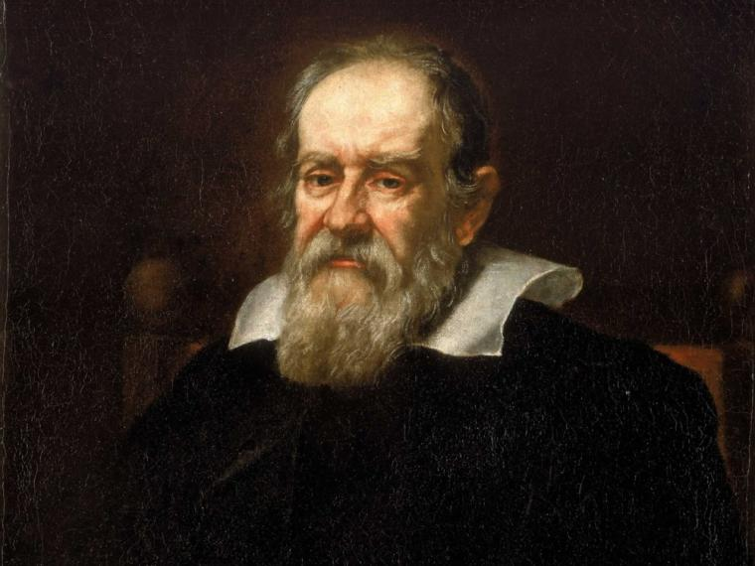
biography
Galileo di Vincenzo Bonaulti de Galilei was born in 1564 in Italy, and died in 1642. He was an astronomer, physicist and engineer from Pisa.

Slide 3
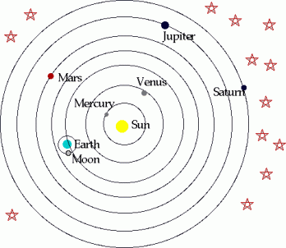
HIS STORY
· He demonstrated the heliocentric model theory: The Sun was the center of the Solar System.
· The theory contradicted what the Bible said.
· He was accused of heresy for that, and he was forced to say:
“ME, GALILEO GALILEI, GIVE UP THE FALSE OPINION THAT SAYS THE SUN IS THE CENTER OF THE UNIVERSE AND IT’S STATIC. I SWEAR, CURSE AND DETEST SUCH ERRORS”, but when he stood up, he said: “ E PUR SI MUOVE”, that means “however, it moves”.

Slide 4
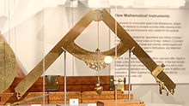
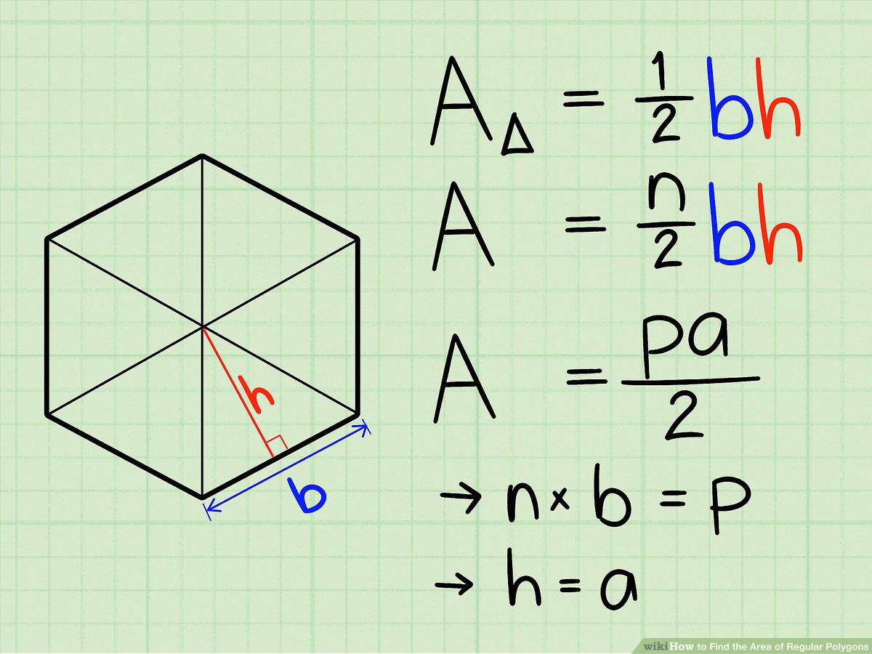
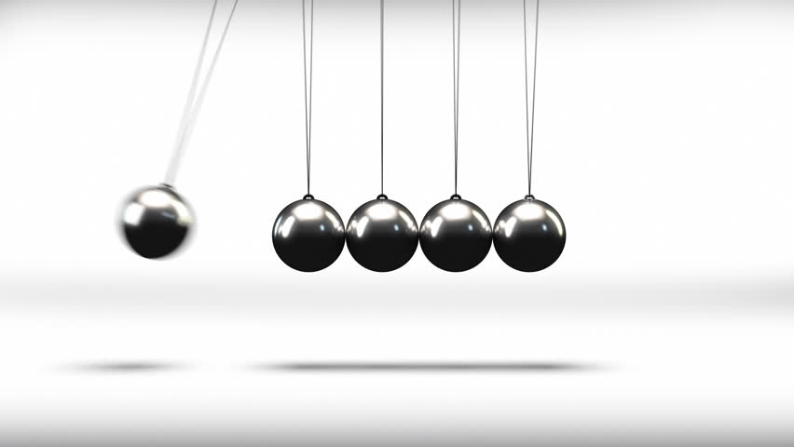
DISCOVERIES
GEOMETRIC AND MILITARY COMPASS HOW TO CALCULATE THE PENDULUM
AREA OF ANY POLYGON

Slide 5
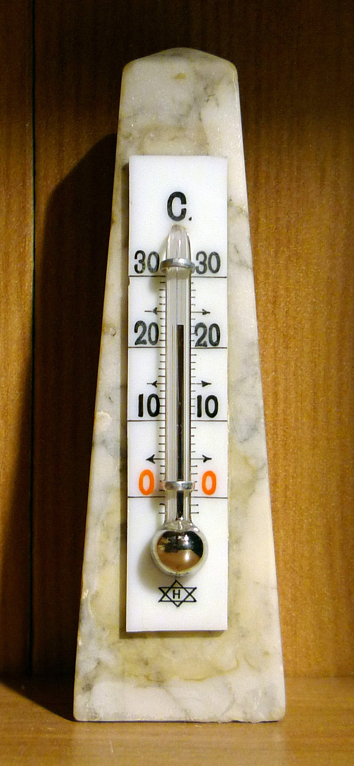
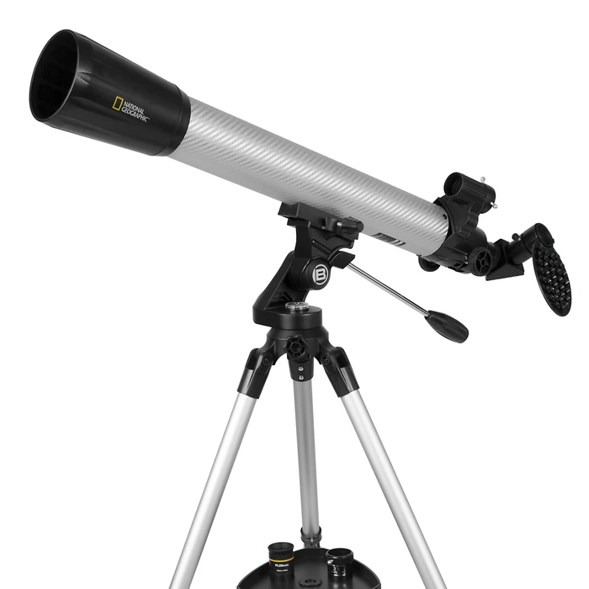
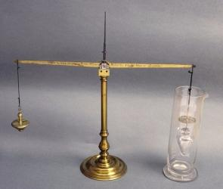
DISCOVERIES
HYDROSTATIC BALANCE THERMOSCOPE TELESCOPE

Slide 6
GAMES
https://learningapps.org/display?v=p287imjxk20 MEMORY
https://learningapps.org/display?v=pchhqb16520 ARCADE

