Slide 1
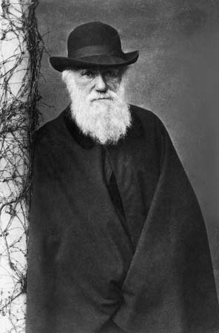
CHARLES DARWIN
Laia March and Jaume Segués

Slide 2
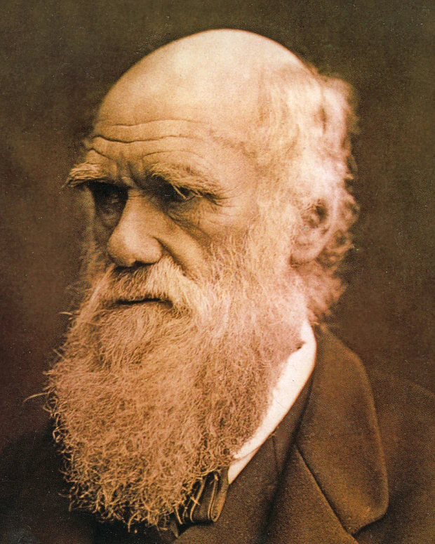
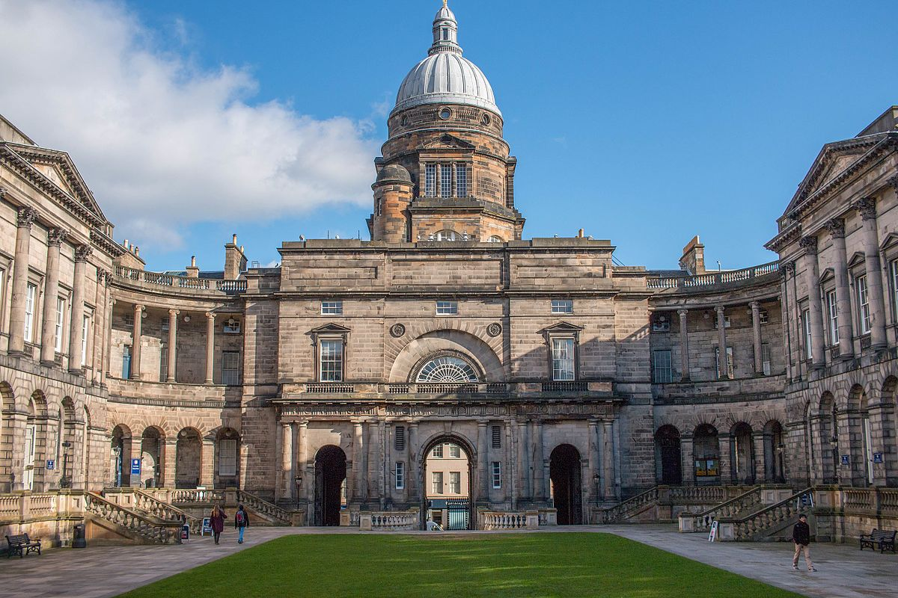
1809 - 1882
famous scientist, geologist and biologist
University of Edinbrugh
from england
Notes:
Charles Darwin was a very famous scientist and he discovered a lot of things. He also was a naturalist, geologist and a biologist. He was born in 1809 and he died in 1882.
At just sixteen, Darwin entered the University of Edinburgh, although he gradually dropped his medical studies to devote himself to marine invertebrate research.

Slide 3
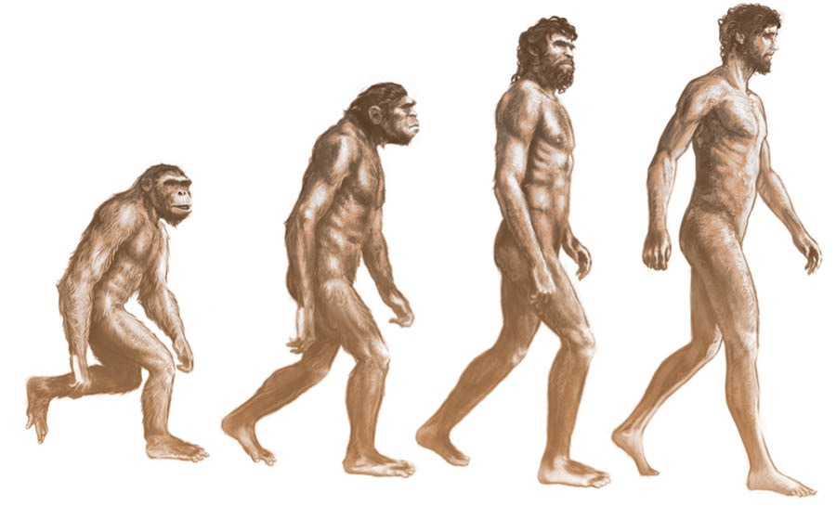
The origin of species
Notes:
Acknowledged as being the most influential scientist that had thought the idea of biological evolution through natural selection, justifying his work “the origin of species” with numerous examples drawn from the observation of nature.
With its modifications, Darwin's scientific discoveries still remain the founding act of biology as a science, since they constitute a logical explanation that unifies observations on the diversity of life. Evolution was accepted as a fact by the scientific community and by a large part of the public in Darwin's life, while his theory of evolution through natural selection was not considered as the primary explanation of the evolutionary process until the 1930s. It currently constitutes the basis of modern evolutionary synthesis.

Slide 4
https://learningapps.org/display?v=pwssvzfda20

