Slide 1
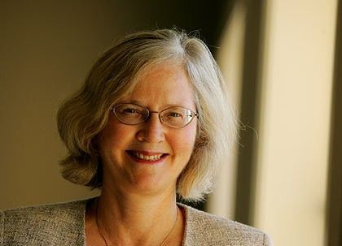
elizabeth blackburn
Àneu Torrelles & Júlia Casanovas

Slide 2
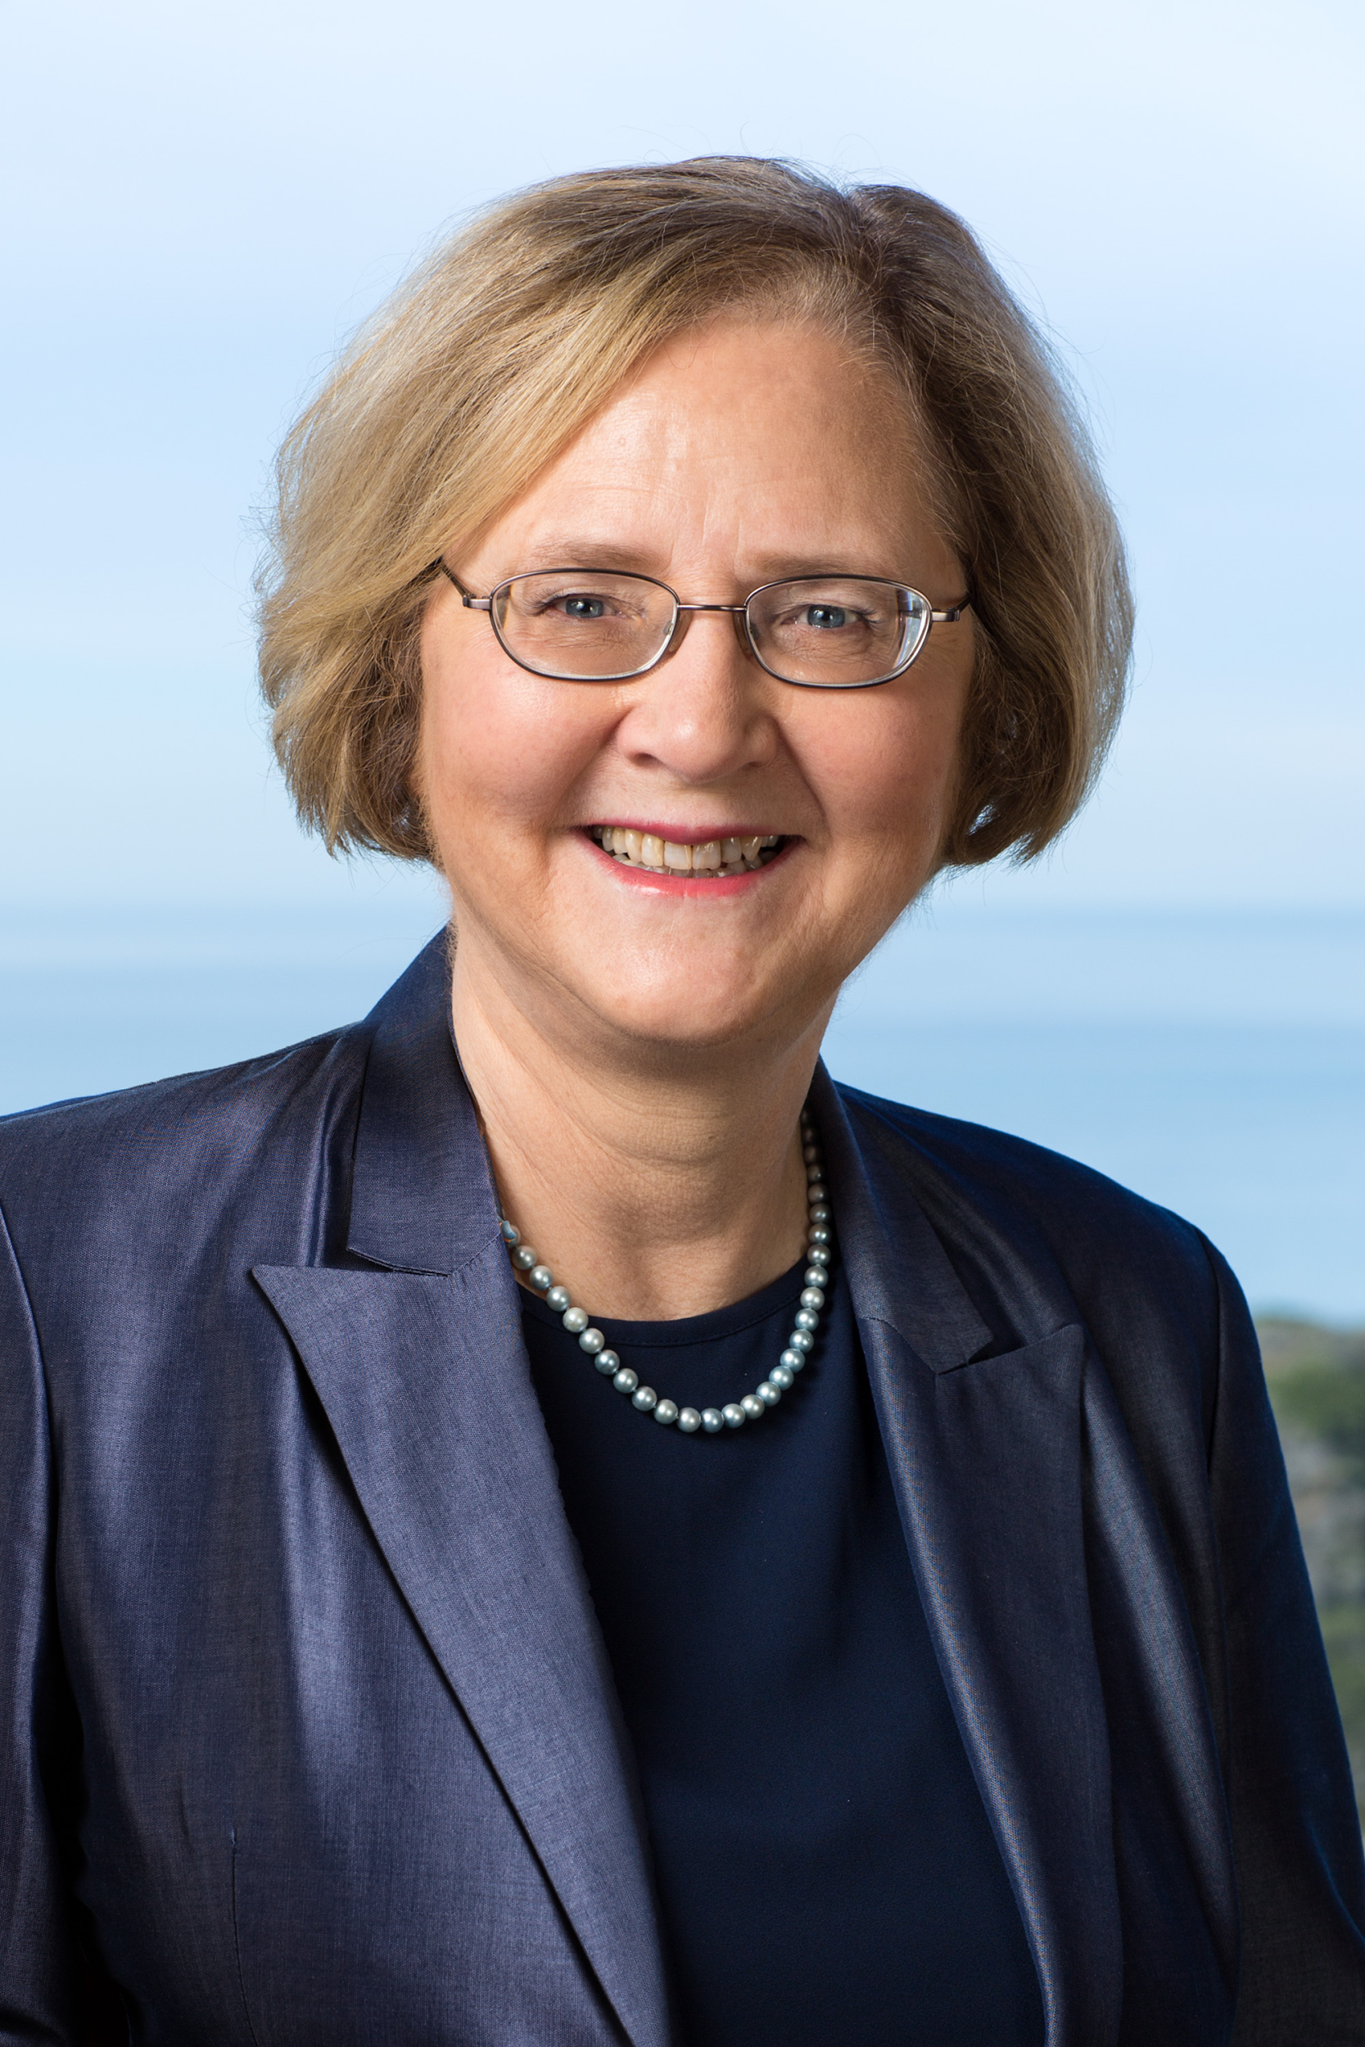
INDEX
Early life.
Telomerase.
Objectives of the research.
Prizes.

Slide 3
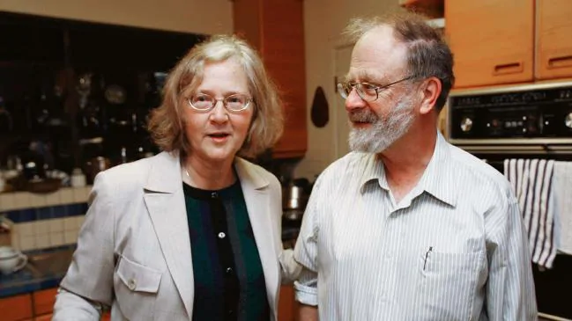
EARLY LIFE
26ºth of November of 1948 in Australia
Married with John Sedat
She studied biochemistry in the University of Melbourne
She discovered the telomerase in 1984

Slide 4
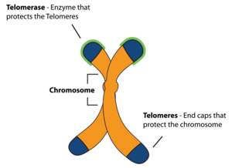
WHAT’S TELOMERASE?
Essential part of human cells that affect how our cells grow.
Are the caps at the end of each strand of DNA.
Protect our chromosomes.

Slide 5
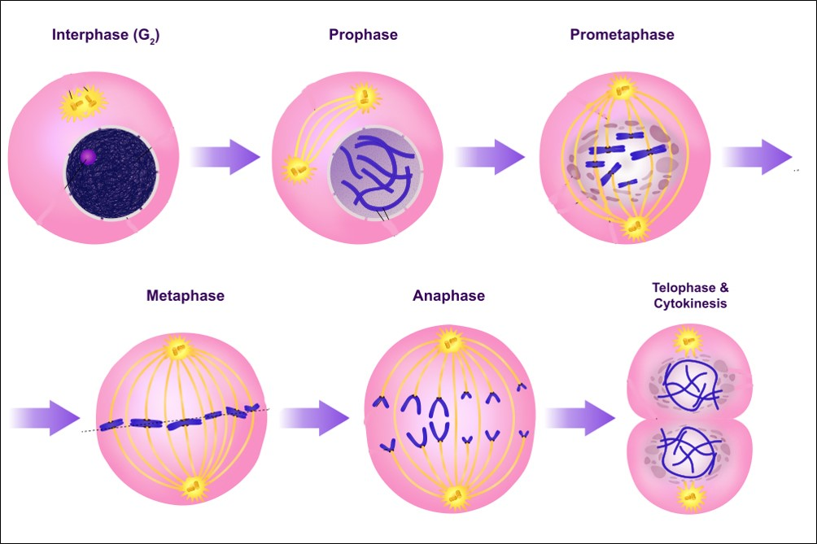
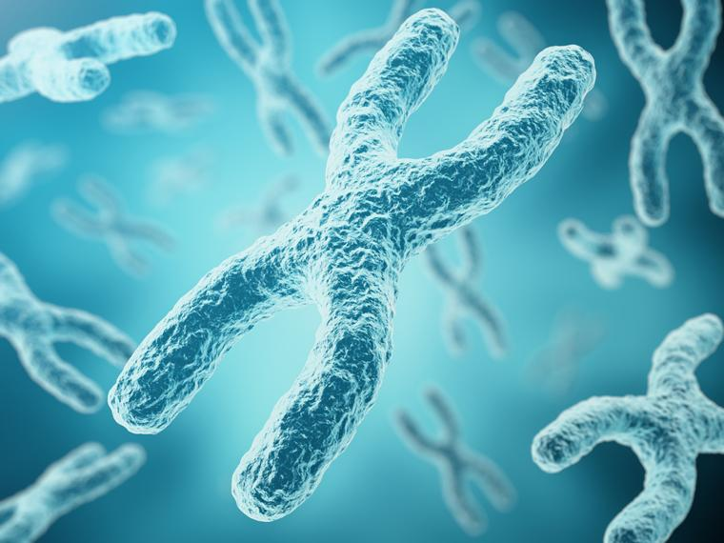
why was important the elizabeth research?
Her objectives were:
-Study the structural stability of chromosomes in eukaryotic cells.
-Study the cell division
-Control the cell life time

Slide 6
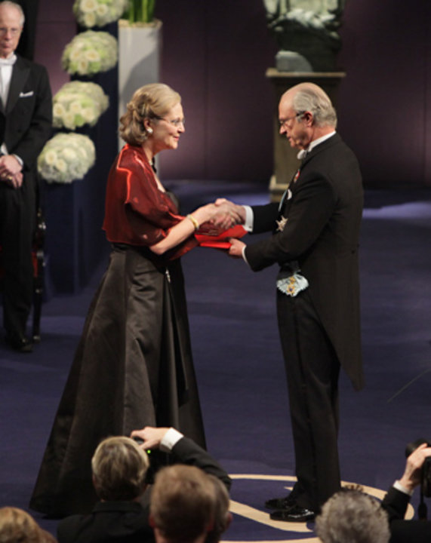
SOME PRIZES THAT SHE HAS WON
Medicine nobel prize (2009)
National chemistry academy of United States price (1990)
Louisa Gross prize (2007)

Slide 7
LINK OF THE FIRST GAME
Here you have our memory game:
https://learningapps.org/display?v=pup90y0ma20

Slide 8
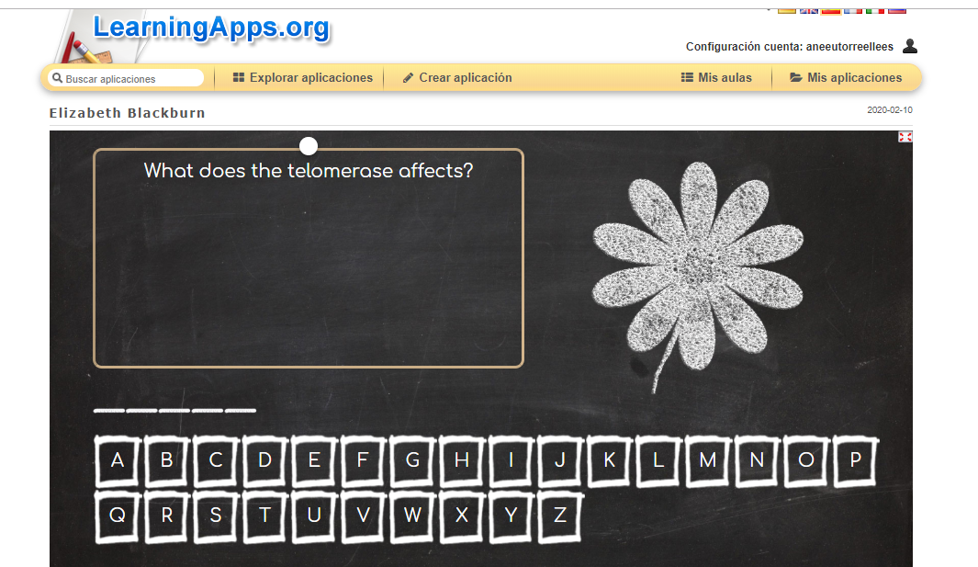
LINK OF THE SECOND GAME
Here you have the link of the second game that we have done.
https://learningapps.org/display?v=pa98rrt5v20

