Slide 1
ROSALIND FRANKLIN
By Abril Isant and Bèrta Molas

Slide 2
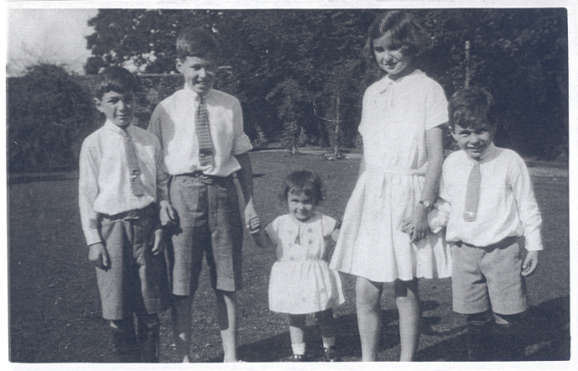
BIOGRAPHY
25th July 1920 - 16th April 1958
London, UK
Muriel Waley ♡ Arthur Franklin
David, Rosalind, Roland, Colin, Jenifer

Slide 3
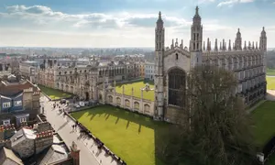
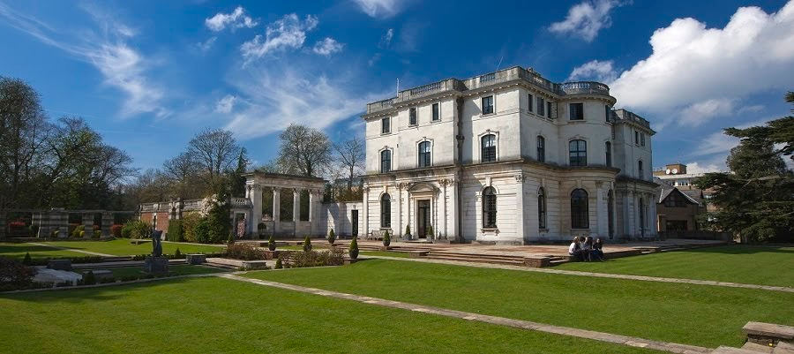
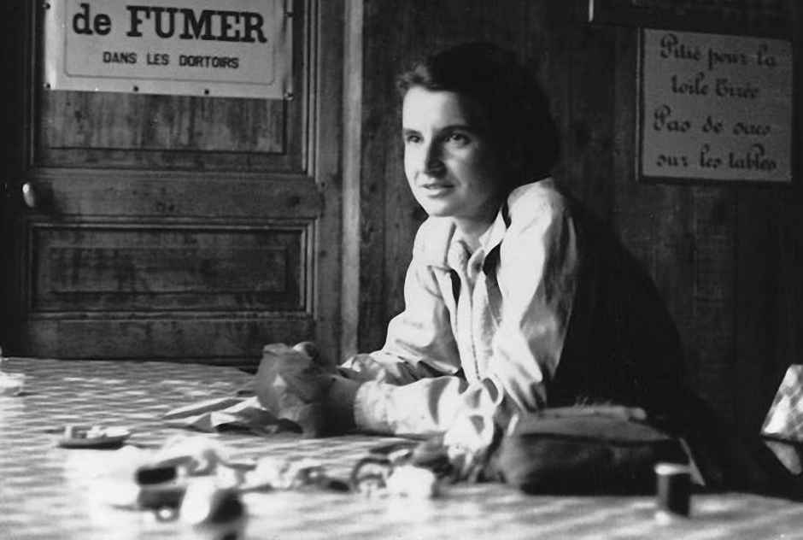
STUDIES
University
Cambridge University
Work
King’s College
Elementary:
North London Collegiate School & Newham College

Slide 4
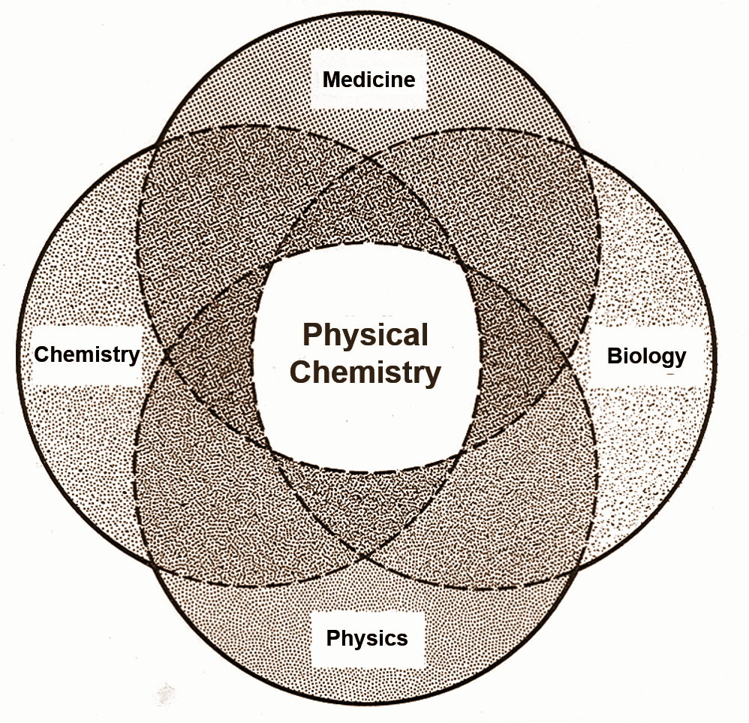
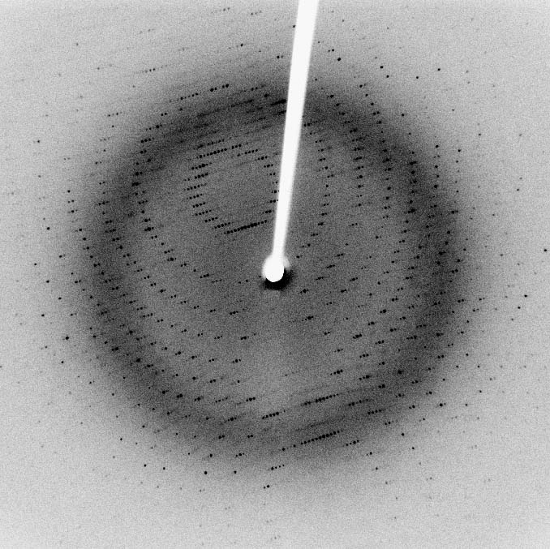
STUDIES
PHYSICAL CHEMISTRY
CAMBRIDGE UNIVERSITY
X-RAY CRYSTALLOGRAPHY
Ph. D
(Phylosophical doctor)

Slide 5
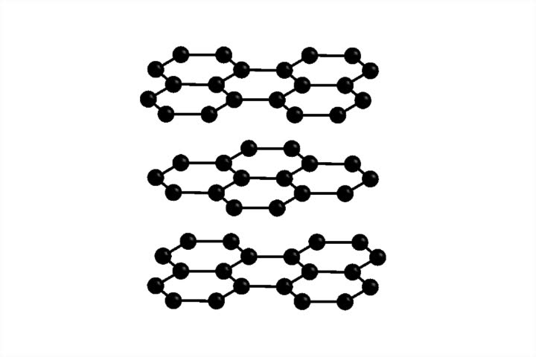
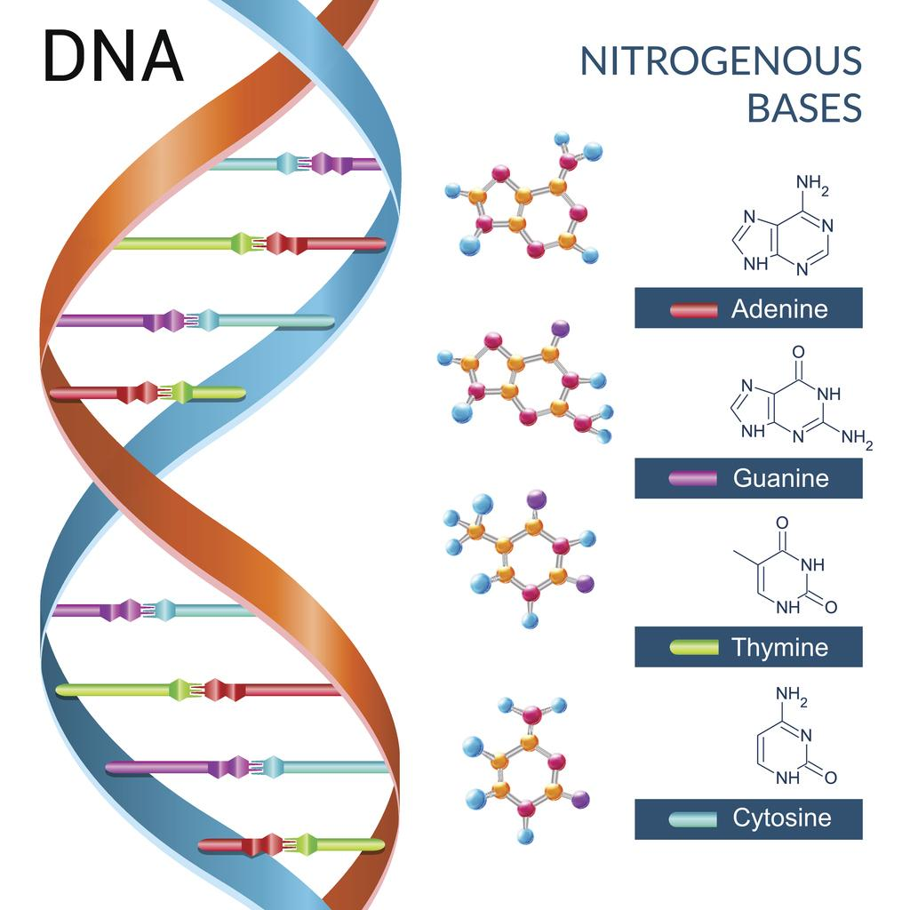
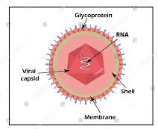
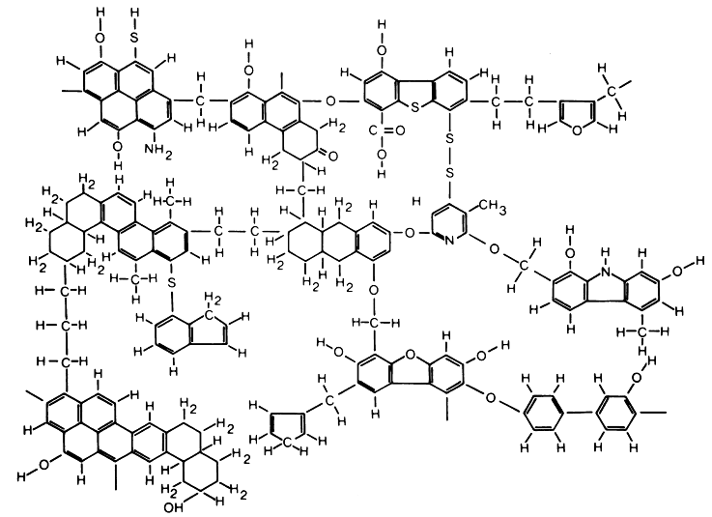
IMPORTANT WORK
· Structure of DNA ·Structure of coal and graphite ·Structure Polio virus

Slide 6
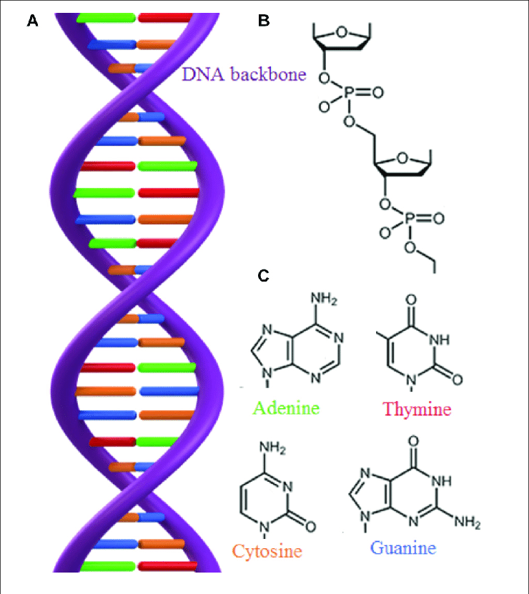
STRUCTURE OF DNA
DNA Nucleotide
Nucleotide Sugar group, nitrogen base, phosphate group.
Nitrogen base (A) (T) (G) (C)

Slide 7
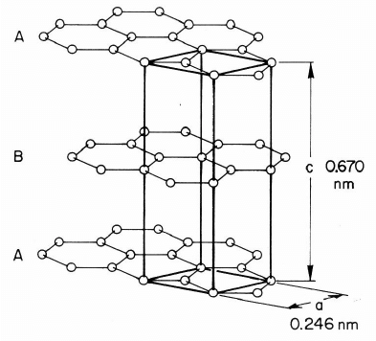
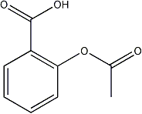
STRUCTURE OF COAL AND GRAPHITE

Slide 8
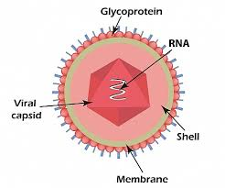
POLIO VIRUS STRUCTURE

Slide 9
SCRIPT
https://drive.google.com/open?id=1pQOI9GK0m4Kw8h-cHIC2edsIniTNCgXmduCTHiHHUEc
Here it is the full information that belongs to every diapositive. It is an informative text written by us.

Slide 10
PLAY THIS GAME TO SEE IF YOU HAVE UNDERSTOOD!
https://learningapps.org/display?v=pyrdqr9ha20

