Slide 1
ALBERT EINSTEIN

Slide 2
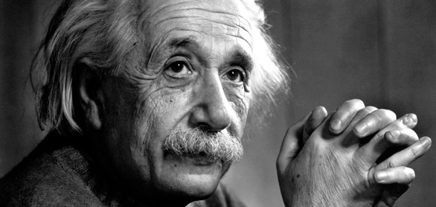
BIOGRAPHY
Born March 14th, 1879, Ulm, Württemberg, Germany—died April 18th, 1955, Princeton, New Jersey, U.S.

Slide 3
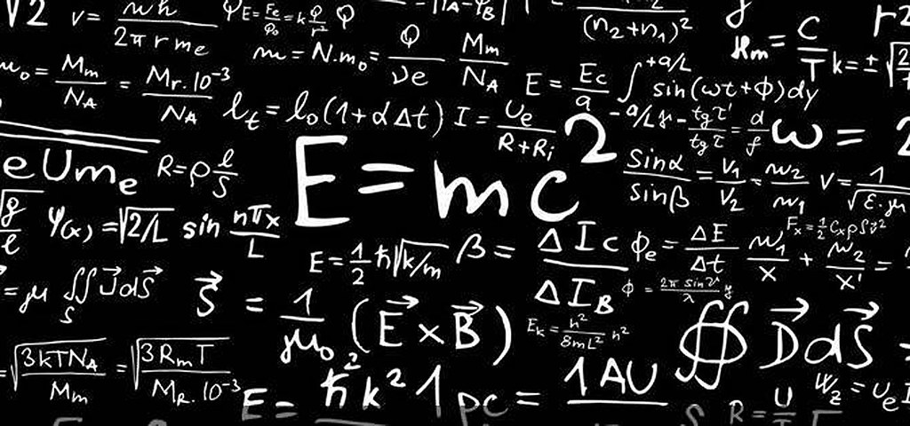
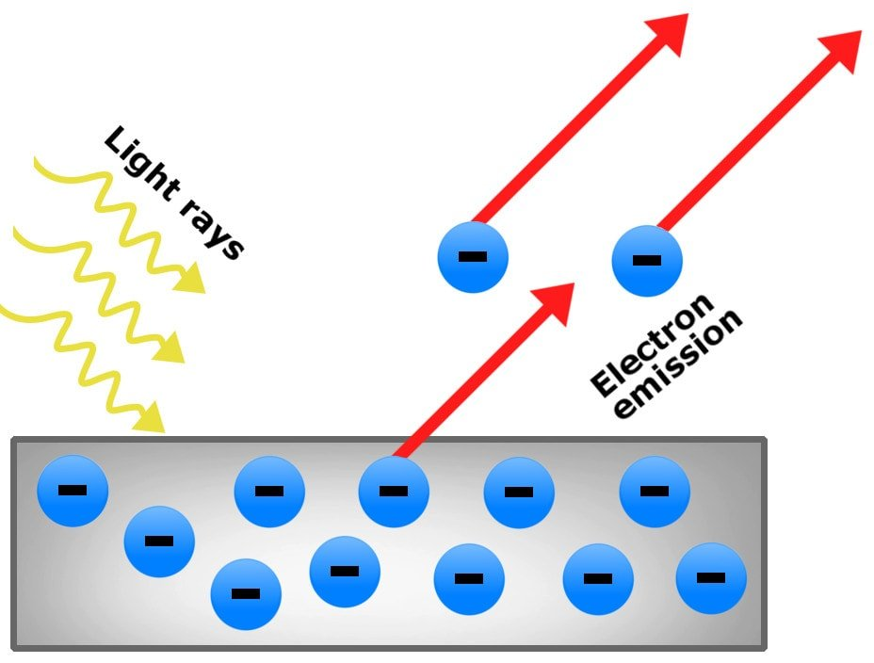
INTRODUCTION
Albert Einstein was a German mathematician and physicist who developed the special and general theories of relativity. In 1921, he won the Nobel Prize for physics for his explanation of the photoelectric effect. In the following decade, he immigrated to the U.S. after being targeted by the German.

Slide 4
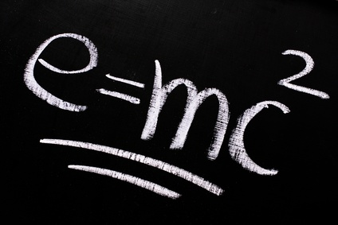
theory of the relativity
In 1916, Einstein published his General Theory of Relativity. This paper generalizes the concepts of Special Relativity and Newton's Law of Universal Gravitation, describing gravity as a property of space and time. This theory has aided our understanding of how the large-scale structure of the universe is set up.

Slide 5
photoelectric effect
He theorized that, as light hits an object, there is an emission of electrons, which he named photoelectrons. This model formed the basis of how solar cells work - light causes atoms to release electrons, which generate a current, and then creating electricity.

Slide 6
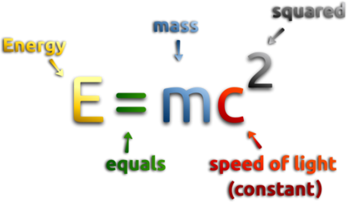
mass energy
Mass-energy equivalence is where mass has an energy equivalence, and energy has a mass equivalence. This is expressed quantitatively using Einstein's equation:

Slide 7
LINK HORSE RACE
This is the link of my game:
https://learningapps.org/display?v=ppj0ewpqt20

