Slide 1
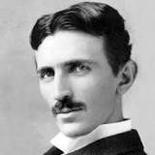
NIKOLA TESLA
Per Aleix Jové i Mario Rodriguez

Slide 2
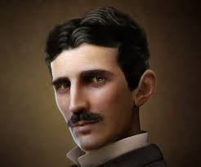
INDEX
Presentation
Who is he?
Biography
His inventions
Games
The end

Slide 3
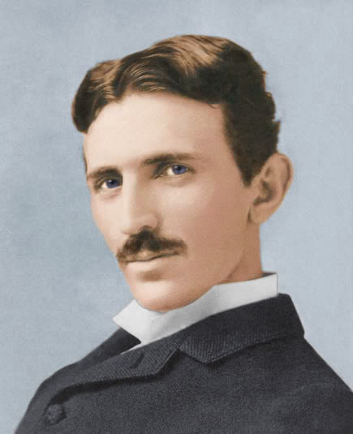
Presentation
In the next presentation you can look at some information of Nikola Tesla, the famous inventor and creator of the tesla tower.
Enjoy the presentation!!!

Slide 4
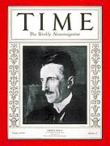
WHO IS HE?
Nikola Tesla (10th July 1856 – 7th January 1943) He was born in Smiljan, in the part of former Austria-Hungary that is now Croatia.
He was a Serbian inventor, electrical engineer, mechanical engineer and physicist, and later he became an American citizen.
His friend Braun introduce him to a company.
He is best known for his contributions to the design of the modern alternating current (AC) electricity supply system.

Slide 5
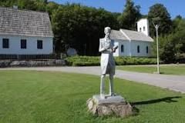
Biography
He was born the 10 of july of 1856 in Smiljan,Croatia. In his life, he studied at many different universities like: Graz university of Technology(1875-1878), in University of Karlovac(1870-1873).
Over his life he invented many different electric machines. Like alternative current, light...

Slide 6
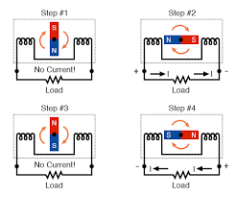
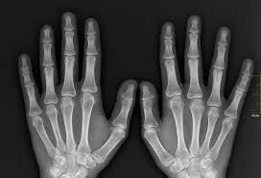
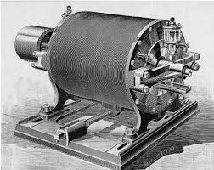
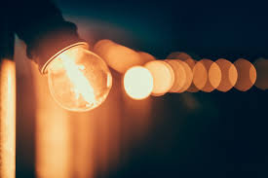
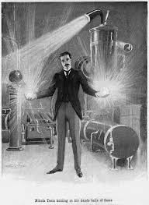
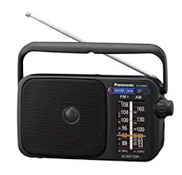
His inventions

Slide 7
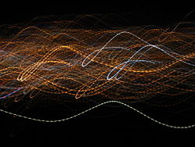
alternating current
An alternating current (AC) is an electric current of which magnitude and direction vary, unlike direct current, whose direction remains constant. This means that the direction of current flowing in a circuit is constantly being reversed back and forth.

Slide 8
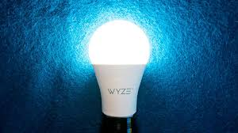
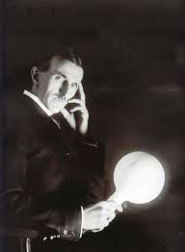
Light
Of course Nikola Tesla didn’t invent light itself, but he did invent how light can be harnessed and distributed. Tesla developed and used fluorescent bulbs in his lab some 40 years before industry “invented” them. At the World’s Fair, Tesla took glass tubes and bent them into famous scientists’ names, in effect creating the first neon signs.

Slide 9
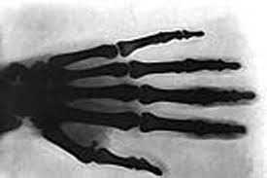
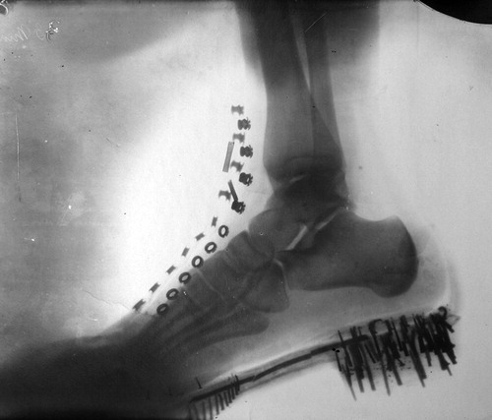
x-rays
Nikola Tesla discovered the X-rays. He made a photo with a camera with a change in the lens. This machine is able to see through what is there behind the clothes.
This photos are the first what he make.

Slide 10
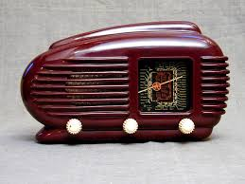
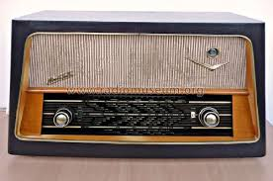
Radio
Nikola Tesla invented the radio in 1892, first the people thought that the inventor of the radio was Guglielmo Marconi , but later people discovered that Marconi sell the radio he didn’t invent it.

Slide 11
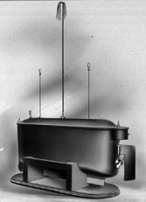
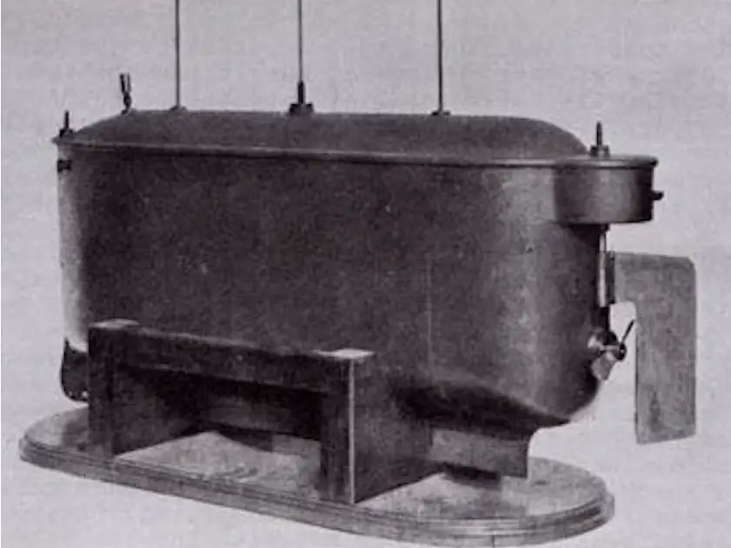
REMOTE CONTROL
His invention, covered in patent No. 613,809 (1898), took the form of a radio-controlled boat, a heavy, low-lying, steel craft about four feet long.He examiners from the US Patent Office were reluctant to recognize improbable claims made in the application "Method of and Apparatus for Controlling Mechanism of Moving Vessels or Vehicles.".

Slide 12
Games
https://learningapps.org/display?v=p0fovpudc20 Memory
https://learningapps.org/display?v=pdzj2iucc20 Hangman
https://learningapps.org/display?v=p5hf9mfnj20 Crossword
https://learningapps.org/display?v=p5wfcvg3c20 Horses race

Slide 13
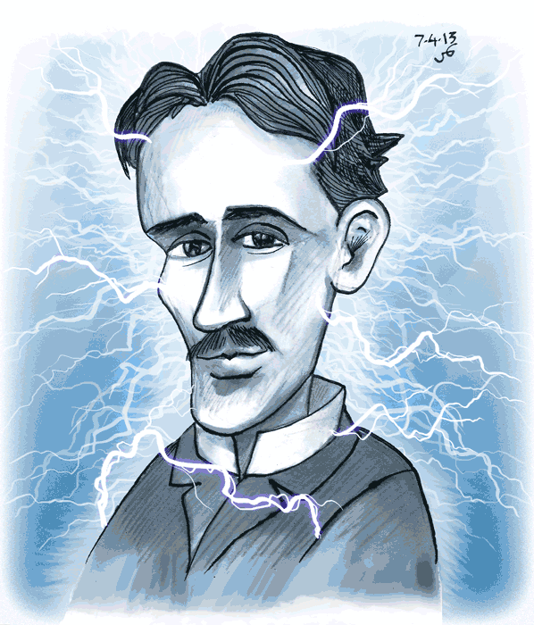
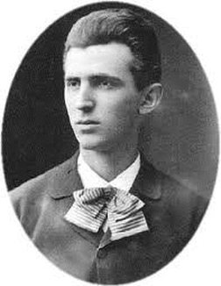
THE END

