Slide 1
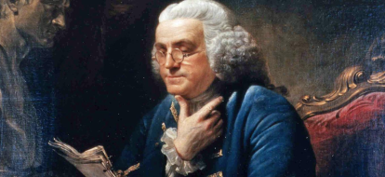
BENJAMIN FRANKLIN
Paula Busquets and Clàudia Sánchez

Slide 2
BENJAMIN FRANKLIN
He was born in 1706 and died in 1790.
Franklin was…
Leading writer
Printer
Politician
Scientist
Inventor
Diplomat
But most importantly he is known for being one of
the Founding Fathers of USA.

Slide 3
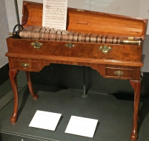
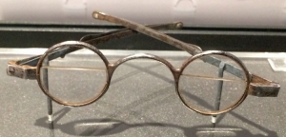
SOME OF HIS INVENTIONS
Swim paddles, he used them to swim faster while he was learning.
Bifocals. He suffered presbyopia, so he didn’t have a perfect vision. Due to his lack of vision he invented this glasses.
Glass Harmonica, they were some glass bowls of different sizes, threaded together on an iron spindle and colour-coded with paint to identify the notes.

Slide 4
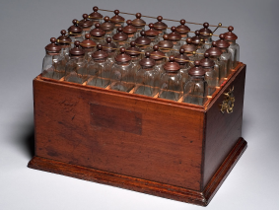
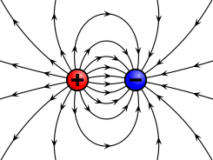
HIS MOST FAMOUS INVENTIONS
The most important things he discover were:
The battery
Positive energy
Negative energy
Conductors

Slide 5
HIS MOST IMPORTANT INVENTIONS
Franklin thought that electricity and lightning were the same, this theory was shared by some people, but never proved. He wrote his reflections in some letters, which he sent to another scientist in London. This scientist with some others thought that the letters had valuable information, so in 1751 they published all his theories in the book experiments and observations on electricity.
To prove that they were the same Franklin needed something to reach clouds and attract the lightnings. So he flew a kite, and for his surprise it worked! He and some others scientists proved that electricity and lightnings were the same.
Yet, he didn’t have enough. He knew that this knowledge should be used for practical purposes.
Lightning rod
Is made of metal
Is attached to the highest point of the house.

Slide 6
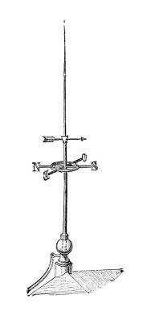
HIS MOST IMPORTANT INVENTIONS
He knew that lightning usually hit the highest part of a building. He also knew that the electrical current in lightning could start a fire. So he invented the lightning rod.
A lightning rod is made of metal and is attached to the highest point on a house. The lightning hits the rod instead of the house, and the electrical current from the lightning goes into the ground and leaves the house undamaged. That way he kept houses from being burned down by lightning. Franklin thought the lightning rod was his most important invention.

Slide 7
TEST YOUR ABILITIES
Here you have the link to go directly to test your abilities and know if you really pay attention or not!
https://learningapps.org/display?v=pyff830w320
THANKS FOR YOU ATTENTON
AND WE HOPE WE WILL ENJOY!
https://learningapps.org/display?v=pyff830w320

