Slide 1
TWO WOMEN SCIENTIST
Xenia Prim, Martina Casas & Martina Claveria

Slide 2
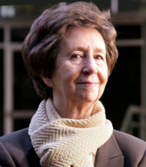
MARGARITA SALAS
WHO IS SHE?
She was a Spanish woman scientist , she was born in 1938 in Asturias and she died last November. In her life she studied in the Complutense University of Madrid.
She had the great fortune of her parents, that always gave the same training opportunities to all their children.

Slide 3
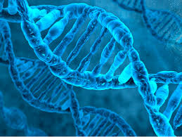
DISCOVERY
Her study on the bacterial virus Phi29 has permitted us to know how DNA works, for each person.
With this discovery she helped in the study of oncology,
archaeology and fluorescence, too.
SHE WAS A MOLECULAR BIOLOGIC SCIENTIST.

Slide 4
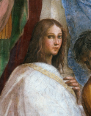
HIPATIA
WHO IS SHE?
She was an Egyptian woman, also was a Teacher, philosopher, astronomer, and mathematician.
She lived in Alexandria during the last years of the Roman Empire, but she was murdered, because there was a Christian rebellion and the people thought that she was a witch, because she was a important scientist and they killed her.

Slide 5
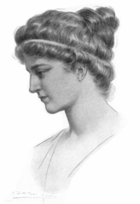
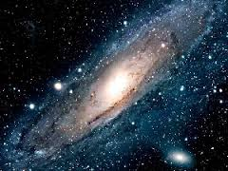
HER DEGREE
Hyatia could get her degree in a time when women didn’t have any studies. She wasn’t content with the studies of astronomy of her father, and then she investigated more. Her contribution to astronomy and literature were very useful. She simplified the mathematical operations and also she wrote eight books about “conic geometry” of Apollonio.
Hypatia has been described
as a universal genius.

Slide 6
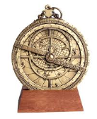
DISCOVERY
She created some improvement for machines, for example the astrolabe, that measures the positions of the celestials bodies, the hydrometer that measures the weight of the liquids and the hydroscopic that measures the level of the water. All her inventions were lost, and other people took her information about these inventions and then they presented them as theirs.
ASTROLABE
hydroscopic
hydrometer

Slide 7
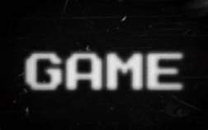
QUESTIONS
Play this game, to test yourself.
https://learningapps.org/display?v=pr6r9z89k20

Slide 8
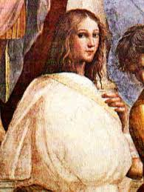
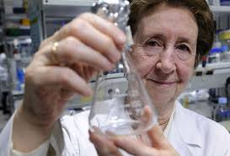
THE END
Thanks for your attention, we hope that you had enjoyed the presentation.

