Slide 1
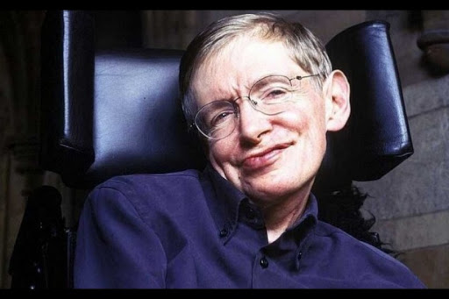
STEPHEN HAWKING
Guillem Solanelles and Albert García

Slide 2
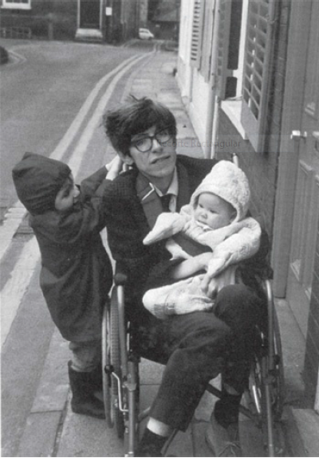
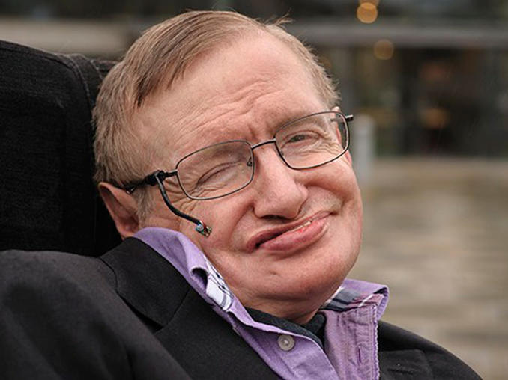
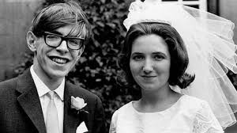
Biography
Stephen William Hawking was born on the 8th of January of 1942 in Oxford. After attending secondary school, Hawking entered the University College of Oxford, where he graduated in 1962 with the titles of mathematician and physicist. He was immediately diagnosed with a neuromuscular degenerative disorder, ALS or amyotrophic lateral sclerosis. Finally, he died on the 14th of March of 2018 in Cambridge.
Notes:
He born the 8 January of 1942 in Oxford. In 1963, during an ice skating session, young Stephen slipped and struggled to get up. He was immediately diagnosed with a neuromuscular degenerative disorder, ALS or amyotrophic lateral sclerosis. Finally, he died 14 march of 2018 in Cambridge.

Slide 3
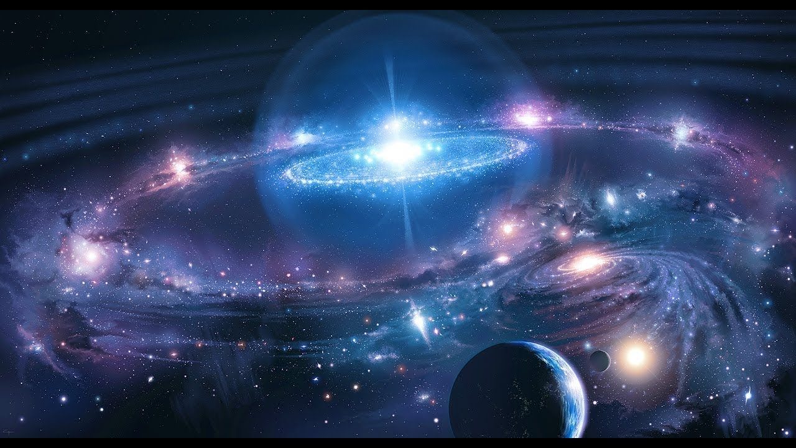
WHAT DID HE DISCOVER?
BIG BANG: According to the current scientific consensus, all of the current and past matter in the Universe came into existence at the same time – roughly 13.8 billion years ago. At this time, all matter was compacted into a very small ball with infinite density and intense heat. Suddenly, this ball started to inflate at an exponential rate, and the Universe as we know it began.

Slide 4
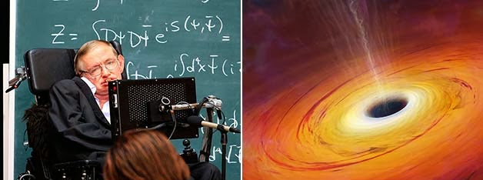
WHAT DID HE DISCOVER?
BLACK HOLES: Black holes are the remains of stars that have collapsed under their own gravity, producing gravitational forces so strong that even light can’t escape. Anything that falls inside is thought to be destroyed by the massive gravity, never to been seen or heard from again.

Slide 5
GAME
This is the link of our game, it’s a horse race and you can play with your friends.
https://learningapps.org/display?v=paooq4gka20

