Slide 1
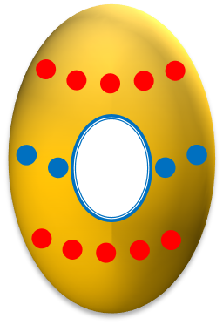
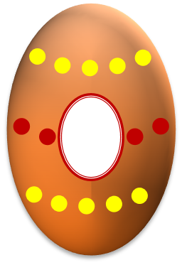
What is the most important Christian holiday?
What is Shrove Tuesday?
What is Ash Wednesday?
What do people in The UK eat on Shrove Tuesday?
How do we call Sunday before Easter?
How do we call Friday before Easter?
1
2
3
4
5
6
Hide
All
How do we call the week before Easter?
When is Maundy Thursday?
How do we call sweet rolls with a cross on them?
Which plants do we need on Palm Sunday?
How do we call coloured eggs?
What do people eat on Easter Sunday for breakfast?
7
8
9
10
11
12
Show
All
What is a traditional Easter lunch in The UK?
Sing Hot Cross Buns!
Name an Easter game when children look for eggs.
What is a traditional Easter game which they play on the grass?
When is Easter celebrated?
What is Egg knocking?
13
14
15
16
17
18
tekhnologic
Notes:
Click on an Easter Egg to see it disappear.
Click on the text box to make the Easter Egg reappear.
Click on the Hide All button to make all the Easter Egg disappear.
Click on the Show All button to make all the Easter Eggs appear.
Rabbit image adapted from ‘Baby rabbit with mum’ taken from http://flickr.com/eltpics by @Dace Praulins, used under a CC Attribution Non-Commercial license. https://creativecommons.org/licenses/by-nc/2.0/

