Slide 1
EASTER ACTIVITIES
by Valentina Barb

Slide 2
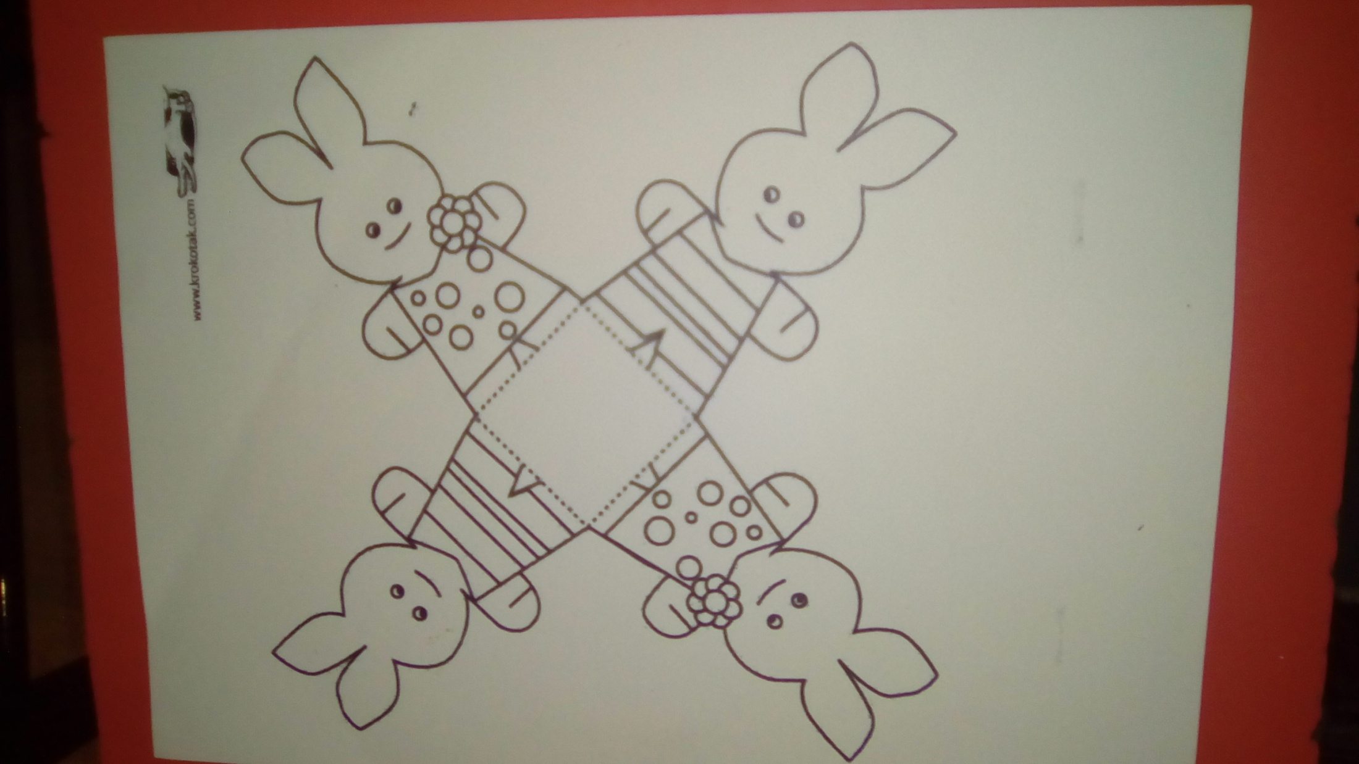

Slide 3
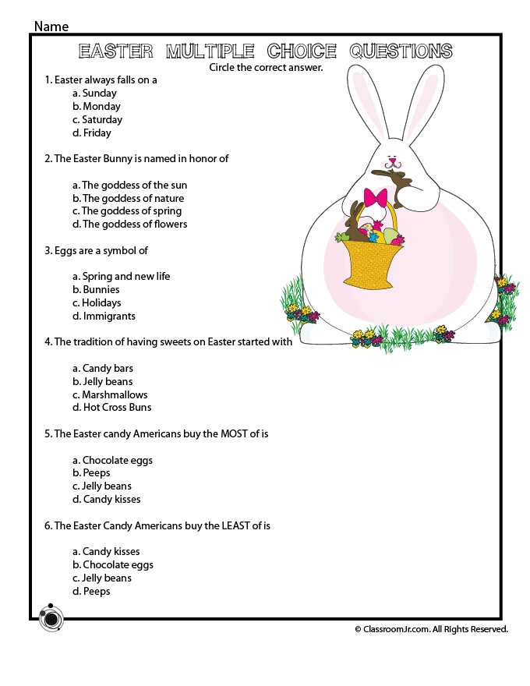

Slide 4
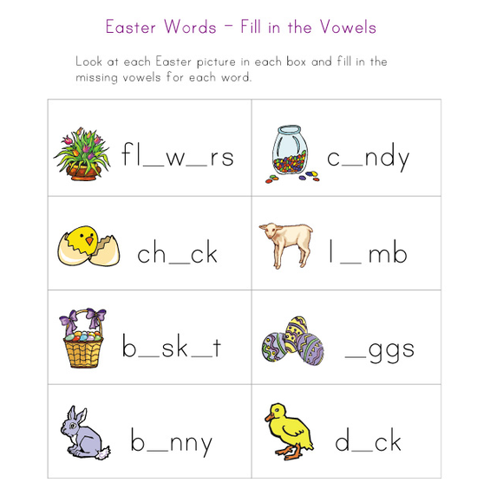

Slide 7
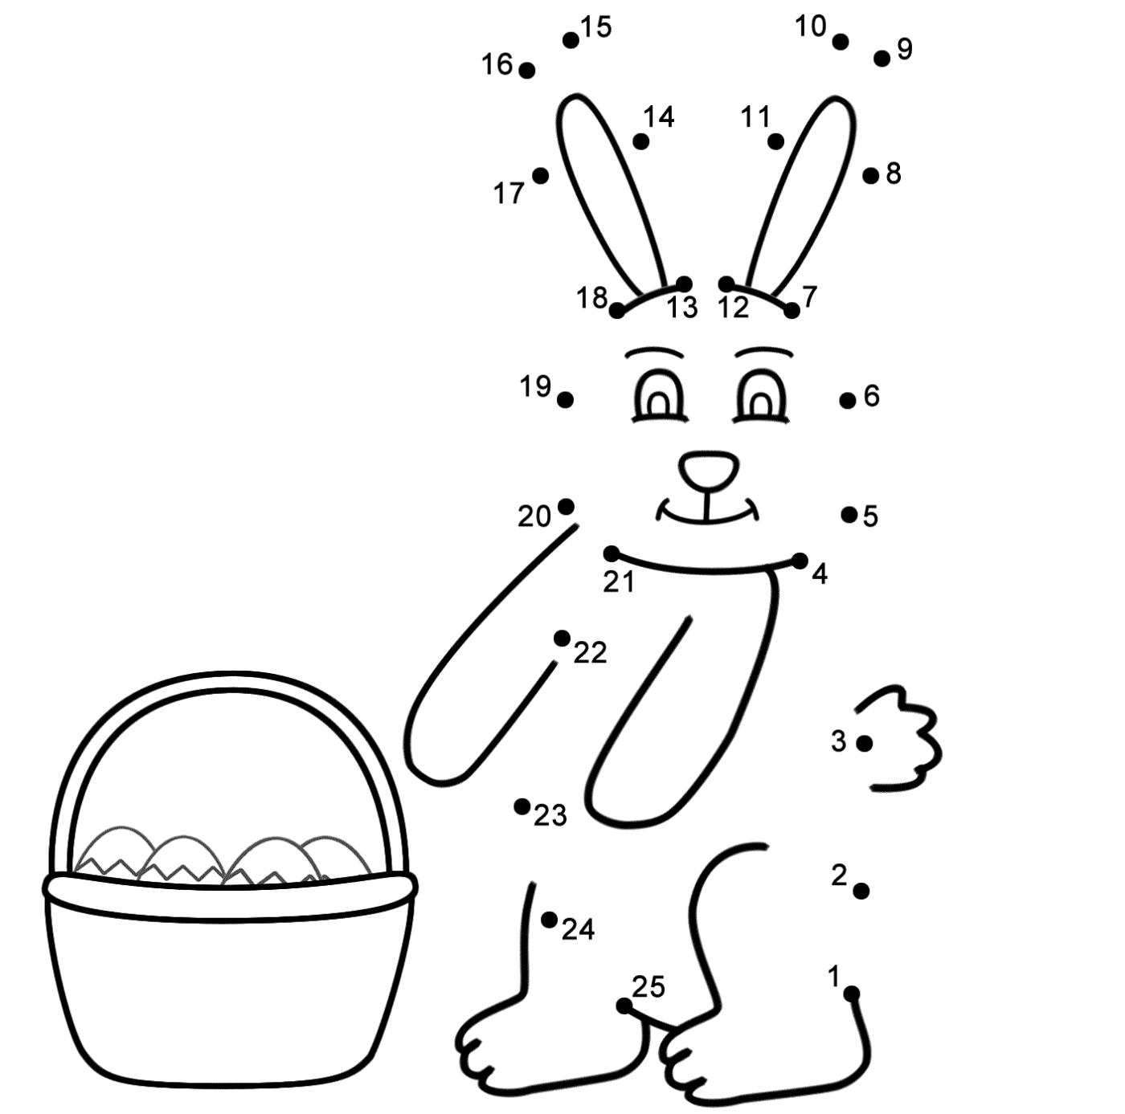
Notes:
Join the dots

