Slide 1
THE EXPLAINING ACTIVITY by TURKEY 1st step by Poland 2nd step by Romania

Slide 2
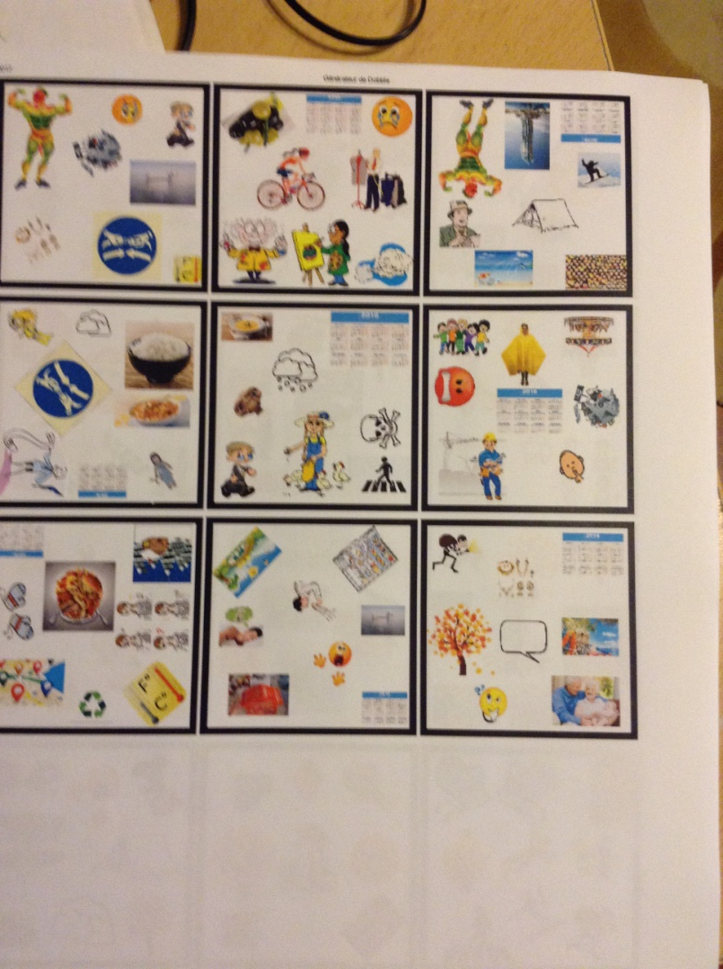
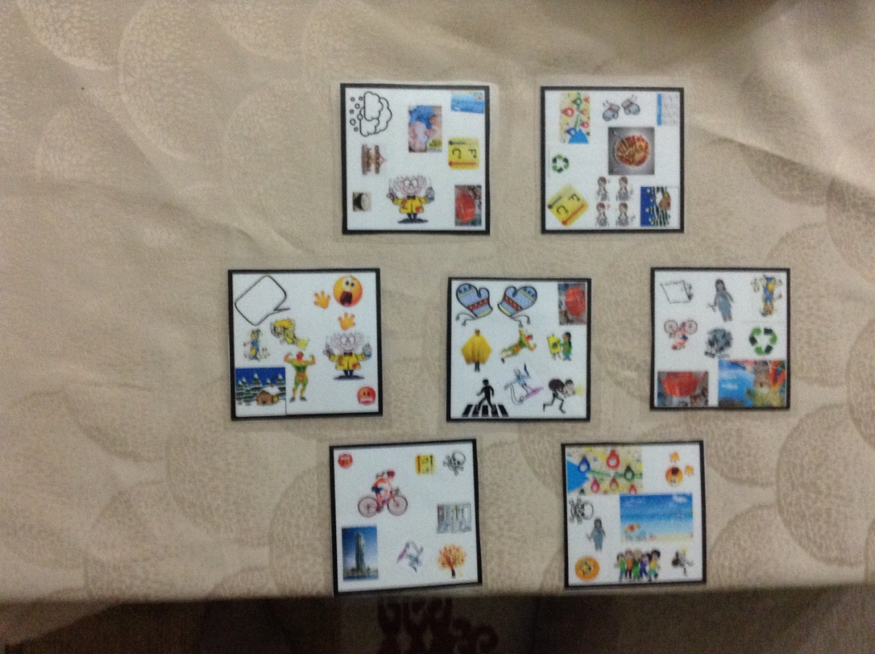
First of all,we created a DOBBLE game which has 56 cards We used the Dobble generator to create it.

Slide 3
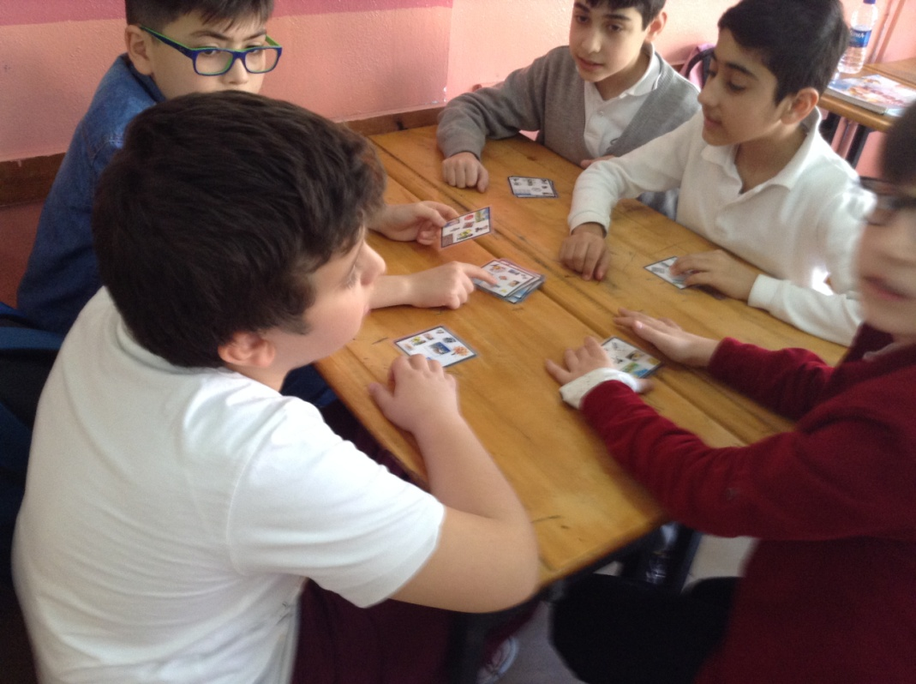
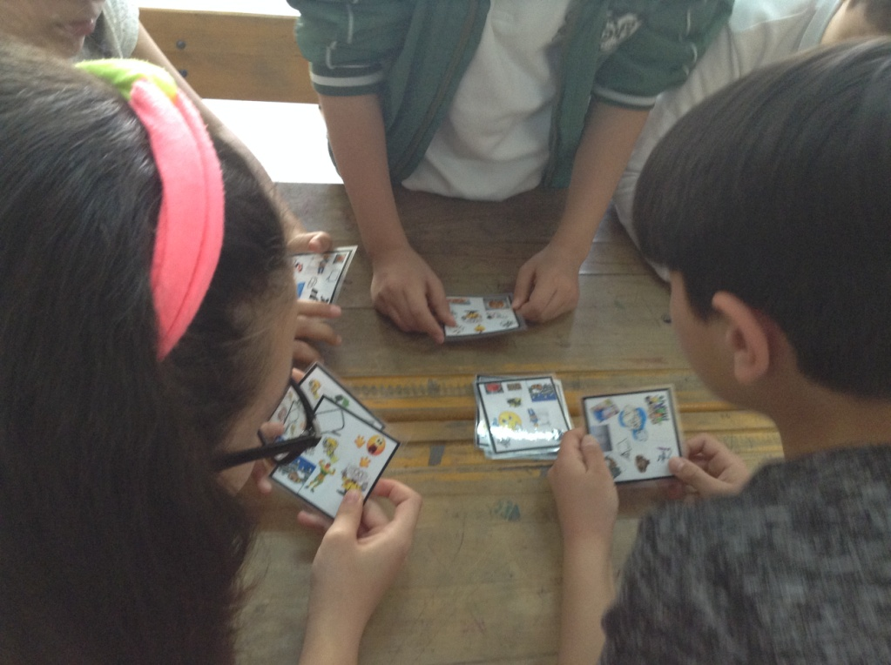
We started our activity by playing this exciting game at the beginning of our class.
PLAY WITH ME!

Slide 4
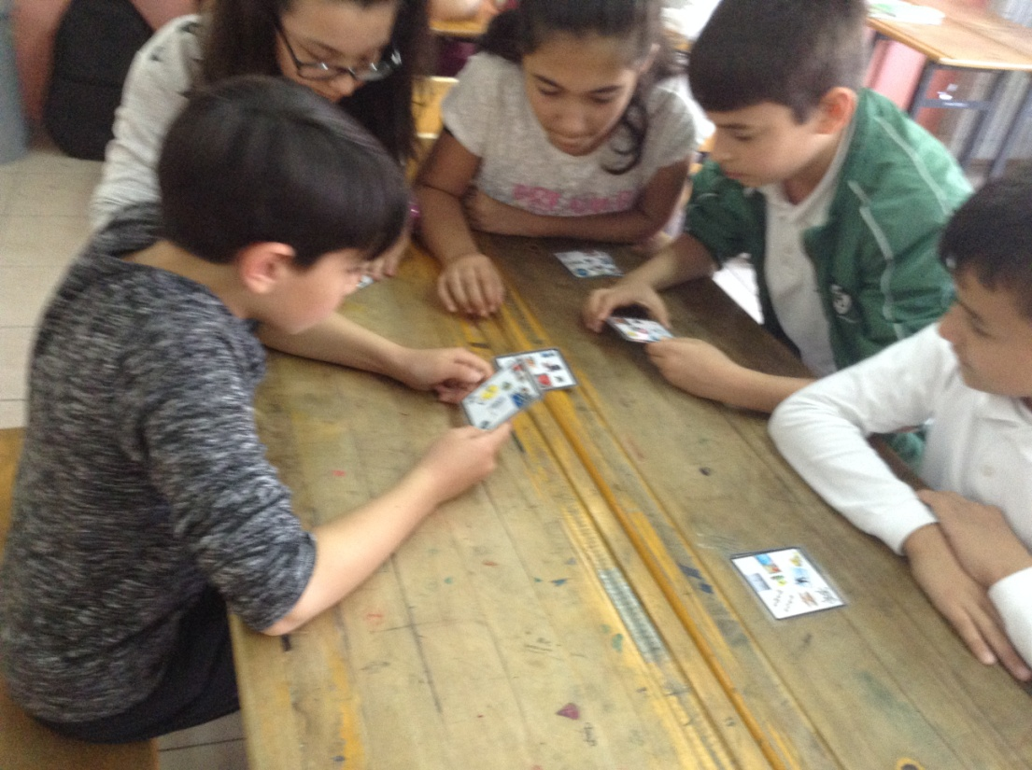
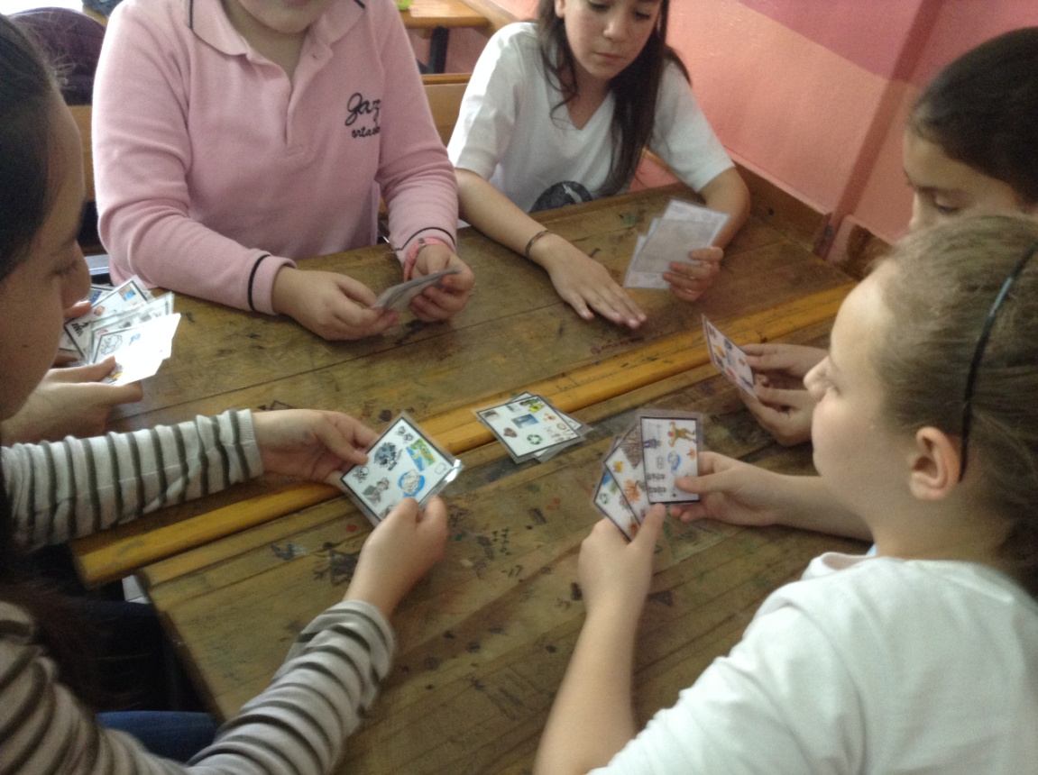
They liked the game and had fun a lot.
Thanks a lot Poland for
sharing this amazing
game wih us.

Slide 5
Second,we switched on our interactive white board and started talking about preferences

Slide 6
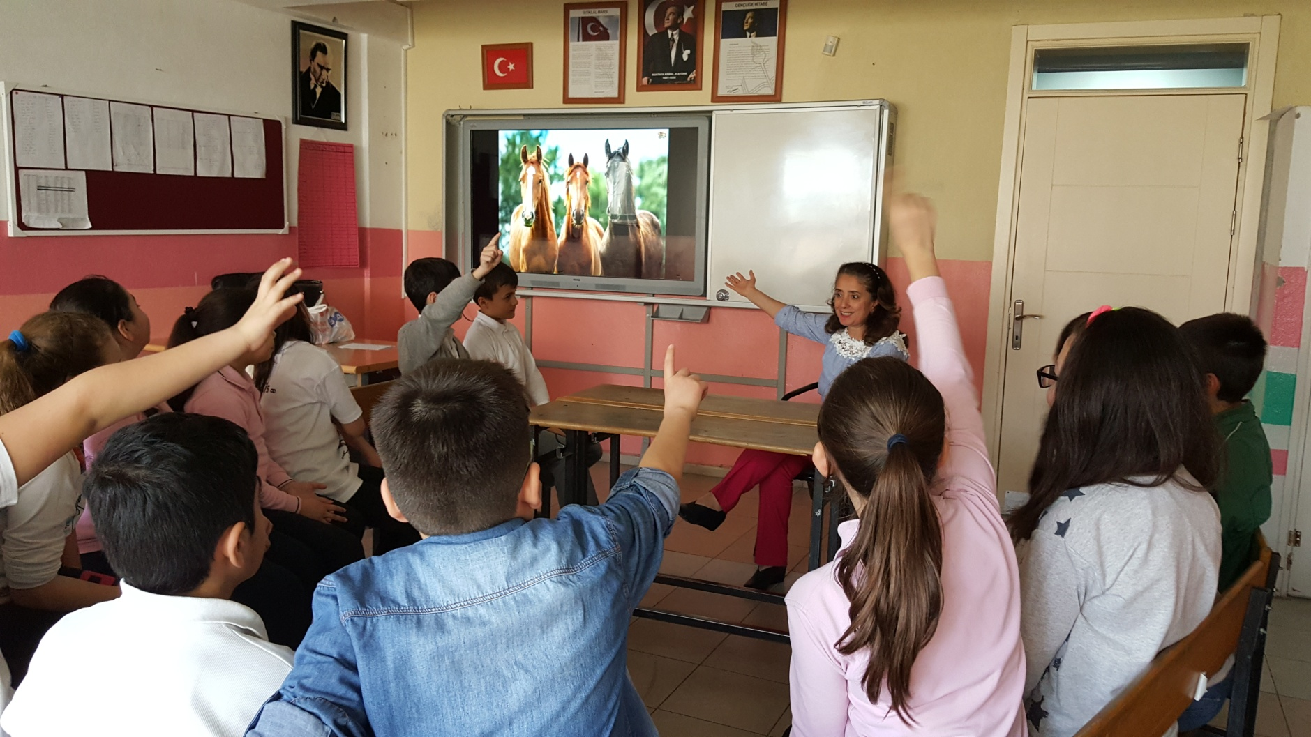
We talked about horses first because the Romanian team did it in the second step. We asked “Do you like horses?Why/Why not?

Slide 7
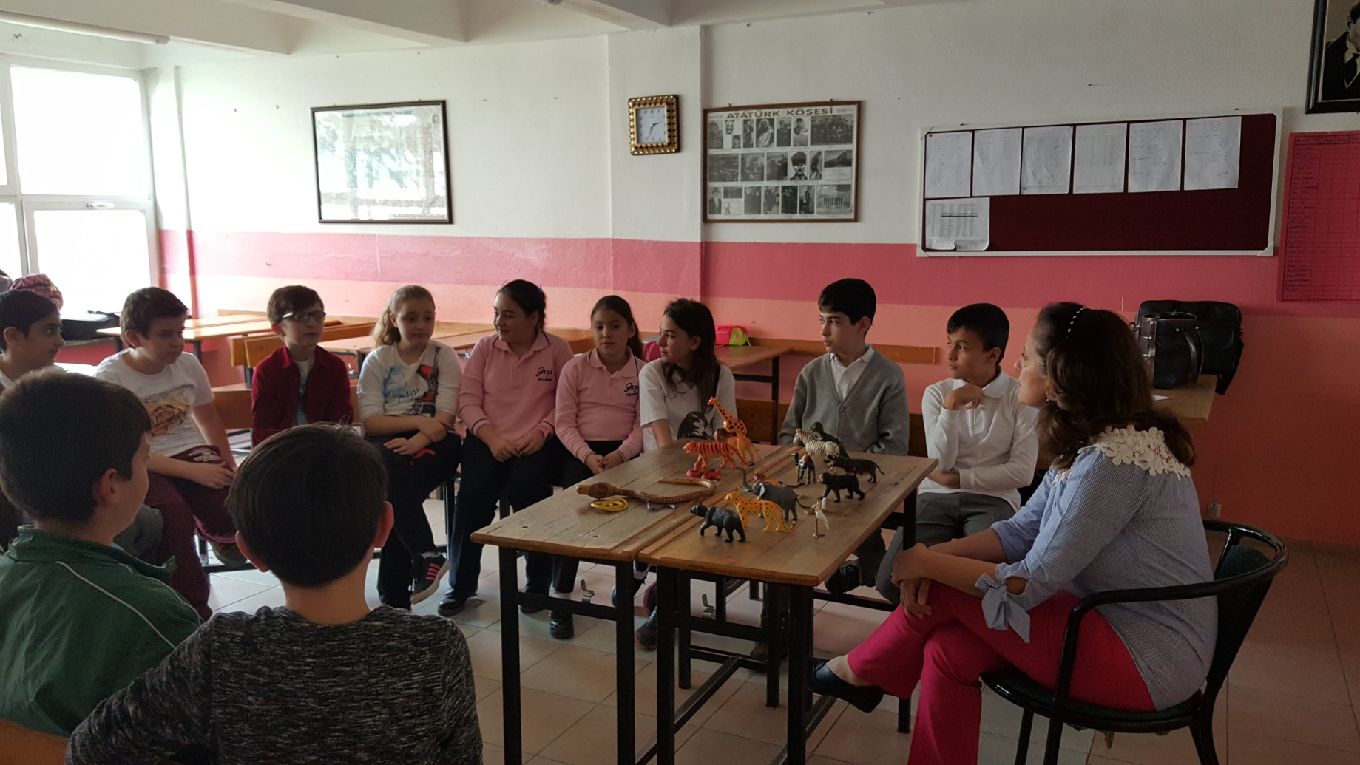
Third,we started to talk about all animals on earth by using toy animals.The questions “What kind of animals do you like/hate? Why?

Slide 8
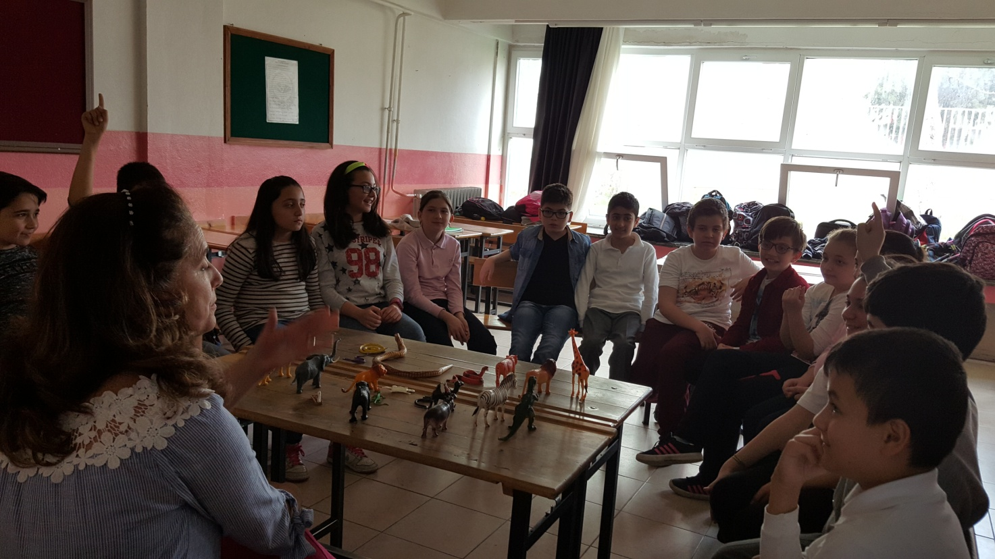
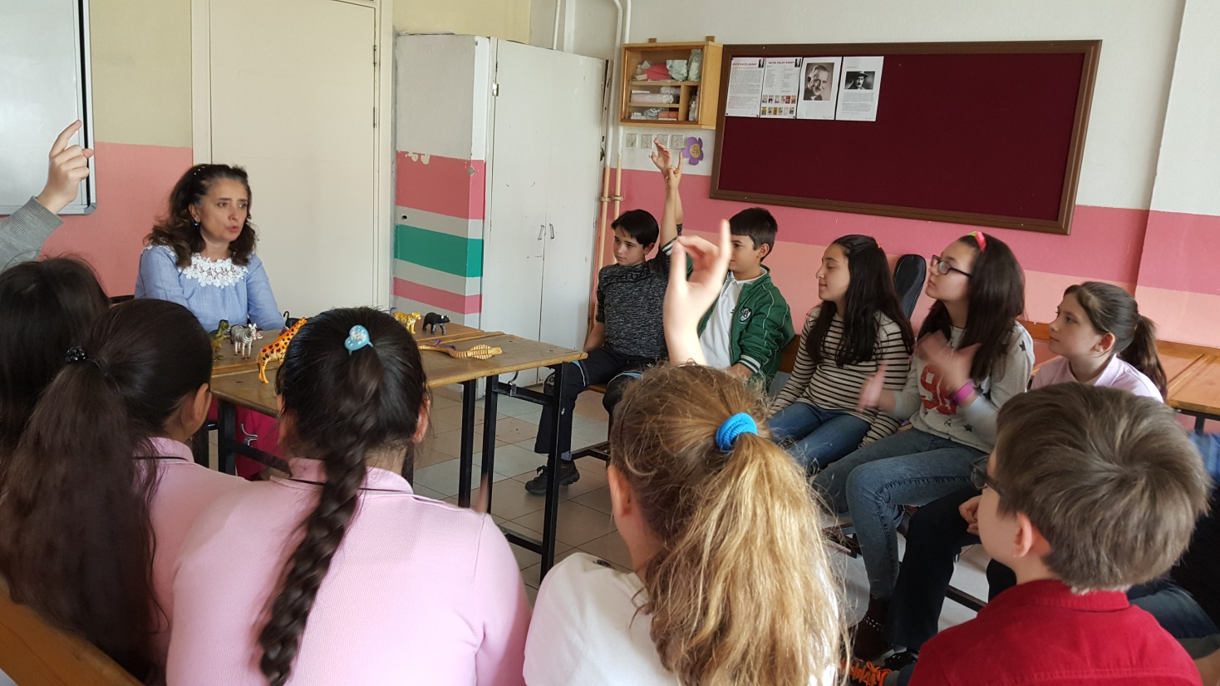
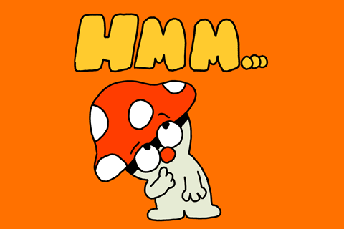

Slide 9
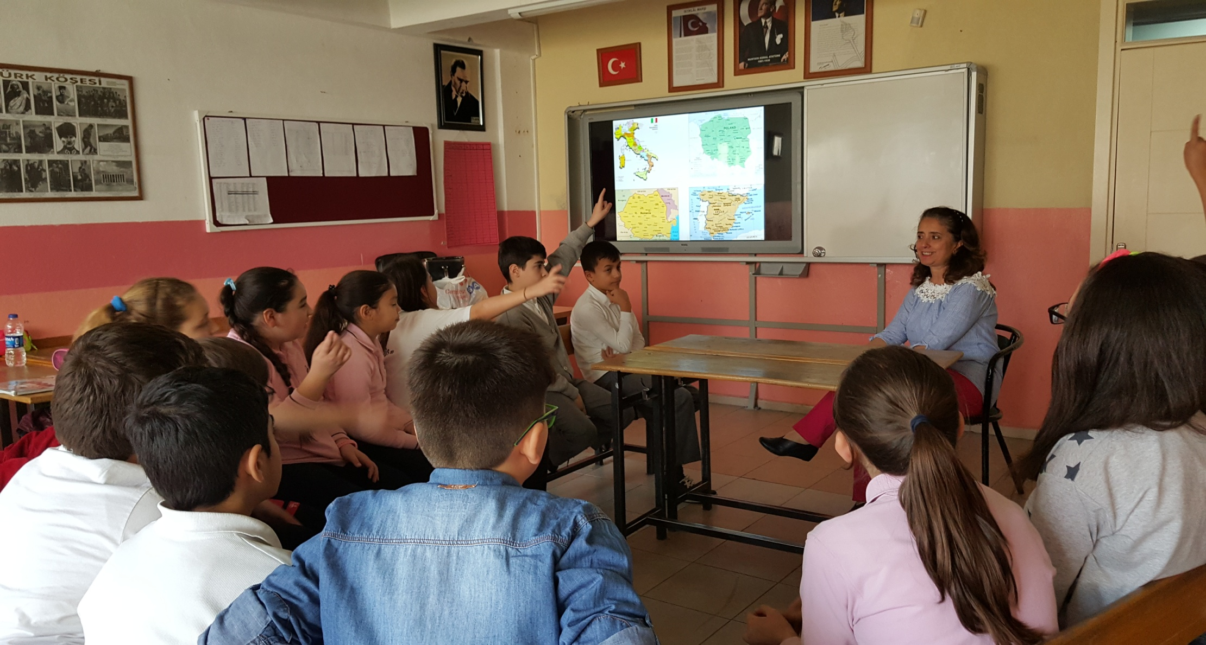
Next,we tried to learn something about partner countries.The question “What do you know about these countries?

Slide 10
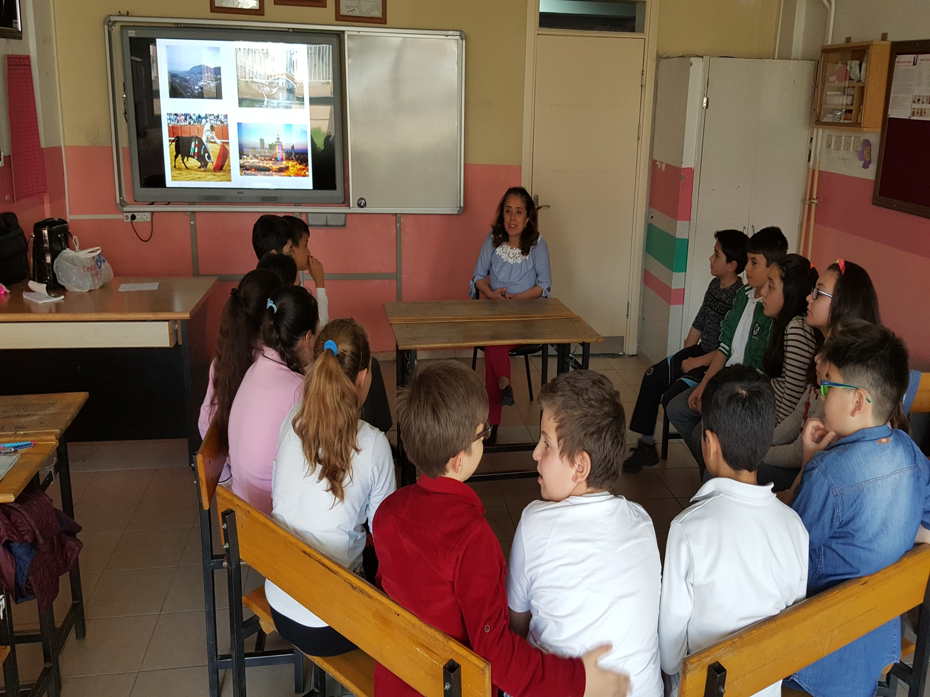

Slide 11
The questions : “Where would you like to go on holiday? Why ? Would you like to visit Warsaw?/climb Mount Tampa?/watch a bullfight? / ride on a gondola?

Slide 12
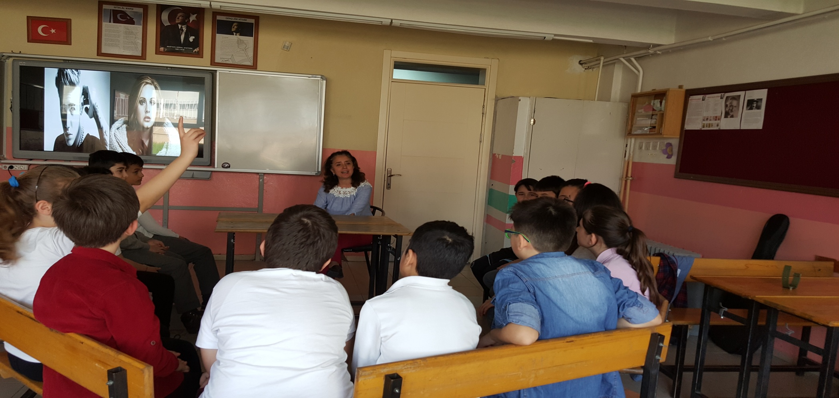
Then,we talked about their favorite singers. The questions “Who is your favorite singer ? Who do you prefer listening to? Why ? “

Slide 13
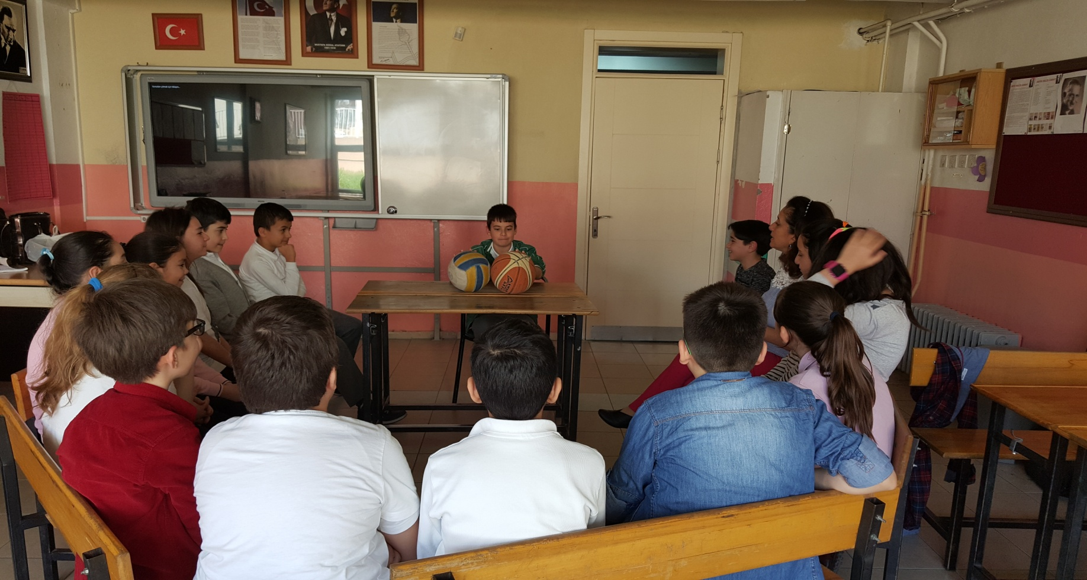
It was the time for the students to become the teacher and ask about the preferences The questions “What kind of sports do you like? Which one do you prefer? Why?

Slide 14
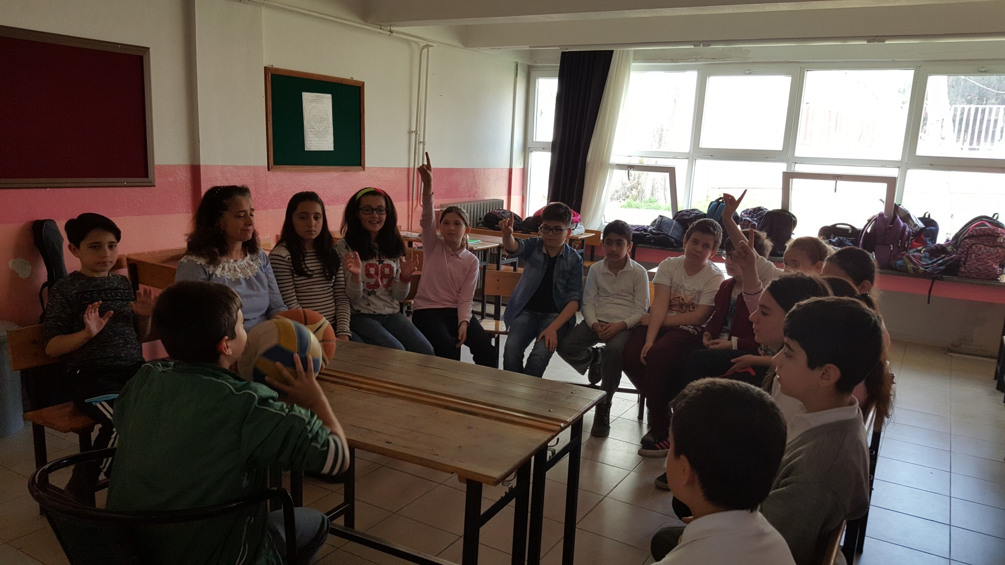
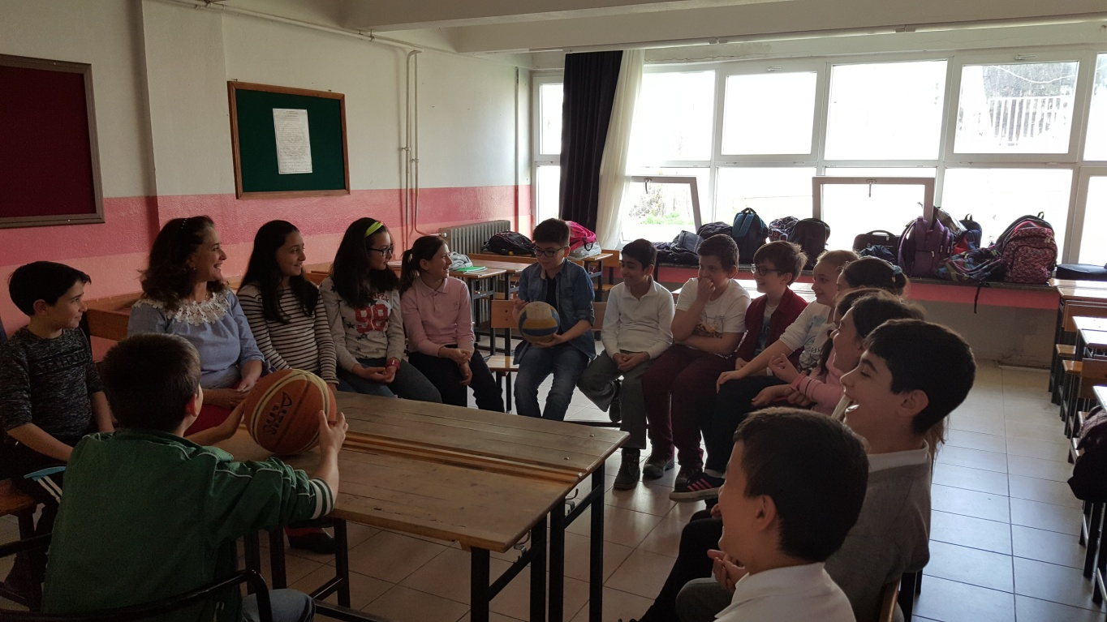
Emircan was the teacher

Slide 15
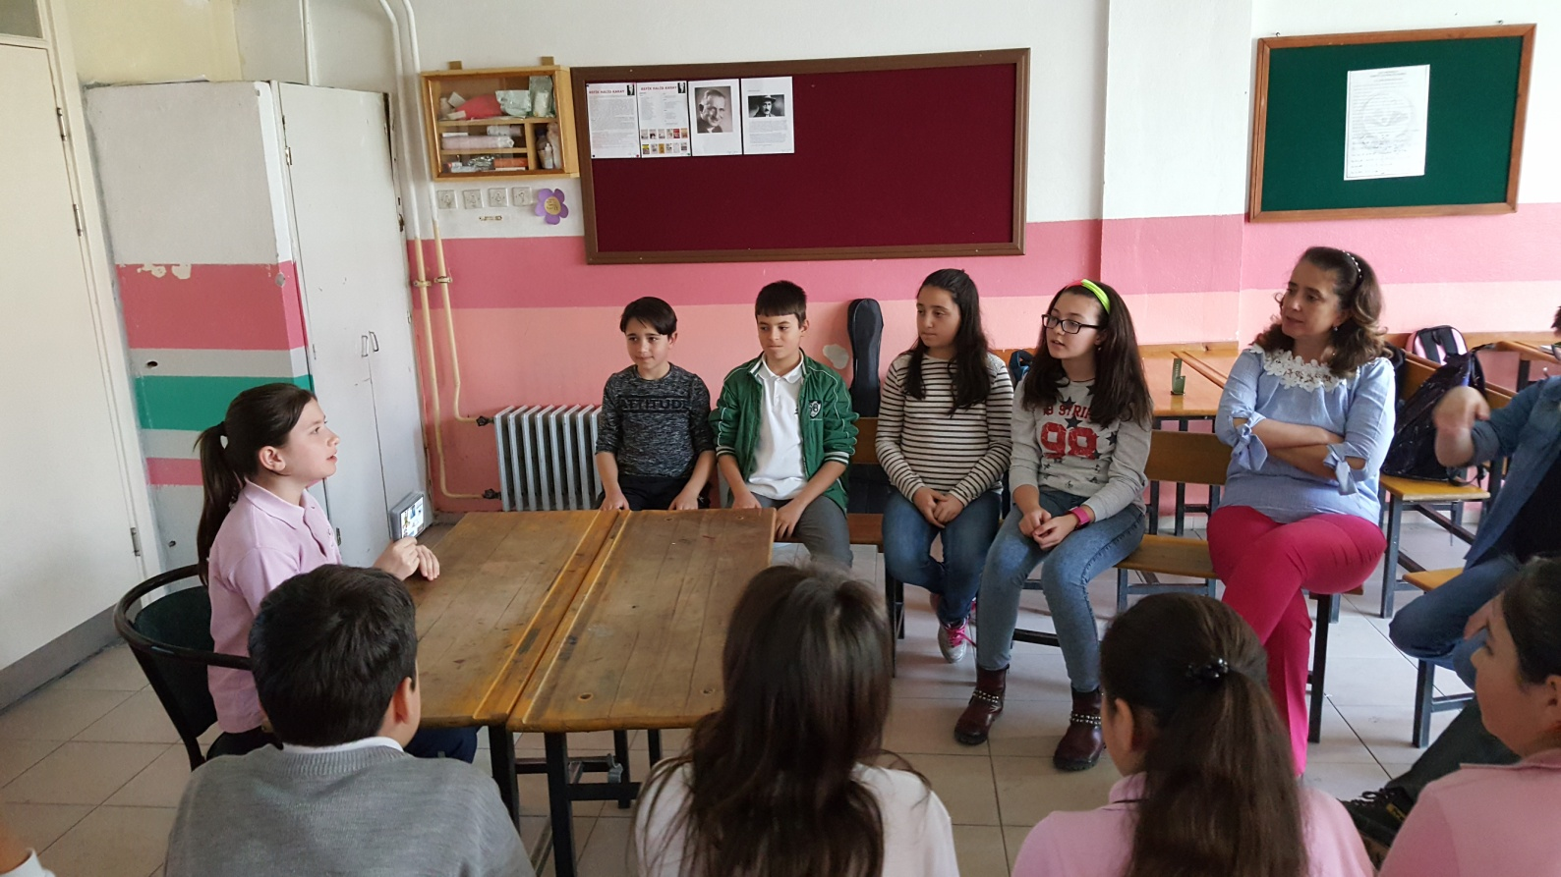
It was Bengisu’s turn and she asked “Do you like card games? Which one is your favorite?Why?

Slide 16
We finished our explaining activity by writing some questions and answers on the board .

Slide 17
We hope you will all like our explanations on the topic.

