Slide 1
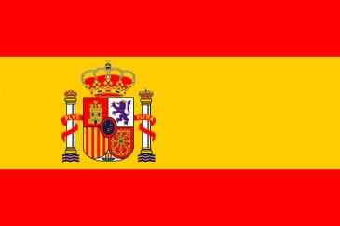
SPAIN

Slide 2
GENERAL DETAILS…
POPULATION:40.280.780
CAPITAL:MADRİD
RELIGIONS:ROMAN CATHOLICH %94 OTHER %6
GOVERNMENT:PARLIAMENTRY MONARCHY
LANGUAGE:SPANISH
MONEY UNIT:EURO-PESOTA

Slide 3
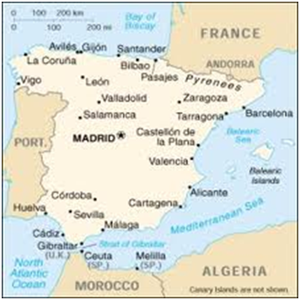
LocatION of SpaIN
Spain is located in the south west of Europe, the largest country on the Iberian Peninsula. France and Andorra are to the north-west, the Mediterranean is to the west and south, the Gibraltar Straits to the south, the Atlantic to the south-west and west with Portugal in between, and the Bay of Biscay is to the north.

Slide 4
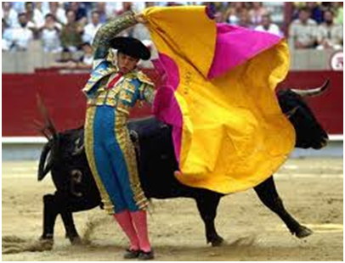
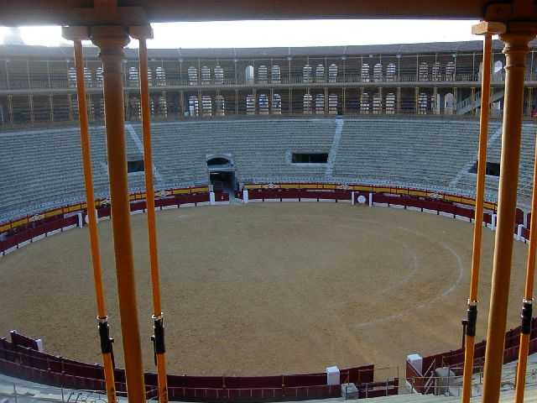
TRADITIONAL
THIS IS A BULL AREA
IT IS SO GREAT!

Slide 5
CAPITAL CITY (MADRID)
Plaza-de espana
MADRID IS THE CAPITAL CITY OF SPAIN.
I THINK SPAIN IS WONDERFUL AND GREAT CITY ☺
ESCORIAL MONASTERY

Slide 6
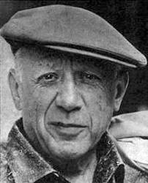
FAMOUS PEOPLE SPAİN
Salvador Dali (artist)
Enrique Iglesias (singer)
Joan Manuel Serrat (singer)
Miguel de Cervantes (literature)
Gerado Diego (literature)
Carlos Checa (motor sports)
Marc Gene (motor sports)
Raul Gonzalez (football)
Xavi Hernandez (football)
Iker Casillas (football)
Sergio Garcia (golf)
<PABLO PICASSO>

Slide 7
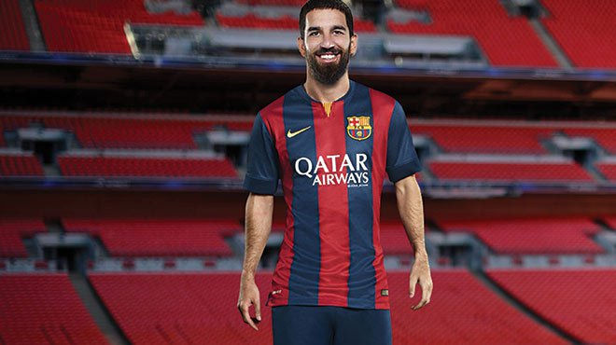
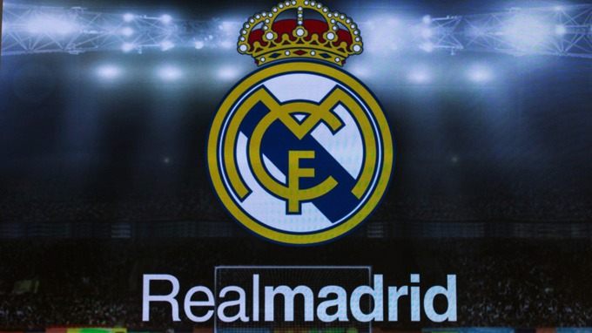
FAMOUS FOOTBALL TEAMS IN SPAIN
BARCELONA
REAL MADRİD
ARDA TURAN IS FAMOUS TURKISH FOOTBALL PLAYER.HE IS FROM BARCELONA.

Slide 8
AND…
THANK YOU GUYS…
KAZIM ALPER KARATAŞ
GAZİ SECONDARY SCHOOL

