Slide 1
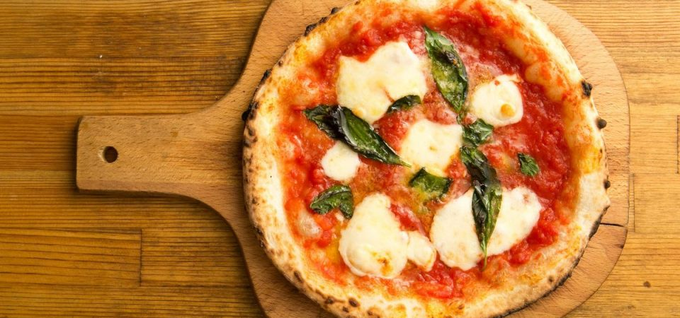
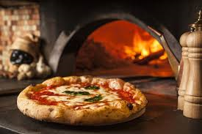
PIZZA

Slide 2
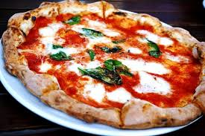
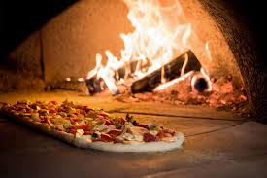
THE HISTORY OF PIZZA
The word pizza was first documented in A.D. 997 in different parts of Central and Southern Italy.
We don’t now with certain what are the true origins of pizza.
It was born as a baked focaccia already at the time of the ancient Greeks and Romans, simply by mixing the basic ingredients which are water, flour and a pinch of salt.
The history of pizza begins to evolve with the discovery of America and the spread of tomatoes in Italy. Since then it has become a fundamental ingredient.

Slide 3
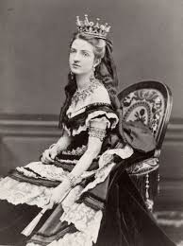
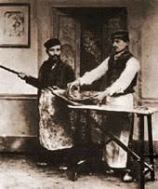
QUEEN MARGHERITA OF SAVOY
We should wait beyond the mid-1800s to find the first pizza "tomato and mozzarella".
Although there are several varieties of pizza, it doesofficial approval in 1889, on the occasion of the visit to Naples of the then sovereigns of Italy King Umberto I and Queen Margherita.
History tells us that Raffaele Esposito, the best pizza maker of the time, made three pizzas for the sovereigns: the Mastunicòla pizza (lard, cheese and basil), the Marinara pizza (tomato, garlic, oil and oregano) and the pizza tomato and mozzarella whose colors deliberately recalled the Italian tricolor (Red, White and Green).
The sovereign appreciated her pizza so much that she wanted to thank and praise the pizza maker in writing. For this reason and to reciprocate Esposito gave the name of the Queen to her culinary creation, which has since been called: «Pizza Margherita»

Slide 4
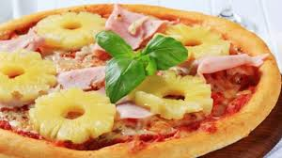
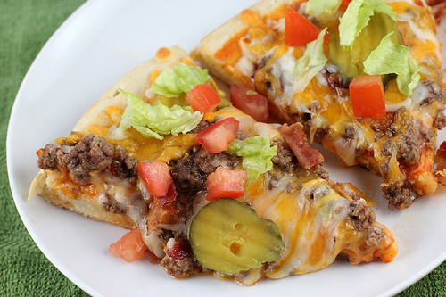
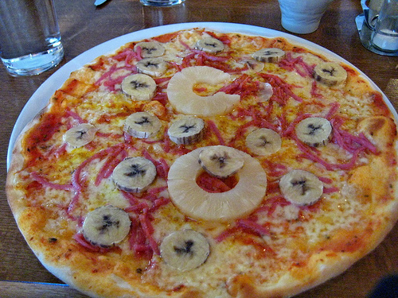
PIZZA, A WIDESPRAD PRODUCT
After the success achieved in Naples, the real Neapolitan pizza "expatriation" to conquer first all of Italy and then the rest of the world. Now that pizza is so common there is a big risk! That of losing the simplicity and authenticity of a product so widespread.
Pizza has become a traditional specialty guaranteed by the European Union since 4 February 2010 around the world, new types of pizzas are created every year, with recipes that move further and further away from the original one.
pizza with pinapple
cheeseburger pizza
pizza with banana
and curry
Despite all the new variations, the traditional recipe of the best known dish in the world will always remain the best!

Slide 5
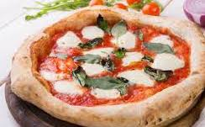
THE REAL PIZZA
Everybody in the world eats and makes pizza but how It is really made.
Now We Italians speak…

Slide 6
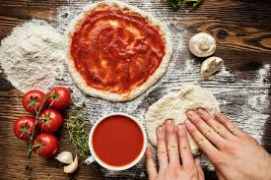
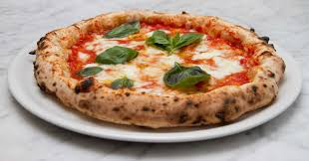
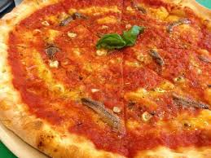
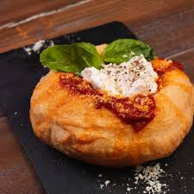
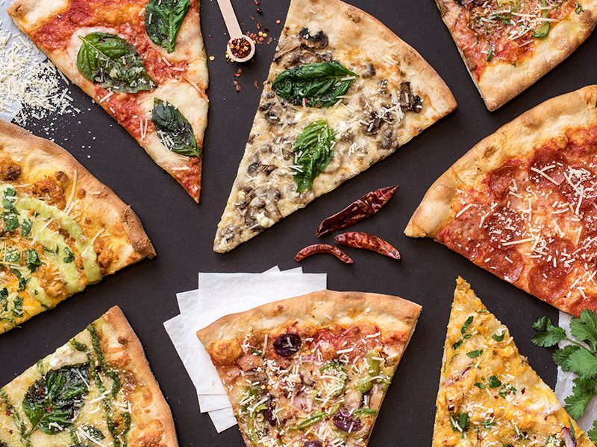
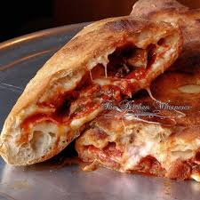
THE ITALIAN PIZZA
2) SECOND: THE INGREDIENTS
The ingredients are few. Water, salt, yeast, olive oil, tomato sauce, flour, basil and mozzarella (a typical Italian cheese).
There are additional elements for the different types of pizza like salami, ham, mushrooms, cheese etc. But ketchup, mayonnaise, steaks, bread, pasta are prohibited. And the evil of the foreign pizza is the pineapple
1) FIRST: THE SHAPE
The real pizza is round and thick,
in particular the board (in Italian it is called “ Cornicione”)
Is taller than the pizza.
The diameter mustn’t exceed 30 cm.
Is important that the pizza is soft and fragrant.
2-
3) THIRD: THE ORIGINAL TYPES OF PIZZA
There aren’t many types of pizza in Italy the most famous are:
1-Margherita: without added items
2-Marinara: with garlic and anchovies
3-Pizza Romana: a types of low and crunchy Roman Pizza
4-Calzone: a rolled up pizza whit ham, mushrooms, and ricotta cheese
5-Pizza fritta: it is similar to the Calzone but It is fried(in Italian fried is Fritta)
1-
3-
5-
4-

Slide 7
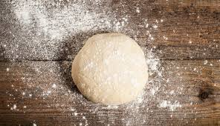
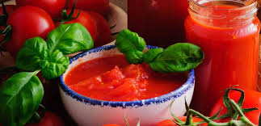
THE PIZZA RECIPE:
There are some steps to make a traditional Neapolitan Pizza:
1) The dough ( in Italian Impasto)
2 ) The condiments ( in italien Condimenti)
3) The cooking and the end
1)
2)
3)

Slide 8
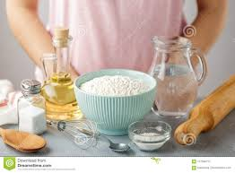
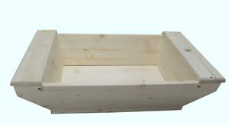
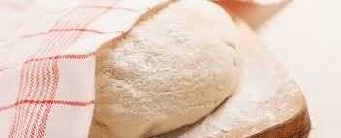
1) THE DOUGH:
Insert inside the madia (a typical Neapolitan wooden container), you can also use a bowl, 1 liter of water, 500g of flour, 40 gr of salt and gr of yeast, and a tear of olive oil.
It is important that the salt and yeast don’t touch each together. Start mixing, put the remaining flour (1kg) slowly.
Knead until a soft and elastic result and You leave the dough for 4 hours covered by a damp cloth called in Italian canovaccio.

Slide 9
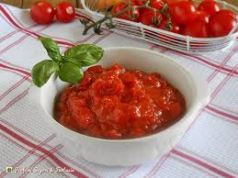
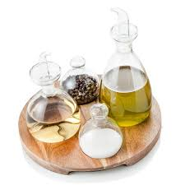
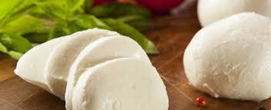
2) THE CONDIMENTS:
To prepare the tomato sauce, pour 1kg of tomato sauce into a bowl and salt, pepper, a little sugar, and 30 grams of olive oil and mix. Then prepare the mozzarella by cutting it and draining it from the milk.
+

Slide 10
3) THE COOKING
Take a stick of dough and spread it in the shape of a circle, add the tomato sauce and the mozzarella without going over the edge. Bake in a wood oven for 2 minutes, or in an oven at 250 ° for 20 min. Finally add olive oil and basil.
This is the real pizza Margherita*.

Slide 11
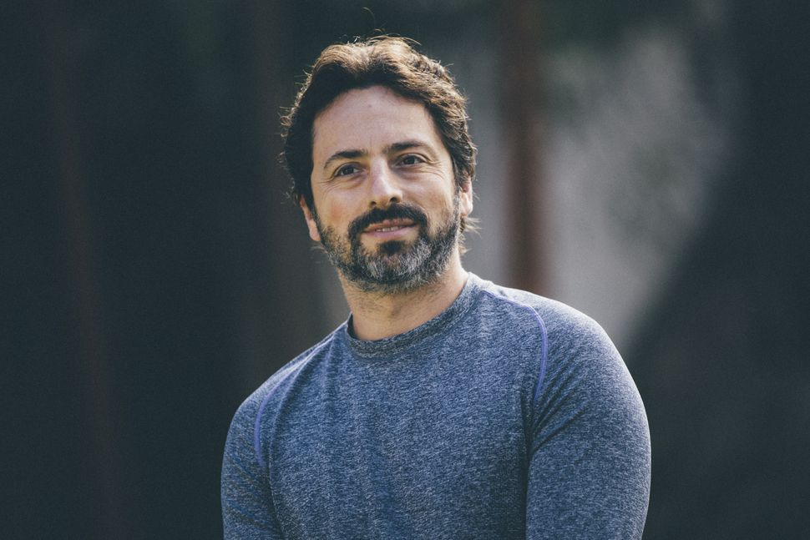
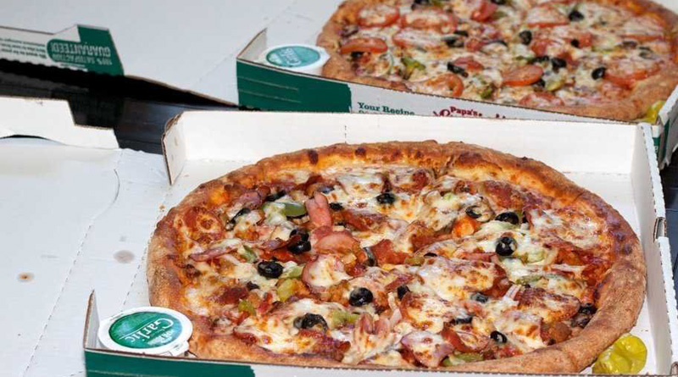
CURIOSITY ABOUT THE PIZZA: IN THE WORLD…
Sergey Brin, the creator of Google, started his carrer with an online service for ordering pizza. The iniziative was a total failure, but if so no had probably been, today we wouldn’t have Google!
The most expensive pizza in the world was ordered in 2009 from the programmer Laszlo Hanyecz. He paid two pizzas door-to-door 10 000 bitcoin, namely 125 millions of euro.

Slide 12
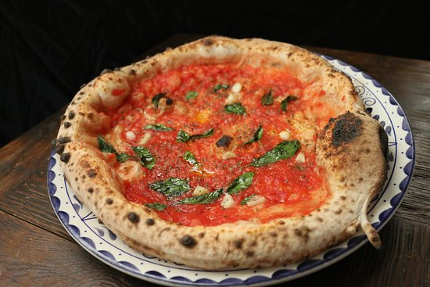
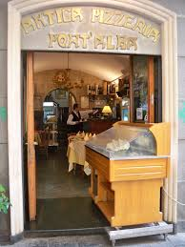
CURIOSITY ABOUT THE PIZZA: IN ITALY…
What is the oldes type of pizza? It’s the «marinara pizza», the most oldest pizza between the red pizzas. In it there are all ingredients used then: tomato, garlic, oregano and olive oil. The name comes from the fact that the sailors ate this dish when they come back from the sea. Infact, in italian, «sea» traslate to «mare» and it in very simal at the name of pizza.
The firt pizzeria was born in Naples in 1738. The name’s of this pizzeria was «Port’Alba».

Slide 13
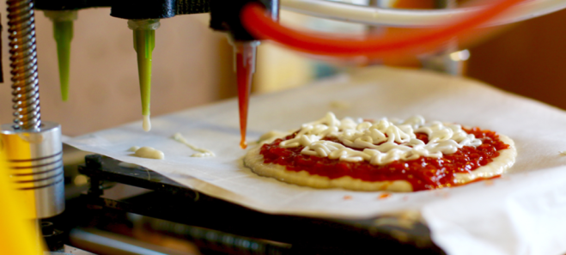
CURIOSITY ABOUT THE PIZZA: IN THE SPACE…
The 3D printer for make pizza. The Anjan Contractor in Austin, Texas, has received 125 000$ from the NASA for create a 3D printer for print a pizza. If will work, will be given to the astronauts committed in some long space missions.

Slide 14
SITOGRAFIA
https://www.chedonna.it
https://wikipedia.org
https://www.ristorazioneitalianamagazine.it
https://www.focus.it
https://www.bitconio.net
https://prodotti-tipici-campania.it
https://it.coinnewstelegraph.com
https://www.tripadvisor.ie
https://www.vesuviolive.it
http://www.bergamopost.it
https://www.firstonline.info
https://www.m.wikipedia.org/pizza
https://wikipedia.org/Margherita-di-Savoia
https://www.pizzanapoletana.org
https://biografiaeonline.it/storia-della-pizza-napoletana/
https://www.pizzanapoletana.org/it/ricetta_pizza_napoletana
https://www.lacucinaitaliana.it/news/cucina/ricetta-facile-pizza-fatta-in-casa/
https://www.lacucinaitaliana.it/news/cucina/ricetta-facile-pizza-fatta-in-casa/
http://www.meteoweb.eu/2019/10/forno-a-legna-cancerogeno-pizza/1326567/
https://www.ebt-trentino.it/formazione/corsi-a-catalogo/la-pizza-napoletana/
https://2night.it/80c148-/dove-mangiare-la-pizza-fritta-migliore-del-veneto-farlo-senza-freni.html

