Slide 1
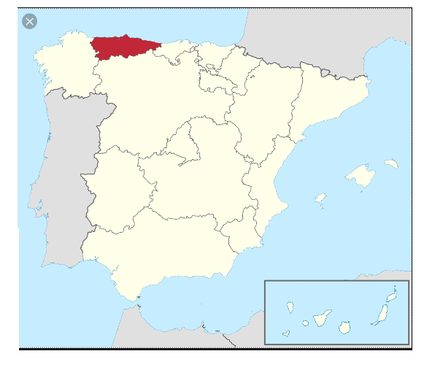
LANDMARKS IN ASTURIAS

Slide 2
CITIES:
OVIEDO

Slide 3
GIJÓN

Slide 4
AVILÉS

Slide 5
MONUMENTS:
SANTA MARÍA DEL NARANCO(CHURCH)

Slide 6
COVADONGA

Slide 7
GEOGRAPHY:
PLAYA DEL SILENCIO

