Slide 1
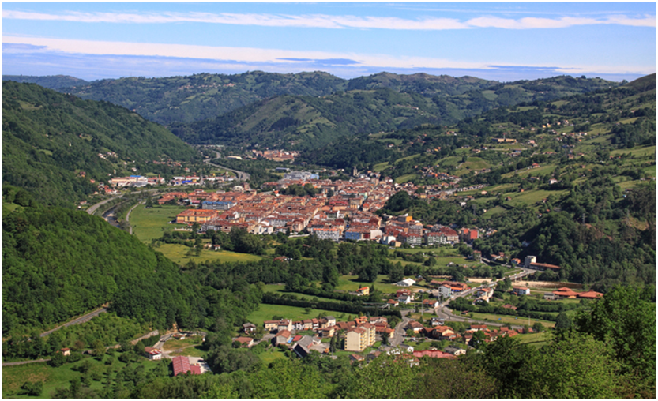
laviana
Our town,
By Aitor and Erika, Asturias (Spain)

Slide 2
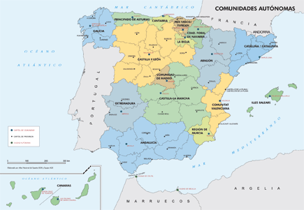
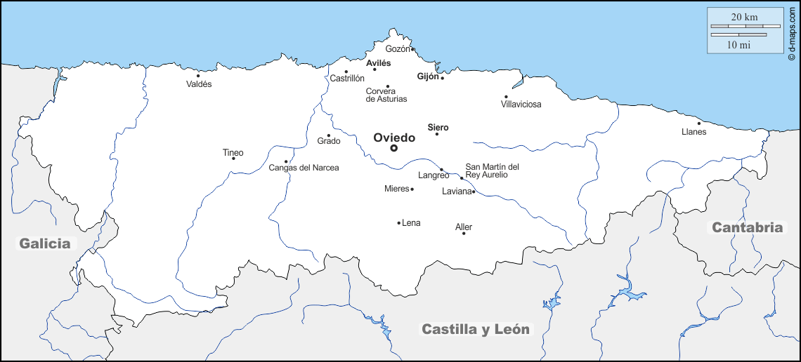
Where is Laviana situated?
Laviana is a small town situated in the north of Spain, in the Autonomic Community of Asturias. It limits in the north with the Cantabric Sea, and in the rest of the directions with other Spain´s Autonomic Communities.

Slide 3
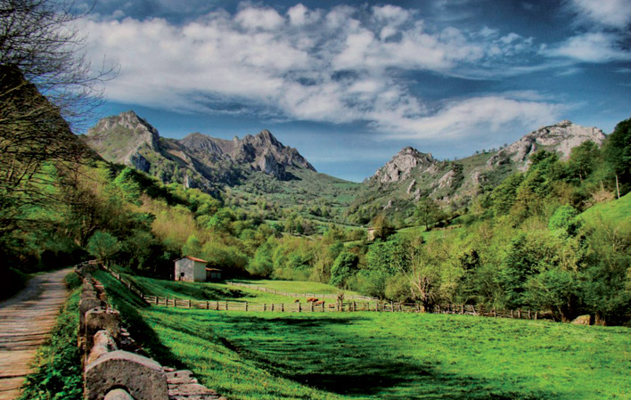
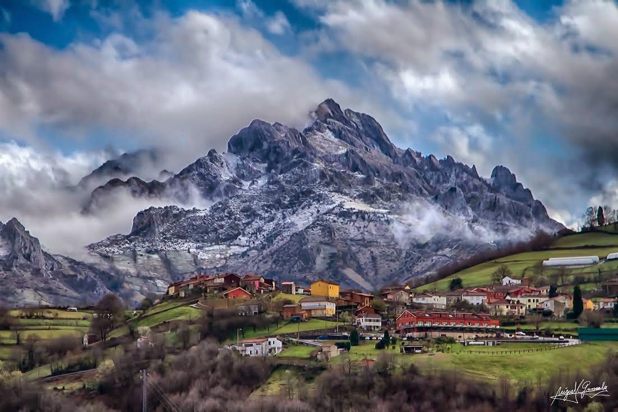
How is Laviana?
Peña Mea, one of our most characteristic mountains
Our town is surrounded by several mountains; In the middle of
a valley that belongs to a zone“Cuenca Minera del Nalón”.

Slide 4
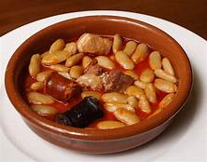
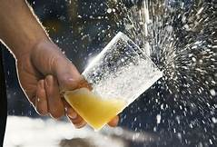
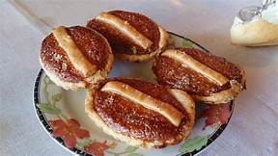
Food!
Bartolos
(A tasty dessert typical of Laviana)
Sidra
(Cider, the most popular drink in all Asturias)
Fabada or fabá
(Asturian beens)
We have a big variety of food. (Asturias is so popular in Spain
partly thanks to that) This are some of our delicious dishes.

Slide 5
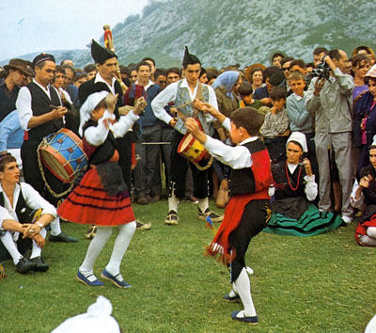
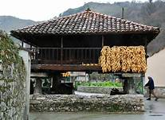
Our culture
This is an “Horru”
We have a very own culture, which comes from
the ancient Celts. Our language, the asturian, envolved
from the latin and they are quite similar. We also have “Horros”, structures that today are not used but in the past were used to save the crops.

Slide 6
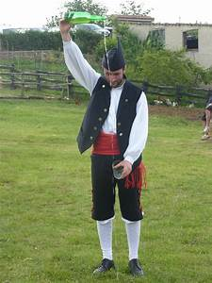
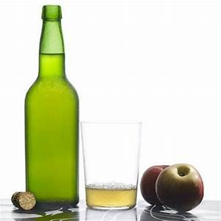
An “escanciaor”
A cider bottle.
Another big part of our culture are the “escanciaores”.
These are people who “escancien” (reaches out) the cider
from the bottle to the glass. Both the bottle and the action
are considered as an art, and they are unique in the world.

Slide 7
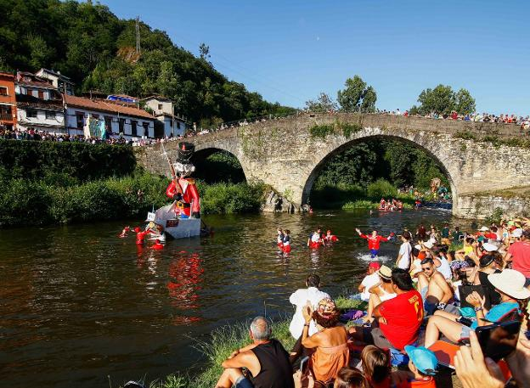
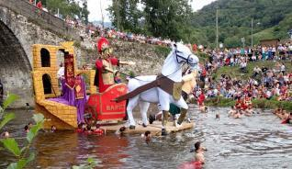
Festive days: Descenso Folklórico del Nalón!
In Asturias and particularly in Laviana, we have a lot of festive days but, our most important event, is the Descenso Folklórico del Nalón, celebrated every 14th of August. In it, people came from all places builds an embarcation and descend by our river, El Nalón. There are so many prizes in different categories.
In this video you can see a summary of last year's edition!
https://www.youtube.com/watch?v=f0kdTfLxdgg

