Slide 1
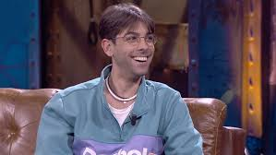
Spanish famous
Name: Patricio Martín Díaz (Don Patricio)
Age: 26
He was born in La Caleta, El Hierro, Spain in 1993
He is a beautiful singer about reggaeton/rap.

Slide 2
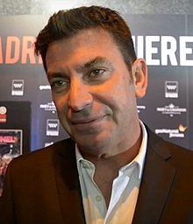
Spanish famous
Name: Arturo Valls Mollá
Age: 44
He was born in Valencia,Spain in 1975
He is an actor, TV presentator and works on Antena 3.

Slide 3
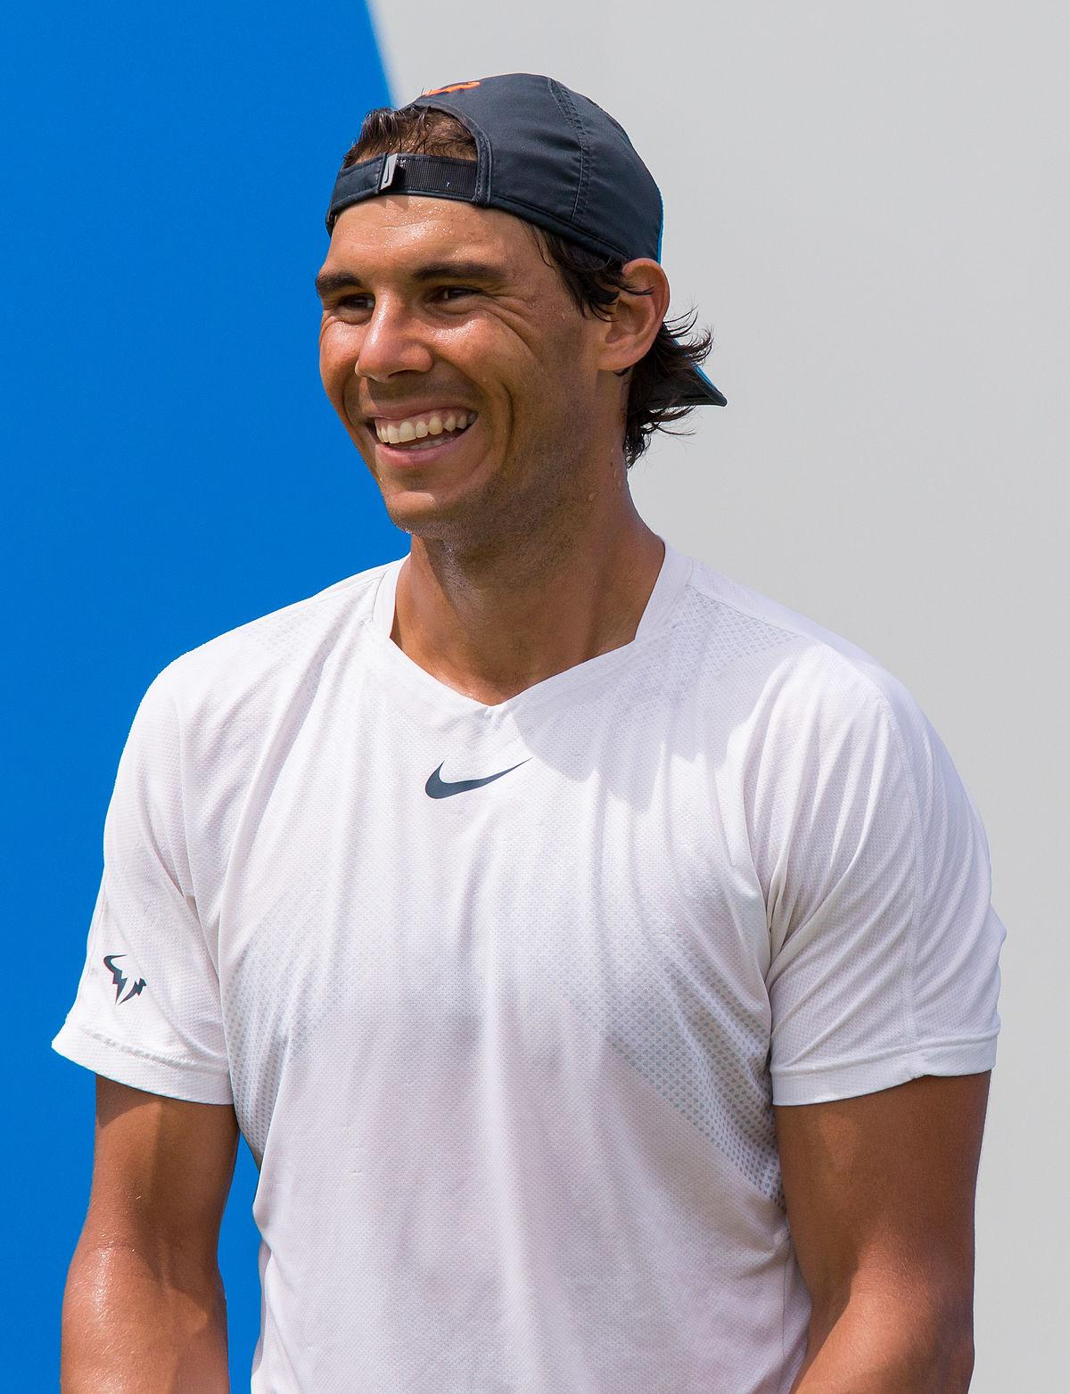
Spanish famous
Name: Rafa Nadal Parera
Age:33
He was born in Manacor,Islas Baleares,Spain in 1986.
He is Spanish professional tennis player.

Slide 4
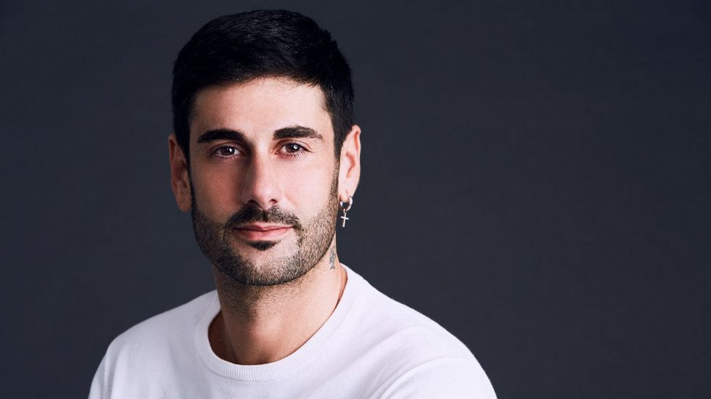
Spanish famous
Name:Ramón Melendi Espina
Age:40
He was born in Oviedo,Asturias,Spain in 1979
He is a Spanish singer and songwriter.

Slide 5
Spanish famous
Name:Penélope Cruz Sánchez
Age:45
She was born in Alcobendas,Madrid,Spain in 1974
She is an Oscar-winning Spanish actress and model.

