Slide 1
PINEROLO

Slide 2
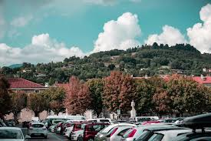
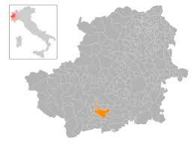
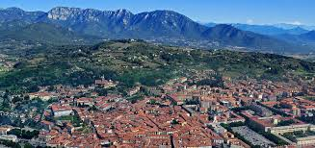
The territory of Pinerolo
Pinerolo is a small town located in the south of Piedmont, which is thirty-seven kilometers from the regional capital: Turin.
Pinerolo is divided into three distinct territories: plain, hills and mountains. The plain area is the largest of the three and it occupies 77% of the total territory, the hills 20% and the mountains 3%.
The hills and mountains have many wooded parts in the poorly sloping areas, and in these cases there are no trees but meadows.
Most of the inhabited area of Pinerolo is located on the plain but also in the hills there are are many independent houses.
Inside the city passes the Lemina (a small river) which is the most important river in the place. Numerous tributaries are linked to it (this happens outside the city) which will join the river Po.

Slide 3
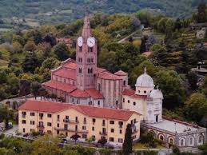
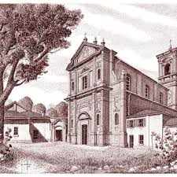
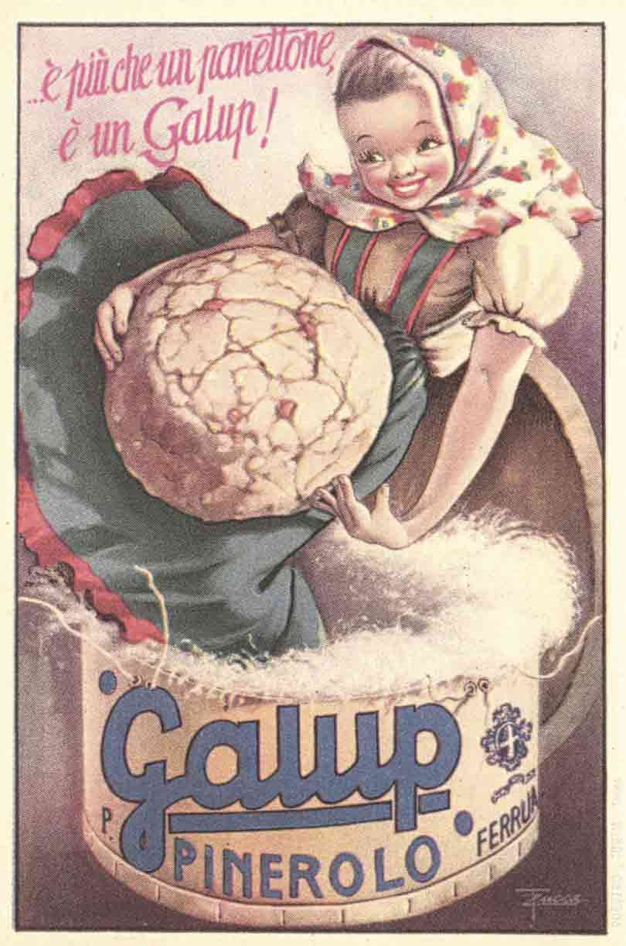
The history of Pinerolo
The first trace of the name "Pinarolium" appears in the 8th century AD but actually the town already existed since prehistoric times. During the 8th century BC Pinarolium was not a city, but a court that included 4 villages, in one of which, today, we find the beautiful Basilica of San Maurizio.
In 1064 it was claimed by the Benedictine monks of the Abbey of San Verano, subsequently it underwent French domination and was then annexed to France itself in 1801 together with the entire Piedmont.
In the 20th century many important factories were born in Pinerolo, now freed from France, especially in the confectionery industry with the Galup company.

Slide 4
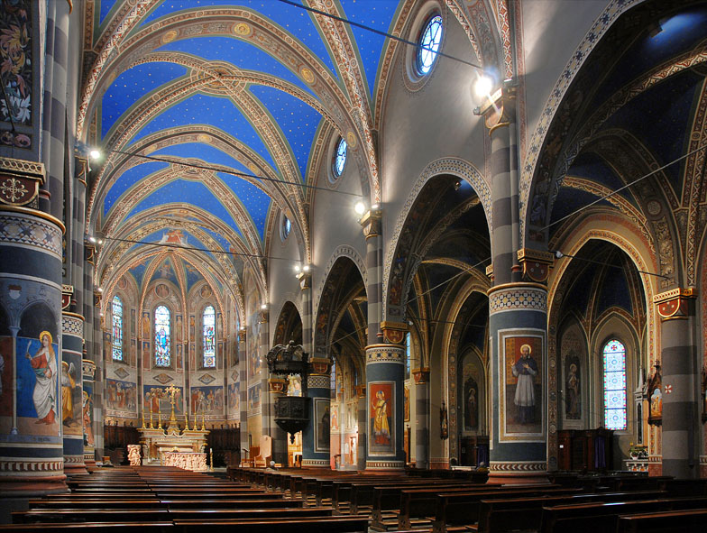
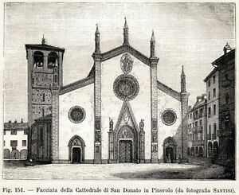
The Cathedral of St. Donato
Walking in the historical centre of Pinerolo we can see the most important church of the city, the Cathedral of St. Donato.
It’s in the centre of place St. Donato, in the heart of Pinerolo.
The church, built between the X and XV centuries, was renovated in 1808 following an earthquake.
The bell tower is behind the church, on the left side.
The facade of the building has three naves.
The building follows the baroque style and inside
there are many frescoes.

Slide 5
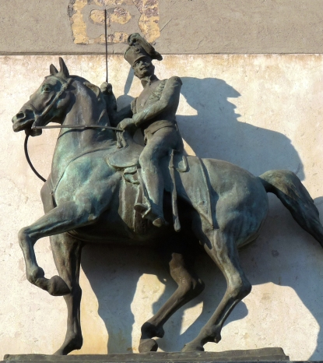
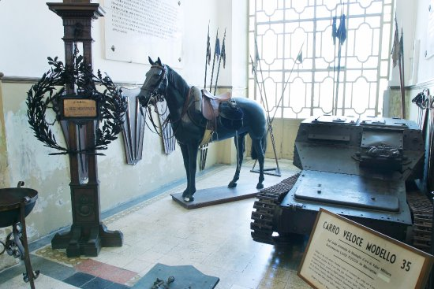
Cavarly museum
Pinerolo is very famous because in 1849 it became the school of Italian cavalry. Knights from armies from all over the world came to the city. In 1849, 144 officers also came to Pinerolo to learn the “new method”.
In Pinerolo there is a museum where the whole history of Italian cavalry is told and in particular how it was in Pinerolo.
The main topics that are treated are the figure of the horse and how it was seen as a perfect animal for men and the values of the soldier during training and especially in battle.

Slide 6
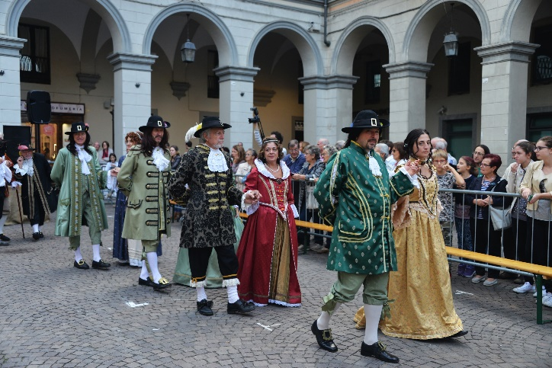
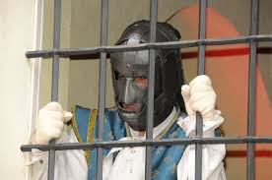
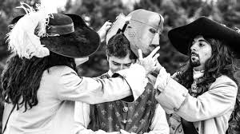
The Iron Mask
Since 1999 in Pinerolo it’s tradition that every two years a historical re-enactment called "The Iron Mask" is celebrated in which citizens dress up in eighteenth-century clothes of ladies, but also of craftsmen and farmers.
This historical re-enactment comes from the famous novel that Dumas wrote in 1848 based on research done by Voltaire a century earlier, exactly when, in the Bastille, a character was held whose identity was never known because he wore a black mask on his face held by iron straps.
This mysterious character had already been in the prisons of Pinerolo and is therefore the protagonist of the historical re-enactment.
Each edition, under the mask, hides a famous person and only at the end of the event it’s possible to discover his identity.
Protagonists of the previous editions were: Francesco Moser, champion in cycling; Ettore Bassi, famous actor and many others...

Slide 7
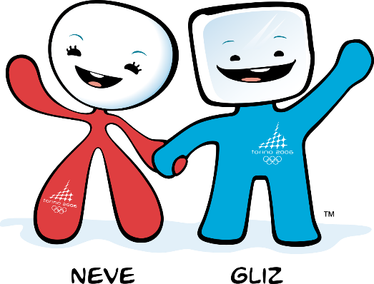
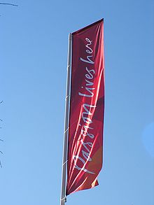
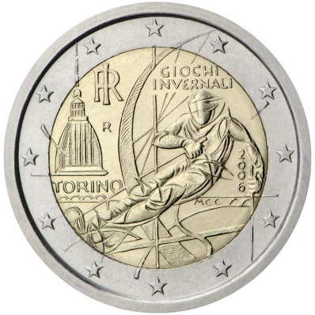
XX winter olympics
The 2006 Winter Olympics, commonly knows as Turin 2006, was held in Turin from February 10 to 26.
Pinerolo was one of the city that helped Turin for the competition, in particular in our city the curling competitions were played.
The two mascots of the Games were Neve (that in italian means ‘snow’), a snowball, and Gliz, an ice-cube.
A commemorative two euro coin was coined for the event.
The motto of this Olympics Games was “Passion lives here”.

Slide 8
Sources:
https://www.google.it/url?sa=i&url=https%3A%2F%2Fwww.pineroloindialogo.it%2Fpineroloindialogo2017%2Fpineroloindialogo6_2017%2Fvivere_pinerolo.htm&psig=AOvVaw2ihAeWlL3wClkTom2XtxNC&ust=1578585761949000&source=images&cd=vfe&ved=2ahUKEwjFi_2tsPTmAhXHBFAKHaV_BVoQr4kDegUIARDTAQ
https://www.google.it/url?sa=i&url=https%3A%2F%2Friforma.it%2Fit%2Farticolo%2F2017%2F06%2F09%2Fvisita-pinerolo-un-nuovo-sito-le-meraviglie-delle-nostre-terre&psig=AOvVaw2HcFZCSGdxzUOOEBMXGkVt&ust=1578585952307000&source=images&cd=vfe&ved=2ahUKEwiA1N-IsfTmAhWMAVAKHbvaC38Qr4kDegUIARDpAQ
https://it.wikipedia.org/wiki/File:Map_-_IT_-_Torino_-_Municipality_code_1191.svg
https://www.google.com/url?sa=i&url=https%3A%2F%2Fwww.hotelbarrage.it%2Fblog%2Fbasilica-san-maurizio-pinerolo&psig=AOvVaw3ZGbY_KyW_FVEue-mEWzxr&ust=1578586212650000&source=images&cd=vfe&ved=2ahUKEwiy2fGEsvTmAhURpbQKHWqBCPoQr4kDegUIARCGAg
https://www.google.com/url?sa=i&url=http%3A%2F%2Fwww.cittaecattedrali.it%2Fit%2Fbces%2F520-prevostura-di-san-verano-in-abbadia-alpina&psig=AOvVaw222YuxPek3pknU4VP5irjK&ust=1578586275197000&source=images&cd=vfe&ved=2ahUKEwj7qtuisvTmAhUaNVAKHcMFATAQr4kDegUIARDRAQ
https://www.google.com/url?sa=i&url=http%3A%2F%2Fwww.galup.it%2Fgalup%2Fazienda%2F&psig=AOvVaw0xC8vIQ_L8u9mVePNX0HTa&ust=1578586312323000&source=images&cd=vfe&ved=2ahUKEwjbpbW0svTmAhVHprQKHTDZB9EQr4kDegUIARDRAQ
https://www.google.com/url?sa=i&url=https%3A%2F%2Fit.m.wikipedia.org%2Fwiki%2FFile%3APinerolo%2C_Duomo_di_Pinerolo_01.jpg&psig=AOvVaw0S9LqVh5R8znM6rzzrV0sw&ust=1578586351050000&source=images&cd=vfe&ved=2ahUKEwjohfHGsvTmAhWCh7QKHSneAHgQr4kDegUIARDOAQ
https://www.google.com/url?sa=i&url=http%3A%2F%2Fwww.comune.pinerolo.to.it%2Fweb%2Findex.php%2Fturismo%2Fvisitare-pinerolo%2Fedifici-e-monumenti%2F298-edifici&psig=AOvVaw0S9LqVh5R8znM6rzzrV0sw&ust=1578586351050000&source=images&cd=vfe&ved=2ahUKEwjohfHGsvTmAhWCh7QKHSneAHgQr4kDegUIARDgAQ
https://www.google.com/url?sa=i&url=https%3A%2F%2Fwww.ebay.it%2Fitm%2FPinerolo-Cattedrale-di-San-Donato-Stampa-Antica-Passepartout-1891-%2F400314841045&psig=AOvVaw0S9LqVh5R8znM6rzzrV0sw&ust=1578586351050000&source=images&cd=vfe&ved=2ahUKEwjohfHGsvTmAhWCh7QKHSneAHgQr4kDegQIARBX
https://www.google.com/url?sa=i&url=https%3A%2F%2Fwww.tripadvisor.it%2FLocationPhotoDirectLink-g616182-d4754258-i285485467-Museo_Storico_dell_Arma_di_Cavalleria-Pinerolo_Province_of_Turin_Piedmon.html&psig=AOvVaw0Mo5b1vhHrEe84NagU-5XA&ust=1578586459091000&source=images&cd=vfe&ved=2ahUKEwi-qbP6svTmAhXtD1AKHTAHD08Qr4kDegUIARDVAQ
https://www.google.com/url?sa=i&url=https%3A%2F%2Fwww.tripadvisor.it%2FLocationPhotoDirectLink-g616182-d4754258-i285485467-Museo_Storico_dell_Arma_di_Cavalleria-Pinerolo_Province_of_Turin_Piedmon.html&psig=AOvVaw0Mo5b1vhHrEe84NagU-5XA&ust=1578586459091000&source=images&cd=vfe&ved=2ahUKEwi-qbP6svTmAhXtD1AKHTAHD08Qr4kDegUIARDVAQ
https://www.google.com/url?sa=i&url=https%3A%2F%2Fwww.ecodelchisone.it%2Fnews%2F2017-03-28%2Fmaschera-ferro-pinerolo-edizione-rinviata-2018-25627&psig=AOvVaw2rKm5vqdaej9BVYKOvgxV1&ust=1578586637482000&source=images&cd=vfe&ved=2ahUKEwjQvLvPs_TmAhXHClAKHeM5AfIQr4kDegUIARDYAQ
https://www.google.com/url?sa=i&url=http%3A%2F%2Fwww.scopripinerolo.it%2Fcultura-tradizioni%2Fmaschera-ferro&psig=AOvVaw2rKm5vqdaej9BVYKOvgxV1&ust=1578586637482000&source=images&cd=vfe&ved=2ahUKEwjQvLvPs_TmAhXHClAKHeM5AfIQr4kDegQIARBM
https://www.google.com/url?sa=i&url=http%3A%2F%2Fwww.comeedove.it%2Fmaschera-di-ferro-si-rivivono-le-emozioni-della-rievocazione%2F&psig=AOvVaw2rKm5vqdaej9BVYKOvgxV1&ust=1578586637482000&source=images&cd=vfe&ved=2ahUKEwjQvLvPs_TmAhXHClAKHeM5AfIQr4kDegUIARCAAQ
https://www.google.com/url?sa=i&url=https%3A%2F%2Fit.wikipedia.org%2Fwiki%2FXX_Giochi_olimpici_invernali&psig=AOvVaw11EhOOsnl9Qwy9cIWYMvbA&ust=1578586728864000&source=images&cd=vfe&ved=2ahUKEwiE-YT7s_TmAhWLNFAKHS11AwMQr4kDegUIARDpAQ
https://it.wikipedia.org/wiki/File:Torino_2006_Mascots.svg
https://it.wikipedia.org/wiki/File:2_%E2%82%AC_commemorativo_Italia_2006.jpg
https://it.wikipedia.org/wiki/File:PassionLivesHere.jpg

