Slide 1
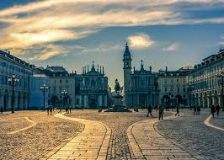
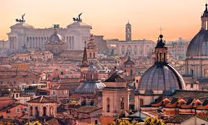
TURIN & ROME

Slide 2
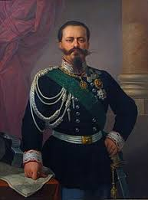
Turin, our city
Turin was the first Italy’s capital
Indead our country was unifyied by Vittorio Emanuele II , the Turin’s king.
The most important monument is “La Mole Antonelliana”

Slide 3
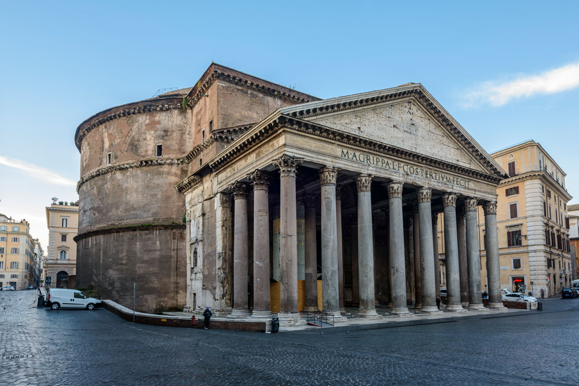
Rome, the capital of Italy
Rome has a population of 2 milions of people
On 20 September of 1870 it become Italy’s capital
The most important monuments are: the Colosseo, Pantheon and the Roman Forum

Slide 4
Sitography
https://it.wikipedia.org/wiki/Vittorio_Emanuele_II_di_Savoia
https://www.viaggioinbaule.it/la-mole-antonelliana-di-torino/
https://www.artribune.com/professioni-e-professionisti/politica-e-pubblica-amministrazione/2017/01/roma-parco-archeologico-colosseo-ministero/
https://www.civitatis.com/it/roma/visita-guidata-pantheon-agrippa/

