Slide 1
Dr Jekyll and Mr Hyde
By Robert Louis Stevenson
As seen by students working on the etwinning project “Jekyll and Hyde” 2019-20
Laviana - Melilla - pinerolo Uherske Hradiste - Koghb

Slide 2
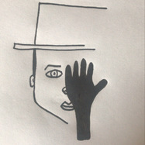
My family and teachers
My literature teacher thinks that the book is important because it was for the first time when someone talked about a mental illness (schizophrenia) in a book.
My mom knows the content of the book but hasn´t read it and my dad doesn´t know the story.
Our chemistry teacher thinks that something like this could happen. For sure there is some substance that could change your personality but our teacher believes that it would change the person forever. It would be useful to use the substance if a person has any mental illness to help him/her.

Slide 3
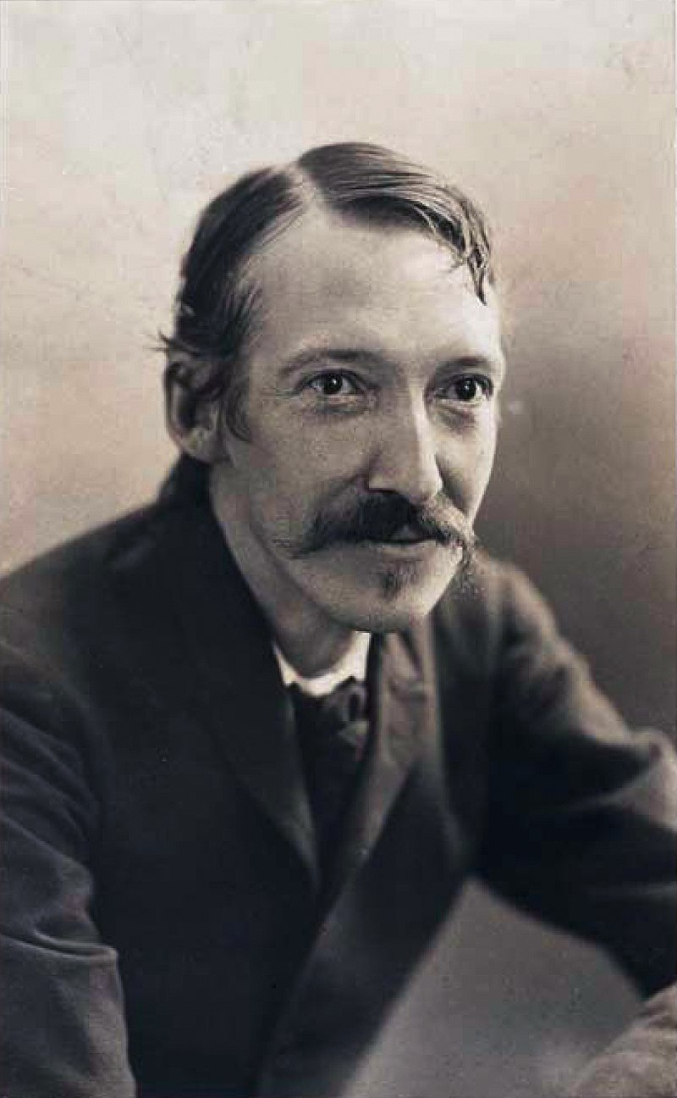
Robert Louis Stevenson- writer
Robert Louis Stevenson was born in Edinburgh 13 Dec. 1850
In 1880 he married Fanny Stevenson.
His first writing was An Inland Voyage.
He was poet and he wrote a lot
He became famous when he wrote the book Treasure Island.
Robert Louis Stevenson wrote The Strange Case of Dr.Jekyll and Mr. Hyde in 1886.
He died in 1894 in Samoa.
By Elena Kubičíková (Czech Republic)

Slide 4
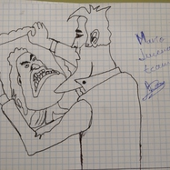
PLOT
The book is about Dr.Jekyll, a crazy scientist who is interested in proving that everyone has a good and a bad part, and he wants to divide each. The other main character of the book is Mr. Utterson, friend of Dr.Jekyll and lawyer, who tries to help him and solve the mystery, but he doesn´t arrive in time because the experiment goes out of control and Jekyll finds an only way to stop Mr.Hyde.

Slide 5
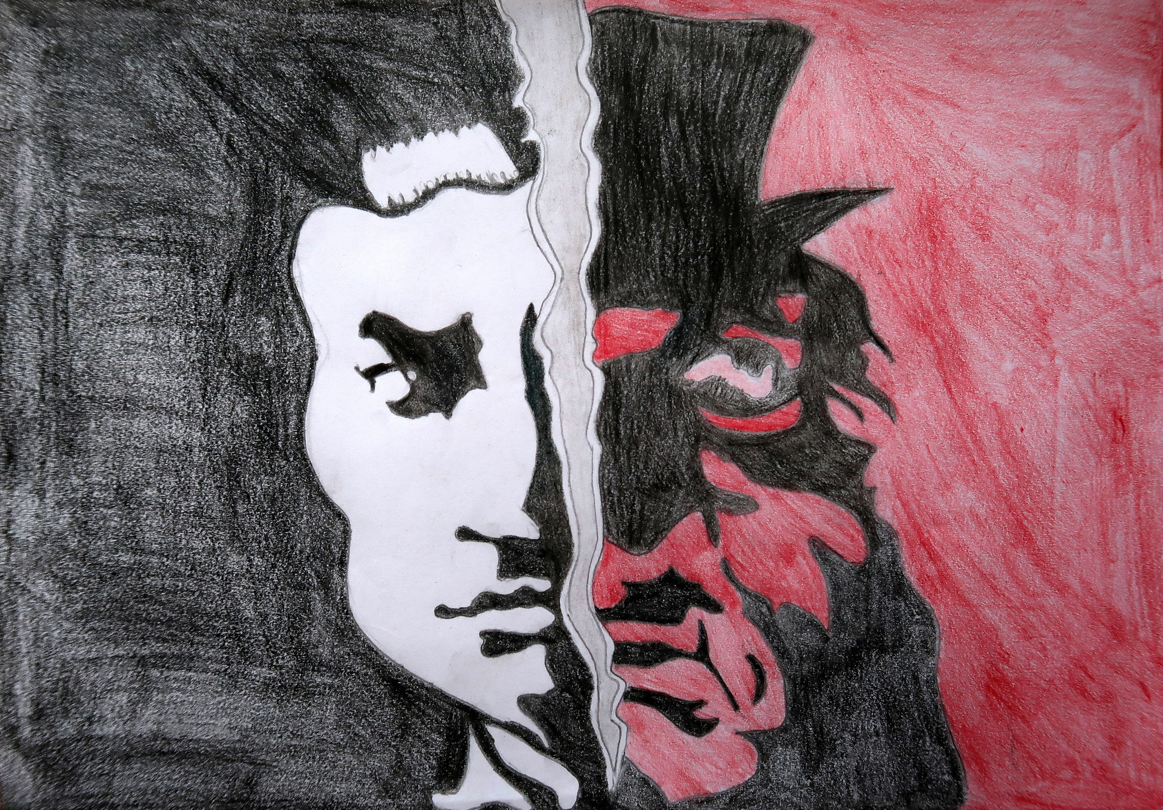

Slide 6
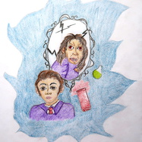
CHARACTERS:
Mr Utterson: quiet, serious lawyer; rational,curious, calm,respectable; wealthy man living in Victorian London.
Mr Enfield: friend of Mr Utterson’s.
Dr Lanyon:old friend of Dr Jekyll and Mr Utterson. Dr Jekyll’s doctor.He died because he was very stressed.
Poole: Mr Jekyll’s butler
Dr Jekyll: Scientist. Respectable, wealthy, kind, helpful and intelligent. Friend and client of Mr Utterson
Mr Hyde:well dressed but evil presence, ugly, murderous, devilish, criminal mastermind; violent,mysterious ,commits terrible crimes . shorter than Jekyll-

Slide 7
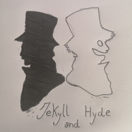
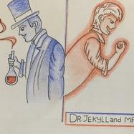

Slide 8
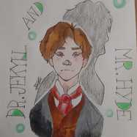
DIFFERENT ENDING
I like how the book ends, but if I had to choose a different one, I´d prefer a happy final for Dr.Jekyll. He was only an ambitious scientist, and he never wanted to make others suffer. Yes, his ambition carried him to the chaos but, like I said, he didn´t mean to hurt anyone. I´d like him to survive so, If I were Stevenson, I might make Utterson or Lanyon get an antidote to help him. And of course, Lanyon wouldn´t have died.

Slide 9
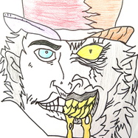
Dr jekyll and Mr Hyde

