Slide 1
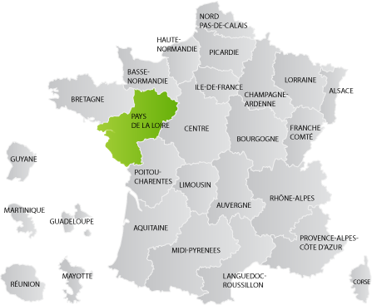
Presentation of our region

Slide 2
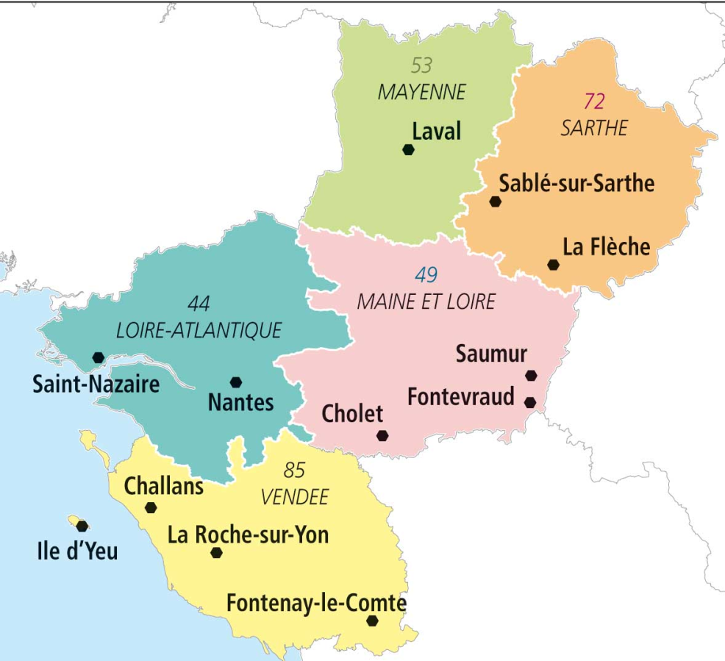
Identity card
Location: West of France
Area: 32,082 km²
Population: 3,553,400
Density: 110/km²
Departments: - Loire Atlantique
- Maine-et-Loire
-Mayenne
-Sarthe
-Vendée
Government:
President: Christelle Morançaise
We all live in Vendée near Challans where our High school is located.

Slide 3
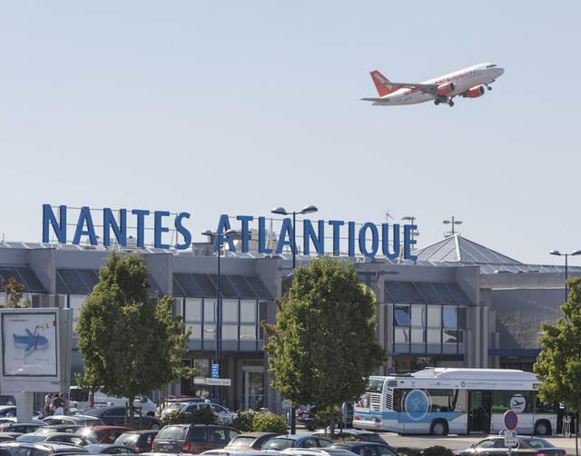
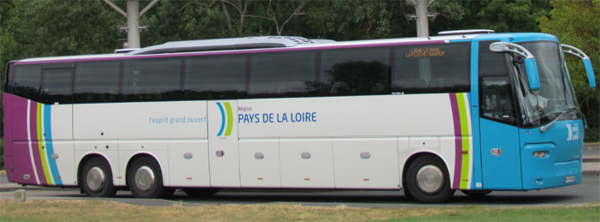
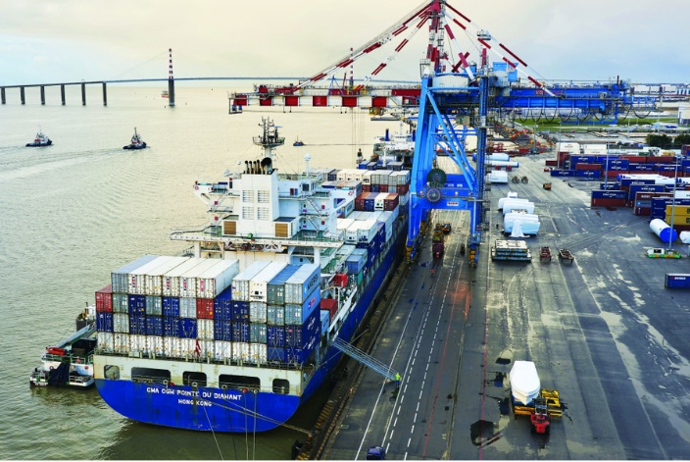
Some other key points…
The region of the Pays de la Loire is the 5th largest region in France.
There are 6 major towns: Nantes, Angers, Le Mans, Laval and La Roche-sur-Yon.
The transportation in the Pays de la Loire is largely developed. Train, bus and plane transportation is allowed by many railways and roads. The international airport is located in Nantes.
Moreover, the region is bordered by the sea. Thanks to the port of Nantes - Saint Nazaire, the region is dynamic on several economical aspects (business, industry…).

Slide 4
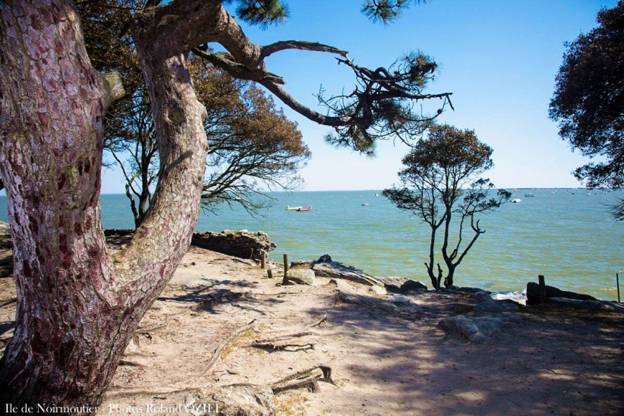
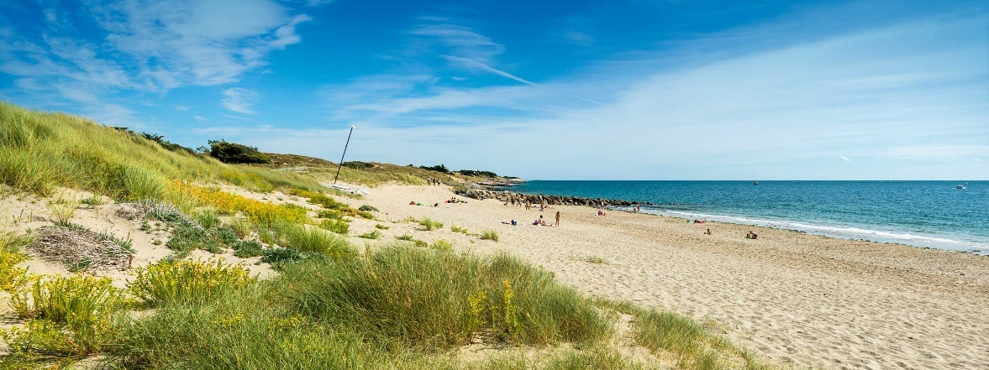
The advantages of our region
Beautiful landscapes : rocky coasts and sandy beaches:

Slide 5
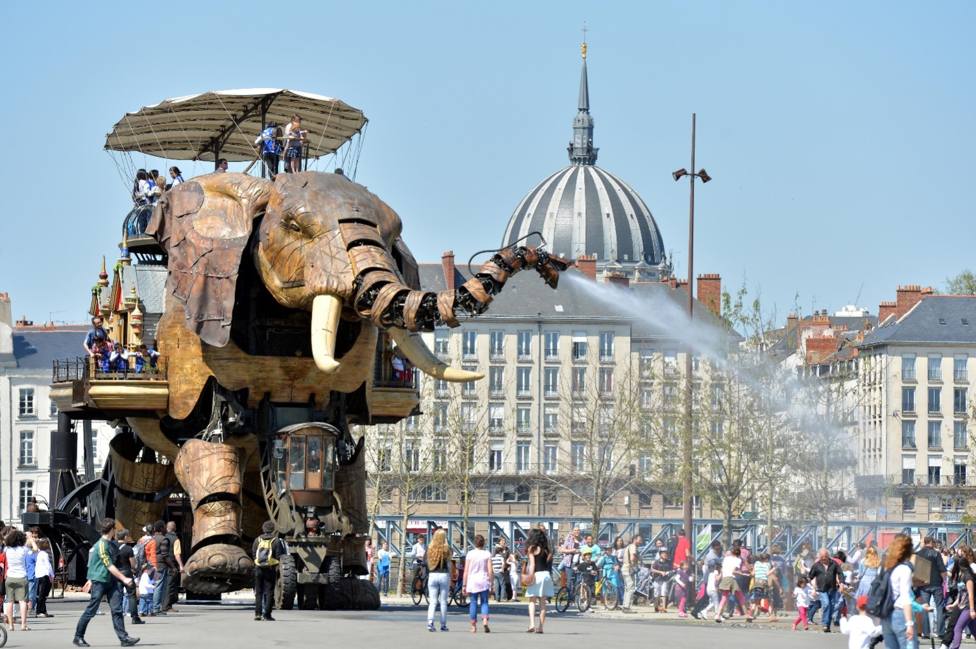
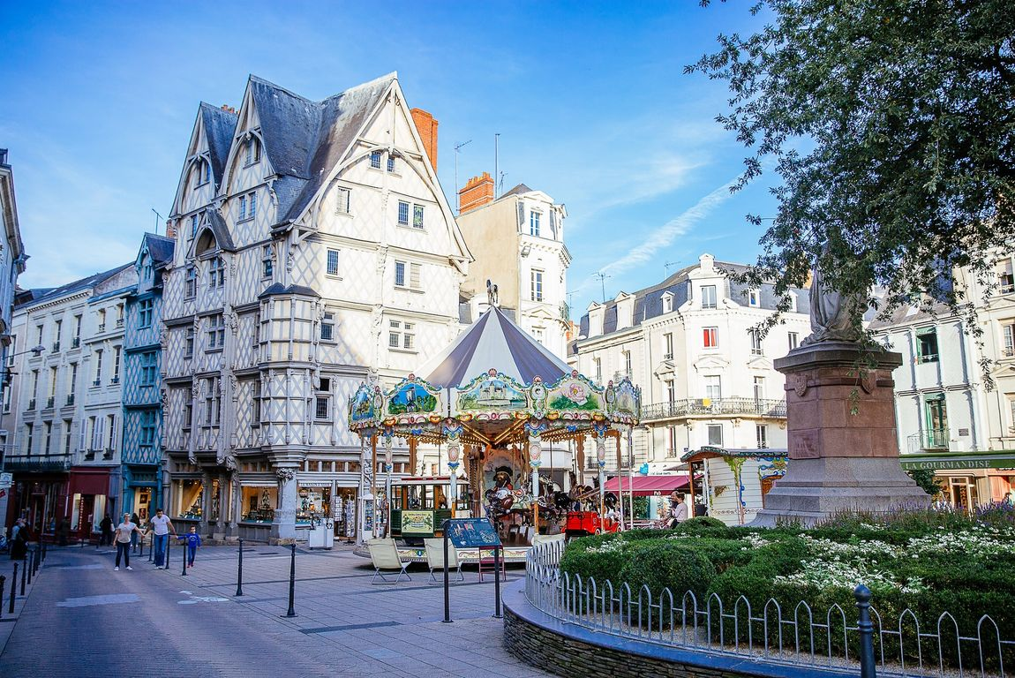
Beautiful towns with great activities :
You can even take a ride on an elephant in Nantes !

Slide 6
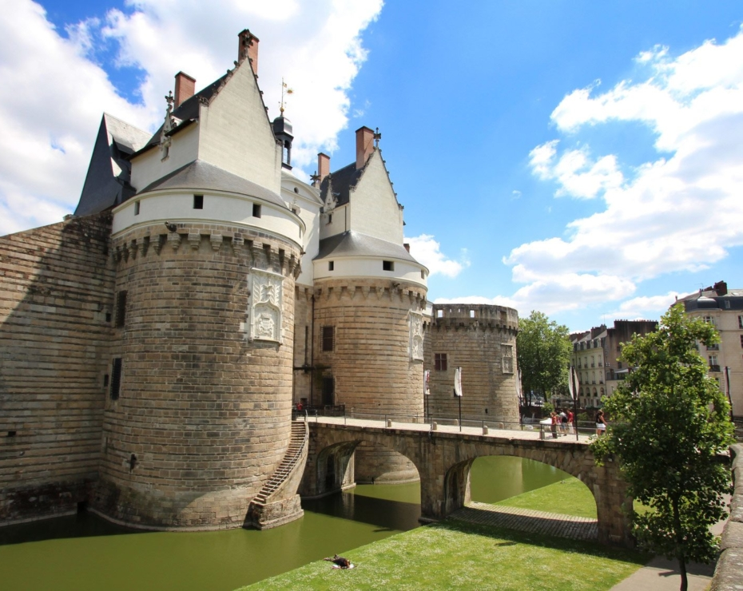
Beautiful castels along the river La loire
Saumur
Nantes

Slide 7
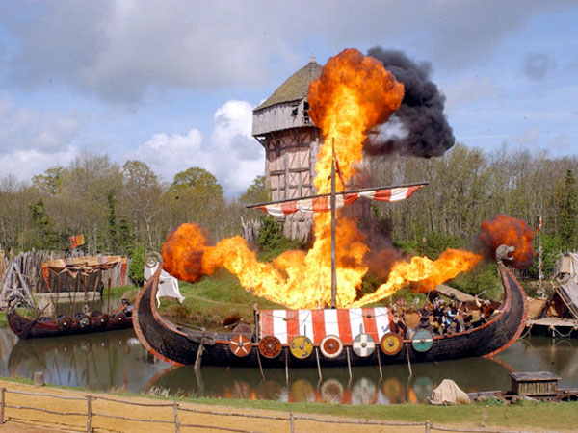
The Puy du Fou:
This park has been elected as the best park of the world and received many awards ! The aim of the Puy du Fou is to entertain and teach French history to the visitors. If you have the chance to go there, we really advice you to!

Slide 8
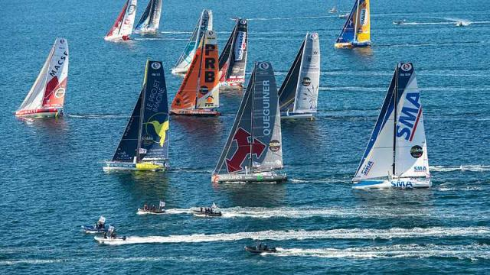
The region gives high importance to sports :
Example :
The Vendée Globe is a famous boat race in which the contestants have to sail all around the world!

Slide 9
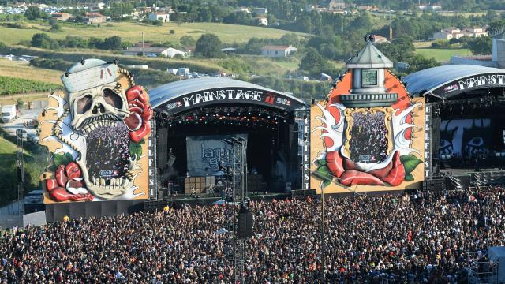
Cultural aspects in the Pays de la Loire :
Example : The Hellfest in Loire Atlantique is one of the biggest music festivals in France.

Slide 10
Conclusion :
The region of the Pays de la Loire is dynamic and attracive on several aspects. Tourism and other economical and cultural aspects are highly developed. It is indeed a beautiful region which has got a lot to offer !

