Slide 1
Diamantoula
Magaliou -Niki Magaliou
2nd High school of Farsala(Greece)
PROJECT
T
T
U
E
N
M
N
P
E
L
I
S

Slide 2
STRUCTURE
This is the project ” Tempi Tunnels “
Tempi’s Tunnel’s benefits
Funded by….
Tempi Tunnels in a map
Bibliography

Slide 3
This is the project “Tempi Tunnels”
Safe, modern motorway cuts journey time from Athens to Thessaloniki ,while it connects Athens(capital city of Greece) and Thessaloniki (2nd largest city in Greece)with the regions of Thessaly and Macedonia.
The motorway is the second longest in Greece. Its total length is around 550 km.
As part of the works, a new 30 km section between Evangelismos and Skotina was constructed, including 11 km of tunnels. This includes a 6 km tunnel at Tempi – the longest road tunnel in south-east Europe – as well as two smaller tunnels.
The new section and tunnels were opened with an inauguration ceremony in 2017.

Slide 4
Tempi’s Tunnels benefits
The Tempi tunnels have halved the travel time on the new sections and reduced the drive from Athens to Thessaloniki to just over four hours. The new section is bringing economic benefits and has dramatically improved road safety.
The new constructions have allowed for an increase of 13 % in commercial and touristic traffic that is contributing to Greece’s economic growth. More than 5.000 local people were directly involved in the construction work, increasing employment in the region.
As well as benefiting from safer travel, tourists can enjoy beautiful views over the Pinios River, Mount Olympus and Mount Kissavos along the route. The Tempi Valley has also benefited from the project’s environmental protection measures.

Slide 5
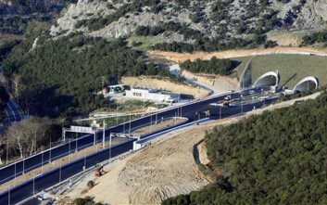
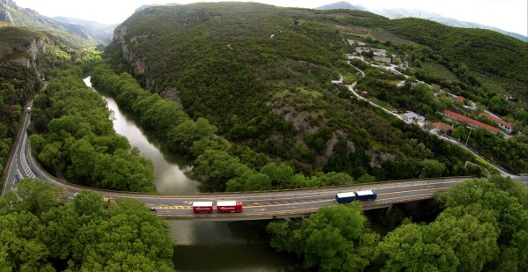
Funded by….
Total investment for part two of the project “Patras –Athens – Thessaloniki Motorway ‘Tempi Tunnels’” is EUR 2 005 480 000.
The EU’s European Regional Development Fund contributing EUR 922 600 000 through the “Improvement of Accessibility” Operational Programme for 2007-2013 programming period.
The investment falls under the priority “Road transport infrastructures”.

Slide 6
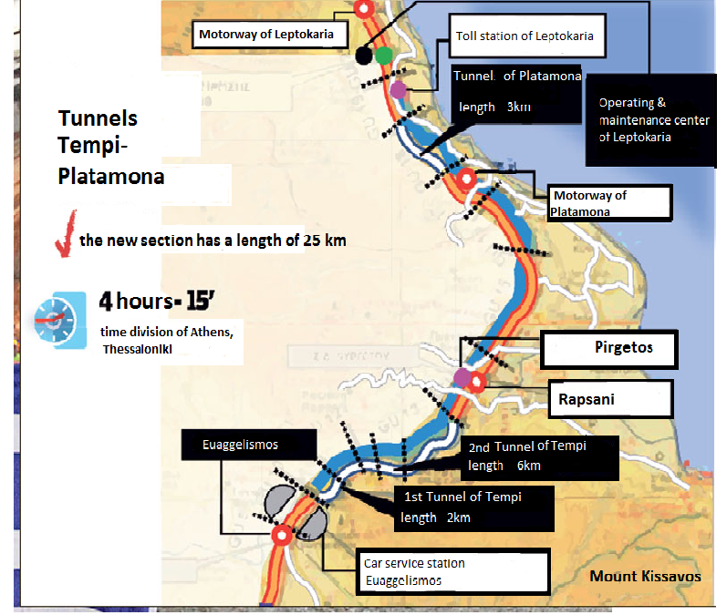

Slide 7
Bibliography
ec.europa.eu
https://ec.europa.eu/regional_policy/el/projects/greece/safe-modern-motorway-cuts-journey-time-from-athens-to-thessaloniki
newsit
https://ec.europa.eu/regional_policy/el/projects/greece/safe-modern-motorway-cuts-journey-time-from-athens-to-thessaloniki

Slide 8
Project
Vanessa Kolk-Femke Stegedirk
Burg-Gymnasium Bad Bentheim(Germany)
T C
O
E R
R
N I
D
T O
R
2

Slide 9
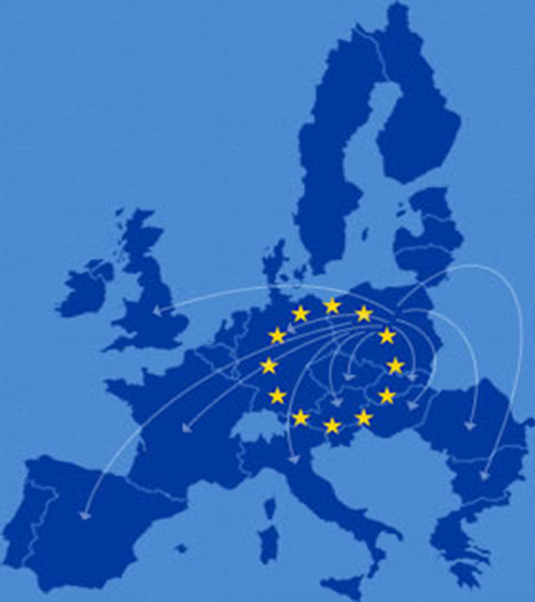
STRUCTURE
TEN-T
European Budget
Corridor 2 regional program
sources

Slide 10
TEN-T
Program for the developement of the european market
seperated into transport(TEN-T), energy(TEN-E), telecommunication infrastructure(eTEN)
Involves physical and digital infrastructure on streets, railways, inland waters and airports
Special Values:
elimination of national and international weak points and shortages
environmental friendly and efficient
developement and expansion of current capacities
high safety standards and dependablity of public transport
9 main traffic corridors
most important routes in the EU

Slide 11
European budget
Costs until 2020 amounted to 600Mrd € according to the EU committee
Main financing falls to member states
Co-financing by the EU comes from:
EU budget line TEN
EU structural funds (in particular european funds for regional developement)
Cohesion fonds
Also international financal institutions who partly finance the project with loans and guarantees:
European investment bank
European investment funds

Slide 12
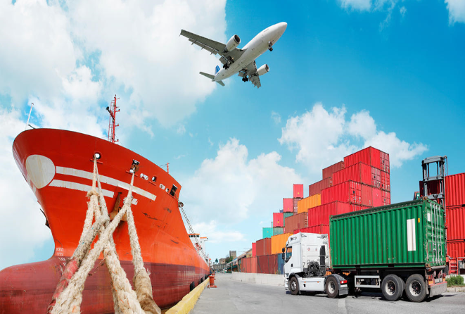
Corridor 2
North Sea-Baltics-corridor
Our region is situated at the Corridor 2
Length: 3200km, connects 8 european capitals:
Amsterdam, Berlin, Vilnius, Tallinn, Brussels, Warsaw, Riga, Helsinki
Involves 16 airports, 33 harbours and 17 rail terminals
The dutch and german sections of the corridor constitute the fundamental infrastructure for 5 out of the 10 biggest cargoports(Antwerp, Rotterdam, Amsterdam, Bremerhaven, Hamburg)
our region is an important transport hub in between the eastern sections of the corridor

Slide 13
Sources
European budget:
https://de.wikipedia.org/wiki/Transeurop%C3%A4ische_Netze
TEN-T and Corridor 2:
https://www.euregio.eu/de/project/ten-t-corridor-2

Slide 14
Transport
Charlotte Pose
La Salle Saint- Charles(La Réunion)
R
L E
U
A N
I
O
N

Slide 15
Road network
Good quality road network, several national roads make it easy to go around the island:
The RN 1 between Saint-Denis and Saint-Pierre passing through the west
The RN 2 between Saint-Denis and Saint-Pierre passing through the east
The RN 3 between Saint-Benoît and Saint-Pierre which constitutes the only transversal route of the island via the Hautes Plaines
The RN 5 between Saint-Louis and Cilaos is the only road access to the Cirque de Cilaos
The mountain topography of the island strongly constrains movement
The numerous rivers and ravines require the construction of work of art or to avoid them to make many turns
On the RN 1 between Saint-Denis and Possession the risk of rock falls and cyclonic swell cause many tipping to see the total closure of the road
The National Road 2 is regularly cut by lava flows from the Piton de la Fournaise

Slide 16
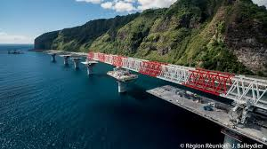
Project “Littoral Road(NRL)
Is a fast track being built at Reunion Island
Carried by a viaduct and a dyke
Won over the sea of a dozen kilometres, will ultimately link Saint-Denis to La Possession by replacing the current coastal road(it is too exposed to the scree of the cliff)
Raises many environmental and financial
problems(costs: 1.6 billion €)
Awarding of some of the contracts is
the subject of a judicial investigation

Slide 17
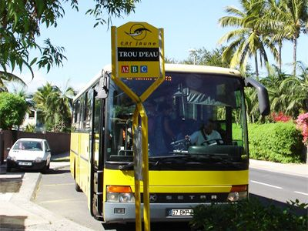
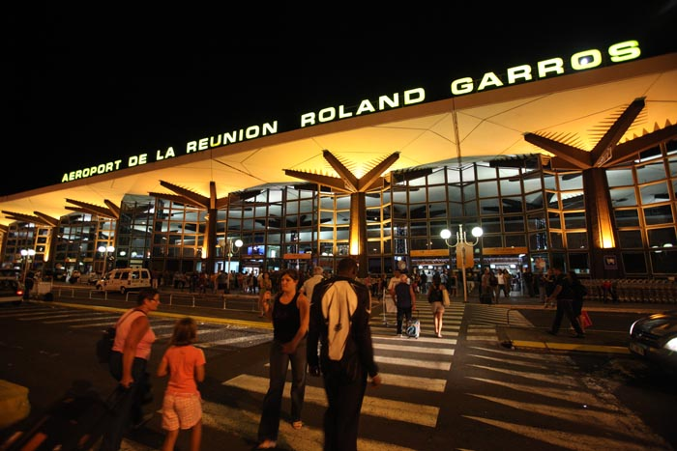
Public transport and airports
Public transport is limited no train and no subway in Reunion Island, only public transport is the bus
Two airports on the island of which both
have paved runways
Main airport is the international Roland
Garros airport located close to Saint-Denis
Second one is the Aéroport de Pierrefond near Saint-Pierre in the south of the island

Slide 18
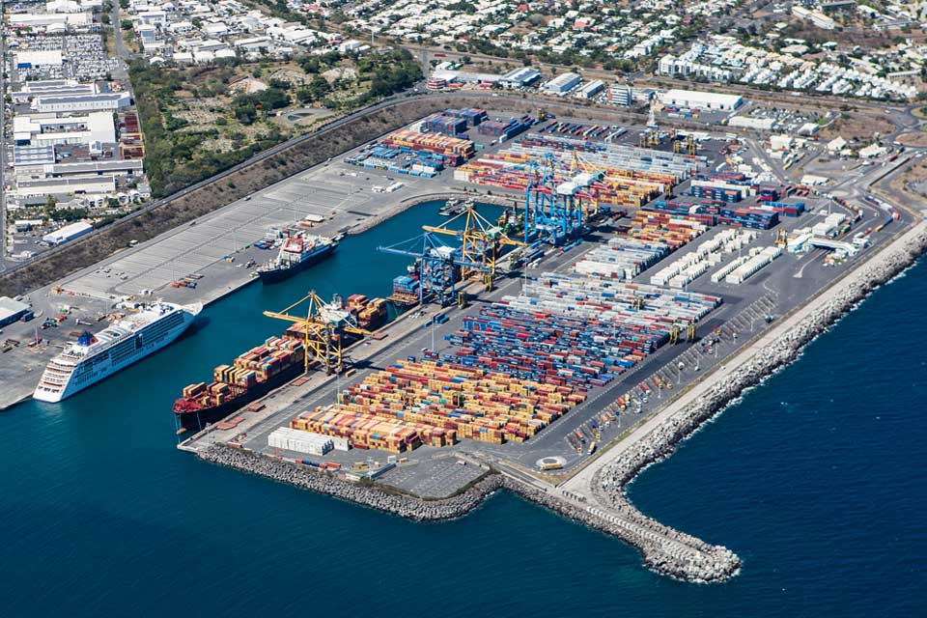
Ports
Main port of the island is the port of “Pointe des Galets”
located on the communal territory of the port
performs the functions of seaport, commercial, military, fishing and recreational
There are other smaller-sized ports scattered around the island such as the port of Saint-Gilles les Bains, the port of Saint-Leu, the port of Saint-Pierre, the port of Sainte-Rose and the port of Sainte-Marie

Slide 19
Why can the European Union be considered as a continent between unity and diversity?
Unity and diversity is part of the EU’s motto. We think the EU can be considered as a continent between unity and diversity because the european countries decided to form a union to create peace and equal living conditions for everyone (which needs some more work because unfortunately in our opinion the living conditions still aren’t the same in all of the EU). But at the same time it’s important to the EU to keep all of the member states’ different cultures, traditions and languages which create diversity.

Slide 20
What are the consequences of the European construction on territories?
Challenges faced by the european construction industry are on the one hand making efficiency improvements and rennovations in existing buildings to stimulate demand. on the other hand the EU has to improve specialised training and make the construction sector more attractive, in particular for technical colleges and universities because they are the future of the european construction sector. Another big and topical challenge to face is energy efficiency with regard to climate change. Buildings account for the largest share of total EU final energy consumption and produce about 35% of all greenhouse emissions which should be desired to drastically be reduced.

Slide 21
How does the European Union have an effect on regional inequalities?
With the help of the european spatial developement policy, the EU tries to reduce the structural inequalities to facilitate the political unification process. By no means though, the alignment shall jeopardise the regions’ cultural identities.

