Slide 1
THE MAJOR PLANNING STAKES OF LES PAYS DE LA LOIRE ( Cyrielle GRENON and Adèle DUPE)

Slide 2
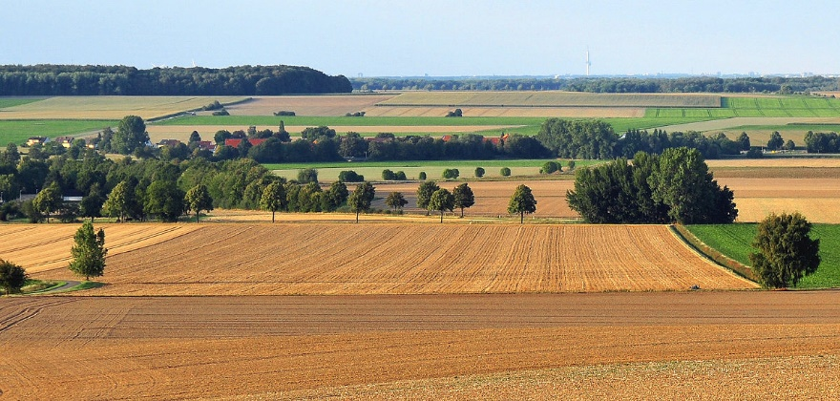
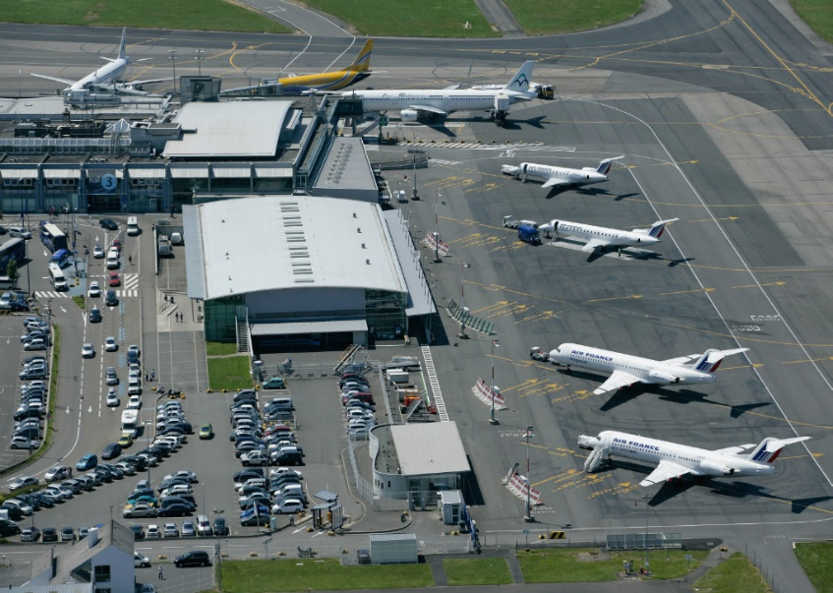
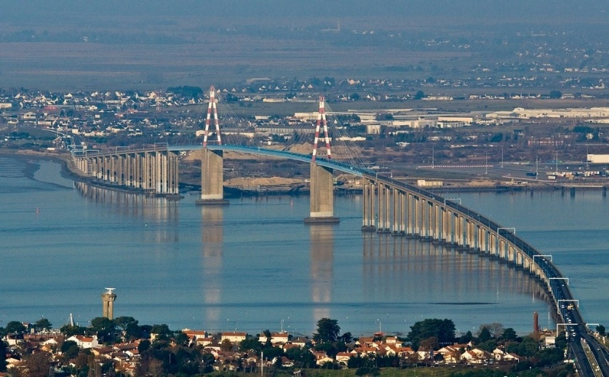

Slide 3
The budget is intended to…
CULTURE
STUDIES/FORMATION
AGRICULTURE
SUSTAINABLE DEVELOPMENT
TOURISM
EMPLOYEMENT
TERRITORY
SPORTS
YOUTH
INTERNATIONAL EXCHANGES
HEALTH

Slide 4
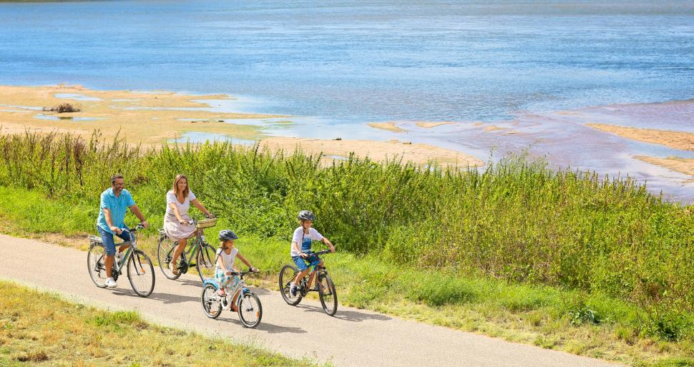
LA LOIRE BY BICYCLE: a major program
To make Loire Atlantique accessible
and to develop much more tourism

