Slide 1
TRANSPORT
TEN-T / Corridor 2
(Grafschaft Bentheim)

Slide 2
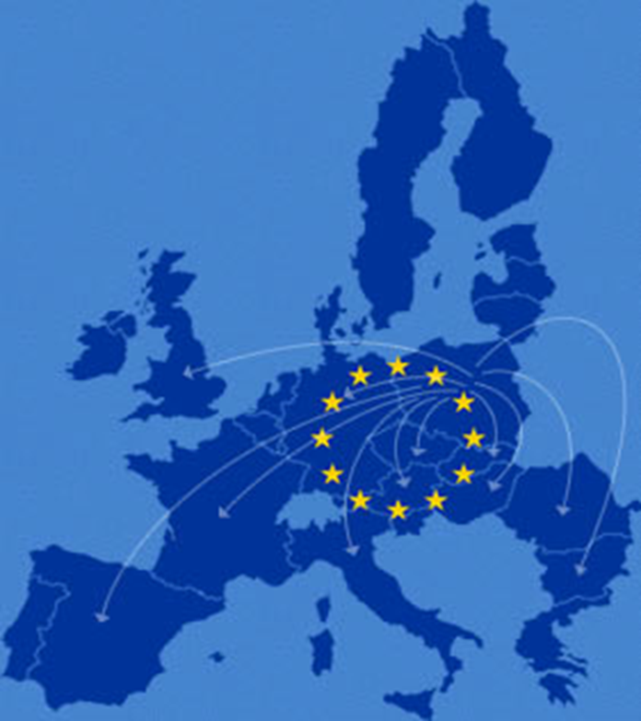
structure
TEN-T
EUROPEAN BUDGET
CORRIDOR 2 regional program
sources

Slide 3
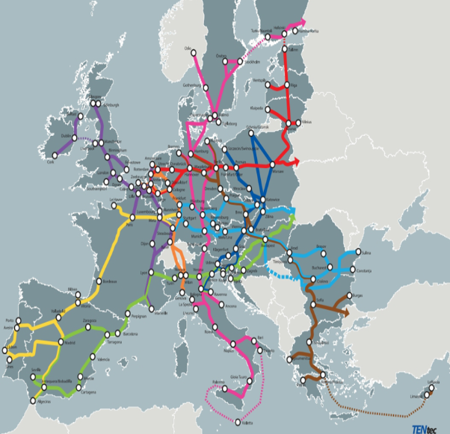
Ten-t
program for the developement of the European Market
seperated into transport (TEN-T), energy (TEN-E)
telecommunication infrastructure (eTEN)
Involes physical & digital infrastructure on streets, railways, inland waters and airports
Special Values:
elimination of national & international weak points & shortages
environmental friendly & efficient
developement & expension of current capacities
High safety standards and dependability public transport
9 main traffic corridors
most important routes in the EU

Slide 4
European budget
TEN-T is neither a construction programme nor a financing programme
the costs for the realisation of the project amounted until 2020 to 600 Mrd. Euro according tot he EU-Committee
The main financing falls to the member states
Co- financing by the union comes from:
EU-Budget line TEN
EU- structural fonds (in particular european funds for regional development)
Cohesion funds
to that there are international financial institutions who also partly finance the project with loans and guarantees:
European investment bank
European investment funds
EU summit of 2013 decided the “Connecting European Facility“ for the traffic and infrastructure which is provided with 29,299 billion Euro in the period of 2014-2020 of those 23,174 billion Euro flows into transport projects

Slide 5
Corridor 2:
North Sea – Baltics – corridor
our region is situated an the corridor 2
length: 3200km, connects & european capitals:
Amsterdam, Berlin, Vilnius, Tallinn, Brussels, Warschau, Riga, Helsinki
involves 16 airports, 33 harbours & 17 rail terminals
the dutch and german sections of the corridor are the fundamental infrastructure for 5 out of the 10 biggest cargoports (Antwerp, Rotterdam, Amsterdam, Bremerhaver & Hamburg)
our region is an important transport hub in between the eastern sections of the corridor

Slide 6
sources
EUROPEAN BUDGET:
https://de.wikipedia.org/wiki/Transeuropäische_Netze
TEN-T & CORRIDOR 2
https://www.euregio.eu/de/project/ten-t-corridor-2

