Slide 1
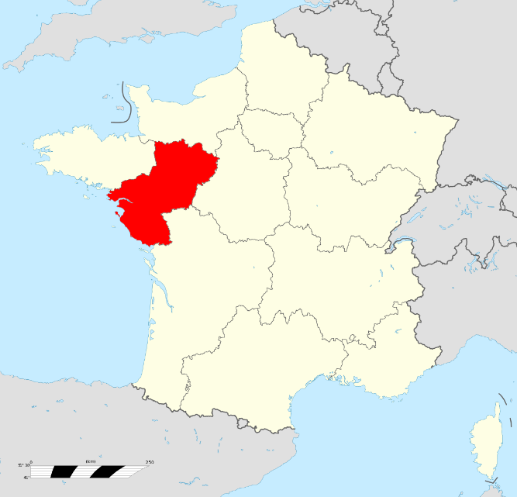
Main features of Pays de la Loire
Here’s a slideshow of some of the main features of our region.
Firstly we’ll see how tourism is part of our area, then what do we eat, follows by the technological situation of our area, and to finish a marvel there is in.

Slide 2
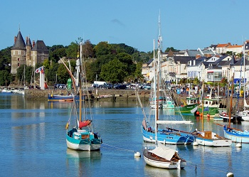
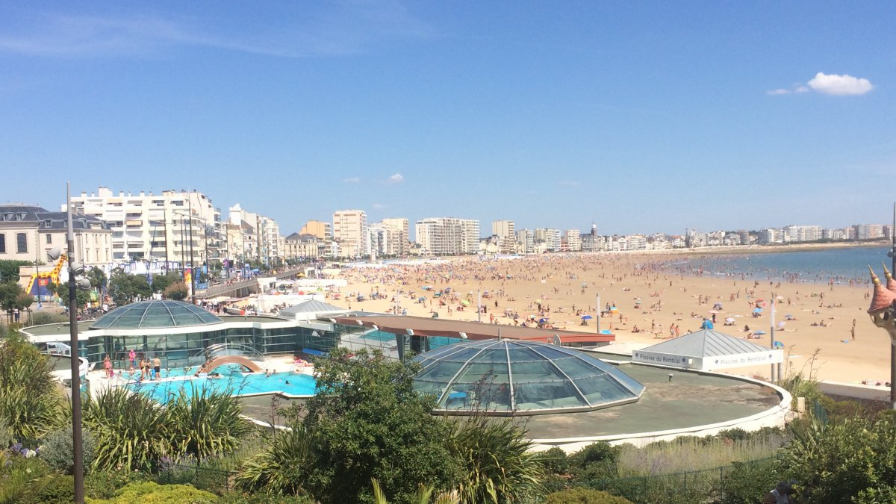
What is the type of tourism in our area ?
We’ve a lot of harbors (more than 200).
By the way, we have also a lot of beaches (and forests) !

Slide 3
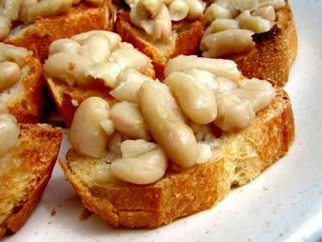
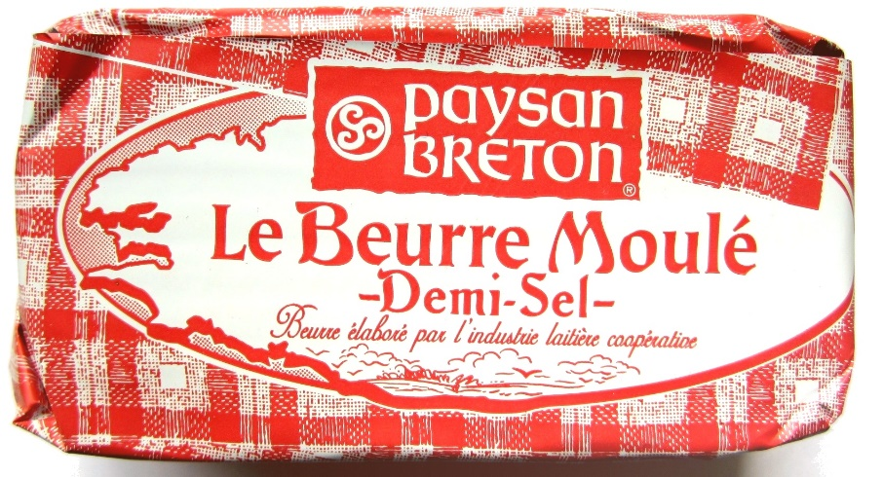
What do we eat ?
We eat salty butter for most of people of the region despite in France for most of butter is not salty
The cultural meal is « mogettes » it looks like beans, we can eat it on bread or with sausages.

Slide 4
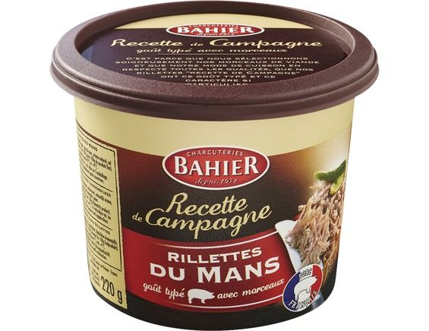
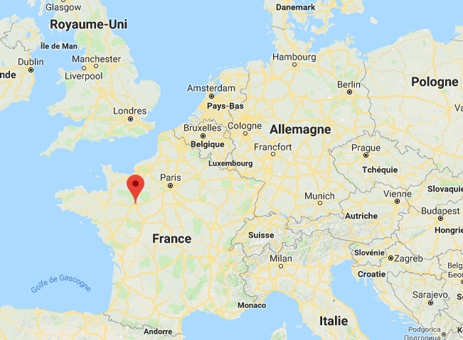
What do we eat II ?
«Les rillettes du mans » is a speciallity craft in « Le mans », you eat it on bread at the starter.
« Le mans » is here :

Slide 5
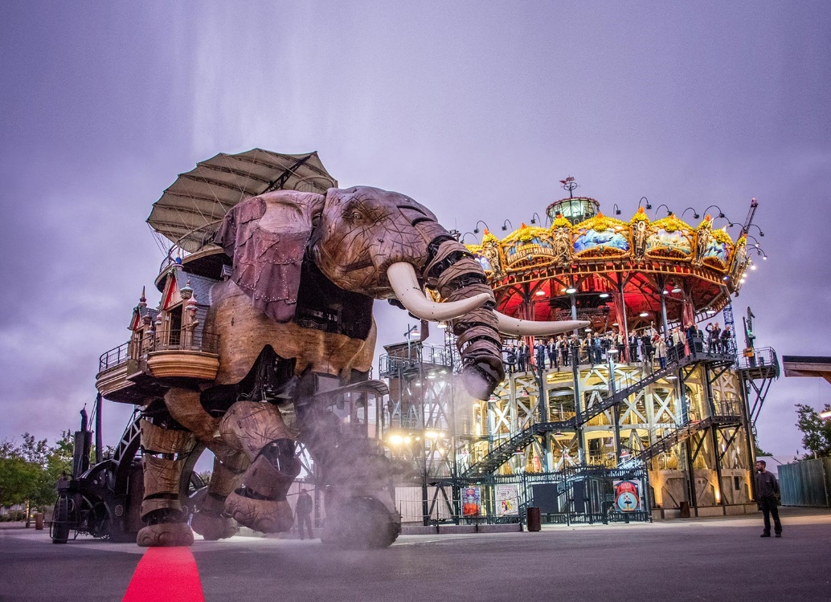
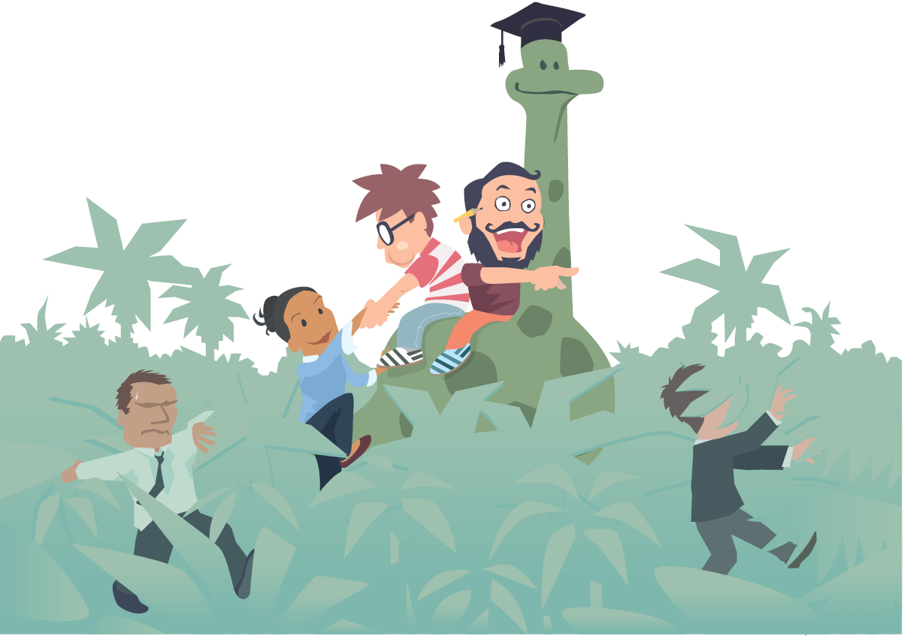
How technological is our area ?
The machines (carousel) of Nantes are very famous, this are sculptures of animals which are fully automatised to move easily.
There is 471 start-up in our area : For the environment, for social interactions…

Slide 6
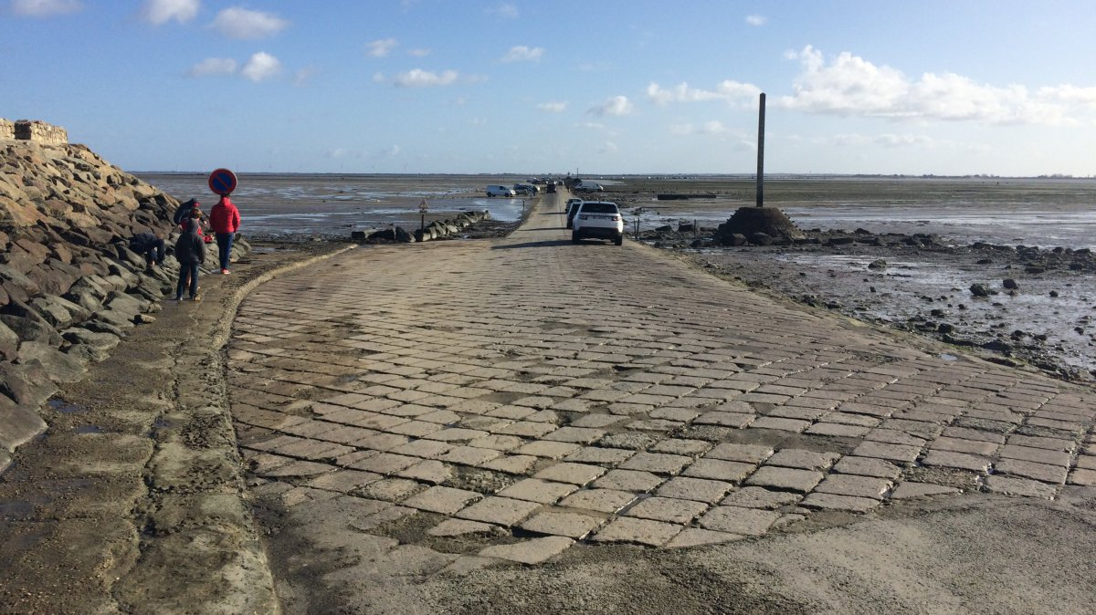
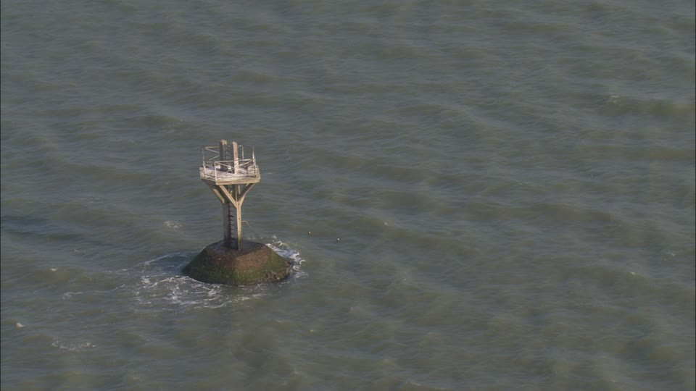
Marvel of Pays de la Loire
« Le gois » is the only road in Europe that can be recovered by the sea. The sea comes by each side.
Here the road when the sea is over !

