Slide 1
How does the European regional policy finance concrete regional projects ?
TEAM 11 – Culture in Pays de la Loire

Slide 2
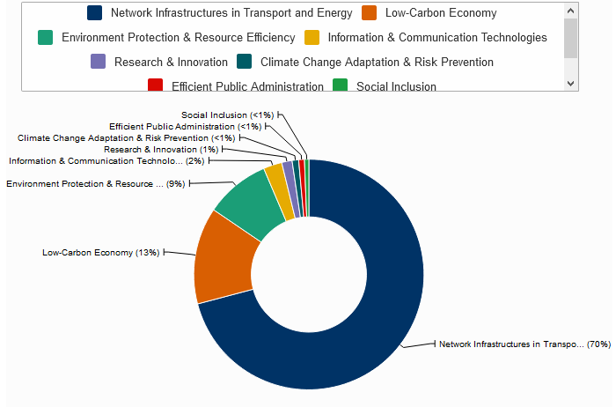
Presentation
The EU finances many projects in the european regions through many sectors such as transport, tourism, ecology or economic developpment
For the period 2014-2020, 351,8 billion euros are dedicated to cohesion of territories ; it represents 32,5 % of the total budget of the EU.

Slide 3
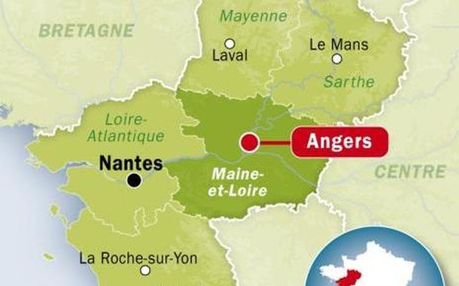
Creating a botanical wonderland in Anjou
Introducing of the project
Opening in April 2010, the park covers 110 000 m2 of landscapes, gardens, business centres, a cinema, restaurants and many other attractions. With annual revenues of €21.13 million, this project represents a major boost for local employment and business growth.

Slide 4
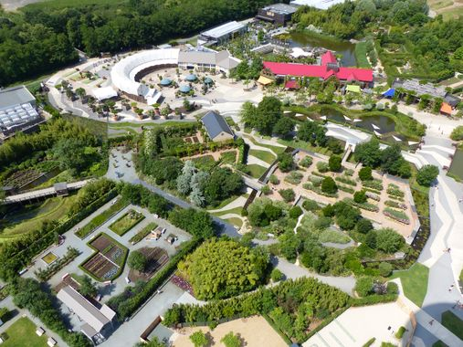
Anjou is expected to gain in many ways from this project, job-wise and economically, with an added boost to local tourism and businesses given the expected 400 000 visitors each year. Revenues generated are expected to be in the region of €21.13 million per year.
Sustainability was present throughout the park’s design and construction, with emphasis placed on using non-polluting technology and optimising energy efficiency.

Slide 5
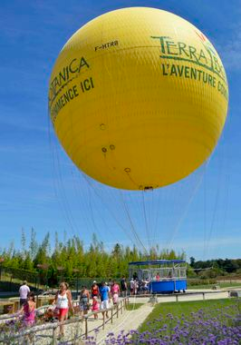
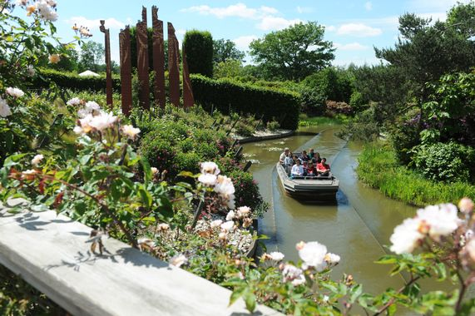
Contribution of the EU
The EU had invested more than 16’500’000 € in this project, which represents 18,5% of the global investiment

