Slide 1
PEOPLE WE ARE PROUD OF
Name: Rabia Sena
Surname: Özdenoğlu
School: Hüseyin Gazi Orta Okulu Zile/TOKAT

Slide 2
Sertap Erener

Slide 3
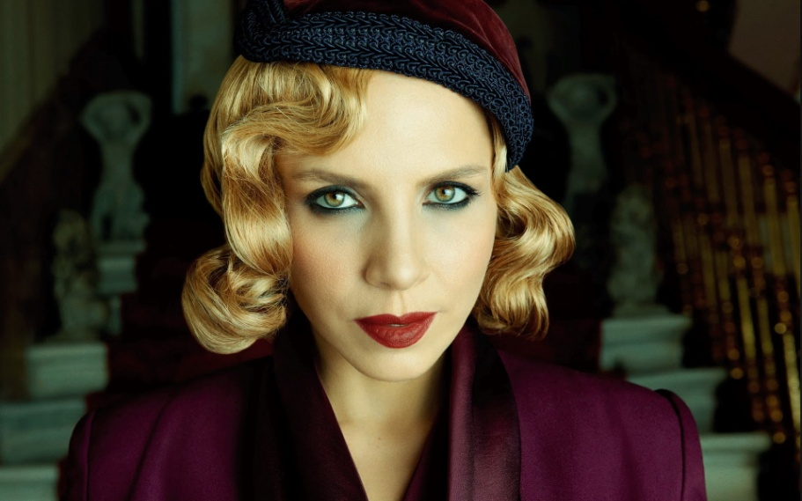
Sertab Erener was born on 4th December 1964. She is a Turkish pop music singer and also a cross-over soprano with a vocal range that extends to high F. She is one of the most successful female Turkish pop singers in her homeland, and is considered one of the divas of Turkish pop music. In Europe, she is best known for winning the Eurovision Song Contest 2003 with her hit song "Every Way That I Can", although she has had many other achievements outside Turkey.

Slide 4
A native of Istanbul, Erener studied opera before beginning her musical career working with Turkish music icon, Sezen Aksu.
She released her first album, Sakin Ol, in 1992, and followed it with four more Turkish-language albums over the next decade. Her album Lâ'l was included by Sony Music in its "Soundtrack for a Century" collection.

Slide 5
İlber Ortaylı

Slide 6
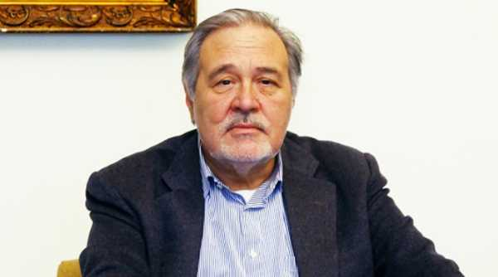
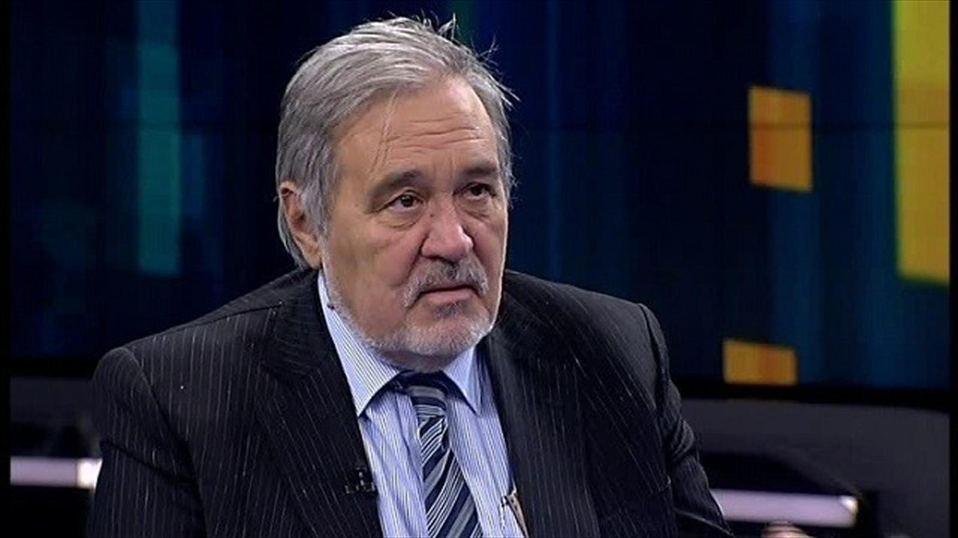
İlber Ortaylı (born 21 May 1947) is a Turkish historian and professor of history at the Galatasaray University in Istanbul and at Bilkent University in Ankara. In 2005, he was appointed as the director of the Topkapı Museum in Istanbul, until he retired in 2012
As a descendant of a Crimean Tatar Mirza nobility from his mother, İlber Ortaylı's family fled Joseph Stalin's persecution and deportation, and was born in Bregenz, Austria in a refugee camp on 21 May 1947. He came to Turkey when he was 2 years old.

Slide 7
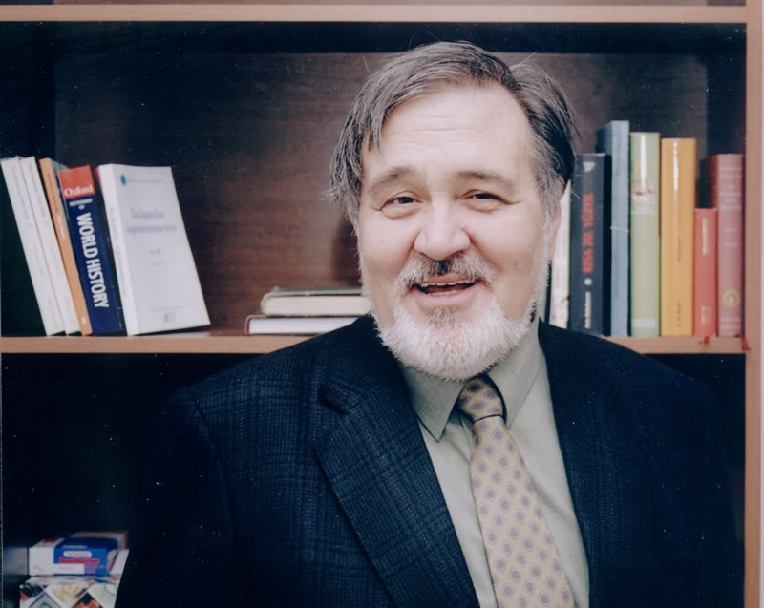
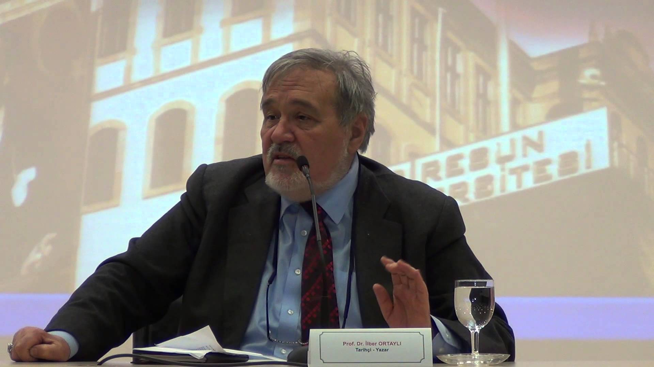
İlber Ortaylı is heir to a bilingual Turkish family so that he obtained German language from his father and Russian language from his mother. As a polyglot historian he has enough competency in Italian, English, French, Persian and also in Ottoman Turkish and Latin in order to fluently employ or maintain historical research with historical documents in the archives. His published articles are mainly in Turkish, German and French and various of them are translated in English.

Slide 8
Fethi Sekin

Slide 9
Fethi Sekin, a police officer in Şahinler Timi, motorcycle at Izmir Police Department's Traffic Supervision Branch, clashed with terrorists until his bullets were over. He killed one of the terrorists and then he was martyred by the terrorists.
The Governor of Erol Ayyıldız emphasized the heroism of the Izmir police. Ayyıldız said, "Our brother who prevented this treason is a martyr. Our police wanted to stop them. The terrorists were on the run, and the police were responding. Then the car was blown. All intelligence is being assessed. In spite of the possibility of action elsewhere, we are on the alert. Three policemen are wounded.T he number of our wounded policemen is around 6-7. They are under treatment.

Slide 10
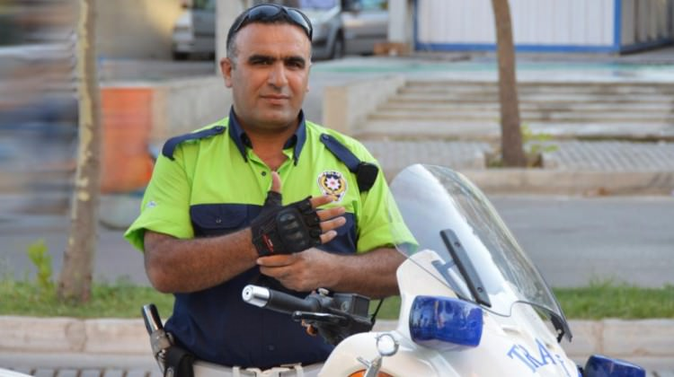
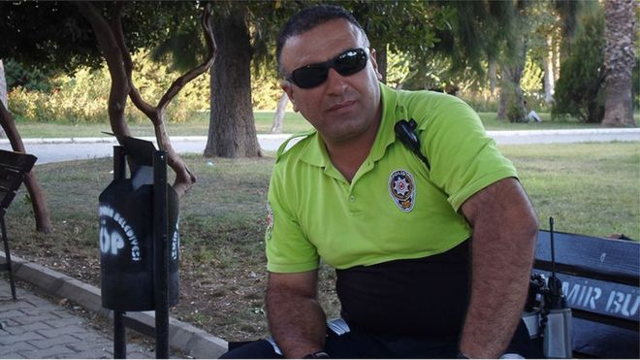
We respectfully remember

Slide 11
THANKS FOR WATCHING!!

