Slide 1
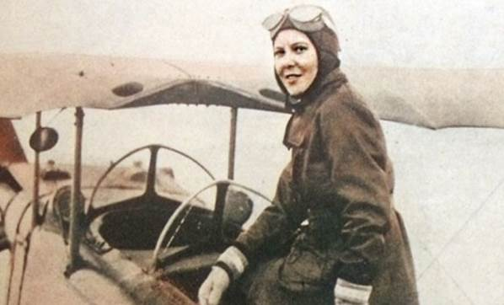
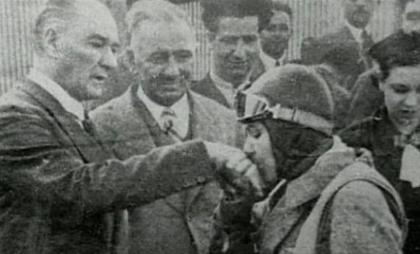
SABİHA
GÖKÇEN

Slide 2
Sabiha GÖKÇEN was born in 1913 in the city of Bursa. It is are of Turkeys first femala pilots and the world’s first femala fighter pilot. Mustafa KEMAL ATATÜRK was one of the eight spiritual sons. Over 8.00 hours during is flying coreer he flow araurd them. Thirty-two of the combat mission. The name Sabiha GÖKÇEN international airpoart is provided.

Slide 3
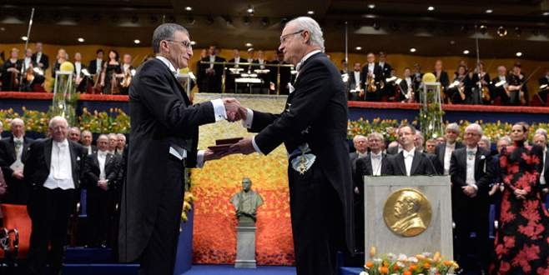
AZİZ SANCAR KİMDİR

Slide 4
Aziz SANCAR was born in 1946 in the city of Savur. Aziz SANCAR is Turkish Academician, molecular biologist,biochemist,scientist specializing in DNA repair ,cell eycle checkpants,and arcadion clock .In 2015,he was aewarded the Nobel Parize in chemistry along with Tamas Lindahland Paul L. Madrich for their mechanistic studies of DNA repair.
Sancar is currently the Sarah Kenan Prfessor of Biachemistry and Biophysics at the University of North Carolna Scool of Medicine and a nember of the UNC Lineberger Comprehnsive Cancer Center.He is the corfounder of the Aziz & Gwen Sancar Foundation ,which is a nan-profit organization topromote Turkish culture and to support.Turkhish students in the Uite States.
Notes:
6
-+3
201

Slide 5
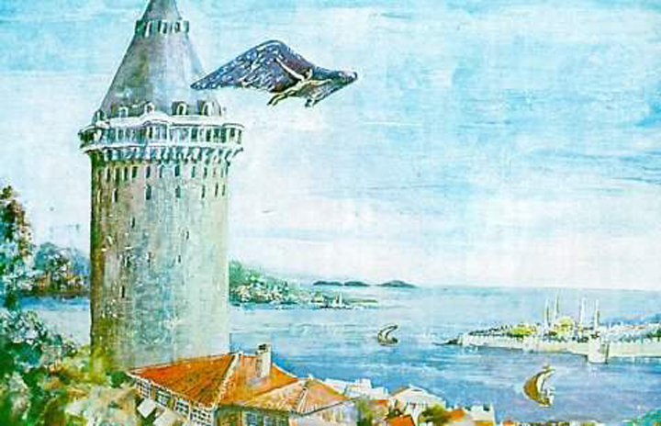
HEZARFEN AHMET ÇELEBİ

Slide 6
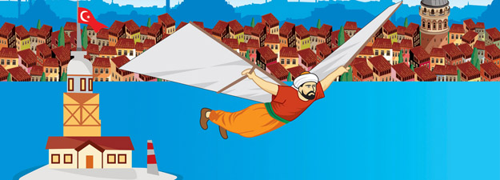
Hazerfan Ahmet ÇELEBİ was bom in 1609 in the city of İstanbul. İn the 17 . Centruy the lived in the Ottoman Empire.
Hazerfan was the first person to fly over Bosphorus . He innented wings to fly.

Slide 7
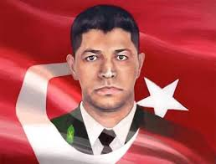
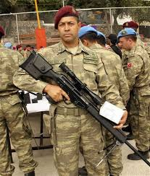
ÖMER HALİSDEMİR

Slide 8
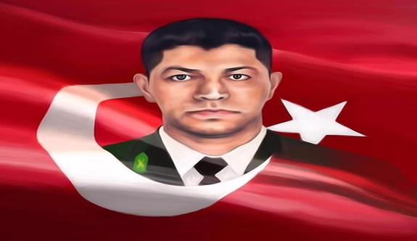
During the night of the coup attempt, The traitor Brigadier Semih Terzi raided To the Akıncı Station with his 20 soldiers and wanted to capture the strategic place. At thah moment , the Major General of the special Forces ,Zekai Aksakallı , called his most-trusted soldier Ömer Halisdemir , and gave him the command to kill the coup plotter and betrayer Semih terzi The Turkis hero ömer did not hesitate, he found the moment andamong 20 soldiers he shot the betrayer semih terzi in his fore head after killing the betrayer ömer halisdemir was martyred by 30 bullets of traitors. Owing to the heroic deed of ömer halis demir the plans of the treitors were spolt and the plan coup attempters failed.

